Slide 1
Python Basics
dictionary, mutable arguments
CS101 Lecture #11
2016-10-31

Slide 2
Administrivia
Administrivia
1

Slide 3
Midterm instructions +
Practice midterm on blackboard.
Administrivia
1

Slide 4
Library Functions
Administrivia
1

Slide 5
import
Python has built-in functions
abs, type, len
There are also specialized libraries
math, numpy, scipy, matplotlib
import math
math.sin(2*math.pi)
from math import sin, pi
sin(2*pi)
Administrivia
1

Slide 6
import
Python has built-in functions
abs, type, len
There are also specialized libraries
math, numpy, scipy, matplotlib
import numpy as np
np.random.rand(3,3)
np.random.randint(0,10)
Administrivia
1

Slide 7
Dictionary
Administrivia
1

Slide 8
dict data type
How do we index a list?
Lists and tuples have implicit indexing scheme
0,1,2,…
How else would you like to organize data?
Administrivia
1

Slide 9
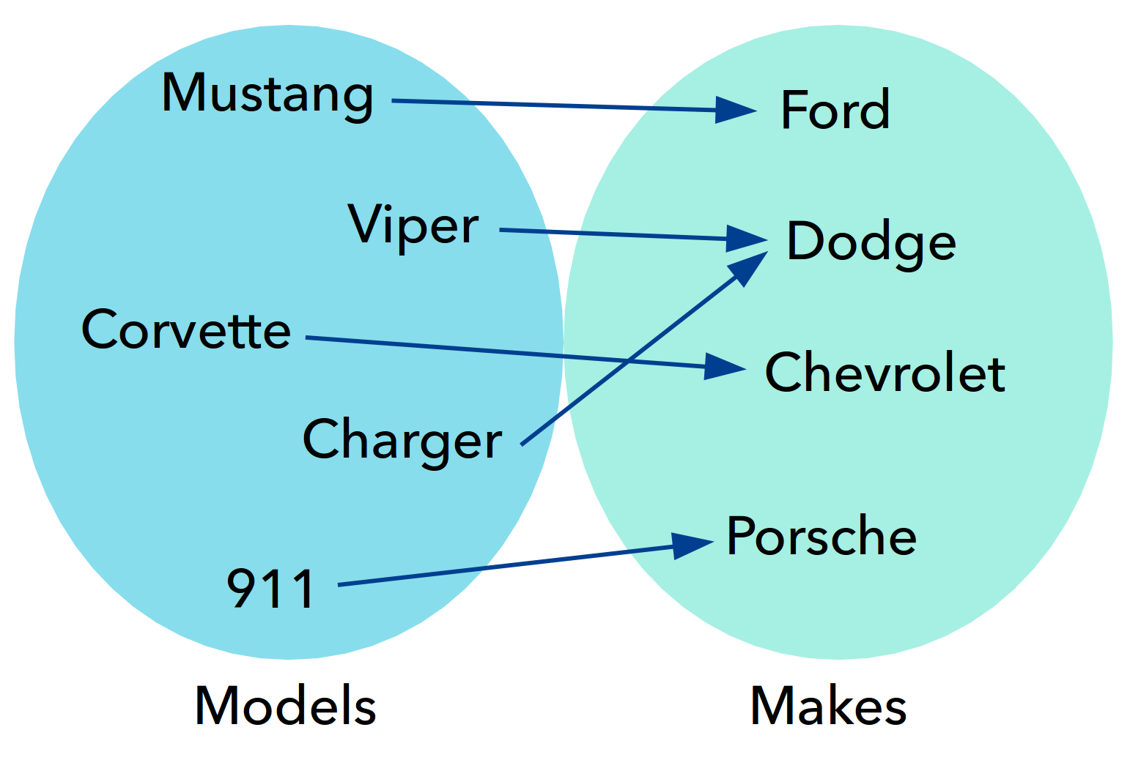
Example
Administrivia
1

Slide 10
dict data type
Indexes data by specified data type (key)
Analogy of a real dictionary (word: explanation), but can use data types besides string
The data type maps key to value
It is a many-to-one mapping
Administrivia
1

Slide 11
dict data type
Administrivia
1

Slide 12
dict data type
Syntax as follows:
Opening brace {
key: value pairs, separated by commas
Closing brace }
cars = {
‘Civic’: ‘Honda’,
‘Mustang’: ‘Ford’,
‘Model S’: ‘Tesla’,
‘Model T’: ‘Ford’
}
Administrivia
1

Slide 13
dict operations and methods
d = {‘one’:1, ‘two’:2, ‘three’:3}
print(d[‘one’])
d[‘four’] = 4 # add a new key-value pair if key
# doesn’t exist
d[‘three’] = 3.0 # modify an existing pair
del d[‘four’]
‘five’ in d
for key in d: # no guarantee on order
print(key, d[key])
d.keys()
d.values()
Administrivia
1

Slide 14
Example
d = {1:’a’, 2:‘b’, 3:‘c’, 4:’d’}
x = d[2] + d[3]
What is the value of x?
A 5
B 7
C ‘cd’
D ‘bc’
Administrivia
1

Slide 15
Example
d = {}
words = [‘red’, ‘orange’, ‘yellow’]
for word in words:
d[word] = words.index(word)
What is stored in d?
Administrivia
1

Slide 16
dict Applications
Link data based on a common field
zipcode = {‘Bill’: 60644,
‘Jill’: 41073,
‘Jack’: 61820,
‘Tony’: 60801}
zip2city = {41073: ‘Cincinnati’,
60644: ‘Chicago’,
61801: ‘Urbana’,
61820: ‘Champaign’}
for name in zipcode:
print(name, zip2city[ zipcode[name] ])
Administrivia
1

Slide 17
dict Applications
Dictionaries can encode/decode data, or translate data from one representation to another
x = ‘ABCDEFGHIJKLMNOPQRSTUVWXYZ’
y = ‘BCDEFGHIJKLMNOPQRSTUVWXYZA’
e = {} for i in range(len(x)):
e[x[i]] = y[i]
encoded = ‘’
for c in ‘HELLO’:
encoded += e[c]
Administrivia
1

Slide 18
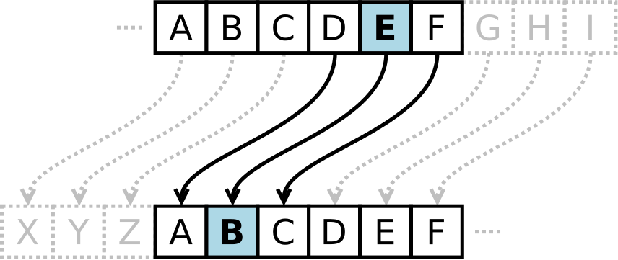

Exercise
Encoder words in a file using a Caesar cipher
$$E_{n}\left(x\right)=\left(x+n\right)\%26$$
https://en.wikipedia.org/wiki/Caesar_cipher
Administrivia
1

Slide 19
Exercise
def encode_caesar(message, n):
from string import ascii_uppercase as alphabet
x = alphabet
e = {}
# initialize e (encoder)
…
message = message.upper()
encoded = ‘’
# encode the message
…
return encoded
Administrivia
1

Slide 20
Exercise
>>> message = ‘the quick brown fox jump over the lazy dog’
>>> cipher.encode_caesar(message, 7)
“AOL XBPJR IYVDU MVE QBTWZ VCLY AOL SHGF KVF”
How would you write a caesar decoder?
Administrivia
1

Slide 21
dict Applications
Dictionary can also be used as accumulators
What is the output of d by the above code?
x = ‘ABBACABD’
d = {}
for c in x:
if c not in d:
d[c] = 1
else:
d[c] += 1
Administrivia
1

Slide 22
Exercise
Count the category frequencies in Jeopardy questions
Find the category name with the highest frequency
myfile = open(‘jeopardy.csv’)
lines = myfile.readlines()
# get category frequencies
…
# get most popular category name
…
Administrivia
1

Slide 23
Mutable Arguments
Administrivia
1

Slide 24
Example
def fun(x):
x = x + 1
return x
x = 5
fun(x)
What is the value of x in the end?
Administrivia
1

Slide 25
Mutable arguments
Mutability causes lists to work differently when passed to a function
Can be changed within a function
Very useful
def fun(q,i):
q.append(i)
a = []
for i in range(10)
fun(a,i)
print(a)
Administrivia
1

Slide 26
Mutable arguments
def readfile(filename, a)
for line in open(filename):
a.append(line.strip())
all_lines = []
readfile(‘cipher.py’, all_lines)
readfile(‘jeopardy.py’, all_lines)
…
Administrivia
1

Slide 27
Mutable arguments
def readfile(filename, a)
for line in open(filename):
a.append(line.strip())
all_lines = []
for f in open(‘filenames.txt’):
readfile(f.strip(), all_lines)
Administrivia
1

Slide 28
Copy mutable type by value
Have a copy of a list, not as an alias
Use the slice operator
x = [3,2,1]
y = x[:] #slice everything
y.sort()
print(x)
Administrivia
1

Slide 29
Copy mutable type by value
Have a copy of a list, not as an alias
Use the slice operator
x = [3,2,1]
y = x[:] #slice everything
z = x
y == x #True
z == x #True
Administrivia
1

Slide 30
test identity: is
Have a copy of a list, not as an alias
Use the slice operator
x = [3,2,1]
y = x[:] #slice everything
z = x
y is x #False
z is x #True
Administrivia
1

Slide 31
Reminders
Administrivia
1

Slide 32
Reminders
Administrivia
1

Slide 33
dict Applications
x = ‘ABCDEFGHIJKLMNOPQRSTUVWXYZ’
y = ‘BCDEFGHIJKLMNOPQRSTUVWXYZA’
#encoded is given
decoded = ‘’
…
Administrivia
1

