Slide 1
Python Basics
Lists, range and loop
CS101 Lecture #8
2016-10-19

Slide 2
Administrivia
Administrivia
1

Slide 3
Administrivia
Homework #4 is out
Due day is Oct 23, 6pm.
Administrivia
1

Slide 4
Administrivia
The first mid-term exam is after Lecture #11
10% of final grade
Administrivia
1

Slide 5
Warmup: if-elif-else
Warm-up
1

Slide 6
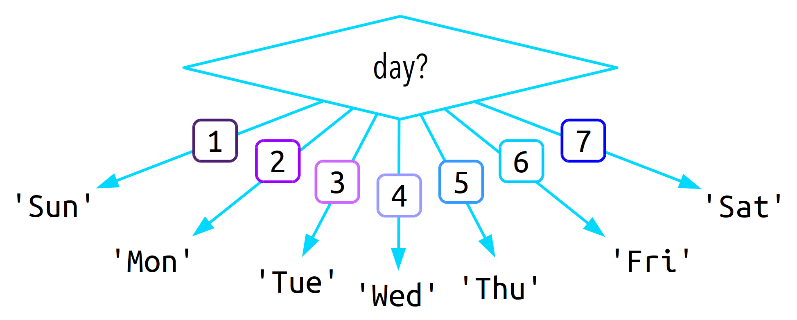
Warm-up
1

Slide 7
if day == 1:
print(‘Sunday’)
if day == 2:
print(‘Monday’)
if day == 3:
print(‘Tuesday’)
if day == 4:
print(’Wednesday’)
if day == 5:
print(‘Thursday’)
if day == ‘6’
print(‘Friday’)
if day == ‘7’
print(‘Saturday’)
else:
print(‘Not a valid input’)
Warm-up
1

Slide 8
if day == 1:
print(‘Sunday’)
else:
if day == 2:
print(‘Monday’)
else:
if day == 3:
print(‘Tuesday’)
else:
if day == 4:
print(’Wednesday’)
else:
if day == 5:
print(‘Thursday’)
else:
if day == ‘6’
print(‘Friday’)
else:
if day == ‘7’
print(‘Saturday’)
else:
print(‘Not a valid input’)
Warm-up
1

Slide 9
if day == 1:
print(‘Sunday’)
elif day == 2:
print(‘Monday’)
elif day == 3:
print(‘Tuesday’)
elif day == 4:
print(’Wednesday’)
elif day == 5:
print(‘Thursday’)
elif day == ‘6’
print(‘Friday’)
elif day == ‘7’
print(‘Saturday’)
else:
print(‘Not a valid input’)
Warm-up
1

Slide 10
Warmup: Recursion
Warm-up
1

Slide 11
Question
Every problem can be formulated in the form of recursion?
Yes
No
Warm-up
1

Slide 12
Question
Only a set of problems can be formulated by recursion
Yes
No
Warm-up
1

Slide 13
Question
If a problem can be formulated as recursion, then recursion is the best way to solve it
Yes
No
Warm-up
1

Slide 14
Question
Recursive algorithms are also called _____ (sometimes) in computer algorithm design?
Dynamic programming
Divide and conquer
Brute force
Randomization
Warm-up
1

Slide 15
Container Data Type
1

Slide 16
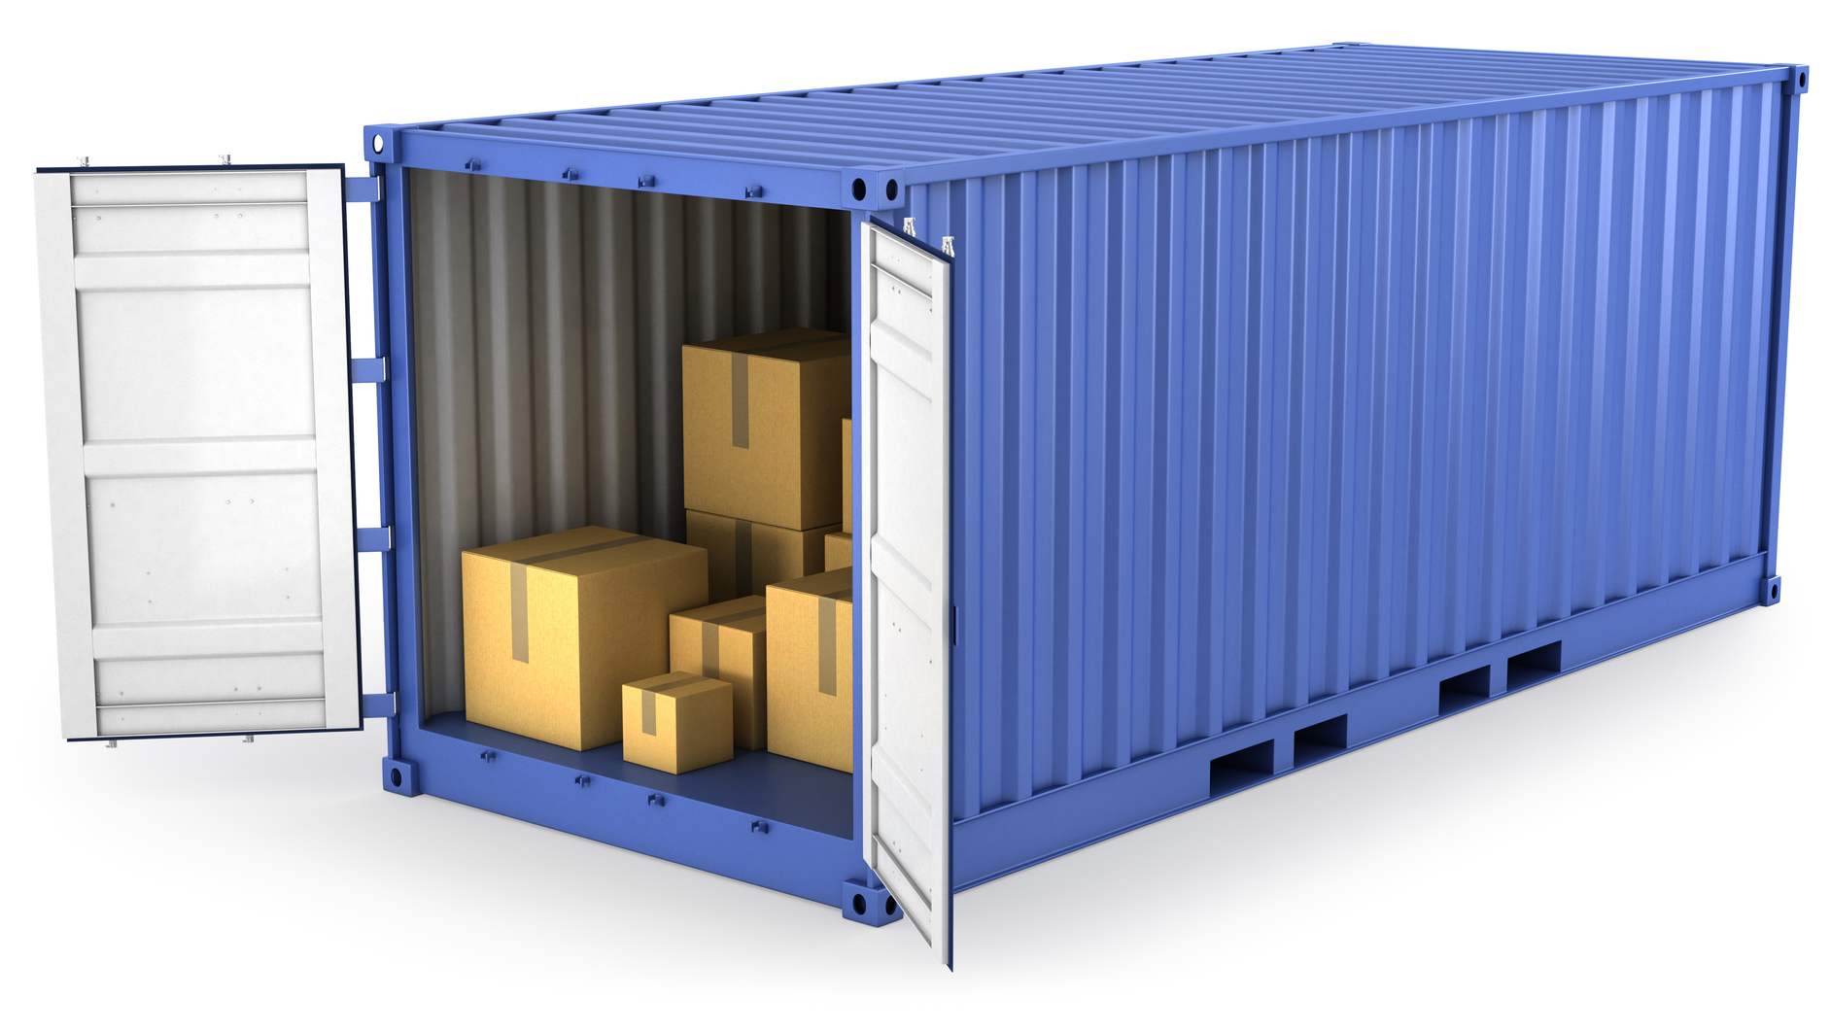
Container
list
1

Slide 17
Example
colors = [‘red’, ‘green’, ‘blue’, ‘cyan’, ‘megenta’, ‘yellow’]
list
1

Slide 18
list data type
It represents an listed collection of items
It is a container data type
Also an iterable data type
Can hold values of any type, and they don’t have to be the same (not the same as array)
list
1

Slide 19
How to create a list?
Syntax:
An opening bracket [
One or more comma-separated data values
A closing bracket ]
x = [10, 3.14, ‘2.71’]
list
1

Slide 20
How to access a list
Works a bit like strings:
x = [10, 3.14, ‘2.71’]
print(x[0])
print(x[1:3])
print(len(x))
list
1

Slide 21
Modify a list?
Modify a string
Strings are immutable; we cannot change its content without creating a new string
s = ‘strang’
s[3] = ‘i’ #nope
s = s[:3] + ‘i’ + s[4:] #correct
list
1

Slide 22
Modify a list?
We can change content of a list – it’s mutable
x = [4,1,2,4]
x[3] = -2 #item assignment
x.append(5) #add an item to the end
x.sort() #sort items by value
del x[1] #delete an item
list
1

Slide 23
for-loop
How to iterate a list?
print out all items of a list
colors = [‘red’, ‘yellow’, ‘blue’, ‘purple’, ‘jale’]
list
1

Slide 24
Loops
1

Slide 25
for loop
colors = [‘red’, ‘green’, ‘blue’, ‘cyan’, ‘megenta’, ‘yellow’]
for color in colors:
print(color)
Loop
1

Slide 26
for loop
A for loop requires:
Keyword for
A loop variable
Keyword in
An iterable data type
A block of code
For can iterate over items of a iterable type one at a time
Loop
1

Slide 27
Example
s = ‘abcdefg’
t = ‘’
for c in s:
t = c + t
What’s the value of t?
A ‘abcdefg’
B ‘gfedcba’
C ‘a’
D ‘g’
Loop
1

Slide 28
Exercise
Write a function to sum up all digits in a number, i.e.,
12145 → 1 + 2 + 1 + 4 + 5 → 13
Loop
1

Slide 29
Solution
def sum_digits(n):
result = 0
for digit in str(n):
result = result + int(digit)
return result
Loop
1

Slide 30
Exercise
Write a function to sum up numbers from 1 to 100
Loop
1

Slide 31
Solution
results = 0
for i in range(1, 101):
result = result + i
Loop
1

Slide 32
range function
The range function returns an iterator containing integers in a specified range
range can be casted as a list
list(range(1, 10))
Two arguments:
(optional) the starting value (inclusive)
The ending value (exclusive)
Loop
1

Slide 33
while-loop
Write a function to sum up numbers from 1 to 100
result = 0
i = 1
while i <= 100:
result = result + i
i += 1
Loop
1

Slide 34
while-loop
A while loop has:
The keyword while
A logical comparison (bool-valued result)
A block of code
Loop
1

Slide 35
Example
x = 3
While x > 0:
print(‘Hello’)
x -= 1
How many times is ‘Hello’ printed?
A 0
B 1
C 2
D 3
Loop
1

Slide 36
Example
i = 0
count = 0
while i < 100:
if (i%2) == 1:
count += 1
i += 1
What is this piece of code doing?
Loop
1

Slide 37
while-loop
Write a program for a user to create a new password. The program should accept a password attempt pwd from the user and check it with the function validate_password(pwd). If the password is valid, the program ends. If the password is invalid, the program asks for a new attempt, repeating until the user enters a valid password.
Loop
1

Slide 38
Solution
pwd = input(‘Enter a password: ’)
while not validate_password(pwd):
pwd = input(‘INVALID! Try again: ’)
print(‘Password correct!’)
Loop
1

Slide 39
Infinite loop
Make sure your code always has a way to end
While True:
print(‘Hello!’)
Loop
1

Slide 40
Infinite loop
Make sure your code always has a way to end
Use ‘Ctrl+C’ to force break
While True:
print(‘Hello!’)
Loop
1

Slide 41
Infinite loop
Make sure your code always has a way to end
Use break
x = 3
while True:
print(‘Hello!’)
x -= 1
if x == 0:
break
Loop
1

Slide 42
Accumulator pattern
Design patterns are common structures we encounter in writing code
The accumulator pattern uses an accumulator variable to track the progress of a loop
i = 0
sum = 0
while i <= 4:
sum += i
i += 1
Loop
1

Slide 43
Exercise
Write a function to sum up all digits in a number, i.e.,
12145 → 1 + 2 + 1 + 4 + 5 → 13
(use while loop)
Loop
1

Slide 44
Solution
def sum_digits(n):
…
Loop
1

