Slide 1
MATLAB
Equation Solving & Curve Fitting
CS101 Lecture #24
2017-12-19

Slide 2
Administrivia
Administrivia
1

Slide 3
Administrivia
HW9 due this Friday 6pm.
Q/A on Wednesday’s lab sessions
Final exam location update:
Administrivia
1

Slide 4
Random numbers
1

Slide 5
Random number generator
Matlab supports a variety of RNG:
rand, uniform distribution [0,1)
randi, random integers [1,n]
randn, standard normal (Gaussian) distribution
Random numbers
1

Slide 6
rand, randi
rand(5) %generate a 5x5 matrix
rand(5,1) %generate a 5x1 column vector
randi(5) %generate a number from [1,2,3,4,5]
randi(5,2) %generate a 2x2 matrix
randi([-1,1],10,1) %generate a 10x1 matrix from [-1,0,1]
Random numbers
1

Slide 7
randn
randn(); %a single normal number
randn(5); %generate a 5x5 matrix
a + b*randn(); %a random number drawn from a
%normal distribution with
%center ‘a’ and std ‘b’
Random numbers
1

Slide 8
rng(seed)
rng(‘default’); %restore the settings as restart
rng(1); %seeds the rng using a nonnegative integer
%so that rand,randi,randn produces a
%predictable sequence of random numbers
x = linspace(0,10*pi,1001)’;
y = sin(x)./x + 0.02*randn(1001,1);
clf; %clear current figure window
plot(x,y,’.’);
Random numbers
1

Slide 9
Equation Solving
1

Slide 10
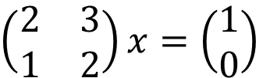
System of linear equations
A classical linear algebra problem:
Also called ‘left division’
A x = b
$\left(\begin{matrix}2 & 3 \\ 1 & 2\end{matrix}\right)x=\left(\begin{matrix}1 \\ 0\end{matrix}\right)$
A = [2 3; 1 2];
b = [1 0]’;
x = A\b; ‘\’: the magic backslash!
Equation solving
1

Slide 11
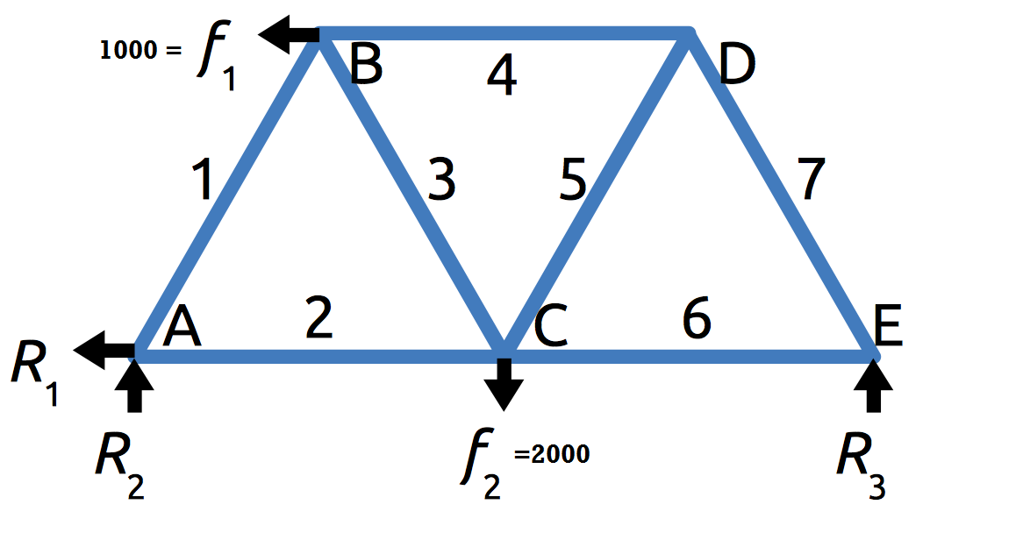

System of linear equations
Consider a truss problem:
$0.5x_{1}+x_{2}=R_{1}={−f}_{1}$
$0.866x_{1}=−R_{2}=−0.5f_{2}−0.433f_{1}$
$−0.5x_{1}+0.5x_{3}+x_{4}=f_{1}$
$0.866x_{1}+0.866x_{3}=0$
$$−x_{2}−0.5x_{3}+0.5x_{5}+x_{6}=0$$
$0.866x_{3}+0.866x_{5}=f_{2}$
$−x_{4}−0.5x_{5}+0.5x_{7}=0$
Equation solving
1

Slide 12
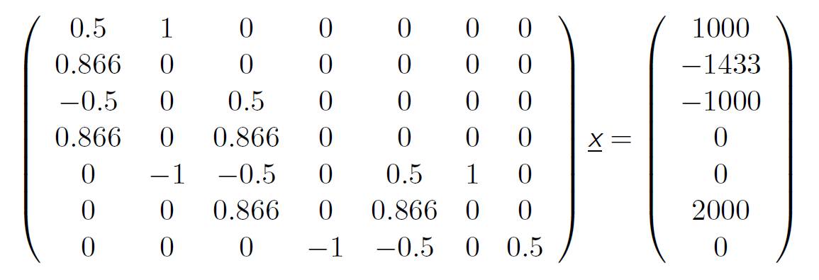


System of linear equations
$$−$$
1
$$Tx=f$$
Equation solving

Slide 13
Curve fitting
Fitting
1

Slide 14
Polynomials
The polynomial form
(note the numbering is a bit odd)
How MATLAB represents polynomials?
$$f\left(x\right)=a_{1}x^{3}+a_{2}x^{2}+a_{3}x+a_{4}$$
Fitting
1

Slide 15
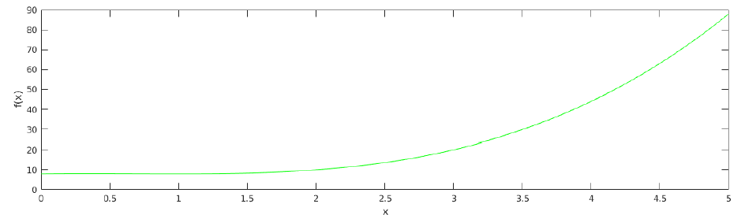


Polynomials
The polynomial form
$[a_{1} a_{2} a_{3} a_{4}]$
$[1 −2 1 8]$
$$f\left(x\right)=a_{1}x^{3}+a_{2}x^{2}+a_{3}x+a_{4}$$
$$f\left(x\right)=x^{3}−2x^{2}+x+8$$
Fitting
1

Slide 16


Polynomials
How to evaluate a polynomial?
$$f\left(x\right)=x^{3}−2x^{2}+x+8$$
$$[1 −2 1 8]$$
y = polyval([1 -2 1 8], 0:0.01:5);
plot(0:0.01:5, y, ‘g-’)
Fitting
1

Slide 17
Fitting data with a polynomial
Function: polyfit(x,y,n)
x = linspace(-1,1,11);
y = [ 0.038 0.058 0.1 0.2 0.5 1 0.5 0.2 0.1 0.058 0.038 ];
coefs = polyfit(x,y,2); %fit data with a polynomial of degree 2
yfit = polyval(coefs, x);
plot(x,y,’.’, x, yfit, ‘r-’);
Fitting
1

Slide 18
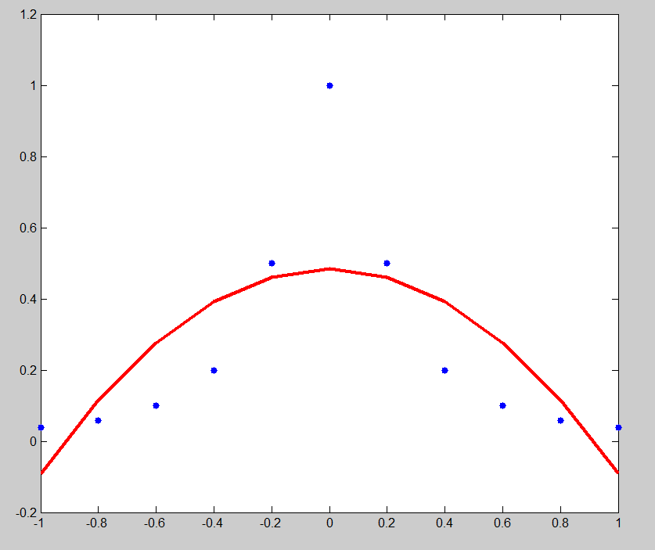
Fitting data with a polynomial
Fitting
1

Slide 19
Fitting data with a polynomial
Function: polyfit(x,y,n)
x = linspace(-1,1,11);
y = [ 0.038 0.058 0.1 0.2 0.5 1 0.5 0.2 0.1 0.058 0.038 ];
coefs = polyfit(x,y,10); %fit data with a polynomial of degree 10
yfit = polyval(coefs, x);
plot(x,y,’.’, x, yfit, ‘g-’);
hold on;
xnew = -1.5:0.01:1.5;
ypred = polyval(coefs, xnew);
plot(xnew, ypred, ‘r--’);
ylim([-1 1]);
Fitting
1

Slide 20
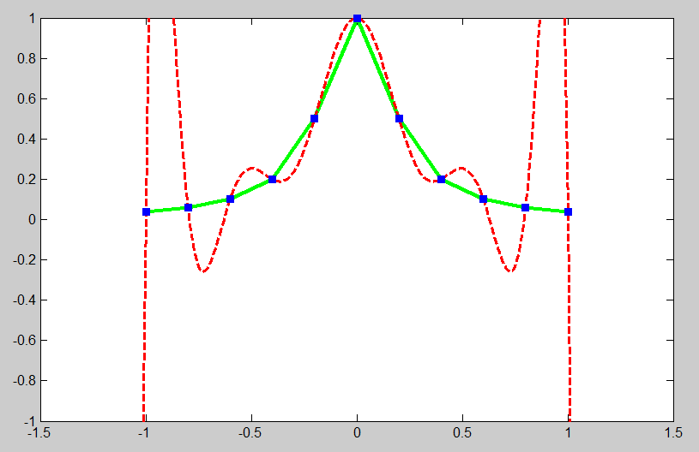
Fitting data with a polynomial
Fitting
1

Slide 21
Line fitting
1

Slide 22
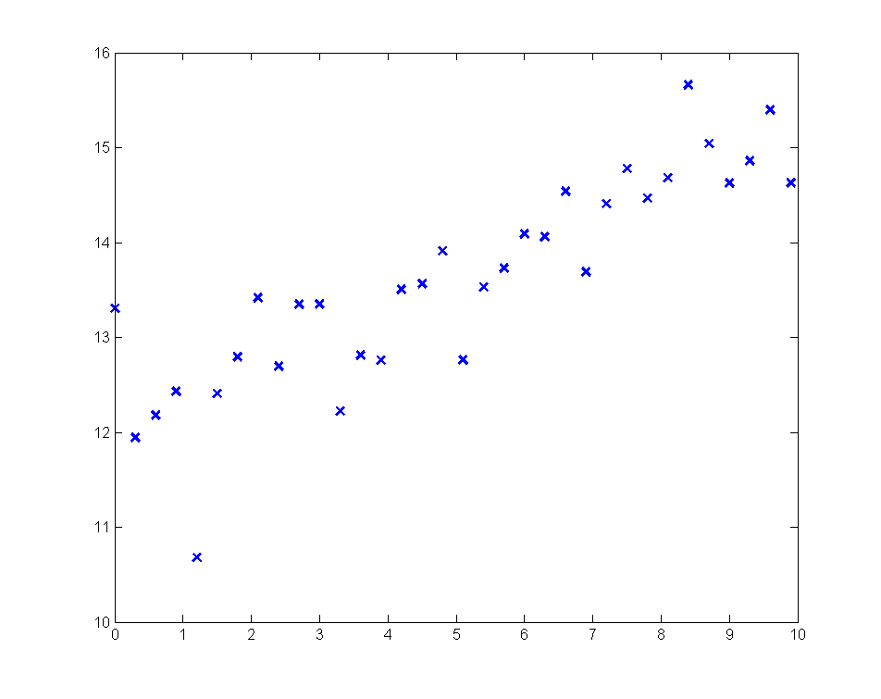
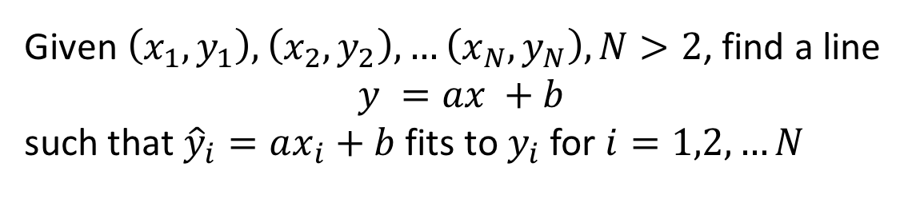
Fit a line to your data
Given $\left(x_{1},y_{1}\right),\left(x_{2},y_{2}\right),…\left(x_{N},y_{N}\right), N>2$, find a line
$$y =ax +b$$
such that ${\hat{y}}_{i}=ax_{i}+b$ fits to $y_{i}$ for $i=1,2,…N$
Fitting
1

Slide 23
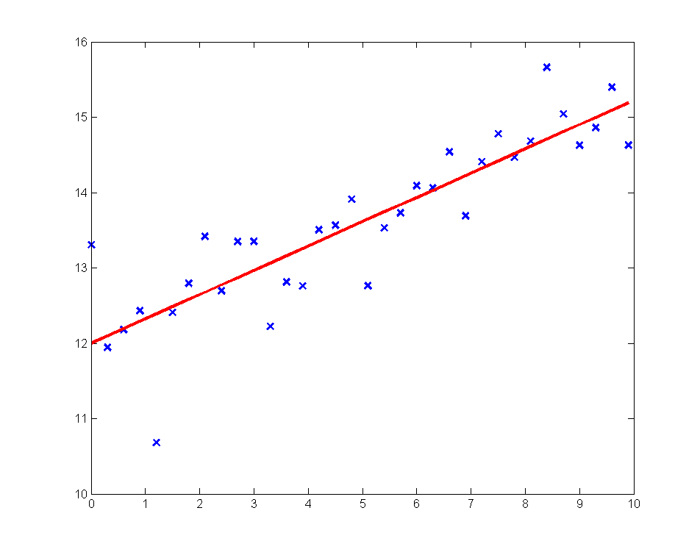
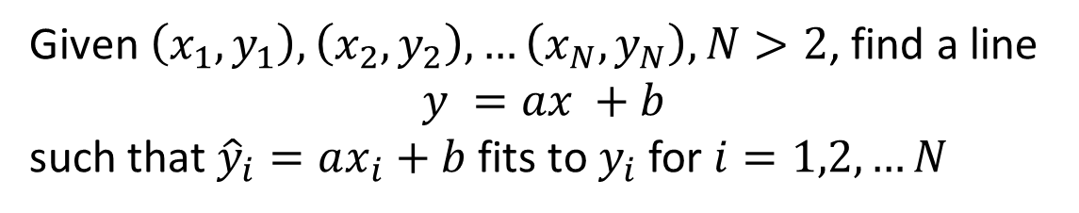
Fit a line to your data
Given $\left(x_{1},y_{1}\right),\left(x_{2},y_{2}\right),…\left(x_{N},y_{N}\right), N>2$, find a line
$$y =ax +b$$
such that ${\hat{y}}_{i}=ax_{i}+b$ fits to $y_{i}$ for $i=1,2,…N$
Fitting
1

Slide 24
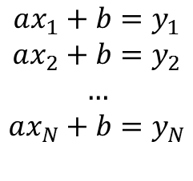
Fit a line to your data
Given $\left(x_{1},y_{1}\right),\left(x_{2},y_{2}\right),…\left(x_{N},y_{N}\right), N>2$, find a line
$$y =ax +b$$
such that ${\hat{y}}_{i}=ax_{i}+b$ fits to $y_{i}$ for $i=1,2,…N$
Goal:
$$ax_{1}+b=y_{1}$$
$$ax_{2}+b=y_{2}$$
$$…$$
$$ax_{N}+b=y_{N}$$
Fitting
1

Slide 25
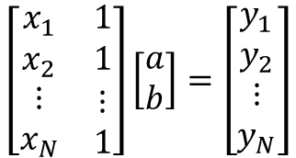
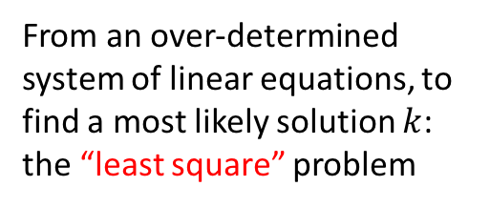
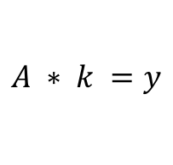
Fit a line to your data
Given $\left(x_{1},y_{1}\right),\left(x_{2},y_{2}\right),…\left(x_{N},y_{N}\right), N>2$, find a line
$$y =ax +b$$
such that ${\hat{y}}_{i}=ax_{i}+b$ fits to $y_{i}$ for $i=1,2,…N$
Put these in matrix form:
$$\left[\begin{matrix}x_{1} & 1 \\ x_{2} & 1 \\ \begin{matrix}⋮ \\ x_{N}\end{matrix} & \begin{matrix}⋮ \\ 1\end{matrix}\end{matrix}\right]\left[\begin{matrix}a \\ b\end{matrix}\right]=\left[\begin{matrix}y_{1} \\ y_{2} \\ \begin{matrix}⋮ \\ y_{N}\end{matrix}\end{matrix}\right]$$
$$A ∗ k =y$$
From an over-determined system of linear equations, to find a most likely solution $k$: the “least square” problem
Fitting
1

Slide 26
Fit a line to your data
load(‘xy.mat’);
%prepare the maxtrix A and rhs vector
A = [x ones(numel(x),1)];
rhs = y;
k = A\rhs; %backslash again!
%compute fitted values
yfit = A*k;
figure; plot(x,y,'bx', 'linewidth', 2);
hold on;
plot(x, yfit, 'r-', 'linewidth',2);
plot(x, yfit, 'ms', 'linewidth',2); %as scattered points
Fitting
1

Slide 27
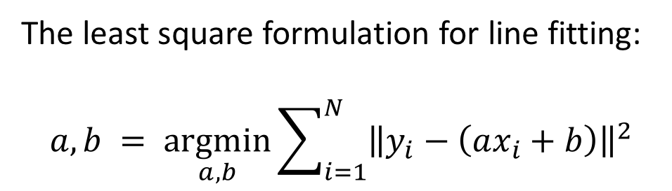
Least square for line fitting
The least square formulation for line fitting:
$$a,b = \underset{a,b}{argmin}{\sum_{i=1}^{N}{{\left\|y_{i}−\left(ax_{i}+b\right)\right\|}^{2}}}$$
Why minimizing the sum of squares?
The MLE interpretation of least squares (after class reading):
http://people.math.gatech.edu/~ecroot/3225/maximum_likelihood.pdf
Fitting
1

