Slide 1
Python Applicaton
Random sampling, Monte Carlo methods
CS101 Lecture #5
2016-10-10

Slide 2
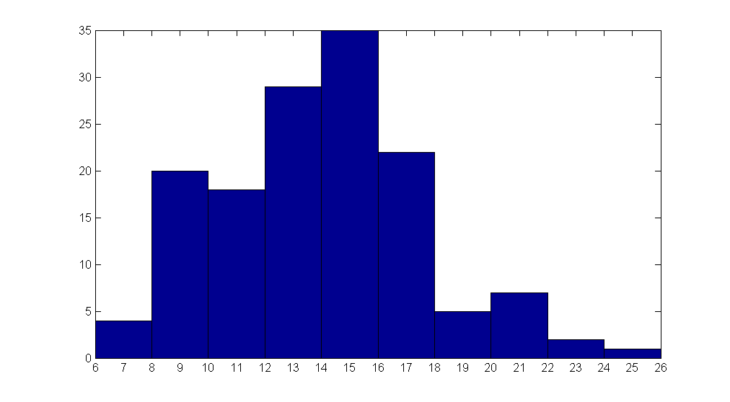
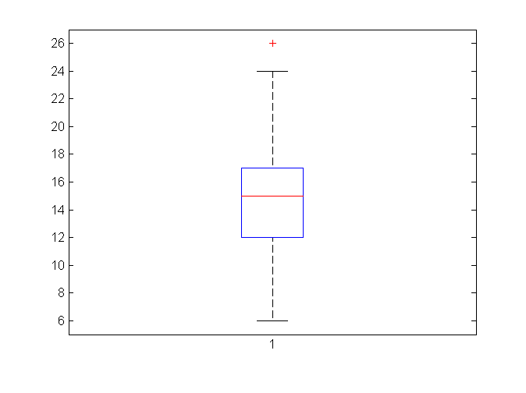
Mid-term I statistics (all)
count
score
Boxplot
Mean: 14.5
Median: 15
Percentile(25, 50, 75): 12, 15, 17
Highest: 26!
1

Slide 3
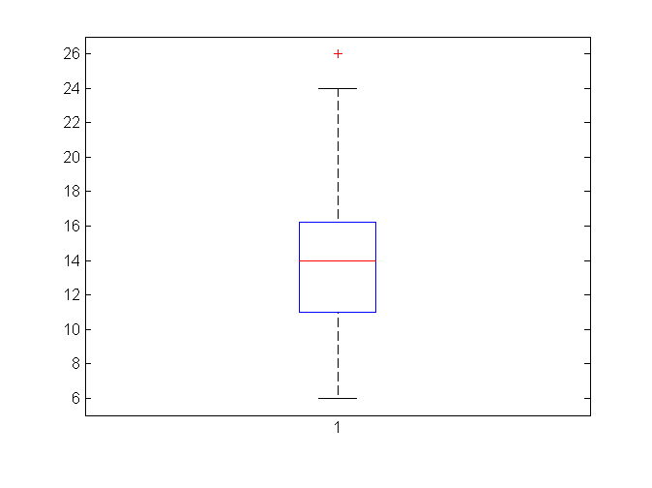
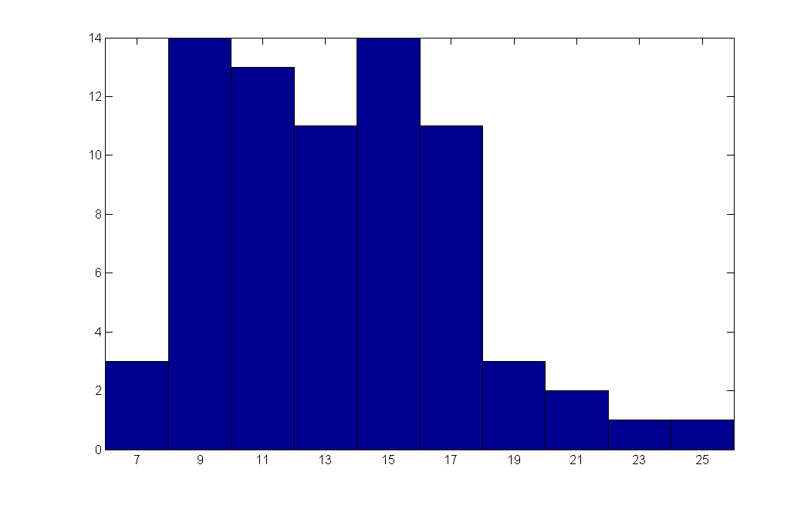
Mid-term I statistics (session A)
count
score
Boxplot
Mean: 13.9
Median: 14
Percentile(25, 50, 75): 11, 14, 16
Highest: 26!
1

Slide 4
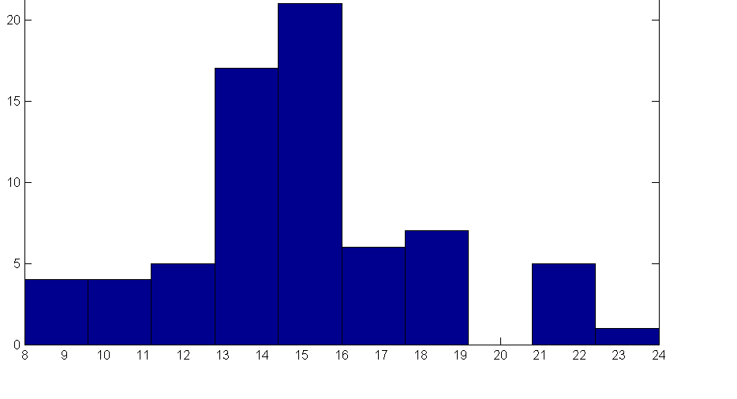
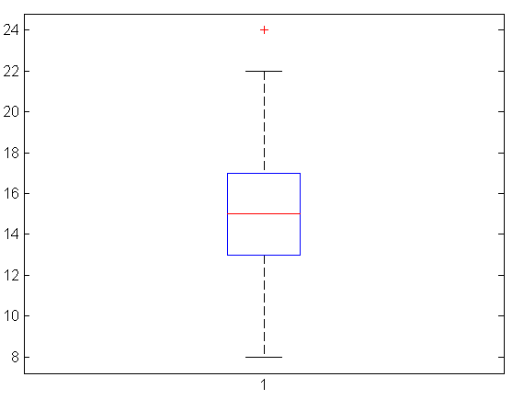
Mid-term I statistics (session B)
count
score
Boxplot
Mean: 15.0
Median: 15
Percentile(25, 50, 75): 13, 15, 17
Highest: 24
1

Slide 5
Finding solution by Simulation
Predict the number of people taking Western/Chinese food in a month
Write a python script to simulate it!
No complicated mathematics
1

Slide 6
Finding solution by Simulation
import numpy as np
W = 250
C = 250
for day in range(1,31):
nextW, nextC = W, C
for i in range(W):
if np.random.randint(10) < 3:
nextW -= 1
nextC += 1
for i in range(C):
if np.random.randint(10) < 2:
nextC -= 1
nextW += 1
W, C = nextW, nextC
print('Day %i: %i for Western food, %i for Chinese foot'%(day, W,C))
1

Slide 7
Find out the value of PI
Historical puzzle in mathematics
~1500 years ago
3.1415926 - 3.1415927
Monte Carlo
1

Slide 8
Find out the value of PI
Historical puzzle in mathematics
~1500 years ago
3.1415926 - 3.1415927
Not that difficult for us any more…
Monte Carlo
1

Slide 9
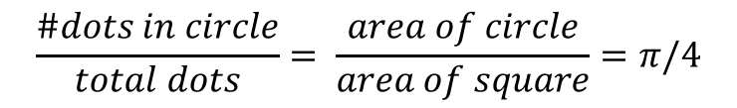
Find out the value of PI
$$\frac{\#dots in circle}{total dots}= \frac{area of circle}{area of square}=π/4$$
animation from wikipedia
Monte Carlo
1

Slide 10
Find out the value of PI
$$\frac{\#dots in circle}{total dots}= \frac{area of circle}{area of square}=π/4$$
animation from wikipedia
Find out PI by generating a ton of random dots!
Monte Carlo
1

Slide 11
Find out the value of PI
import numpy as np
def myrand():
return np.random.rand(1,1)[0][0]
samples = 10000
count = 0
for i in range(samples):
x, y = myrand(), myrand()
if (x**2 + y**2)**0.5 < 1:
count += 1
PI = count/samples*4
print('Pi = %f'%PI)
Monte Carlo

Slide 12
Monte Carlo methods
Use randomness to solve problems that might be deterministic in principle
optimization, statistical inference, biology, computer graphics
Simulating random samples is relatively cheap
Re-think the nature of computation
Computation vs. mathematics
Monte Carlo

Slide 13
Monte Carlo methods
Knowledge
Mathematics
Computation!
Monte Carlo

