Slide 1
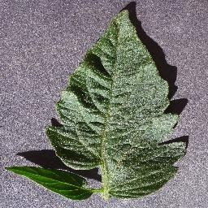
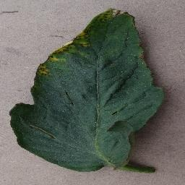
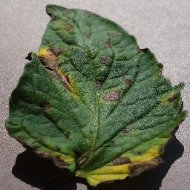
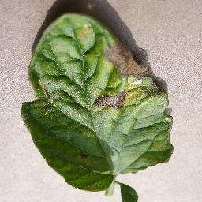
Accurate on clean photos, fragile outside them
Tomato leaf disease classification on PlantVillage
COMP7015 Group Project · Topic 1 · Group 5
Notes:
We classify tomato leaves into healthy and three diseases, with three models. Our headline is in the title: all three models are almost perfect on clean PlantVillage photos, and all three are fragile once the photo changes. The talk has two halves: first how we built and compared the models, then how we tested what they really learned.

Slide 2
A 99% score may not mean much
82%
accuracy from the colour of the four image corners alone. No leaf is seen.
Random forest on 12 numbers, validation set. Always answering the largest class gives 42%.
Healthy
Bacterial spot
Our two questions
How do a CNN from scratch, a pre-trained CNN and a pre-trained ViT compare on clean photos, and at what cost?
How much of that score survives a change of background, colour, light or image quality, or a field photo?
Early blight
Late blight
Notes:
PlantVillage photos show one leaf on a plain surface, and published accuracies are above 99 percent. But each class was photographed under its own conditions. Look at the backgrounds of these four photos: they differ between the classes. We checked this with a random forest that sees only the mean colour of the four image corners, no leaf at all. It reaches 82 percent accuracy. So a model can score well without looking at the disease. That gives our two questions: how do the three models compare on clean photos, and how much of that score survives when the photo changes?

Slide 3
A leak-free split by physical leaf
6,627
5,045
1,262
70 / 15 / 15
colour photos in four tomato classes
photos with an official leaf id (1,582 excluded)
physical leaves, about four photos each
split of the leaves: 3,529 / 760 / 756 photos
Class | Train | Val | Test | Leaves
Healthy | 699 | 152 | 148 | 250
Bacterial spot | 1,487 | 320 | 320 | 532
Early blight | 699 | 152 | 148 | 250
Late blight | 644 | 136 | 140 | 230
All | 3,529 | 760 | 756 | 1,262
1
Same input for all models 224 x 224, ImageNet normalisation, cached once.
2
Augmentation keeps the symptoms Flips, 90° rotations, ±10% brightness and contrast. Training photos only, no hue change.
3
Imbalance Bacterial spot has 2.1x the photos: class-weighted loss, macro-F1 as main metric.
4
Honest evaluation Tune on validation, test once. Three seeds (62, 63, 64), compared seed by seed.
Notes:
Most leaves were photographed about four times. If photos of one leaf end up in both training and test, the test score is inflated. So we split by leaf, not by photo. We keep only the 5,045 photos that have an official leaf id in the repository's metadata. That is 1,262 leaves, split 70, 15, 15 with a fixed seed, and the code asserts that no leaf is in two splits. All models get the same input. Augmentation is only applied to training photos, and it does not change hue, because lesion colour is part of the diagnosis. Bacterial spot has about twice the photos, so we use a class-weighted loss and report macro-F1. We tune on validation only and touch the test set once.

Slide 4
Three models, from 0.4 M to 86 M parameters
SE-CNN
ResNet18
ViT-B/16
0.41 M
11.2 M
85.8 M
parameters · trained from scratch
parameters · ImageNet pre-trained CNN
parameters · ImageNet pre-trained ViT
4 conv blocks (32 to 256 channels)
Squeeze-and-Excitation channel attention after every conv
Dropout 0.3, lr 3e-3, cosine schedule, 50 epochs
New 4-class head
Two stages: 1 epoch head only, then the whole network
lr 1e-4, cosine schedule, up to 20 epochs
New 4-class head
3 epochs head only, then full fine-tuning
lr 1e-5 backbone, 1e-4 head, up to 20 epochs
1.7 MB · 2.0 ms per image
264 s training
44.8 MB · 2.6 ms per image
94 s training
343 MB · 6.3 ms per image
595 s training
All models: AdamW, mixed precision, early stopping on validation macro-F1, checkpoint of the best validation epoch.
Notes:
We compare three models of very different size. The SE-CNN is our own small network, trained from scratch, with Squeeze-and-Excitation blocks, a cheap form of channel attention. ResNet18 is pre-trained on ImageNet. We first train only the new head for one epoch, so that the random head does not disturb the pre-trained features, and then fine-tune everything with a small learning rate. The ViT is also pre-trained, with three head-only epochs before fine-tuning. The bottom line of each card is the cost: model size, time per image and training time. Note that ResNet18 is the cheapest to train, because it stops early.

Slide 5
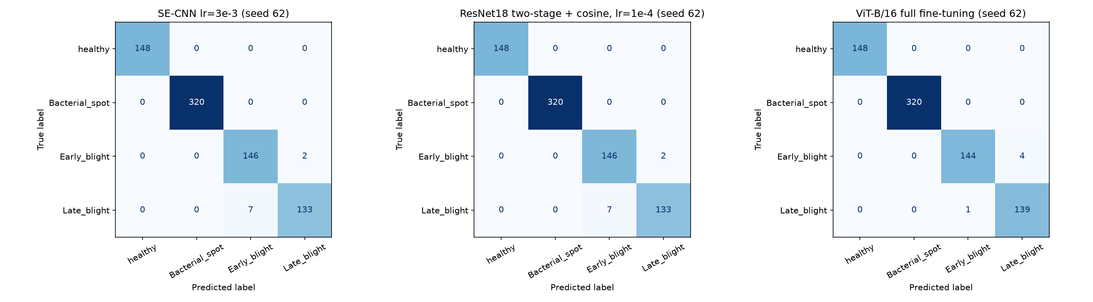
On clean photos all three are near-perfect
0.980
0.985
0.992
SE-CNN · ± 0.005 · 9, 12, 15 errors per seed
ResNet18 · ± 0.001 · 9, 9, 8 errors per seed
ViT-B/16 · ± 0.001 · 5, 4, 6 errors per seed
Test macro-F1, mean ± sd over three seeds, 756 test photos
Errors are blight vs. blight
33 of 36, 25 of 26 and 13 of 15 errors are between early and late blight.
The ViT beats ResNet18 in 3 of 3 seeds, but by only 3 to 4 photos, for 6.3x the training time.
Notes:
On the 756 clean test photos, all three models are almost perfect: macro-F1 of 0.980, 0.985 and 0.992. The order is ViT, ResNet18, SE-CNN, and the ViT is ahead in all three seeds. But the gap is small: five wrong photos per seed against nine and twelve. Healthy and bacterial spot are recognised almost perfectly, so the larger class does not dominate the errors. Nearly all errors are between early blight and late blight, which also look alike to people. Most errors change with the seed: only three to six photos are wrong in every seed. On clean photos alone, the ViT's extra cost would be hard to justify. The second half of the talk changes that picture.

Slide 6
Tuning: what mattered and what did not
ViT: unfreezing more helps
Test macro-F1 0.977, 0.984, 0.992: better in 3 of 3 seeds at each step, for 2.7x the training time.
Augmentation helps the ViT
+0.007 macro-F1 for the partial ViT, 3 of 3 seeds.
ResNet18: only freezing hurts
Frozen backbone 0.956 validation macro-F1; every fine-tuned recipe 0.997 to 1.000.
SE-CNN: ablations inside seed noise
All recipes 0.987 to 0.992, seeds vary by ±0.003: no proven gain from attention, dropout or class weights.
Notes:
What did tuning tell us? For the ViT, the fine-tuning strategy matters. The chart shows wrong test photos per seed: fourteen with only the head trained, about ten with the last two blocks, and five with full fine-tuning. Each step is better in all three seeds, and full fine-tuning costs 2.7 times the training time. Augmentation also helps the ViT. For ResNet18 the only clear effect is freezing the backbone, which costs four points. For our own CNN we want to be honest: every recipe lands between 0.987 and 0.992 on validation, and the same recipe varies by 0.003 between seeds. So on this saturated validation set we cannot show that attention, dropout or class weights help. We selected the recipe with the best mean over three seeds.

Slide 7
Change the photo and the models diverge
0.09
SE-CNN without the background: far below guessing.
Pre-training gives robustness to light; the ViT also to noise.
The ViT keeps 0.85 without the background, ResNet18 only 0.42.
ResNet18 seeds differ by ±0.11 to 0.14 under blur, noise and background removal.
Retrained on leaf-only photos, the ViT reaches 0.978: the leaf alone is enough.
Notes:
Now the second question. We take the same 756 test leaves and change them: remove the background, convert to grayscale, darken, blur, add noise. On the left of the chart all three models are equal. Everywhere else they are not. Our small CNN collapses under every change. Without the background it scores 0.09, far below guessing, so it relied on the background. The pre-trained models are robust to darkening, and the ViT also to noise. Without the background the ViT keeps 0.85 and ResNet18 only 0.42. We also retrained the ViT on background-removed photos: it reaches 0.978. So the leaf alone carries almost all the information. The background is a shortcut, not a necessity.

Slide 8
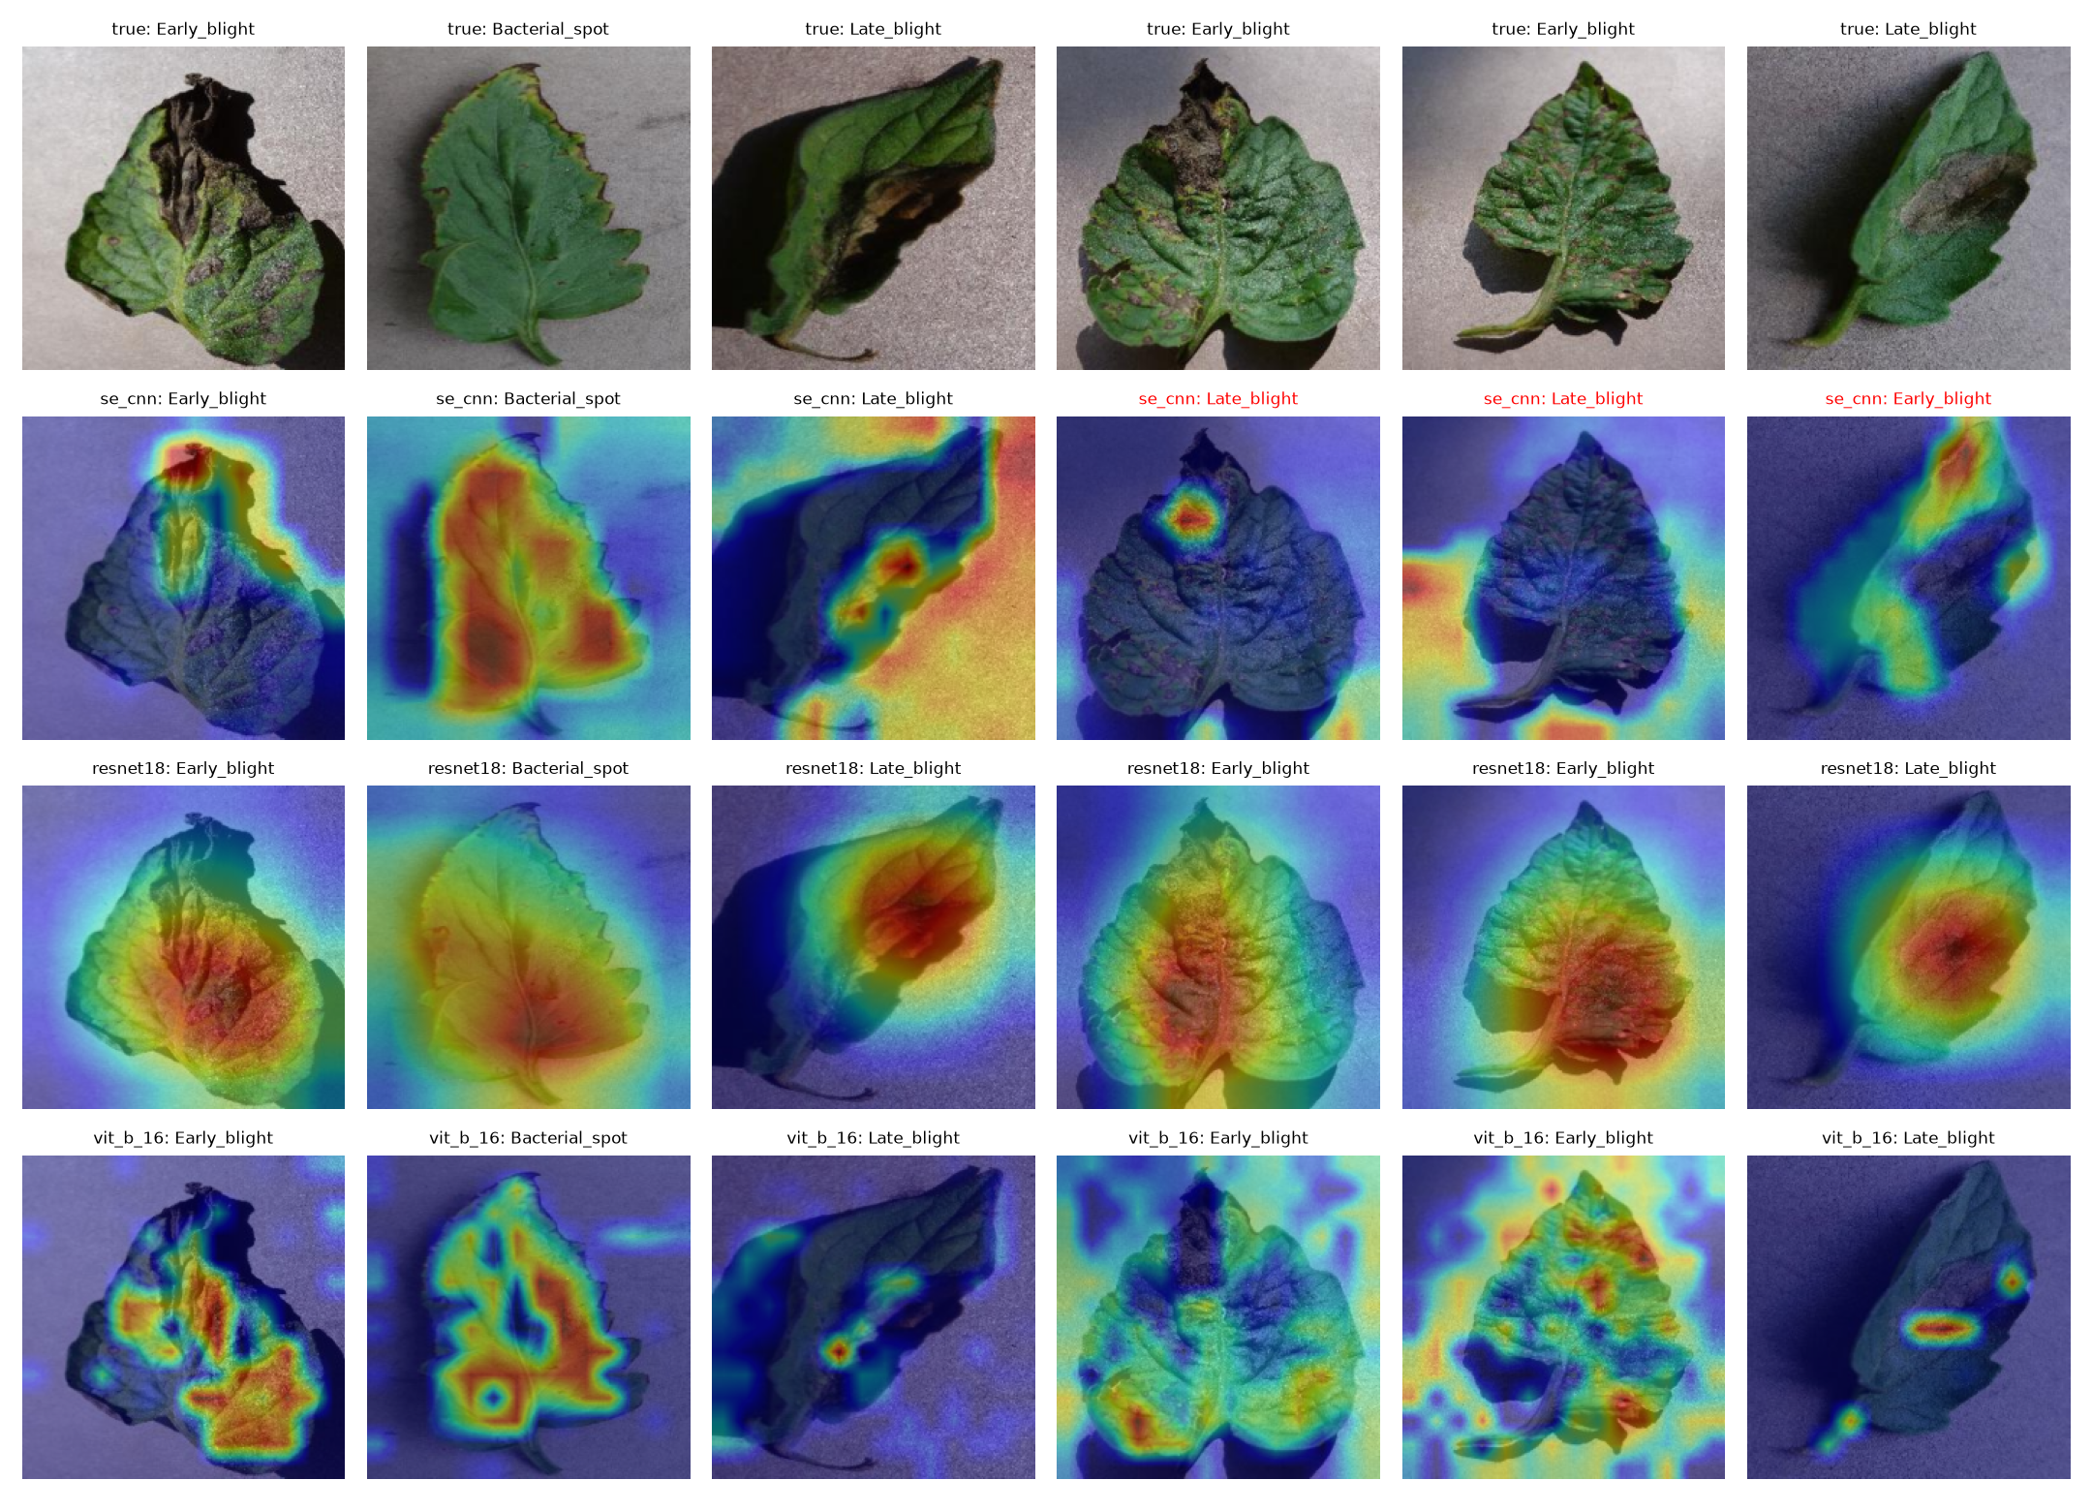
The CNNs follow the background
Same leaf pixels, pasted on a background from a photo of another class. How often does the model predict the class of the background?
25%
SE-CNN
macro-F1 0.836 to 0.481
12%
ResNet18
macro-F1 0.930 to 0.773
2%
ViT-B/16
macro-F1 0.913 to 0.894
macro-F1: same-class to other-class background. On a healthy background, ResNet18 calls 39% of diseased leaves healthy.
Grad-CAM, seed 62. Rows: photo, SE-CNN, ResNet18, ViT. Red titles are wrong predictions.
Notes:
To separate leaf from background, we paste each test leaf, with identical leaf pixels, onto a background tile from another test photo: once from the same class, as a control, and once from another class. With a background of another class, our CNN predicts the class of the background for 25 percent of the leaves, ResNet18 for 12 percent, the ViT for 2 percent. The worst case is a healthy background: ResNet18 then calls 39 percent of diseased leaves healthy. On the right are Grad-CAM maps. The second row is our CNN: in the third and fifth photo its attention lies on the background. ResNet18 stays on the leaf. For the ViT, Grad-CAM is coarse and varies between seeds, so we trust the behavioural test more than the heat maps.

Slide 9
Random backgrounds remove the shortcut
The fix
In half of the training photos, replace everything outside the leaf by a random background.
Cost on clean photos
+0.001
−0.006
−0.010
ResNet18
SE-CNN
ViT-B/16
Predictions that follow the background fall below 2% for every model.
The control sees pasted leaves too, but gains far less: the gain comes from breaking the link between background and label.
Notes:
Can we remove the shortcut? We retrained all three models with one extra augmentation: in half of the training photos, everything outside the leaf is replaced by a random background, such as a colour, a gradient, noise or a tile from another photo. The background then no longer tells the class. The chart shows a background type that never occurs in training, diagonal stripes. Our CNN goes from 0.22 to 0.92 and ResNet18 from 0.48 to 0.97. The cost on clean photos is nothing for ResNet18 and at most one point for the others. The light green bars are a control: the same pasted leaves, but with a background from the same class. It gains far less. So the gain comes from breaking the link between background and label, not from seeing pasted leaves.

Slide 10
No model works on field photos
0.19 to 0.37
macro-F1 in the field, down from 0.97 or more. Most field photos are called early blight.
Can the confidence warn us?
Clean photos: yes. Skipping the 5% least confident photos gives 0.998 to 0.999 accuracy.
Changed photos: no. The models are confidently wrong (calibration error up to 0.79), and skipping 5% gains less than 0.01.
Removing the background shortcut is necessary, not sufficient.
Notes:
The hardest test is PlantDoc: 372 web photos of the same four classes, with several leaves, hands, soil and natural light. We test without retraining. Every model fails: macro-F1 falls from 0.97 or more to between 0.19 and 0.37. Most field photos are simply called early blight. Random backgrounds help a little, and the ViT with random backgrounds is the best, at 0.37, which is still far from usable. So removing the background shortcut is necessary but not sufficient. We also asked whether the model's confidence could warn us. On clean photos it can: skipping the 5 percent least confident photos removes most errors. Under changed conditions it cannot: the models are confidently wrong.

Slide 11
What we take away
1
Clean scores hide the differences
Our recommendation
0.980 to 0.992 on clean photos: three to seven photos apart.
Controlled photos: ResNet18 with random backgrounds. 0.986 clean, 0.97 to 0.98 on changed backgrounds, 45 MB, 94 s training.
Varying light and cameras: ViT with random backgrounds.
Next: field photos in training, photometric augmentation, several splits.
2
Pre-training buys robustness
The ViT's extra compute pays off under changed conditions, not on clean photos.
3
Small CNNs take the shortcut
Trained from scratch on 3,529 photos, the SE-CNN leans on the background.
4
Random backgrounds are a cheap fix
No model is ready for the field
They remove this one shortcut at little or no clean cost.
Notes:
To conclude. One: on clean PlantVillage photos the choice of model hardly matters; the three models are a few photos apart. Two: pre-training buys robustness. The ViT's extra compute pays off under changed conditions, not on clean photos. Three: the small CNN trained from scratch takes the easy shortcut, the background. Four: random backgrounds are a cheap and effective fix for this one shortcut. Our recommendation for controlled photos is ResNet18 with random backgrounds: it keeps its clean score, is robust to background changes and is cheap. Where light and cameras vary, the ViT with random backgrounds is safer. But no model is ready for the field. The next step is field photos in training. Thank you, we are happy to take questions.

