Slide 1


Efficient Kernel Selection
via Spectral Analysis
Jian Li ^{1,2} ,Yong Liu^{1,3∗}, Hailun Lin¹, Yinliang Yue¹, Weiping Wang¹
¹Institute of Information Engineering, Chinese Academy of Sciences
²School of Cyber Security, University of Chinese Academy of Sciences
³Tianjin University
August 23, 2017
Notes:
Good morning every one. It’s glad to give presentation here. My name is Li Jian. I am a student from Institute of Information Engineering, which belongs to Chinese Academy of Sciences. And This is our paper, efficient kernel selection via spectral analysis. In this paper, we propose a novel kernel selection method based on kernel matrix.

Slide 2

目录
1
Introduction
1
Introduction
2
Spectral Measure
3
Spectral Kernel Selection
4
Experiments
5
Conclusion
Notes:
And I will introduce our paper in following 5 parts. Firstly, let’s see introduction.

Slide 3
Kernel Selection
Kernel methods
a class of algorithms by using kernel functions(SVM, KRR, etc)
Kernel function ^{[1]}
linearly inseparable
linearly separable
operates in a high-dimensional, implicit feature space
computation is cheaper by using kernel trick
Kernel Selection
Performance of kernel methods depends on kernel selection
Notes:
As we know, kernel methods have been widely used in machine learning. The most famous kernel method is SVM, and there are other kernel methods like KRR, KPCA. Kernel methods are a class of algorithms by using kernel functions, but what’s kernel function?
Firstly, let’s see a picture. Samples are linearly inseparable in low-dimensional space but may be linearly separable in high-dimensional space after feature mapping. function \phi is a feature map from low-dimensional input space to high-dimensional feature space. And kernel function K is the inner product of two maps \phi x and \phi z. For kernel function, it operates in a high-dimensional, implicit feature space and its computation can be simplified by kernel trick.
We know performance of kernel method like SVM mainly depends on the kernel it used, so the performance of kernel methods depends on kernel selection. And our paper is talk about a novel method to select kernel.

Slide 4
Existing Kernel Selection Methods
Cross validation (CV)
GCV ^{[2]}, span bound ^{[3]}, ELOO ^{[4]}, influence function ^{[5]}, etc
Kernel target alignment (KTA)
KTA^{[6]}, CKTA^{[7]}, FSM^{[8]}, etc
kernel matrix
alignment
label
Minimizing theoretical bounds of generalization error
VC dimension^{[9]}, Rademacher complexity^{[10]}, ER ^{[11]}, etc
Notes:
There are three kinds of existing kernel selection methods. The first one is cv and approximate CV: GCV, span bound, ELOO, influence function and so on.
Secondly, Kernel target alignment (KTA) is another widely used criterion that can be effectively calculated in O(n2). It uses maximizing alignment of kernel matrix and label as a criterion. And some improved methods like CKTA, FSM.
Thirdly, minimizing theoretical estimate bounds of generalization error. To this end, some measures of complexity are introduced: such as VC dimension, Rademacher complexity, ER and others.

Slide 5
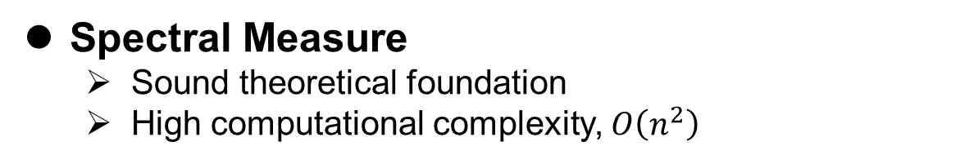
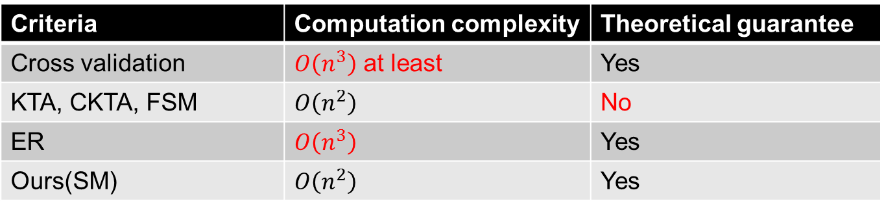
Existing Kernel Selection Methods
Criteria | Computation complexity | Theoretical guarantee
Cross validation | $O\left(n^{3}\right)$ at least | Yes
KTA, CKTA, FSM | $$O\left(n^{2}\right)$$ | No
ER | $$O\left(n^{3}\right)$$ | Yes
Ours(SM) | $$O\left(n^{2}\right)$$ | Yes
Existing measures for kernel selection
No theoretical guarantee
High computational complexity
Spectral Measure
Sound theoretical foundation
High computational complexity, $O\left(n^{2}\right)$
Notes:
Although those three kinds of methods are widely used, they have some drawbacks. There is a table contains time complexity and theoretical guarantee for cv, KTA, ER. We can see cv has high computation complexity, which is O(n3) at least. KTA has no sound theoretical guarantee. And ER is computation intensive, calculated in O(n3).
We can see existing measures for kernel selection either provide less theoretical guarantee or have high computational complexity.
So, we propose a novel kernel selection criteria named spectral measure. It has sound theoretical foundation and high computational efficiency, O(n2).

Slide 6
目录
1
Introduction
2
Spectral Measure
2
Spectral Measure
3
Spectral Kernel Selection
4
Experiments
5
Conclusion
Notes:
Then, let’s see what is Spectral Measure

Slide 7

Definition
Kernel matrix
contains most of information needed by kernel methods
its spectral decomposition is useful in kernel selection
Spectral Measure
$Κ={\left[K(x_{i},x_{j})\right]}_{i,j=1}^{n}$ is the kernel matrix
$Ν=Κ/{\left|Κ\right|}_{1}$ is the normal kernel matrix
$λ_{i}$ is the eigenvalue and $v_{i}$ is the eigenvector
$\left(λ_{i},v_{i}\right)$ is the spectral decomposition of $Ν$, so $λ_{i}∈\left[0,1\right]$
$φ\left(λ_{i}\right)≤λ_{i}$ for all $ⅈ∈\left\{1,2,…,n\right\}$
Notes:
kernel matrix is important to kernel methods. Which contains most of information needed by kernel method and its spectral decomposition is useful in kernel selection.
Spectral Measure is given in following form. K is the kernel matrix, N is the normal kernel matrix$. λ_{i}$ is the eigenvalue and $v_{i}$ is the eigenvector.$\text{, }\left(λ_{i},v_{i}\right) \text{is} \text{the} \text{spectral} \text{decomposition} \text{of} Ν\text{, }\text{so} λ_{i}∈\left[0,1\right]\text{.}\text{we} \text{set} \text{function} φ\left(λ_{i}\right)≤λ_{i}$ for all $ⅈ∈\left\{1,2,…,n\right\}$

Slide 8

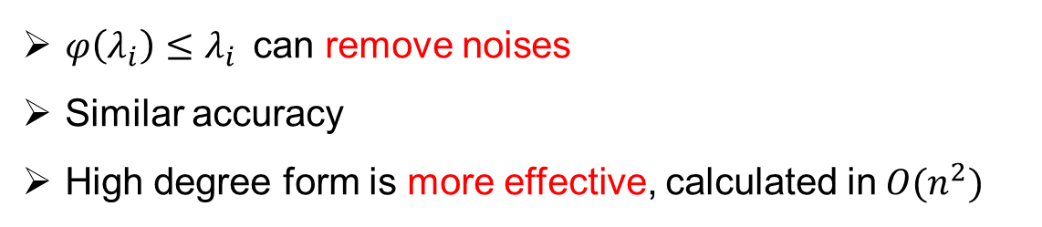
Conditions of $φ\left(λ_{i}\right)≤λ_{i}$
Hinge form: $h≥0$
High degree form:
$φ\left(λ_{i}\right)≤λ_{i}$can remove noises
Similar accuracy
High degree form is more effective, calculated in$O(n^{2})$
Notes:
We can define function \phi as following two forms.
Hinge form, \phi \lambda equals zero when \lambda is not greater than h, otherwise \phi \lambda equals to \lambda.
High degree form. \phi \lambda equals \lambda to r-th power, where r is bigger than 0. And we can conduct SM to this form when we use High degree form.
Both of them can remove noises and have similar accuracy.
But We use high degree form in this paper, because high degree form is more effective, can be calculated in O(n2).

Slide 9
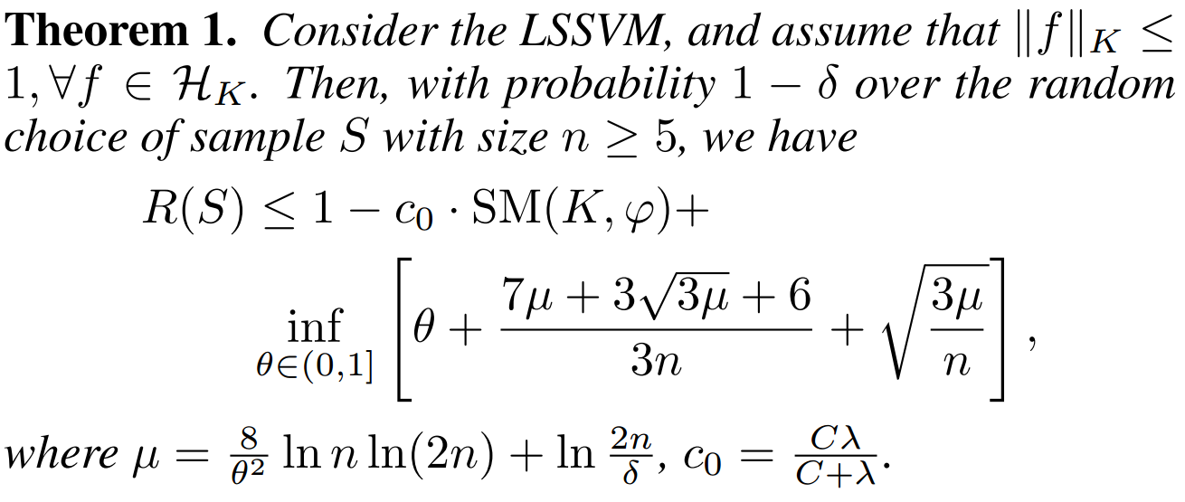
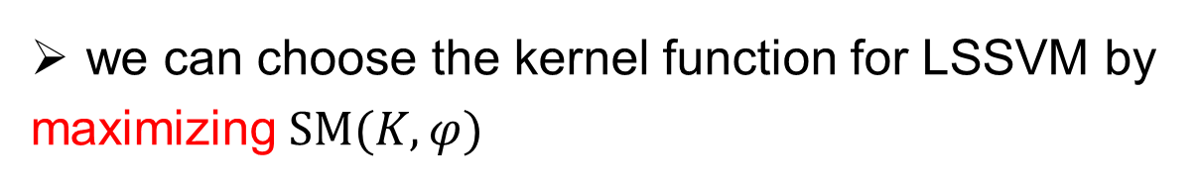
SM-based Generalization Error Bounds
we can choose the kernel function for LSSVM by
maximizing$SM(K,φ)$
Notes:
Then, there is SM-based Generalization Error Bounds for LSSVM. To confine generalization error bounds, we need to get minimum of this part, so we need to maximize SM.
we can choose the kernel function by maximizing SM(K, ϕ) to guarantee good generalization performance.

Slide 10
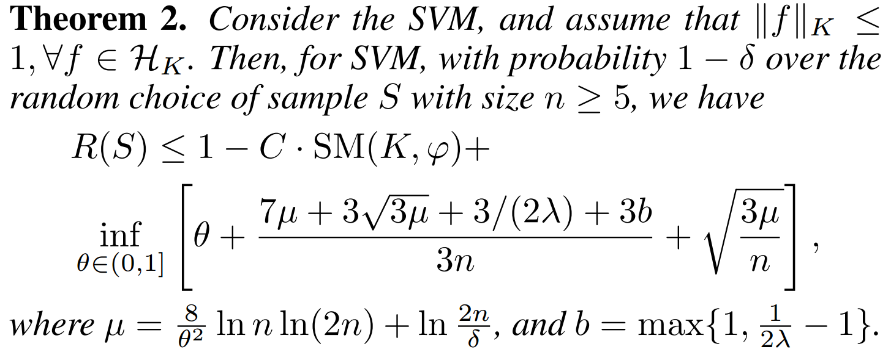
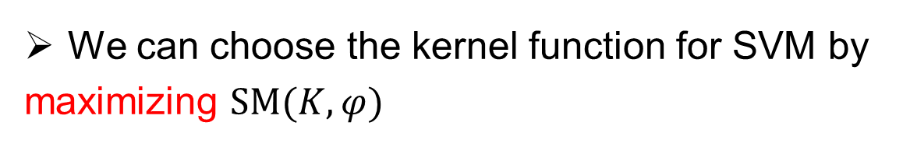
SM-based Generalization Error Bounds
We can choose the kernel function for SVM by
maximizing $SM(K,φ)$
Notes:
For theroem2, It is similar to LSSVM. To confine generalization error bounds, we need to get minimum of this part, so we need to maximize SM.
we can choose the kernel function by maximizing SM(K, ϕ) to guarantee good generalization performance.

Slide 11
目录
1
Introduction
2
Spectral Measure
3
3
Spectral Kernel Selection
Spectral Kernel Selection
4
Experiments
5
Conclusion
Notes:
Then, let’s see our kernel selection criterion.

Slide 12
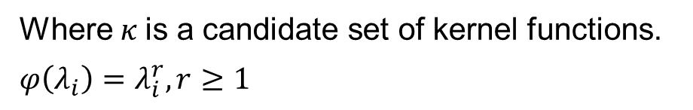
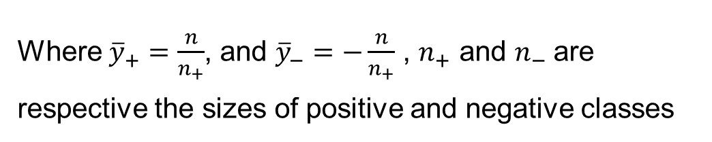
Spectral Kernel Selection
Spectral measure criterion(SM)
Where $κ$is a candidate set of kernel functions.
$$φ\left(λ_{i}\right)=λ_{i}^{r},r≥1$$
Weighted SM
Where ${\overline{y}}_{+}=\frac{n}{n_{+}}$, and ${\overline{y}}_{−}=−\frac{n}{n_{+}}$ , $n_{+}$ and $n_{−}$are respective the sizes of positive and negative classes
Notes:
According to above Theorems, we can guarantee good generalization performance by maximizing the spectral measure SM(K; ’).. Thus, we give following spectral measure criterion: xxx. where K is a candidate set of kernel functions and function \phi uses high degree form.
In practice, we always come to imbalance problem of positive and negative samples. To avoid this problem, we can give different weights to positive and negative classes according to their sample sizes. Then, we finally consider the following weighted SM.

Slide 13
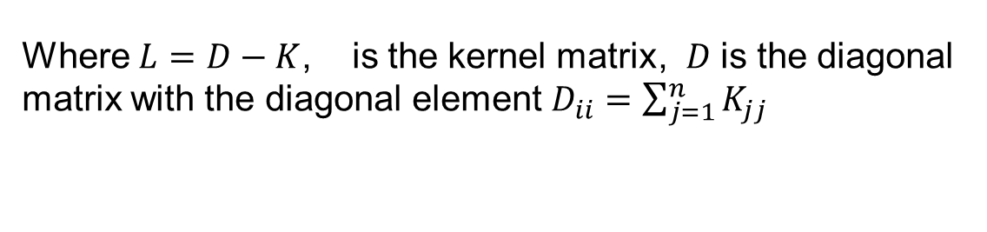
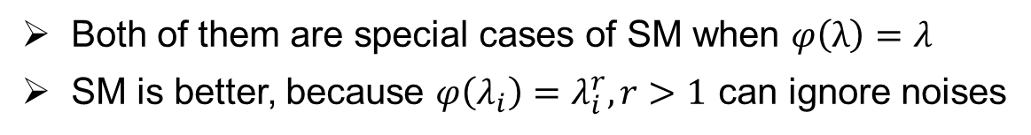
d
Connections to Other measures
Graph Cut^{[11]}
Where $L=D−K$, is the kernel matrix, $D$ is the diagonal matrix with the diagonal element $D_{ii}=\sum_{j=1}^{n}{K_{jj}}$
Mean Discrepancy^{[12]}
where ${\left\langle φ\left(x_{i}\right), φ(x_{j})\right\rangle }_{K}=K_{ij}$
Both of them are special cases of SM when $φ\left(λ\right)=λ$
SM is better, because $φ\left(λ_{i}\right)=λ_{i}^{r},r>1$ can ignore noises
Notes:
Let’s see connections between our spectral measure and other spectral methods.
In graph theory, graph cut is used to measure the degree of dissimilarity of different segmentation. we can use kernel matrix as similarity matrix to construct a graph. In this case, the normalized graph cut (Ncut) can be written as this form.
Mean discrepancy (MD) is proposed to test whether two distributions are different on the basis of samples drawn from each of them. The estimate of MD can be written as following form.
However,
Both of them are special cases of SM when \phi \lambda equals \lambda. In another words, r = 1.
SM is better. $φ\left(λ_{i}\right)$approach 0 very quickly , which can be used to ignore the noise

Slide 14
目录
1
Introduction
2
Spectral Measure
3
Spectral Kernel Selection
4
Experiments
4
Experiments
5
Conclusion
Notes:
Then, let’s see experiments. We do two experiments: compare our criterion with current popular kernel selection criterions and see the influence of different r.

Slide 15

Experiments
Datasets: 25 public datasets from UCI, StatLib and Weka Collections
Partitions: For every dataset, all methods run 50 times with randomly
selected 70% of all data for training and the other for testing.
Environment: Dell PC with 3.1-GHz 4-core CPU and 4 GB memory.
Kernel functions: $K\left(x, x^{′}\right)=exp⁡(−\frac{{\left\|x−x^{′}\right\|}_{2}^{2}}{2τ})$ as candidate kernels, where$τ∈\{2^{i}, i=−15,−14,…,15\}$
Regularization parameter: λ = 1
Learning machine: LSSVM
Notes:
Let’s see some basic environment.
Datasets: 25 public datasets from UCI, StatLib and Weka Collections
Partitions: For every dataset, all methods run 50 times with randomly
selected 70% of all data for training and the other for testing.
Environment: Dell PC with 3.1-GHz 4-core CPU and 4 GB memory.
Kernel functions: $K\left(x, x^{′}\right)=exp⁡(−\frac{{\left\|x−x^{′}\right\|}_{2}^{2}}{2τ})$ as candidate kernels, where$τ∈\{2^{i}, i=−15,−14,…,15\}$
Regularization parameter: λ = 1
Learning machine: LSSVM

Slide 16
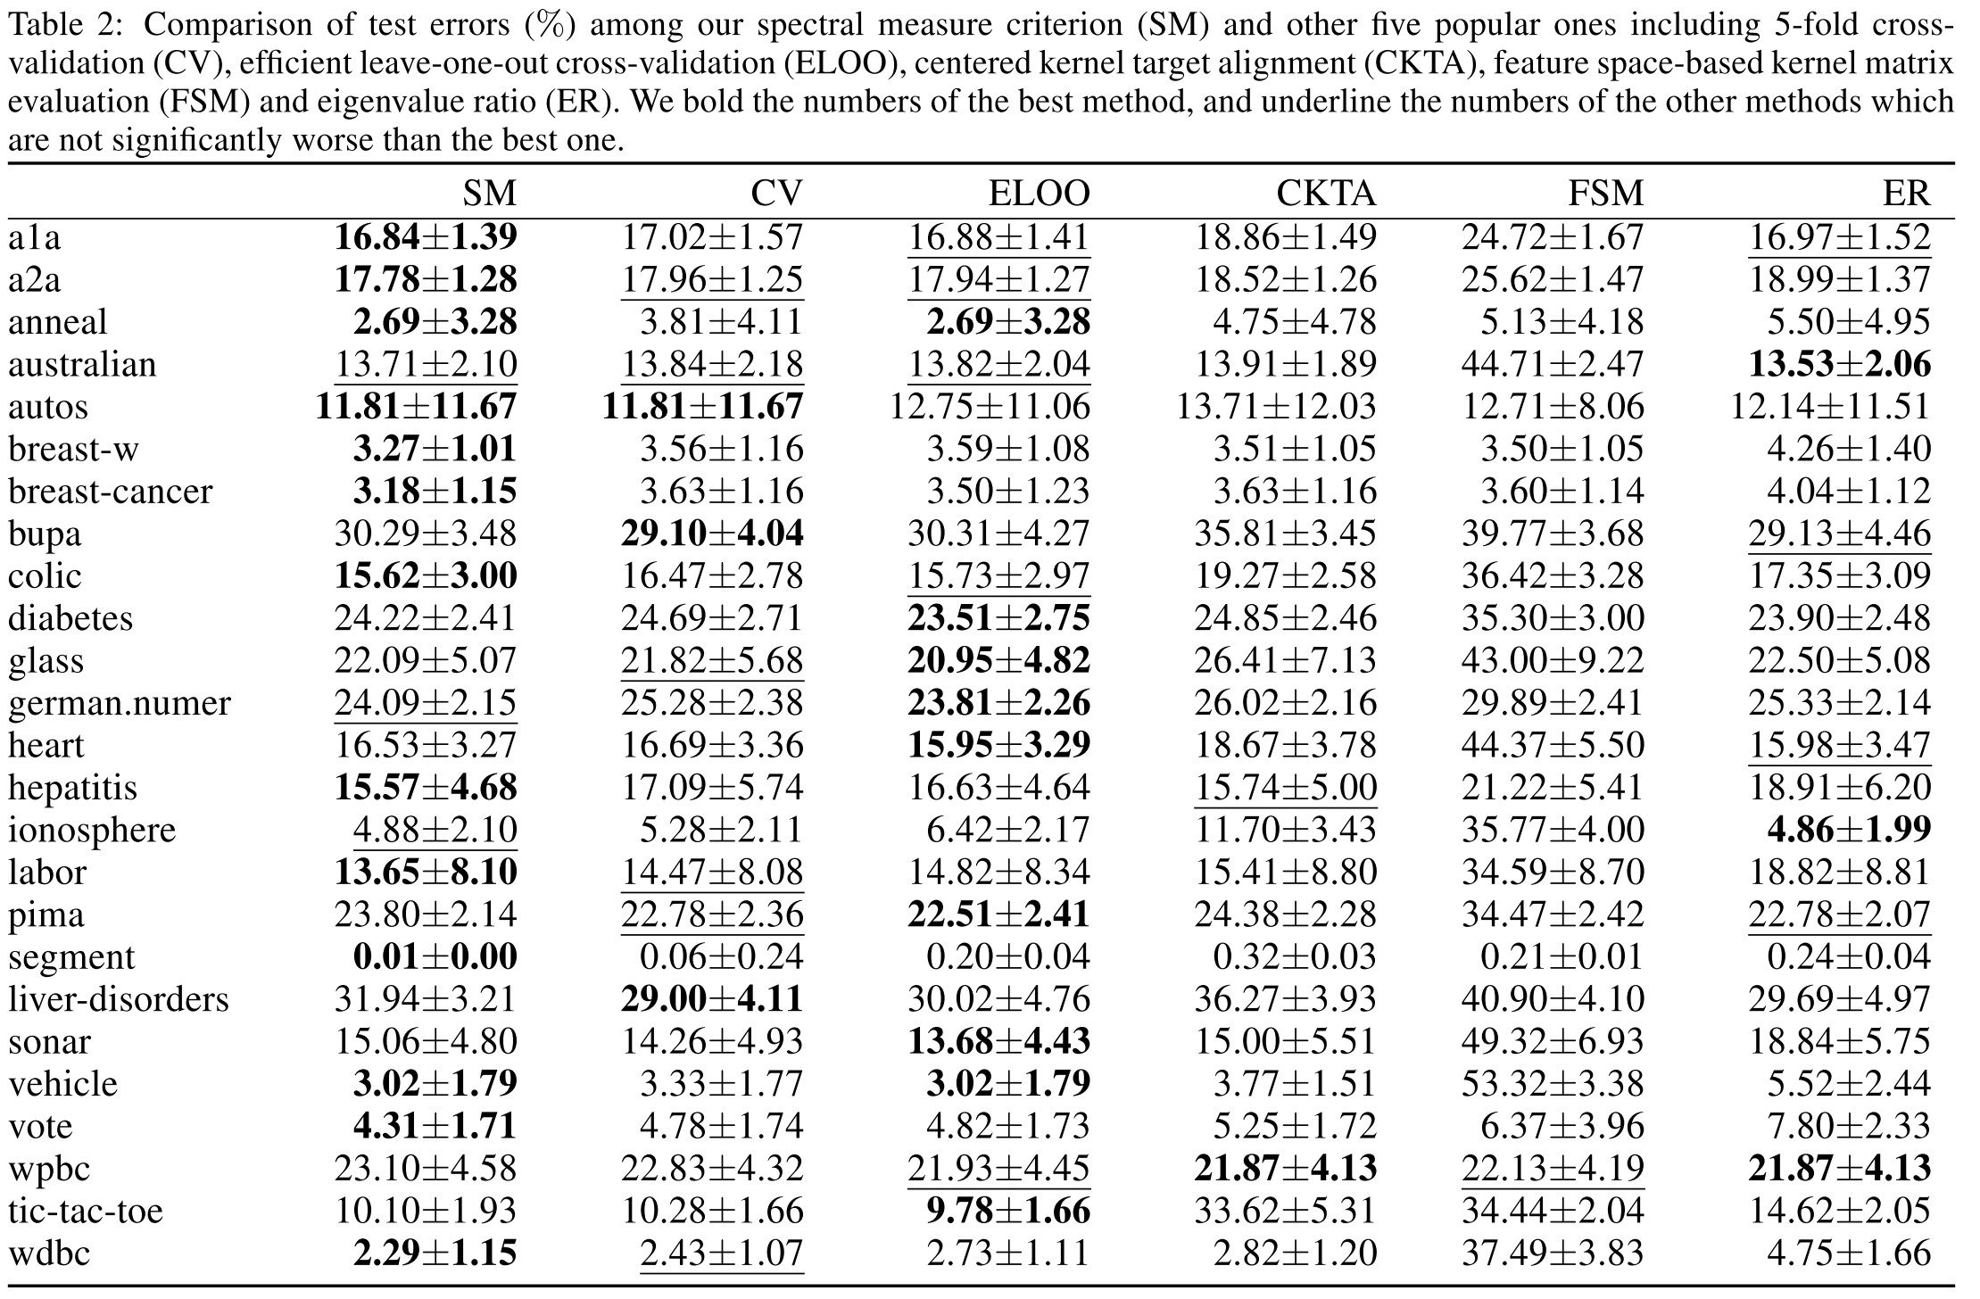
Performance: test errors
SM vs 5-folds cv, ELOO, CKTA, FSM, ER
Set r = 3
Notes:
In the first experiment, we compare our criterion SM with 5-folds cv, ELOO, CKTA, FSM, ER and set r = 3.
The table reports the average test errors. And we can see from the table: (a) SM is much better than CV, CKTA, FSM and ER. And SM is comparable with ELOO.

Slide 17
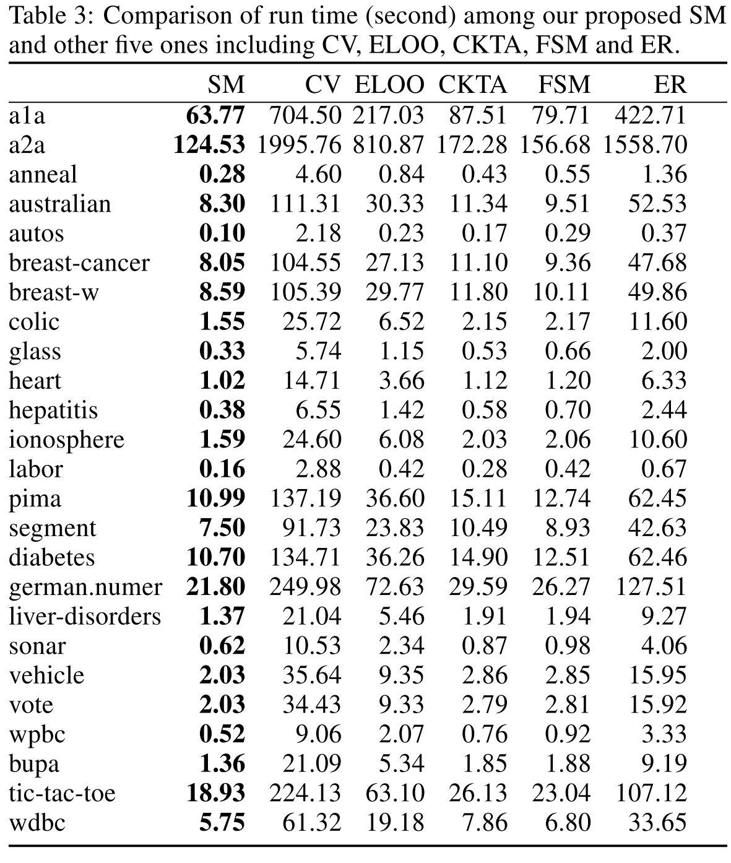
Performance: run time
The above results show that SM
can guarantee generalization performance
have high computational efficiency.
Notes:
What’s more, we can see comparison of run time. Result shows that SM is much faster than CV, ELOO and ER, and gives comparable results with CKTA and FSM.
The above results shows that SM can guarantee generalization performance and has high computational efficiency as well.

Slide 18
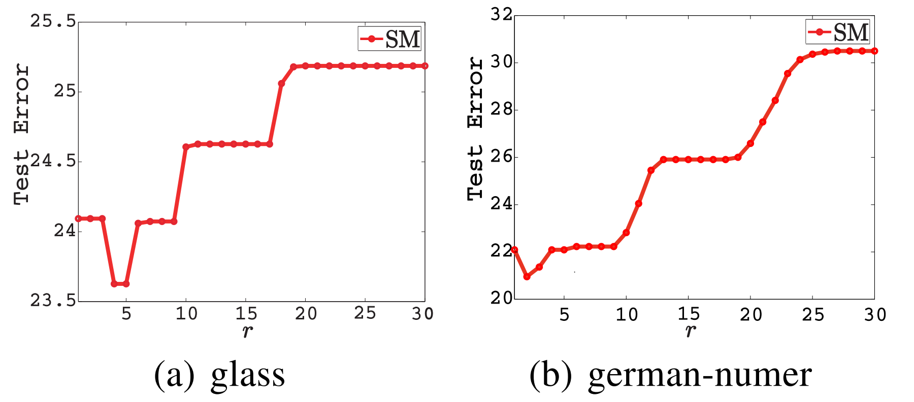
Influence of r
The result shows the optimal r is in [2, 5]
Notes:
In the second experiment, we explore the influence of different r. The figure plots the average test errors with different r . We find the optimal r belongs to [2, 5] on most datasets.

Slide 19
目录
1
Introduction
2
Spectral Measure
3
Spectral Kernel Selection
4
Experiments
5
Conclusion
5
Conclusion
Notes:
At last, let’s see conclusion.

Slide 20
d
Conclusion
A novel kernel selection criterion
based on spectral measure of kernel matrix
sound theoretical foundation
high computational efficiency
Future work
Our spectral measure criterion can be applied to multiple kernel learning (MKL) ^{[13]}
where
Notes:
In this paper, we define
A novel kernel selection criterion
based on spectral measure of kernel matrix
It has sound theoretical foundation
And high computational efficiency
For the future work
Our spectral measure criterion can be applied to multiple kernel learning (MKL)

Slide 21
;:
References
[1] Boser B, Guyon I, Vapnik V. A training algorithm for optimal margin classiﬁers [C]. In Proceedings of the ﬁfth annual workshop on Computational learning theory, 1992: 144–152.
[2] Gene H. Golub, Michael Heath, and Grace Wahba. Generalized cross-validation as a method for choosing a good ridge parameter. Technometrics, 21(2):215–223, 1979.
[3] Olivier Chapelle, Vladimir Vapnik, Olivier Bousquet, and Sayan Mukherjee. Choosing multiple parameters for support vector machines. Machine Learning, 46(1-3):131–159, 2002.
[4] Gavin C. Cawley. Leave-one-out cross validation based model selection criteria for weighted LSSVMs. In Proceeding of the International Joint Conference on Neural Networks (IJCNN 2006), pages 1661– 1668, 2006.
Notes:
There are papers used in my presentation.

Slide 22
;:
References
[5] Michiel Debruyne, Mia Hubert, and Johan A.K. Suykens. Model selection in kernel based regression using the influence function. Journal of Machine Learning Research, 9:2377–2400, 2008.
[6] Nello Cristianini, John ShaweTaylor, Andr´e Elisseeff, and Jaz S. Kandola. On kernel target alignment. In Advances in Neural Information Processing Systems 14 (NIPS 2001), pages 367–373, 2001.
[7] Corinna Cortes, Marius Kloft, and Mehryar Mohri. Learning kernels using local Rademacher complexity. In Advances in Neural Information Processing Systems 25 (NIPS 2013), pages 2760–2768. MIT Press, 2013.
[8] Canh Hao Nguyen and Tu Bao Ho. An efficient kernel matrix evaluation measure. Pattern Recognition, 41(11):3366–3372, 2008.
[9] Vladimir Vapnik. The nature of statistical learning theory. Springer Verlag, 2000.

Slide 23
;:
References
[10] Peter L. Bartlett and Shahar Mendelson. Rademacher and Gaussian complexities: risk bounds and structural results. Journal of Machine Learning Research, 3:463–482, 2002.
[11] Yong Liu, Shali Jiang, and Shizhong Liao. Eigenvalues perturbation of integral operator for kernel selection. In Proceedings of the 22nd ACM International Conference on Information and Knowledge Management (CIKM 2013), pages 2189–2198, 2013.
[12] Jianbo Shi and Jitendra Malik. Normalized cuts and image segmentation. IEEE Transactions on Pattern Analysis and Machine Intelligence, 22(8):888– 905, 2000.
[13] Arthur Gretton, Karsten M. Borgwardt, Malte Rasch, Bernhard Scholkopf, and Alexander J. Smola. A kernel method for the two sample problem. In Advances in Neural Information Processing Systems 15 (NIPS 2007), pages 513–520, 2007.

Slide 24
;:
References
[14] Gert R. G. Lanckriet, Nello Cristianini, Peter L. Bartlett, Laurent El Ghaoui, and Michael I. Jordan. Learning the kernel matrix with semidefinite programming. Journal of Machine Learning Research, 5:27– 72, 2004.

Slide 25


Thank you！
lijian9026@iie.ac.cn
Notes:
That’s all. Thanks for listening and Any question?

