Slide 1
Ridge and Lasso Regression
Understanding Regularization Techniques in Linear Regression
Jyotiska Saha
7 August 2024

Slide 2
Introduction to Regression
Regression analysis is a statistical method used for estimating the relationships among variables. It is used to predict the value of a dependent variable based on the value of one or more independent variables.
There 2 types of regression : Linear Regression & Polynomial Regression.

Slide 3
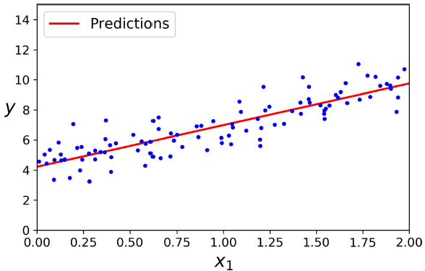
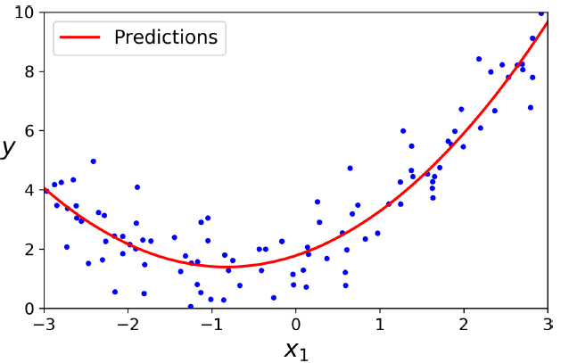
Example of Linear(left) and Polynomial Regression(right)

Slide 4

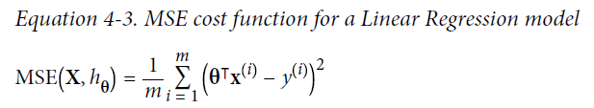

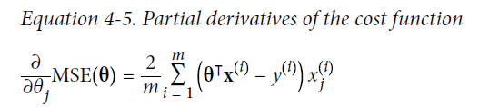
Recap of linear regression

Slide 5
Problem with Simple Linear Regression
Overfitting: Occurs when the model learns the noise in the training data instead of the actual relationship. This leads to high accuracy on training data but poor performance on new, unseen data. When model have high variance and low bias, then it is said to be overfitting.
Need for Regularization: Techniques to prevent overfitting by adding a penalty to the model complexity. This helps in balancing the bias-variance trade-off.

Slide 6
What is Regularization?
Definition: Prevents overfitting by adding a penalty to model complexity.
Purpose: Improves generalization by discouraging overly complex models.
Techniques:
Ridge Regression (L2 Regularization): Penalty = square of coefficients.
Lasso Regression (L1 Regularization): Penalty = absolute value of coefficients.
Effect: Shrinks coefficients, balances bias-variance trade-off.

Slide 7

Ridge Regression
Definition: Also known as Tikhonov regularization, addresses overfitting and multicollinearity by adding an L2 penalty.
Cost Function:
Effect of alpha:
= 0 : No regularization, equivalent to ordinary least squares.
-> ∞ : All coefficients shrink towards zero.

Slide 8

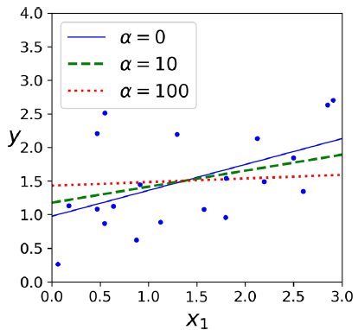
Direct solution of Ridge Regression:
Here A = (n+1) x (n+1) identity matrix.
Advantages:
Reduces overfitting by shrinking coefficients.
Handles multicollinearity well.
Disadvantages:
Does not perform feature selection (coefficients are shrunk but not eliminated).

Slide 9

Lasso Regression
Definition: Least Absolute Shrinkage and Selection Operator, addresses overfitting by adding an L1 penalty.
Cost Function:
Effect of alpha:
= 0 : No regularization, equivalent to ordinary least squares.
-> ∞ : All coefficients shrink towards zero.
An important characteristic of Lasso Regression is that it tends to eliminate the weights of the least important features (i.e., set them to zero).

Slide 10
Advantages:
Performs feature selection.
Reduces overfitting.
Disadvantages:
Can discard important features if alpha is too large.
Less stable than Ridge with highly correlated predictors.

Slide 11
Ridge vs. Lasso Regression
Similarities:
Both are regularization techniques to prevent overfitting.
Both add a penalty to the cost function.
Both aim to improve model generalization by discouraging overly complex models.
Differences:
 | Ridge | Lasso
Penalty | L2 penalty | L1 penalty
Coefficient Shrinkage | Shrinks coefficients, but none to exactly zero. | Can shrink some coefficients to exactly zero (feature selection).

Slide 12
When to Use Ridge vs. Lasso
Use Ridge When:
All predictors are important.
Multicollinearity exists.
Slight overfitting is present.
Use Lasso When:
Feature selection is desired.
Sparse solutions are preferred.
High-dimensional data.

Slide 13
Q&A

