Slide 1

Loan Prediction Model (Major Project)
A comprehensive model for predicting loan eligibility status
Jyotiska Saha (MST03-0056)
19 August 2024

Slide 2
Introduction
Goal: To predict whether a loan applicant will be approved for a loan based on various customer data.
Overview:
This project explores different machine learning algorithms to predict loan approval status.
Data preprocessing and feature engineering were performed to prepare the data for model training.
The final model was deployed using Streamlit for interactive loan prediction.

Slide 3
Classification Algorithms
Classification is a supervised learning technique that involves predicting the class or category of a given input based on training data. It is widely used for applications such as spam detection, fraud detection, and loan approval prediction.
Algorithms Used
Logistic Regression: Estimates the probability of a binary outcome.
Linear SVC: Finds the hyperplane that best separates classes with maximum margin.
Naive Bayes: Uses Bayes' theorem to classify data based on feature independence.
Decision Tree: Splits data into subsets based on feature values.
Random Forest: Builds multiple decision trees and averages their predictions.
AdaBoost: Combines weak classifiers to improve accuracy.
K-Nearest Neighbors: Classifies data points based on the majority class of nearest neighbors.

Slide 4
Dataset
No. | Attribute | Description | Data type
1 | LoanID | 🆔 Unique Loan ID | Categorical
2 | Gender | 👫 Gender (Male/Female) | Categorical
3 | Married | 💍 Married (Y/N) | Categorical
4 | Dependents | 👨‍👩‍👧‍👦 Dependents (0/1/2/3+) | Categorical
5 | Education | 🎓 Education (Graduate/Not Graduate) | Categorical
6 | Self_Employed | 💼 Self-employed (Y/N) | Categorical
7 | ApplicantIncome | 💰 Applicant's Income | Numeric/Integer
8 | CoapplicantIncome | 💵 Coapplicant's Income | Numeric/float
9 | LoanAmount | 💸 Loan Amount (in thousands) | Numeric/float
10 | Loan_Amount_Term | ⏰ Loan Term (in months) | Numeric/float
11 | Credit_History | 📜 Credit History (0/1) | Categorical
12 | Property_Area | 🏡 Property Area (Urban/Semi-Urban/Rural) | Categorical
13 | Loan_Status | 📋 Loan Status (Approved/Not Approved) | Categorical

Slide 5
Data Preprocessing
Imputation technique used for missing values.
Categorical columns: Imputed with the most frequent value.
Numerical columns: Imputed with the median to prevent distortion from outliers.

Slide 6
Data Visualization

Slide 7
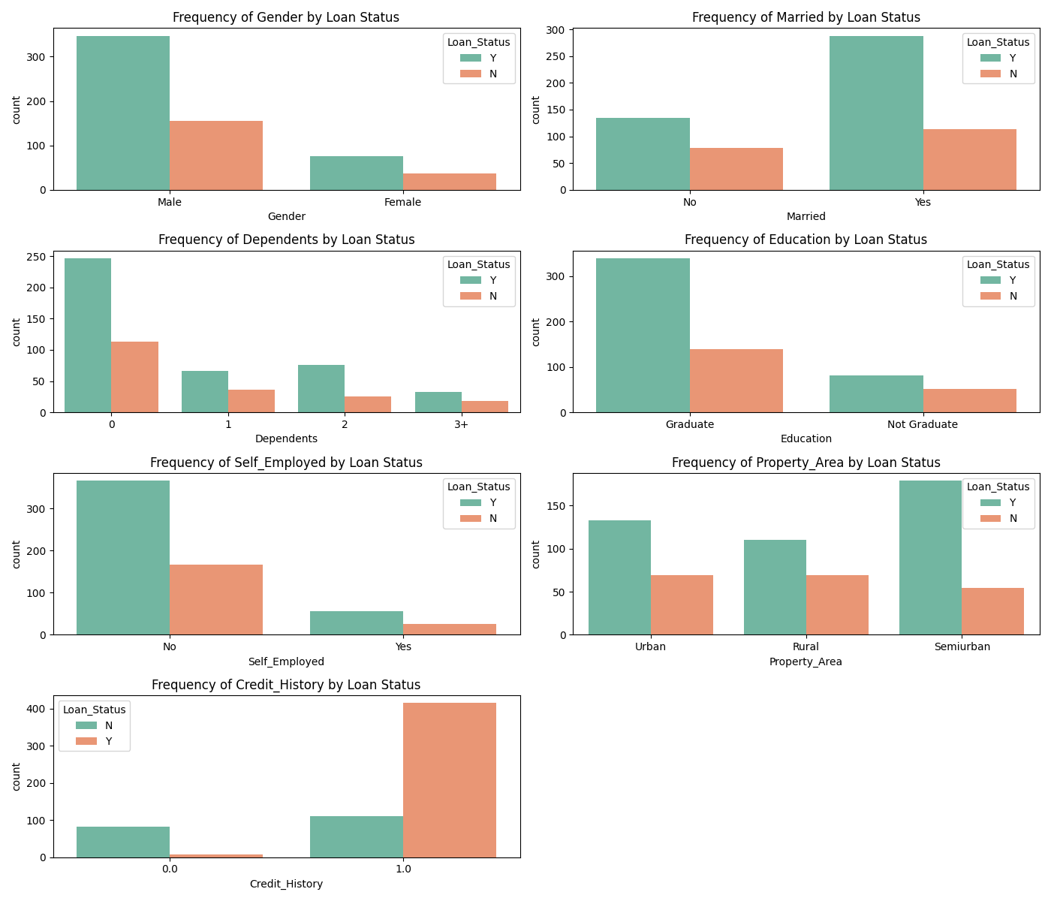
Bar plot of categorical features (Plotted against Loan_status)

Slide 8
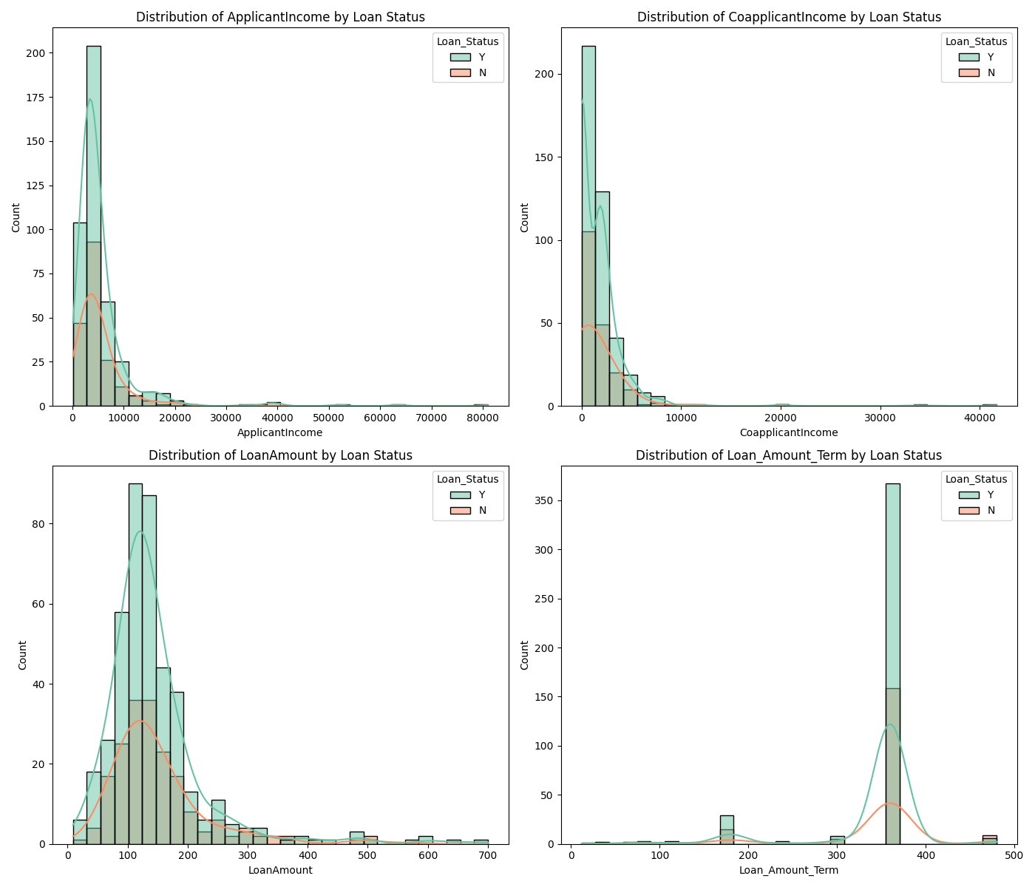
Histogram of numeric features (Plotted against Loan_status)

Slide 9
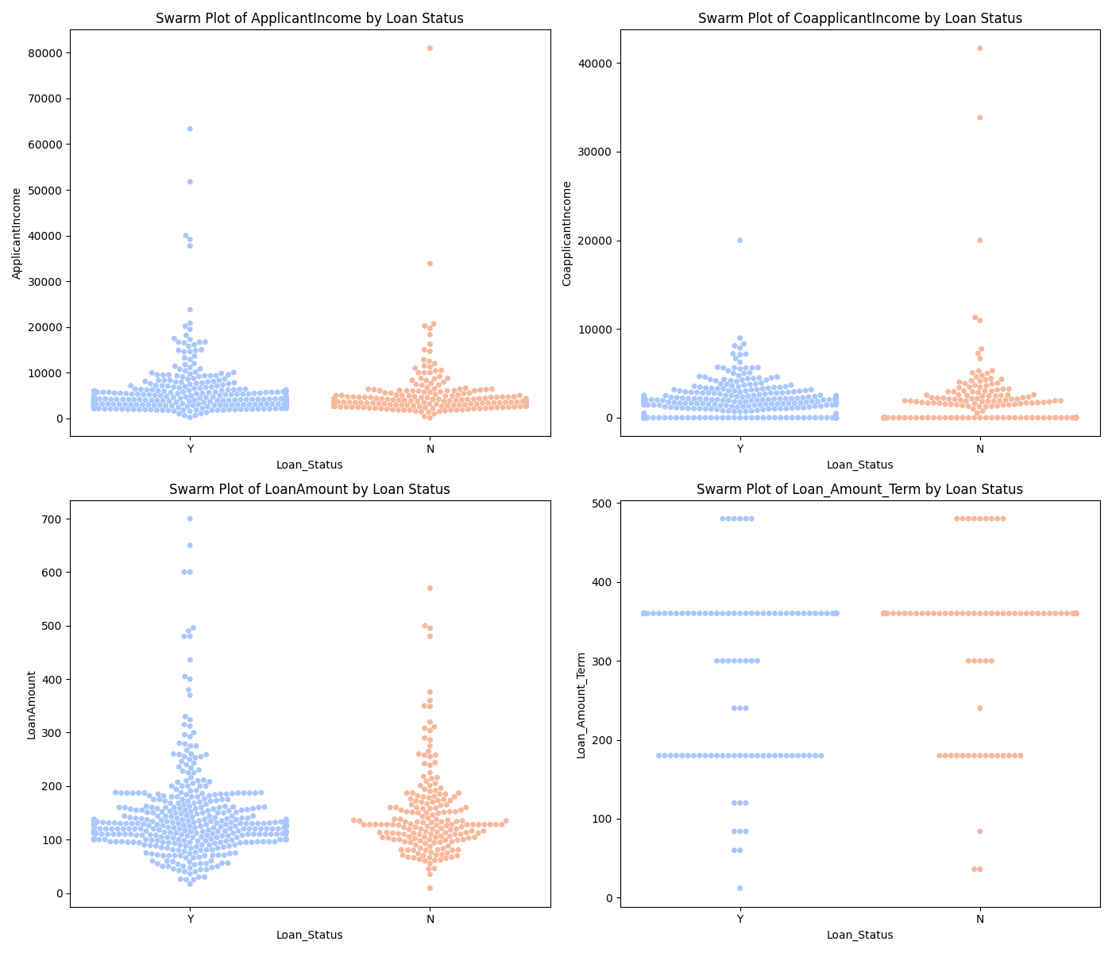
Swarn Plot of numeric features (Plotted against Loan_status)

Slide 10
Categorical Encoding
Converted categorical features into numerical values.
Essential for models that require numerical input for processing.
Gender [Male: 1, Female: 0]
Married [Yes: 1, No: 0]
Dependents [0: 0, 1: 1, 2: 2, 3+: 3]
Education [Graduate: 0, Not Graduate: 1]
Self_Employed [Yes: 1, No: 0]
Credit_History [1: 1, 0: 0]
Property_Area [Rural: 0, Semiurban: 1, Urban: 2]
Loan_Status [Y: 1, N: 0]

Slide 11
Outlier Capping
Purpose: To reduce the influence of extreme values (outliers) that can skew model performance.
Method Used:
1.5 x IQR Rule: Outliers were capped using the Interquartile Range (IQR) method.
Values outside the range defined by Q1 − (1.5 × IQR) and Q3 + (1.5 × IQR) were capped to the nearest boundary within this range.
Here Q1 -> first quartile, Q3 -> third quartile, IQR -> (Q3 – Q1)
*Capping must be done before feature scaling.

Slide 12
Feature Scaling
Used Standard Scaling technique for scaling numeric features.
The features will have mean = 0 and standard deviation = 0
Ensures that all features contribute equally to the model and improves convergence.
Some model like Logistic Regression, Support Vector Classifier, KNN Classifier requires scaling.

Slide 13
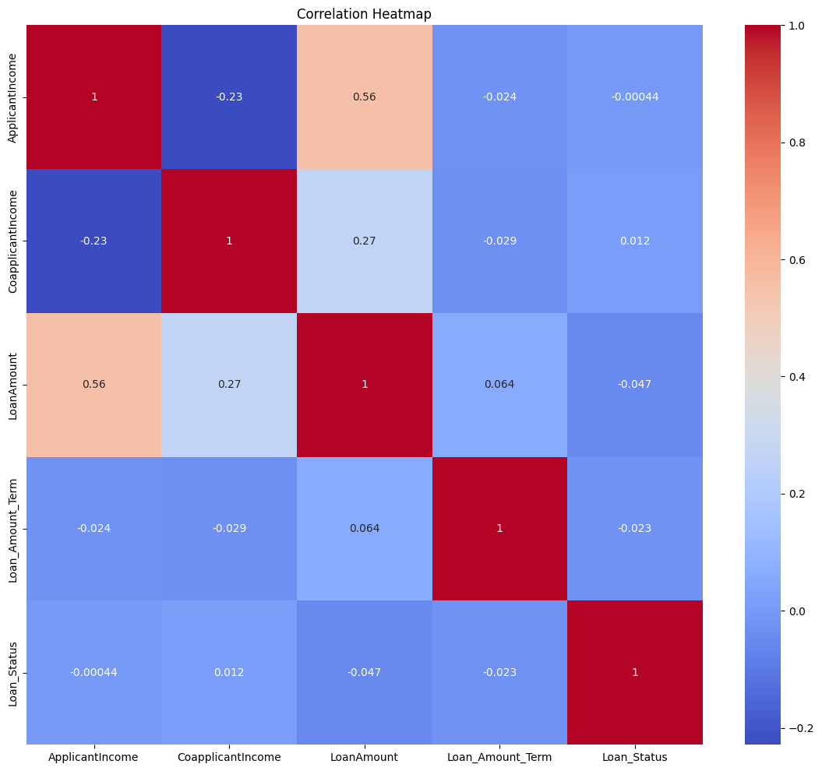
Correlation coefficient matrix (Numeric Columns)

Slide 14
Model Selection & Training
Data Splitting:
The dataset was split into training (80%) and testing (20%) sets.
The training set was used to fit the models, and the testing set was used to evaluate performance.
Models Used: Logistic Regression, Linear SVC, Naive Bayes, Decision Tree, Random Forest, AdaBoost, Gradient Boosting, K-Nearest Neighbors (KNN)
Hyperparameter Tuning:
GridSearchCV was employed to find the best hyperparameters.
Focused on reducing overfitting and maximizing accuracy.

Slide 15
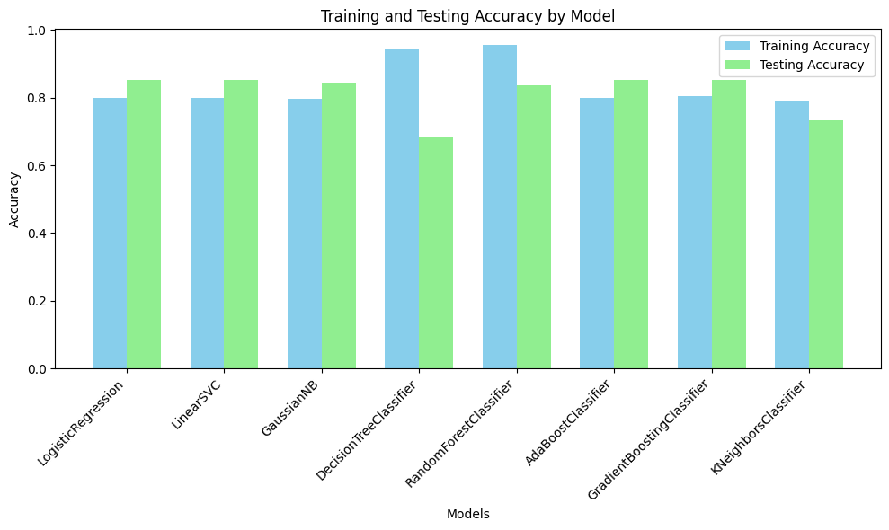
Model PerFormance on Training & Testing Data

Slide 16
Model Deployment
The final loan prediction model was deployed as a web application using Streamlit.
The app allows users to input loan-related information and get predictions for loan approval.
User can select the any model to get the result. This adds more flexibility.
Also user can see the training models’ information like, training data visualization and training and testing accuracy.

Slide 17
Conclusion
This project demonstrates the potential for machine learning to assist in making data-driven decisions in loan processing.
Model improvement?
The model can be improved further if we provide more good data. This includes data without null values and also data should contain equal ratio of classes.

Slide 18
References
Dataset: Loan Prediction Dataset
Book Reference: Géron, A. (2019). Hands-On Machine Learning with Scikit-Learn, Keras, and TensorFlow. O'Reilly Media.

Slide 19
Thank You

