Slide 1

Multi-Class Image Classification Using Convolutional Neural Networks (CNN)
A Comprehensive Study on Classifying Various Objects and Animals
(Bikes, Cars, Cats, Dogs, Flowers, Horses, and Humans)
Name – Jyotiska Saha
ID – MST03-0056
Date – 27 July 2024

Slide 2
Image Classification
The process of categorizing and labeling groups of pixels or vectors within an image based on specific rules.
Real World Application:
Healthcare: Identifying diseases in medical imaging (e.g., cancer detection).
Security: Face recognition systems for surveillance.
Autonomous Vehicles: Recognizing objects like traffic signs and pedestrians.
Social Media: Content moderation and categorization.
Types of Image Classification:
Binary Classification: Classifying images into two categories.
Multi-Class Classification: Classifying images into more than two categories.

Slide 3
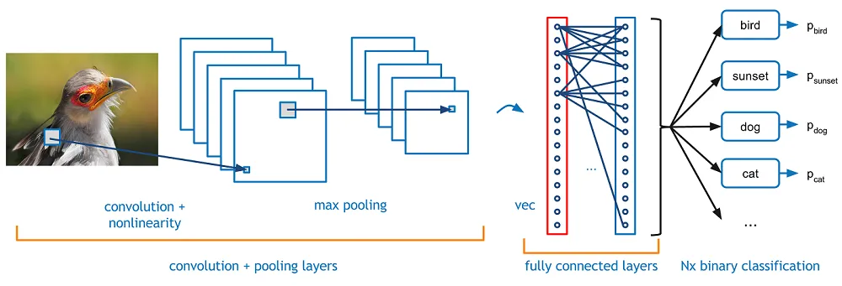
Why Convolutional Neural Networks (CNNs)?
Convolutional Neural Network (CNN, or ConvNet) are a special kind of multi-layer neural networks, designed to recognize visual patterns directly from pixel images with minimal pre-processing. It is a special architecture of artificial neural networks.
Key Components:
Convolutional Layers: Extract features from the input image by applying various filters.
Pooling Layers: Reduce the spatial dimensions of the feature maps, making the model more computationally efficient and robust to variations in the image.

Slide 4
Advantages of CNNs:
Automatic Feature Extraction: Unlike traditional methods that require manual feature extraction, CNNs automatically learn hierarchical features from raw pixel data.
Spatial Hierarchies: CNNs effectively capture spatial hierarchies and patterns in images, recognizing local features (e.g., edges) in earlier layers and more complex structures (e.g., objects) in deeper layers.
Parameter Sharing: Convolutional layers share weights across the input, reducing the number of parameters and computational complexity.
Translation Invariance: The ability of CNNs to recognize objects regardless of their position in the image.

Slide 5
CNN Architecture
Key components of CNN architecture:
Input Layer: The input layer receives the raw image data (3 * m * n)
Convolutional Layer: This layer applies a set of filters (also known as kernels) to the input image. Each filter is a small matrix that slides over the entire image, computing a dot product between the filter values and the input at each position. This process produces a feature map, highlighting specific patterns like edges or textures in the image.
Activation Function: An activation function (usually ReLU, or Rectified Linear Unit) is applied to introduce non-linearity. ReLU replaces negative values with zero, allowing the network to learn more complex patterns.

Slide 6
CNN Architecture (cont.)
Key components of CNN architecture:
Pooling Layers: Pooling layer reduces the spatial dimensions (height and width) of the feature maps by taking the maximum value(Max Pooling) or the average value(Average Pooling) in each region of the feature map. This process helps in down sampling, reducing the computational load and controlling overfitting.
Fully Connected (Dense) Layers: These layers are typically placed at the end of the network. They connect just like in traditional neural networks. The output from the previous layers is flattened and passed through one or more dense layers. The final dense layer usually has as many neurons as there are classes in the classification task, with softmax activation function to produce a probability distribution over the classes.
Regularization:
Dropout: A technique used to prevent overfitting by randomly setting a fraction of the input units to zero during training.
Batch Normalization: It normalizes the inputs of each layer so that they have a mean of zero and a variance of one.

Slide 7
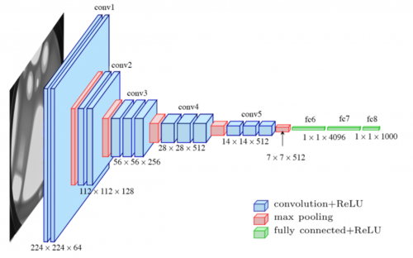
CNN Architecture (cont.)
Input Image -> (Convolution + Activation) -> Pooling ->
-> (Convolution + Activation) -> Pooling ->
…
-> Flatten -> Dense Layer -> Output Layer

Slide 8
About the Data
Source: https://www.kaggle.com/datasets/pavansanagapati/images-dataset
Classes: Total 7 classes. They are: [‘bike’, ‘cars’, ‘cats’, ‘dogs’, ‘flowers’, ‘horses’, ‘human’]
Number of Images: 1803
File type: bmp (bitmap image file)
Number of Images per class:
bike : 365
cars : 420
cats: 202
dogs: 202
flowers: 210
horses: 202
human: 202
There is an imbalance in the number of images in classes ‘bike’ and ‘cars’.

Slide 9
Dataset Splitting
The overall Dataset is split in 3 sets, Training, Validation and Testing.
Training Set: used to train the model. The model learns the underlying patterns and relationships in the data. It is used to fit the model and adjust its weights based on the input data and corresponding labels.
Validation Set: used during training to evaluate the model's performance and tune hyperparameters. It is used to monitor the model's performance on unseen data, helping to prevent overfitting and ensure the model generalizes well.
Testing Set: reserved for evaluating the final model's performance. It is not used during training.
In the project the dataset is split in 70-20-10 ratio.

Slide 10
Model Building
In the project, the model is built using a sequential API, which allows layers to be stacked one after the other.
The model was built with 3 layers of (Convolutional + Max-Pooling), then Flattening and passing it to a dense Neural Network.
32, 68 and 128 filters were applied on (3 x 3) kernel in the first, second and third Convolutional layers with ReLU activation function and L2 regularization with a factor of 0.01 to prevent overfitting.
Then after each Convolutional layers, Batch Normalization, Max-pooling and 30 % Dropout is being used.
After flattening the feature map into 1D vector, it is being passed to a Dense layer with 512 neurons and ReLU activation with 50% dropout.
Output is Dense layer with 7 units and softmax activation, corresponding to the 7 classes.

Slide 11
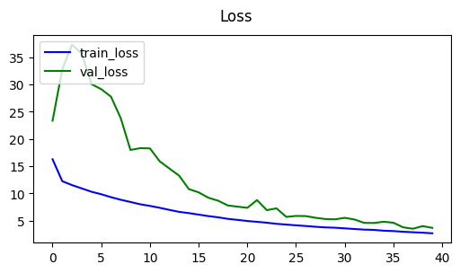
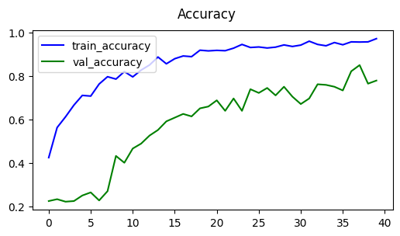
Training and Results
Upon Training the data with 40 iterations(Epochs). Here are the final results:
Training Accuracy: 0.9763
Training Loss: 2.7373
Validation Accuracy: 0.7784
Validation Loss: 3.7087

Slide 12
Test Results
Below is the result after passing Test data to the model
Accuracy: 0.8182
Precision: 0.9577
Recall: 0.9714

Slide 13
Challenges and Limitations
Class Imbalance: Certain classes have significantly more examples than others, leading to biased learning.
Overfitting: The model may overfit on the training data, especially with a limited dataset size.

Slide 14
Conclusion and Future Work
Summary: CNNs effectively classified multiple classes with notable accuracy.
Future Works
Improving Data Diversity: Increase the dataset size and diversity to improve generalization.
Advanced Architectures: Explore deeper or more advanced CNN architectures like ResNet or EfficientNet.

Slide 15
Thank You

