Slide 1

연구진행 현황
2020. 06. 18 송창희

Slide 2
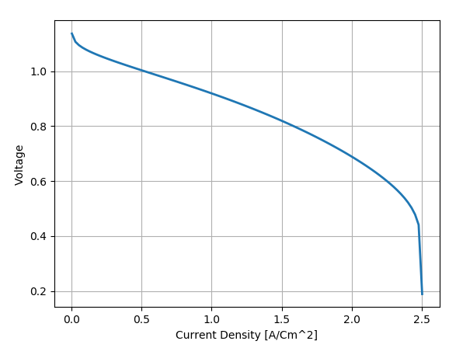
Research Status
Model development
Ohmic, Activation, Concentration Loss를 고려한 연료전지 모델 개발
개발된 연료전지 모델에서는 current density를 입력 받아 연료전지내의 loss를 계산하여 실제적인 Voltage 값을 계산함
아래의 수식에 의해 Polarization curve를 도출함:
$$V=V_{thermo}−η_{activation}−η_{ohmic}−η_{concentration}$$
RECL

Slide 3
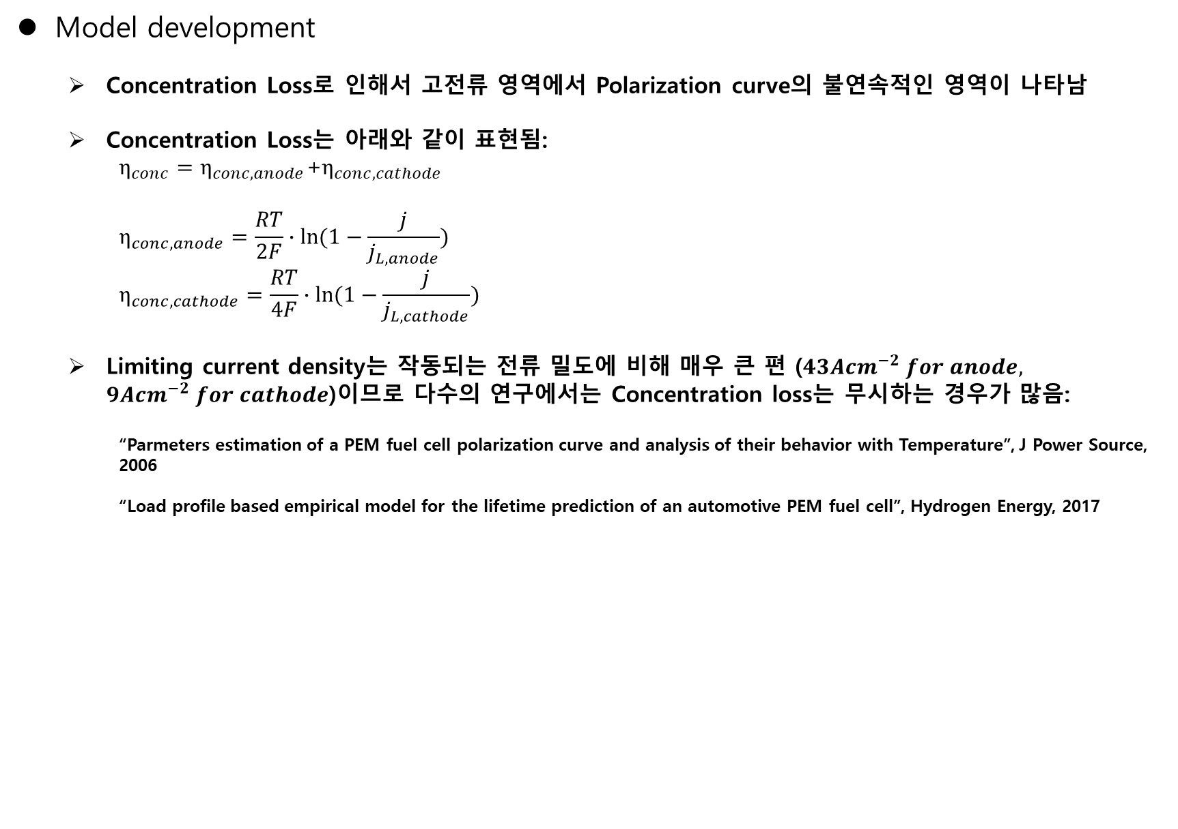
Research Status
Model development
Concentration Loss로 인해서 고전류 영역에서 Polarization curve의 불연속적인 영역이 나타남
Concentration Loss는 아래와 같이 표현됨:
$η_{conc}=η_{conc,anode}$+$η_{conc,cathode}$
$$η_{conc,anode}=\frac{RT}{2F}∙\ln{(1−\frac{j}{j_{L,anode}})}$$
$$η_{conc,cathode}=\frac{RT}{4F}∙\ln{(1−\frac{j}{j_{L,cathode}})}$$
Limiting current density는 작동되는 전류 밀도에 비해 매우 큰 편 ($43Acm^{−2} for anode, 9Acm^{−2} for cathode$)이므로 다수의 연구에서는 Concentration loss는 무시하는 경우가 많음:
“Parmeters estimation of a PEM fuel cell polarization curve and analysis of their behavior with Temperature”, J Power Source, 2006
“Load profile based empirical model for the lifetime prediction of an automotive PEM fuel cell”, Hydrogen Energy, 2017
$$∴V=V_{thermo}−η_{activation}−η_{ohmic}$$
RECL

Slide 4
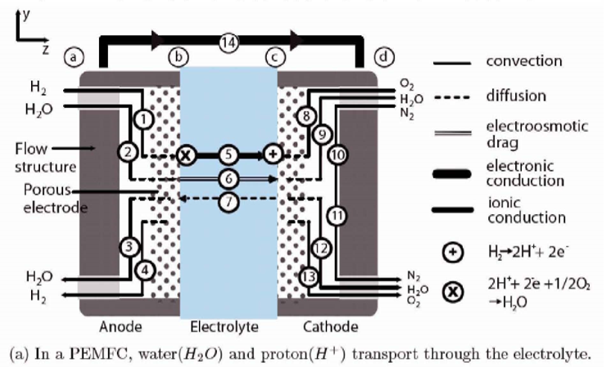
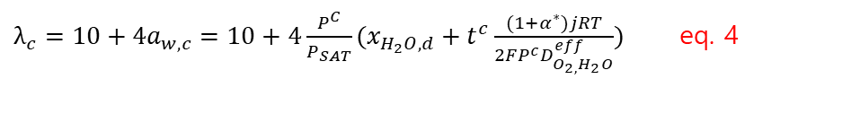
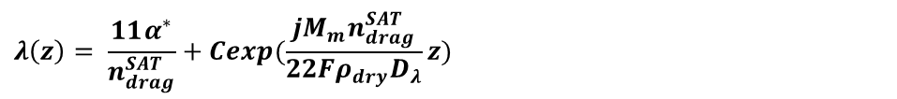

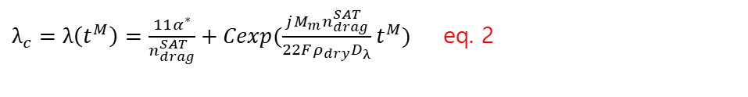
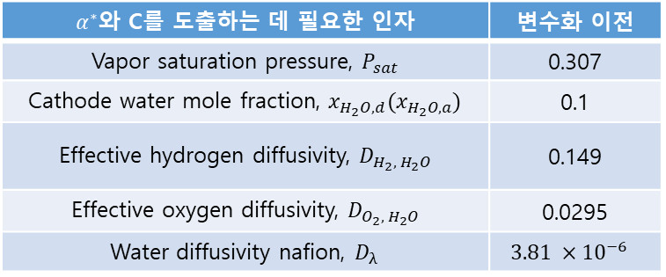
Research Status
Model development
Ohmic Loss는 아래의 수식으로 도출 가능함:
$$λ\left(z\right)= \frac{11α^{∗}}{n_{drag}^{SAT}}+Cexp(\frac{jM_{m}n_{drag}^{SAT }}{22Fρ_{dry}D_{λ}}z)$$
$λ_{b}=λ\left(0\right)=\frac{11α^{∗}}{n_{drag}^{SAT}}$ eq. 1
$λ_{c}=λ\left(t^{M}\right)=\frac{11α^{∗}}{n_{drag}^{SAT}}+Cexp(\frac{jM_{m}n_{drag}^{SAT }}{22Fρ_{dry}D_{λ}}t^{M})$ eq. 2
$α^{∗}$와 C를 도출하는 데 필요한 인자 | 변수화 이전
Vapor saturation pressure, $P_{sat}$ | 0.307
Cathode water mole fraction, $x_{H_{2}O,d}(x_{H_{2}O,a})$ | 0.1
Effective hydrogen diffusivity, $D_{H_{2},{ H}_{2}O}$ | 0.149
Effective oxygen diffusivity, $D_{O_{2},{ H}_{2}O}$ | 0.0295
Water diffusivity nafion, $D_{λ}$ | $$3.81 ×{10}^{−6}$$
$$λ=14a_{w} for 0<a_{w}≤1$$
$$λ=10+4a_{w} for 1<a_{w}≤3$$
$λ_{b}=14a_{w,b}=14\frac{P^{A}}{P_{SAT}}\left(x_{H_{2}O, a}−t^{A}\frac{α^{∗}jRT}{2FP^{A}D_{H_{2,}H_{2}O}^{eff}}\right)$ eq. 3
$λ_{c}=10+4a_{w,c}=10+4\frac{P^{C}}{P_{SAT}}(x_{H_{2}O, d}+t^{c}\frac{{(1+α}^{∗})jRT}{2FP^{c}D_{O_{2,}H_{2}O}^{eff}})$ eq. 4
eq. 1 ~ eq. 4의 연립을 통한 $α^{∗}$ 와 C의 도출
RECL

Slide 5

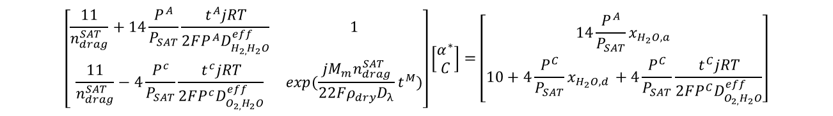
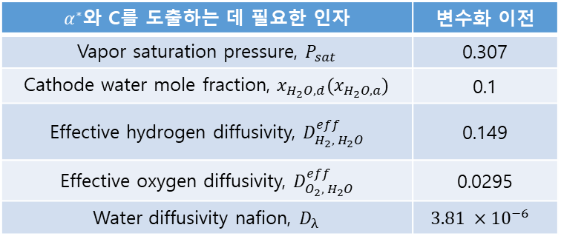
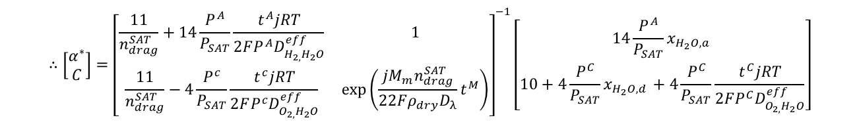
Research Status
Model development
$$\left[\begin{matrix}\frac{11}{n_{drag}^{SAT}}+14\frac{P^{A}}{P_{SAT}}\frac{t^{A}jRT}{2FP^{A}D_{H_{2,}H_{2}O}^{eff}} & 1 \\ \frac{11}{n_{drag}^{SAT}}−4\frac{P^{c}}{P_{SAT}}\frac{t^{c}jRT}{2FP^{c}D_{O_{2,}H_{2}O}^{eff}} & exp(\frac{jM_{m}n_{drag}^{SAT }}{22Fρ_{dry}D_{λ}}t^{M})\end{matrix}\right]\left[\begin{matrix}α^{∗} \\ C\end{matrix}\right]=\left[\begin{matrix}14\frac{P^{A}}{P_{SAT}}x_{H_{2}O, a } \\ 10+4\frac{P^{C}}{P_{SAT}}x_{H_{2}O,d }+4\frac{P^{C}}{P_{SAT}}\frac{t^{C}jRT}{2FP^{C}D_{O_{2,}H_{2}O}^{eff}}\end{matrix}\right]$$
$$∴\left[\begin{matrix}α^{∗} \\ C\end{matrix}\right]={\left[\begin{matrix}\frac{11}{n_{drag}^{SAT}}+14\frac{P^{A}}{P_{SAT}}\frac{t^{A}jRT}{2FP^{A}D_{H_{2,}H_{2}O}^{eff}} & 1 \\ \frac{11}{n_{drag}^{SAT}}−4\frac{P^{c}}{P_{SAT}}\frac{t^{c}jRT}{2FP^{c}D_{O_{2,}H_{2}O}^{eff}} & \exp\left(\frac{jM_{m}n_{drag}^{SAT }}{22Fρ_{dry}D_{λ}}t^{M}\right)\end{matrix}\right]}^{−1}\left[\begin{matrix}14\frac{P^{A}}{P_{SAT}}x_{H_{2}O, a } \\ 10+4\frac{P^{C}}{P_{SAT}}x_{H_{2}O,d }+4\frac{P^{C}}{P_{SAT}}\frac{t^{C}jRT}{2FP^{C}D_{O_{2,}H_{2}O}^{eff}}\end{matrix}\right]$$
→ Derive $α^{∗}, C$
$α^{∗}$와 C를 도출하는 데 필요한 인자 | 변수화 이전
Vapor saturation pressure, $P_{sat}$ | 0.307
Cathode water mole fraction, $x_{H_{2}O,d}(x_{H_{2}O,a})$ | 0.1
Effective hydrogen diffusivity, $D_{H_{2},{ H}_{2}O}^{eff}$ | 0.149
Effective oxygen diffusivity, $D_{O_{2},{ H}_{2}O}^{eff}$ | 0.0295
Water diffusivity nafion, $D_{λ}$ | $$3.81 ×{10}^{−6}$$
$$σ\left(T,λ\right)=\left(0.005193λ−0.00326\right)∙exp[(1268\left(\frac{1}{303}−\frac{1}{T}\right)]$$
$$σ\left(z\right)=[0.005193(\frac{11α^{∗}}{n_{drag}^{SAT}}+Cexp(\frac{jM_{m}n_{drag}^{SAT }}{22Fρ_{dry}D_{λ}}z))−0.00326]∙exp[(1268\left(\frac{1}{303}−\frac{1}{T}\right)]$$
$$R_{m}= \int_{0}^{t^{M}}{\frac{1}{σ\left(z\right)}dz }$$
→ $η_{ohmic}=R_{m}∗j$
RECL

Slide 6
Research Status
Model development
Ohmic Loss의 주요인자의 도출 방식:
변수명 | 기존 값 | 참고문헌
Vapor saturation pressure, $P_{sat}$ [atm] | 0.307 | Fuel cell fundamentals 2nd Edition, p.133
$$\log_{10}{P_{SAT}}=−2.1794+0.02953T−9.1837×{10}^{−5}T^{2}+1.4454×{10}^{−7}T^{3}$$
$$∴P_{SAT}={10}^{−2.1794+0.02953T−9.1837×{10}^{−5}T^{2}+1.4454×{10}^{−7}T^{3}}$$
RECL

Slide 7
Research Status
Model development
Ohmic Loss의 주요인자의 도출 방식:
변수명 | 기존 값 | 참고문헌
Cathode water mole fraction, $x_{H_{2}O,d}(x_{H_{2}O,a})$ | 0.1 | 참고문헌 조사 필요
RECL

Slide 8
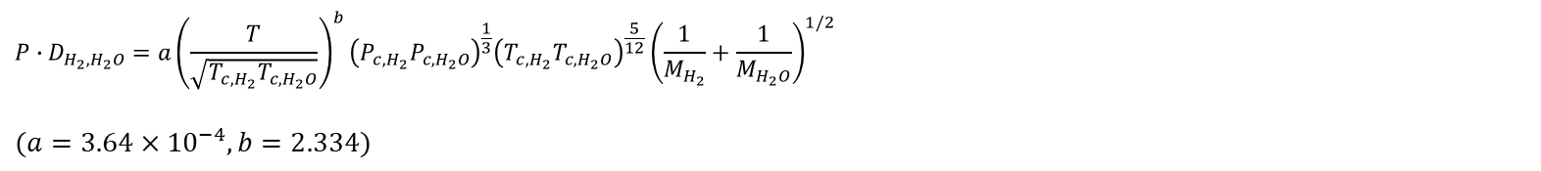
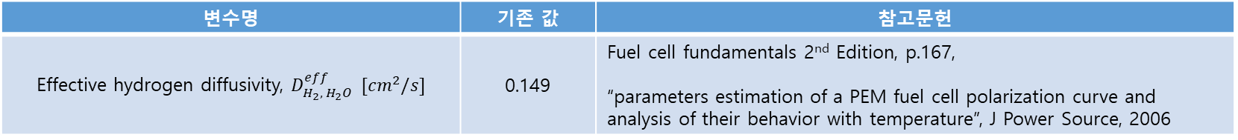
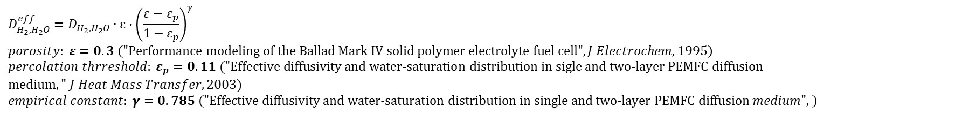
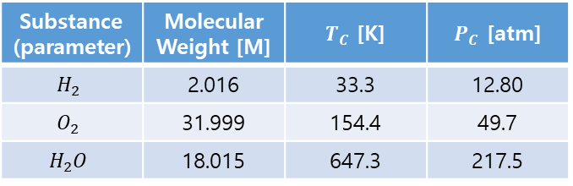
Research Status
Model development
Ohmic Loss의 주요인자의 도출 방식:
변수명 | 기존 값 | 참고문헌
Effective hydrogen diffusivity, $D_{H_{2},{ H}_{2}O}^{eff} [cm^{2}/s]$ | 0.149 | Fuel cell fundamentals 2nd Edition, p.167, “parameters estimation of a PEM fuel cell polarization curve and analysis of their behavior with temperature”, J Power Source, 2006
$$P∙D_{H_{2},H_{2}O}=a{\left(\frac{T}{\sqrt{T_{c,H_{2}}T_{c,H_{2}O}}}\right)}^{b}{\left(P_{c,H_{2}}P_{c,H_{2}O}\right)}^{\frac{1}{3}}{\left(T_{c,H_{2}}T_{c,H_{2}O}\right)}^{\frac{5}{12}}{\left(\frac{1}{M_{H_{2}}}+\frac{1}{M_{H_{2}O}}\right)}^{1/2}$$
$$(a=3.64×{10}^{−4}, b=2.334)$$
Substance (parameter) | Molecular Weight [M] | $T_{C}$ [K] | $P_{C}$ [atm]
$$H_{2}$$ | 2.016 | 33.3 | 12.80
$$O_{2}$$ | 31.999 | 154.4 | 49.7
$$H_{2}O$$ | 18.015 | 647.3 | 217.5
$$D_{H_{2},H_{2}O}^{eff}=D_{H_{2},H_{2}O}∙ε∙{\left(\frac{ε−ε_{p}}{1−ε_{p}}\right)}^{γ} \\ porosity: ε=0.3 \left(\text{"}\text{Performance} \text{modeling} \text{of} \text{the} \text{Ballad} \text{Mark} \text{IV} \text{solid} \text{polymer} \text{electrolyte} \text{fuel} \text{cell}\text{"}, J Electrochem, 1995\right)$$
$percolation thrreshold: ε_{p}=0.11 ("\text{Effective} \text{diffusivity} \text{and} \text{water}\text{-}\text{saturation} \text{distribution} \text{in} \text{sigle} \text{and} \text{two}\text{-}\text{layer} \text{PEMFC} \text{diffusion} \text{medium}," J Heat Mass Transfer, 2003)$
$$empirical constant: γ=0.785 \left(\text{"}\text{Effective} \text{diffusivity} \text{and} \text{water}\text{-}\text{saturation} \text{distribution} \text{in} \text{single} \text{and} \text{two}\text{-}\text{layer} \text{PEMFC} \text{diffusion} medium", \right)$$
RECL

Slide 9
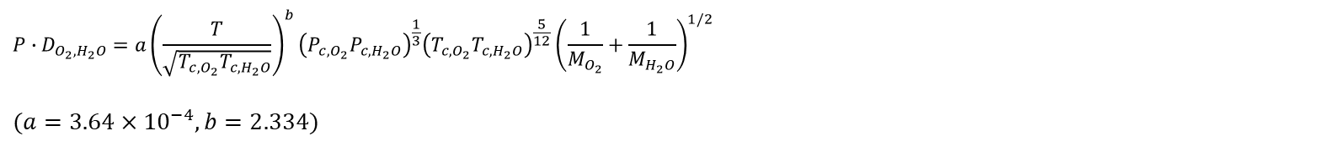
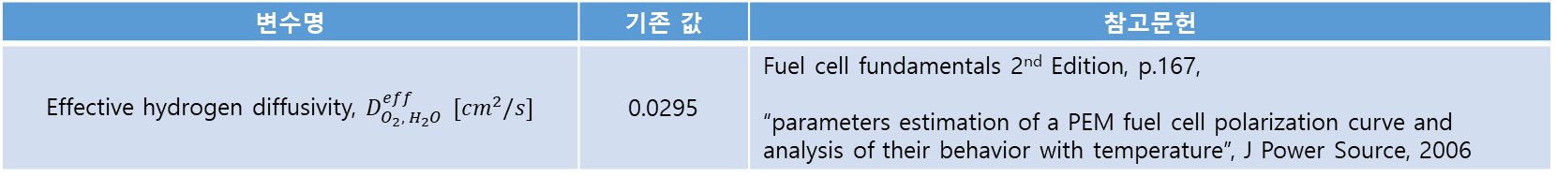
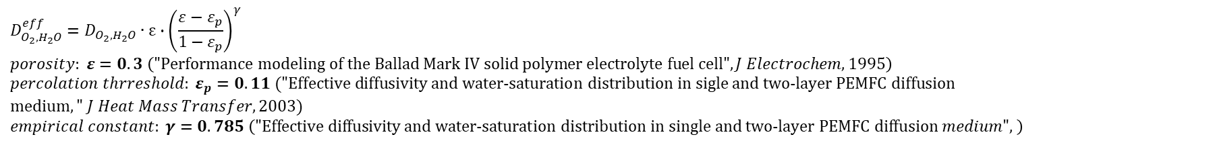
Research Status
Model development
Ohmic Loss의 주요인자의 도출 방식:
변수명 | 기존 값 | 참고문헌
Effective hydrogen diffusivity, $D_{O_{2},{ H}_{2}O}^{eff} [cm^{2}/s]$ | 0.0295 | Fuel cell fundamentals 2nd Edition, p.167, “parameters estimation of a PEM fuel cell polarization curve and analysis of their behavior with temperature”, J Power Source, 2006
$$P∙D_{O_{2},H_{2}O}=a{\left(\frac{T}{\sqrt{T_{c,O_{2}}T_{c,H_{2}O}}}\right)}^{b}{\left(P_{c,O_{2}}P_{c,H_{2}O}\right)}^{\frac{1}{3}}{\left(T_{c,O_{2}}T_{c,H_{2}O}\right)}^{\frac{5}{12}}{\left(\frac{1}{M_{O_{2}}}+\frac{1}{M_{H_{2}O}}\right)}^{1/2}$$
$$(a=3.64×{10}^{−4}, b=2.334)$$
Substance (parameter) | Molecular Weight [M] | $T_{C}$ [K] | $P_{C}$ [atm]
$$H_{2}$$ | 2.016 | 33.3 | 12.80
$$O_{2}$$ | 31.999 | 154.4 | 49.7
$$H_{2}O$$ | 18.015 | 647.3 | 217.5
$$D_{O_{2},H_{2}O}^{eff}=D_{O_{2},H_{2}O}∙ε∙{\left(\frac{ε−ε_{p}}{1−ε_{p}}\right)}^{γ} \\ porosity: ε=0.3 \left(\text{"}\text{Performance} \text{modeling} \text{of} \text{the} \text{Ballad} \text{Mark} \text{IV} \text{solid} \text{polymer} \text{electrolyte} \text{fuel} \text{cell}\text{"}, J Electrochem, 1995\right)$$
$percolation thrreshold: ε_{p}=0.11 ("\text{Effective} \text{diffusivity} \text{and} \text{water}\text{-}\text{saturation} \text{distribution} \text{in} \text{sigle} \text{and} \text{two}\text{-}\text{layer} \text{PEMFC} \text{diffusion} \text{medium}," J Heat Mass Transfer, 2003)$
$$empirical constant: γ=0.785 \left(\text{"}\text{Effective} \text{diffusivity} \text{and} \text{water}\text{-}\text{saturation} \text{distribution} \text{in} \text{single} \text{and} \text{two}\text{-}\text{layer} \text{PEMFC} \text{diffusion} medium", \right)$$
RECL

Slide 10
Research Status
Model development
Ohmic Loss의 주요인자의 도출 방식:
변수명 | 기존 값 | 참고문헌
Water diffusivity nafion, $D_{λ}$ | $$3.81 ×{10}^{−6}$$ | 참고문헌 조사 필요
RECL

Slide 11

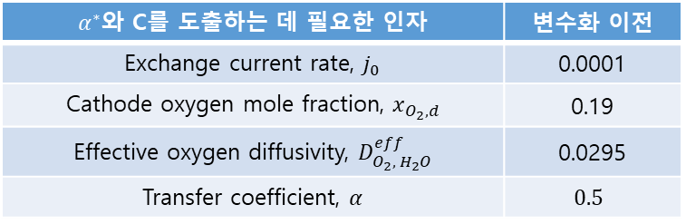
Research Status
Model development
Activation Loss는 아래의 수식으로 도출 가능함:
$$η_{act, cathode}=\frac{RT}{4αF}\ln{\frac{jC_{O_{2}}^{0}}{j_{0}C_{O_{2}}}}=\frac{RT}{4αF}\ln{\frac{jP_{0}}{j_{0}P^{C}x_{O_{2}}}}$$
(Anode 측 Activation loss는 Cathode 측의 Activation loss에 비해 매우 작으므로 무시 가능함)
$$x_{O_{2},c}=x_{O_{2,d}}−t^{c}\frac{jRT}{4FP^{c}D_{O_{2},H_{2}O}^{eff}}$$
$${∴ η}_{act, cathode}=\frac{RT}{4αF}\ln\left[\frac{jP_{0}}{j_{0}P^{C}\{x_{O_{2,d}}−t^{c}\frac{jRT}{4FP^{c}D_{O_{2},H_{2}O}^{eff}}\}}\right]$$
$α^{∗}$와 C를 도출하는 데 필요한 인자 | 변수화 이전
Exchange current rate, $j_{0}$ | 0.0001
Cathode oxygen mole fraction, $x_{O_{2},d}$ | 0.19
Effective oxygen diffusivity, $D_{O_{2},{ H}_{2}O}^{eff}$ | 0.0295
Transfer coefficient, $α$ | $$0.5$$
RECL

Slide 12
Research Status
Model development
Activation Loss의 주요인자의 도출 방식:
변수명 | 기존 값 | 참고문헌
Exchange current rate, $j_{0}$ | 0.0001 | 참고문헌 조사 필요
$$\log_{10}{P_{SAT}}=−2.1794+0.02953T−9.1837×{10}^{−5}T^{2}+1.4454×{10}^{−7}T^{3}$$
$$∴P_{SAT}={10}^{−2.1794+0.02953T−9.1837×{10}^{−5}T^{2}+1.4454×{10}^{−7}T^{3}}$$
RECL

Slide 13
Research Status
Model development
Activation Loss의 주요인자의 도출 방식:
변수명 | 기존 값 | 참고문헌
Cathode oxygen mole fraction, $x_{O_{2},d}$ | 0.19 | 참고문헌 조사 필요
$$\log_{10}{P_{SAT}}=−2.1794+0.02953T−9.1837×{10}^{−5}T^{2}+1.4454×{10}^{−7}T^{3}$$
$$∴P_{SAT}={10}^{−2.1794+0.02953T−9.1837×{10}^{−5}T^{2}+1.4454×{10}^{−7}T^{3}}$$
RECL

Slide 14
Research Status
Model development
Activation Loss의 주요인자의 도출 방식:
변수명 | 기존 값 | 참고문헌
Transfer coefficient, $α$ | $$0.5$$ | “parameters estimation of a PEM fuel cell polarization curve and analysis of their behavior with temperature”, J Power Source, 2006
$$Transfer coefficient in Anode: α^{a}=\left(1−B\right)∙n_{el}$$
$$Transfer coefficient in Cathode: α^{c}=B∙n_{el}$$
$$n_{el}:Number of electrons in the rate determining step of the reaction \\ n_{el}=4 for Anode,{ n}_{el}=1 for Cathode$$
$$B:Symmetry factor \\ B≅0.5$$
(“Fuel cell System”, Plenum Press, 1993)
(“A general three-dimensional model for proton exchange membrane fuel cells”, Int. J. Trans. Phenom, 2001)
$$∴α^{c}=0.5$$
RECL

Slide 15
Degradations
연번 | 항목 | 영향 | PPT page
1 | Flooding | Concentration loss (main) Activation loss
2 | Catalyst degradation | Activation loss Ohmic loss
3 | Bipolar plate degradation? | Ohmic loss Activation loss
4 | Nafion degradation? (hole) | Ohmic loss Concentration loss
5 | GDL degradation
6
7
어제 이야기 한 것 처럼, 신입생에게 하나씩 item 주고 논문 검색해서 정리해보라고 하면 될 듯.
네가 format 주고, 맞춰서 정리해보라고 해
Degradation 항목들 적고, PPT page 표시해서 해당 ppt 로 넘어가면 내용 볼 수 있으면 좋을 것 같은데… 해당 ppt 에 reference 도 다 적어두면 좋을 것 같음

Slide 16
Degradations_조구영
연번 | 항목 | 영향 | Modeling 요약 / reference link
1 | Flooding | Concentration loss (main) Activation loss

Slide 17
Degradations_조구영
연번 | 항목 | 영향 | Modeling 요약 / reference link
1 | Catalyst degradation | Activation loss Ohmic loss

Slide 18
Degradations_조구영
연번 | 항목 | 영향 | Modeling 요약 / reference link
1 | Bipolar plate degradation? | Ohmic loss Activation loss

Slide 19
Degradations_조구영
연번 | 항목 | 영향 | Modeling 요약 / reference link
1 | Nafion degradation? (hole) | Ohmic loss Concentration loss

Slide 20
감사합니다

