Slide 1
Instructions
Follow the learner instructions in the grey text boxes for each slide.
Delete the text box and instructions when complete.
Instructions for learner:
Action 1
Action 2
Action 3

Slide 2
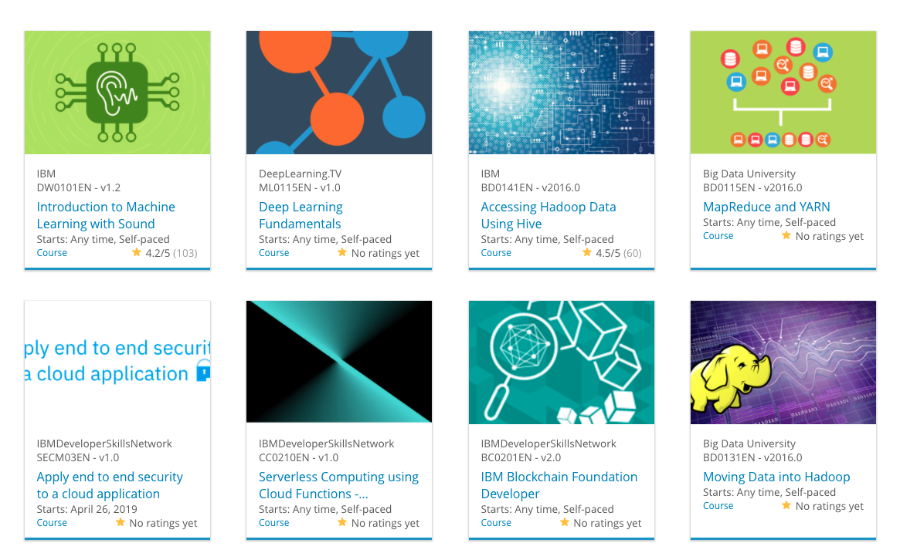

Build a Personalized Online Course Recommender System with Machine Learning
Zidan Qurosey S.
02-21-2024

Slide 3

Outline
Introduction and Background
Exploratory Data Analysis
Content-based Recommender System using Unsupervised Learning
Collaborative-filtering based Recommender System using Supervised learning
Conclusion
Appendix

Slide 4
Introduction
Course Recommendation System;
Finding better courses
Finding courses that suits well for each person’s interests
Find the best courses to recommend to users based on their interests, another users interests, and the courses they already enrolled in.
Obstacles
To many approaches
Small data

Slide 5
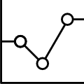
Exploratory Data Analysis

Slide 6
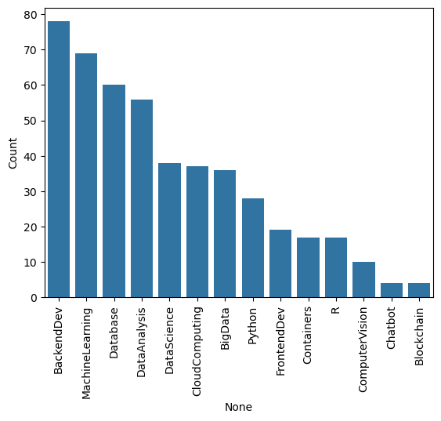
Course counts per genre

Slide 7
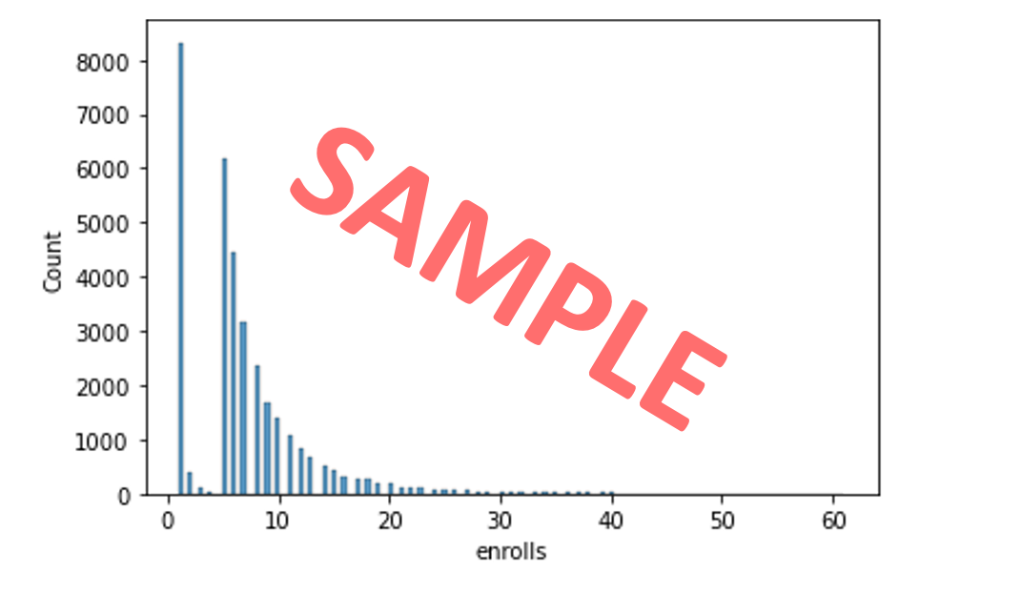
Course enrollment distribution
- Place the histogram showing the enrollment distributions here, e.g., it clearly shows how many users enrolled in just 1 course or how many enrolled 10 courses, etc.
- Briefly explain the histogram in the slide notes (for peer-review purpose)
- A sample histogram may look like the following:

Slide 8
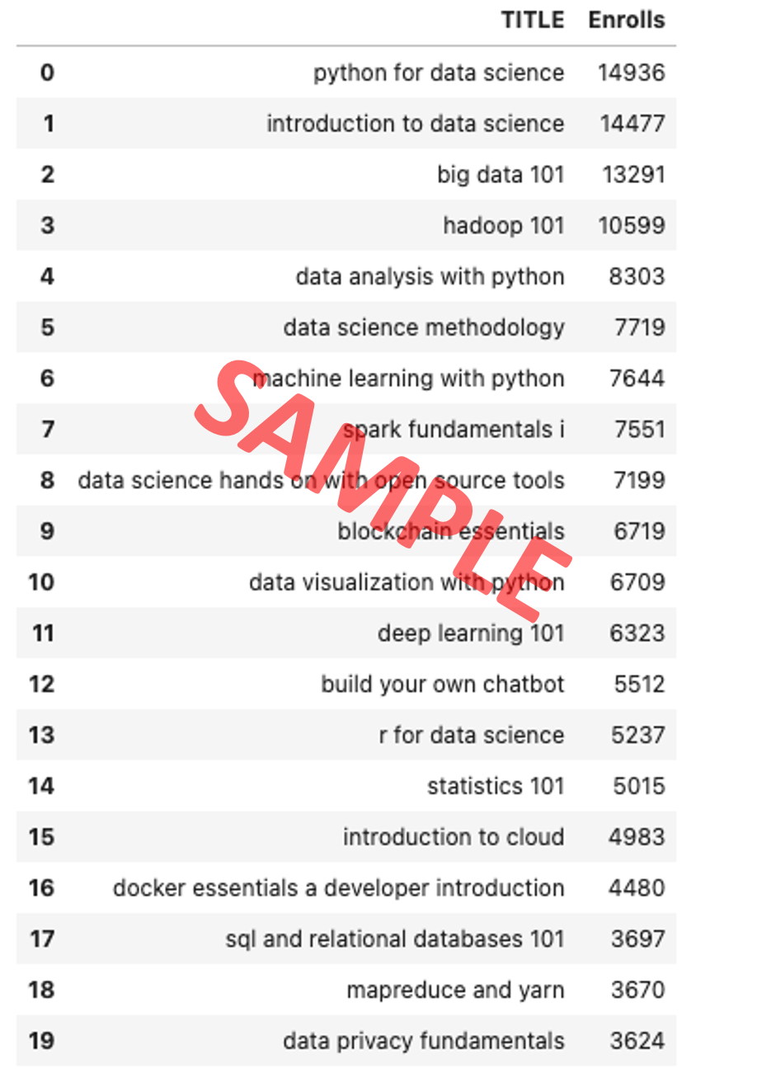
20 most popular courses
List the most popular 20 courses here
Briefly explain the course list in the slide notes (for peer-review purpose)

Slide 9
Word cloud of course titles
Place the word cloud (created from course titles) here
Briefly explain the word cloud in the slide note (for peer-review purpose)

Slide 10
Content-based Recommender System using Unsupervised Learning
Cluster2
Cluster1

Slide 11
Flowchart of content-based recommender system using user profile and course genres
- Plot a flowchart which should clearly illustrate how you implemented the content-based recommender system using user profile vectors and course genre vectors
Briefly explain the flowchart in the slide note
An example flowchart may look like the following:
Raw data
Data processing
Cleaned datasets
Feature engineering
Features

Slide 12
Evaluation results of user profile-based recommender system
Place your hyper-parameter settings, such as recommendation score or course similarity thresholds, etc.
Note: if you have tried multiple hyper-parameters, you may group and show all results in a grouped bar chart
On average, how many new/unseen courses have been recommended per user (in the test user dataset)
What are the most frequently recommended courses? Return the top-10 commonly recommended courses across all users

Slide 13
Flowchart of content-based recommender system using course similarity
- Plot a flowchart which should clearly illustrate how you implemented the course similarity based recommender system
- Briefly explain the flowchart in the slide note
An example flowchart may look like the following:
Raw data
Data processing
Cleaned datasets
Feature engineering
Features

Slide 14
Evaluation results of course similarity based recommender system
Your hyper-parameter settings, such as a score or similarity threshold
Note if you have tried multiple hyper-parameters, you may show your results in a grouped bar chart
On average, how many new/unseen courses have been recommended per user (in the test user dataset)
What are the most frequently recommended courses? Return the top-10 commonly recommended courses

Slide 15
Flowchart of clustering-based recommender system
Plot a flowchart which should clearly illustrate how you performed user profile clustering based recommender system
- Briefly explain the flowchart in the slide note
An example flowchart may look like the following:
Raw data
Data processing
Cleaned datasets
Feature engineering
Features

Slide 16
Evaluation results of clustering-based recommender system
Your hyper-parameter settings, such as a score or similarity threshold
Note if you have tried multiple hyper-parameters, you may show your results in a grouped bar chart
On average, how many new/unseen courses have been recommended per user (in the test user dataset)
What are the most frequently recommended courses? Return the top-10 commonly recommended courses

Slide 17
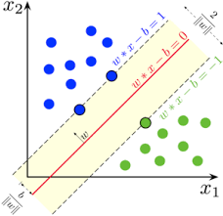
Collaborative-filtering Recommender System using Supervised Learning

Slide 18
Flowchart of KNN based recommender system
Plot a flowchart which should clearly illustrate how you performed KNN based recommender system using course enrollments history
- Briefly explain the flowchart in the slide note
An example flowchart may look like the following:
Raw data
Data processing
Cleaned datasets
Feature engineering
Features

Slide 19
Flowchart of NMF based recommender system
- Plot a flowchart which should clearly illustrate how you performed NMF based recommender system
- Briefly explain the flowchart in the slide note
An example flowchart may look like the following:
Raw data
Data processing
Cleaned datasets
Feature engineering
Features

Slide 20
Flowchart of Neural Network Embedding based recommender system
- Plot a flowchart which should clearly illustrate how you performed Neural Network Embedding based recommender system
- Briefly explain the flowchart in the slide note
An example flowchart may look like the following:
Raw data
Data processing
Cleaned datasets
Feature engineering
Features

Slide 21
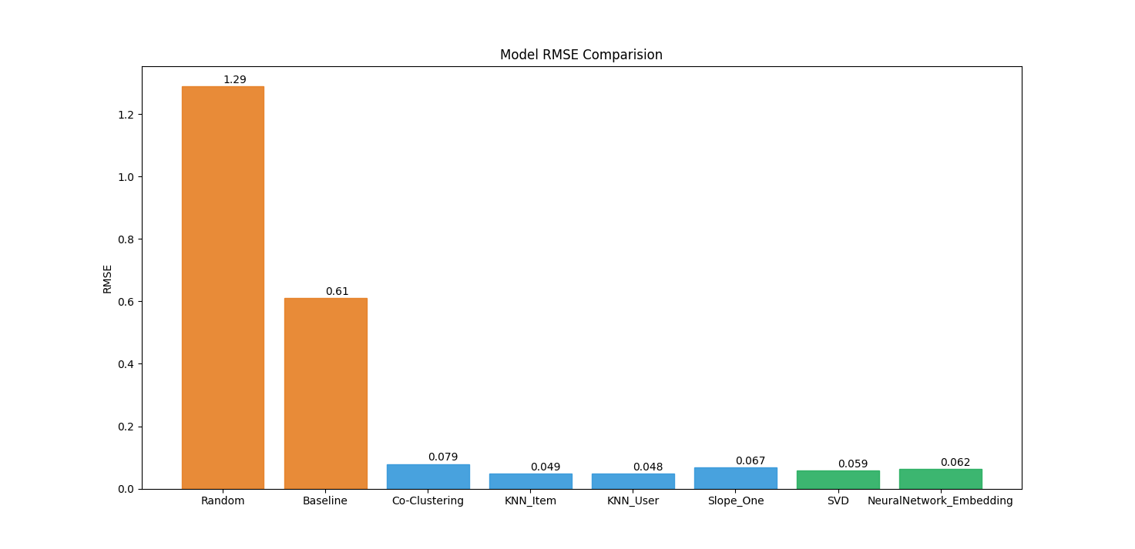
Compare the performance of collaborative-filtering models
Plot a barchart visualizing the performance metric (such as RMSE) of different collaborative-filtering models you have built so far
Briefly explain the barchart in the slide note
A sample barchart may look like the following

Slide 22
Optional: Build a course recommender system app with Streamlit
Streamlit app screenshot1
Streamlit app screenshot2
A published Streamlit App URL for a live demo

Slide 23
Conclusions
Point 1
Point 2
Point 3
Point 4
…

Slide 24
Appendix
Instructions for learner:
Include any relevant assets like a GitHub repo, key Python code snippets, charts, notebook outputs, or deployed Streamlit app URLs that you may have created during this project
Asset 1
Asset 2
Asset 3
Asset 4
…

