Slide 1


5G Mobile Network Performance in France
Territorial disparities and potential explanatory factors
RNCP 37827 · Data Analyst Project
Ironhack Data Analytics
Zidène Aourdache
Sept. 2026
Notes:
Good morning and welcome to my project presentation. My name is Zidene Aourdache, and today I am going to present to you my project about 5G network performance. Why did I chose this subject?
➔
Nowadays, Mobile connectivity has become an essential part of everyday digital activity. Users increasingly rely on mobile networks for web browsing, video streaming, file transfers and professional applications. However, network quality is not uniform across territories. Differences in infrastructure deployment, radio conditions, population distribution and operator strategies may contribute to variations in measured performance.
“This project investigates 5G mobile network performance in metropolitan France. The objective is to identify whether significant territorial disparities exist and to investigate which factors could help explain them

Slide 2
Agenda
01 — Business Question & Objectives
02 — Data Sources
03 — End-to-End Data Pipeline Architecture
04 — MySQL Relational Database
05 — BigQuery: Analytical Data Layer
06 — Measurement Coverage & Balance
07 — What Are the Performance Disparities?
08 — Statistical Evidence: Do the Differences Hold?
09 — What Could Explain the Differences?
  09.1 — Interpretation
10 — ML Process
11 — Final Conclusion
12 — Challenges & Next Steps
12 — Power BI Dashboard

Slide 3
1. Business Question & Objectives
BUSINESS QUESTION:
Are there significant territorial inequalities in mobile network performance in France, and what can explain these disparities?
OBJECTIVES:
01 — Analyze
02 — Identify
03 — Explore
Potential factors associated with performance difference
5G network performance across key QoS indicators
Territorial and operator-level disparities
SCOPE:
Metropolitan France · 2025(T3) · 4 * 5G QoS · 4 operators
Notes:
“The project starts from a simple business question: are there significant territorial inequalities in mobile network performance in France, and what could explain these disparities?
To answer it, I structured the analysis around three objectives. First, Understand the 5G performance using the main QoS indicators. Second, identify differences between operators and territories. And finally, explore potential factors that could be associated with these differences.
The analysis focuses on metropolitan France, using 2025 data and four mobile operators.”

Slide 4



2. Data sources & Collection
ARCEP
ARCEP
File1: 5G_Mobile_QoS: 317,998
File2: Operators’ sites: 118,087
Source: "https://data.arcep.fr/mobile/mesures_qualite_arcep/2025/Metropole/"
Source:
"https://data.arcep.fr/mobile/sites/"
INSEE
INSEE
File3: Population
File4: Insee Geo: 34,875 com
Source: "https://api.insee.fr/melodi/data/
flat file ‘.csv’)
Source: "https://www.insee.fr/
Common Geographic key: insee_com
Notes:
“The analysis is based on 4 dastasets from 2 public data sources.
First, ARCEP Mobile QoS, which provides the network measurements used to evaluate performance. Used collection Method: WEB Scraping
Second, ARCEP Mobile Sites, which provides information about network infrastructure and 5G deployment.
3rd, I used INSEE population data to add territorial context.
4th, Geographic data for administrative territories.
How did I deal with data?

Slide 5
3. End-to-End Data Pipeline Architecture
File names: refer to slide4
“mobile_5g_network_fr”
Notes:
“After extracting the 4 datasets, I kept the raw data separate and performed the cleaning independently for each source.
I standardized the geographic identifiers and data types, cleaned columns names and deleted non relevant ones, handled quality issues (for ex region names).
The cleaned data was structured in a relational MySQL database.
From this integrated dataset, I performed the statistical analysis and built the Power BI dashboards.”

Slide 6
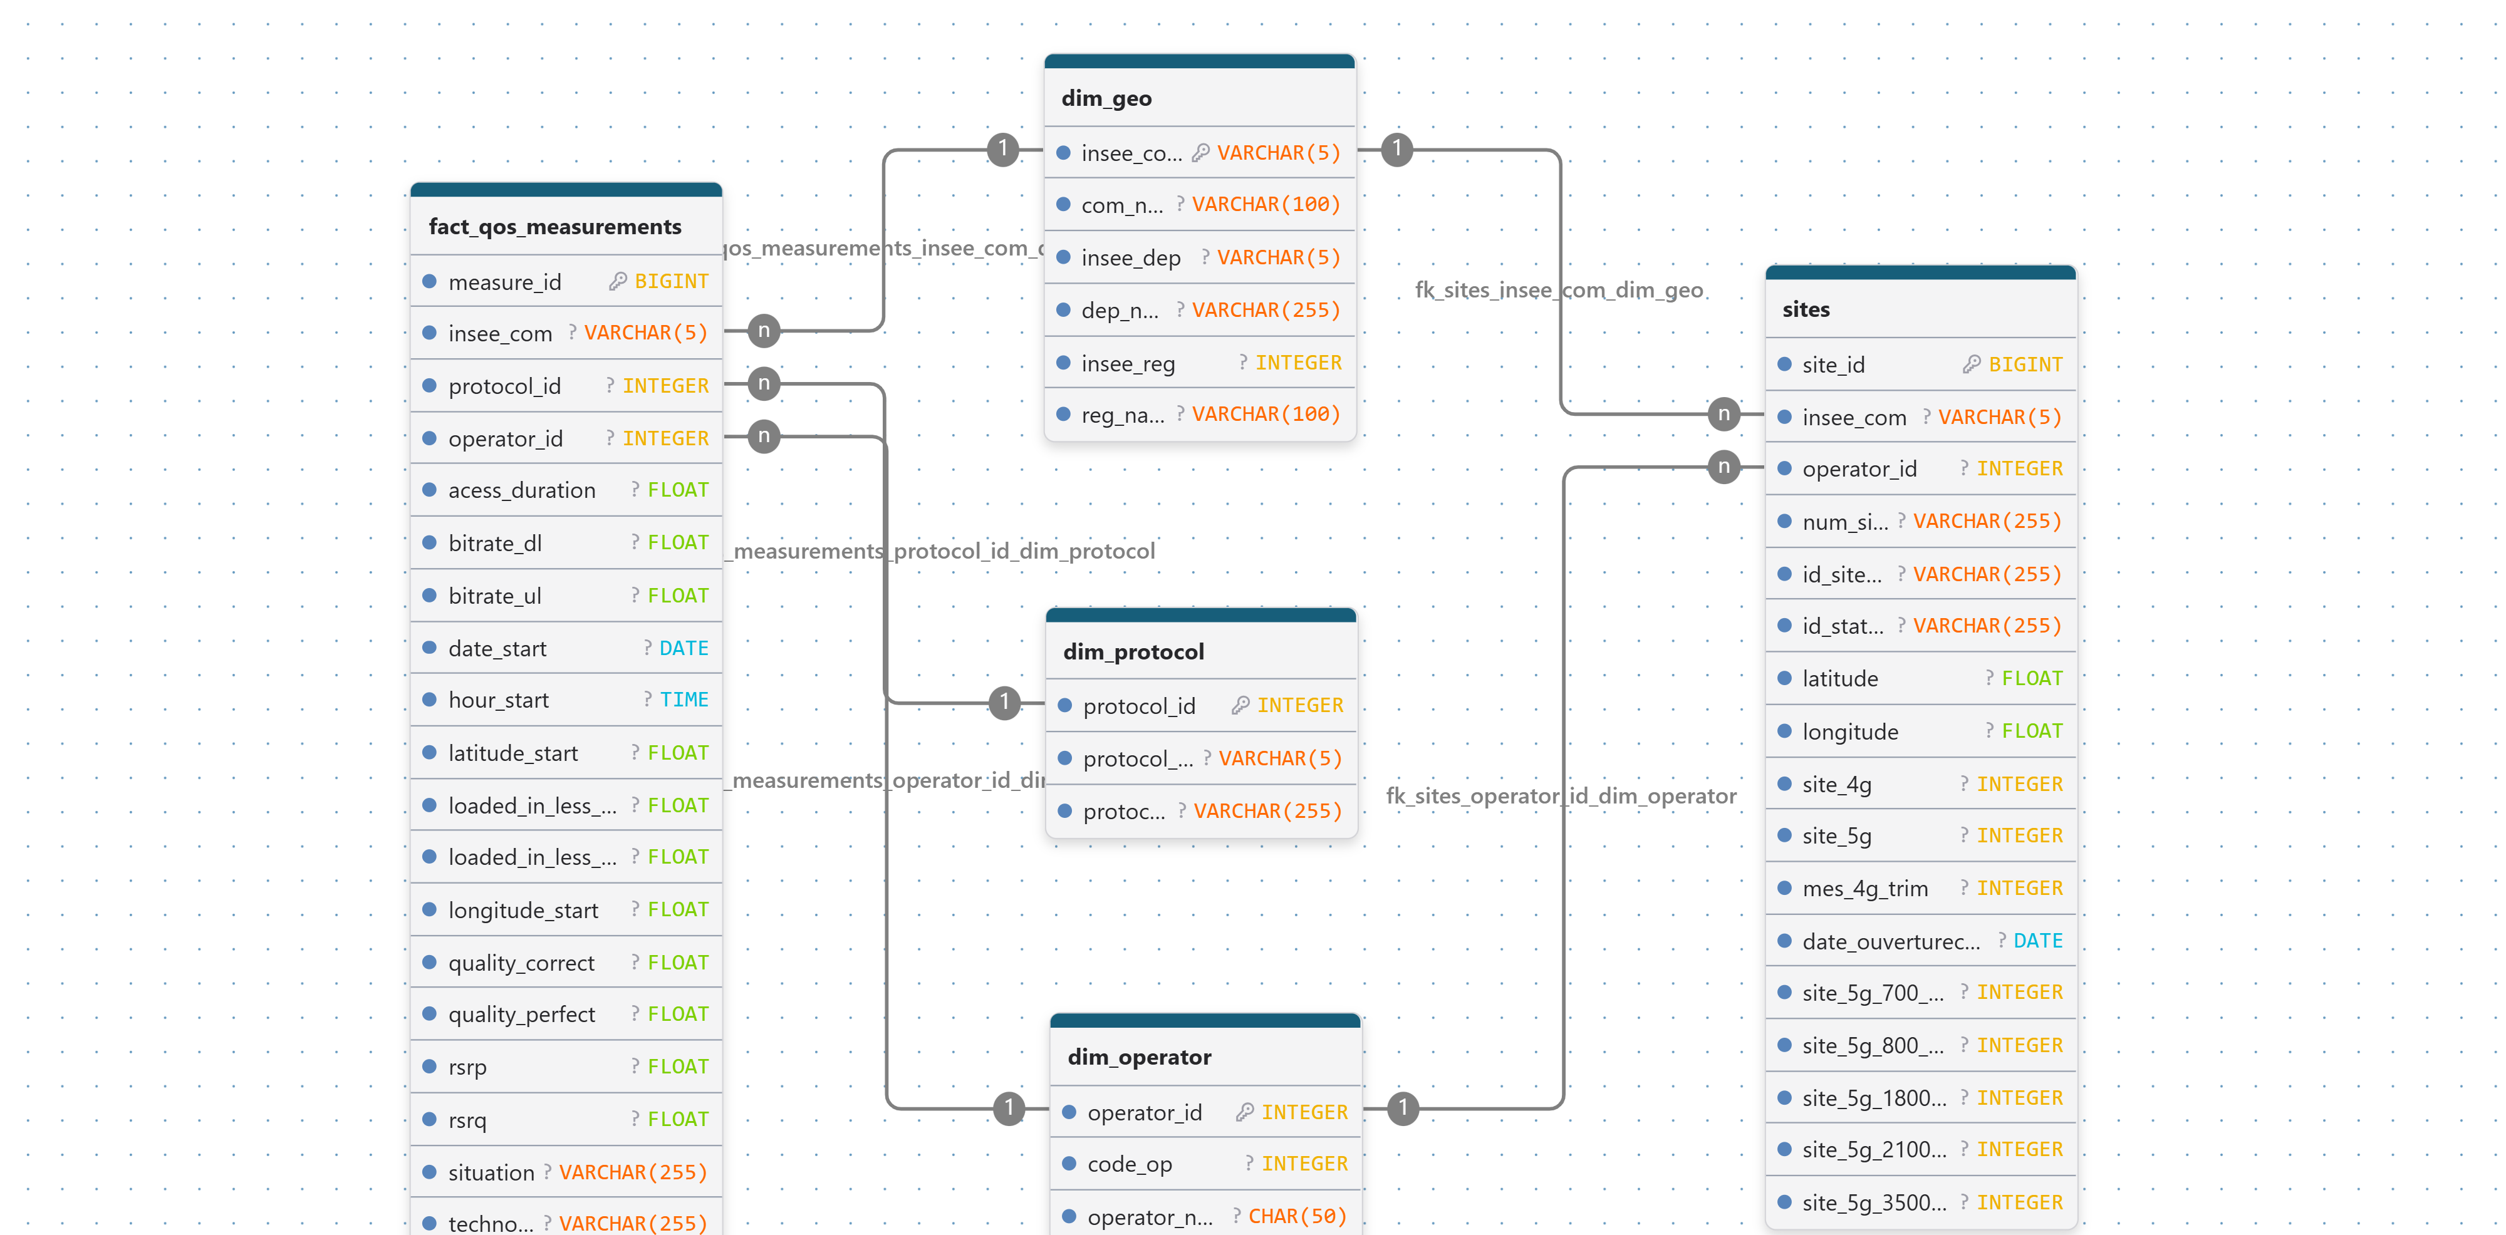
4. ERD & Relational Database
From clean data to relational database
ERD
Notes:
The model relies on 1 fact table and 4 dimension tables: This separates the geographic and operator dimensions from the two main tables: QoS measurements and mobile sites.
The INSEE commune code is the main geographic key used to connect the datasets, while the operator identifier links measurements and infrastructure to the operator dimension.
This relational structure provides a consistent foundation for the subsequent analysis.”

Slide 7
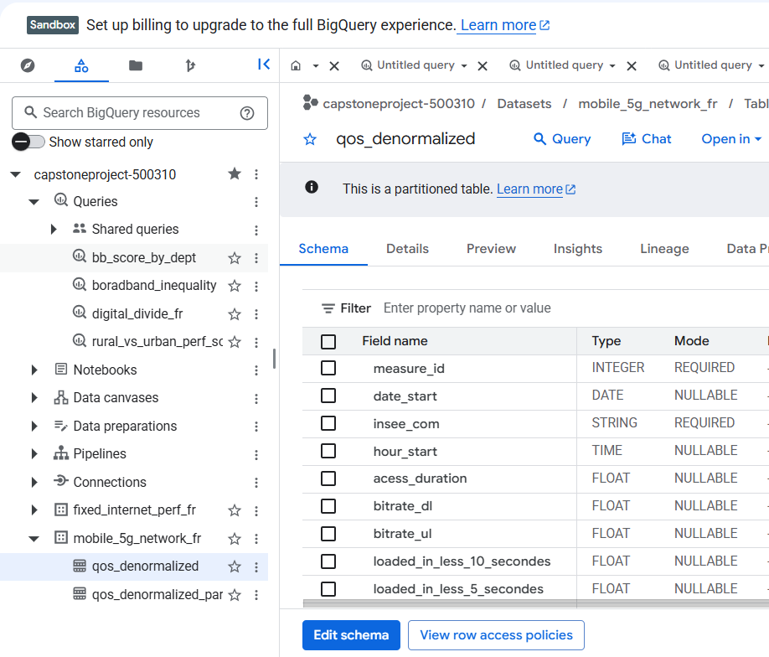
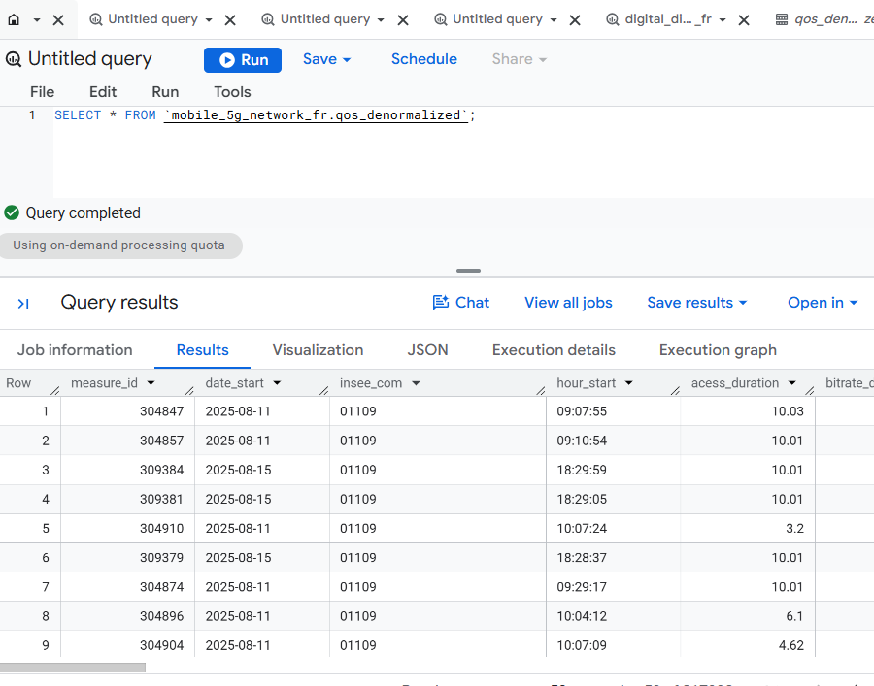
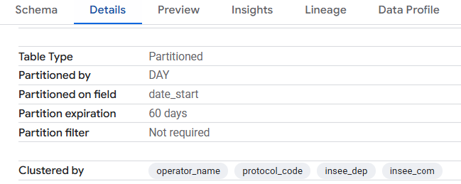
5. BigQuery: Analytical Data Layer
Notes:
Slide5: 5. BigQuery: Analytical Data Layer
“After creating the relational MySQL database, I created the denormalized qos table and imported it to BigQuery.
The table contains the integrated QoS, infrastructure and geographic information. I partitioned it by measurement date and clustered it by operator, protocol and geographic identifiers.
The relational MySQL database therefore remains the structured data model, while BigQuery provides the analytical representation.”

Slide 8
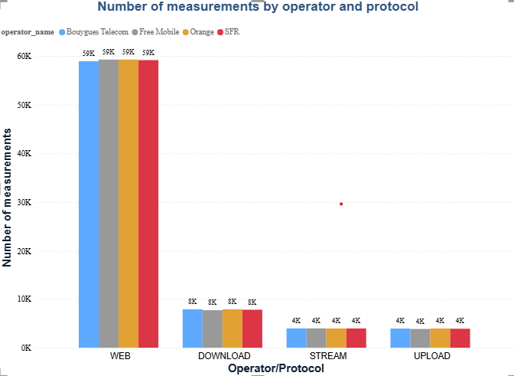
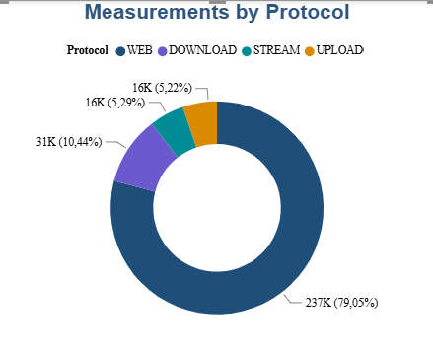
6. Initial EDA: Measurement Coverage & Balance 1/2
1486 communes
299340
Notes:
Slide6: 6.Measurement Coverage & Balance
“Before looking at performance disparities, I first checked the coverage and distribution of the ARCEP measurements.
The dataset contains 300K measurements collected between the 26th of May and the 2nd of September 2025, covering the four operators and the 13 metropolitan regions.
We can see that the measurements are not evenly distributed between the protocols. Web measurements represent around 79 percent of the dataset, while Download, Upload and Streaming account for smaller proportions.
However; measurements are evenly distributed among the operators, across different protocols and different territories. Which is fair.
“After checking the coverage and distribution of the measurements, let’s do the exploratory analysis to understand what the data reveals about 5G performance.
.

Slide 9
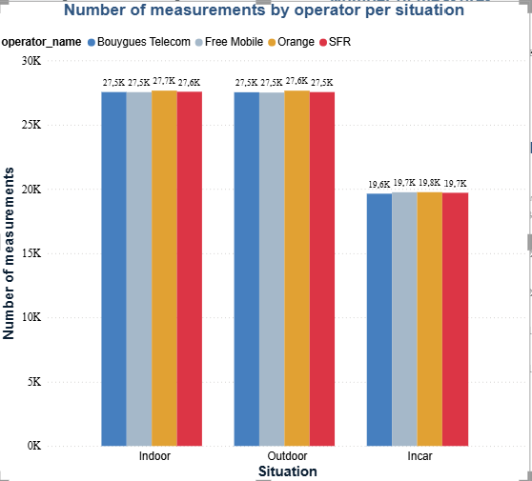
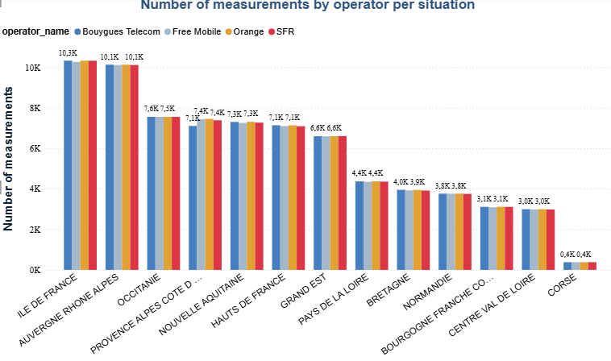
6. Initial EDA: Measurement Coverage & Balance 2/2
Measurements are evenly distributed on operators

Slide 10
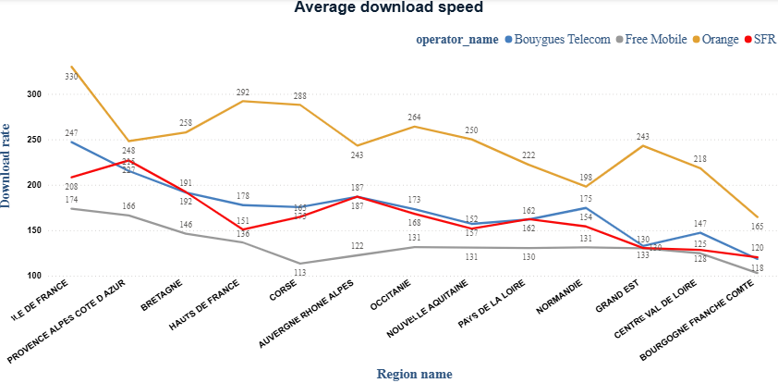
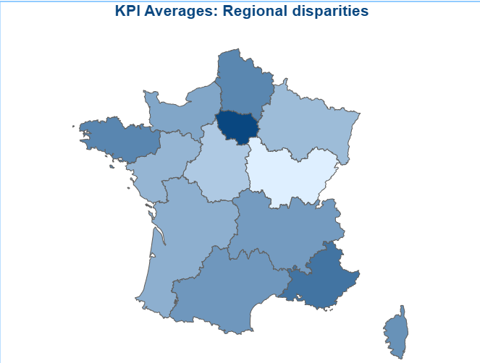
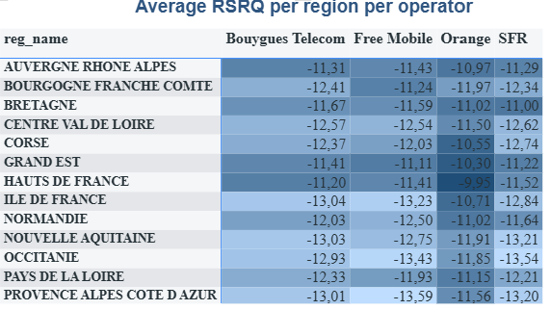
7. What Are the Performance Disparities?
Where do we observe differences in 5G performance?
01 — Operator disparities
02 — Territorial disparities
03 — Radio environment disparities
KEY OBSERVATION: 5G performance differs both between operators and across territories. Download speed is used as the main KPI for the next steps (explanatory analysis.)
Notes:
In the following slides I will show only one protocol (Download speed), however we will explore the others in the dashboard.
I ordered the disparities into 3 categories: operator, territorial and radio environment.
First, we can see differences between the four operators. In terms of average download speed, Orange has the highest value, followed by Bouygues Telecom, SFR and Free Mobile.
But the differences are not limited to the operators. When we look at the regional distribution, we also observe geographical variation in download performance.
This is important because the objective is not simply to compare operators. The business question also concerns territorial inequalities.
At this stage, these are observed disparities. We haven't yet tested whether the differences between operators are statistically significant, and we haven't investigated what could explain them.
So the next step is to statistically test these observed differences.”

Slide 11
“Do these observed differences between operators/territories hold statistically?”

Slide 12
8. Statistical Evidence: Do the Differences Hold?
1. Hypotheses
  H₀ — Null hypothesis: Mean download speed is equal across the four operators.
  H₁ — Alternative hypothesis At least one operator has a different mean download speed.
2. Main result
  Test: One-way ANOVA: comparison between more than 3 means, independent observations
  F = 32.44
  p < 0.001
➔p < 0.05 → Reject H₀: There is statistically significant evidence that the four operators do not all have the same mean download speed
Notes:
Slide8: 8.Statistical Evidence: Do the Differences Hold?
I therefore tested whether these differences were statistically significant. The ANOVA gives a p-value below 0.05, so we reject the hypothesis that all operators have the same mean download performance. Levene's test has a p-value of 0.191, so we do not find evidence that the variances are significantly different. This supports the use of ANOVA and confirms that the operator differences observed in the data are statistically significant.”
➔ “Now that we have established that the differences are statistically significant, I looked at what could be associated with these performance differences

Slide 13
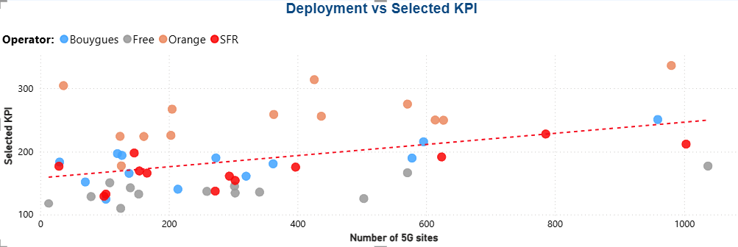
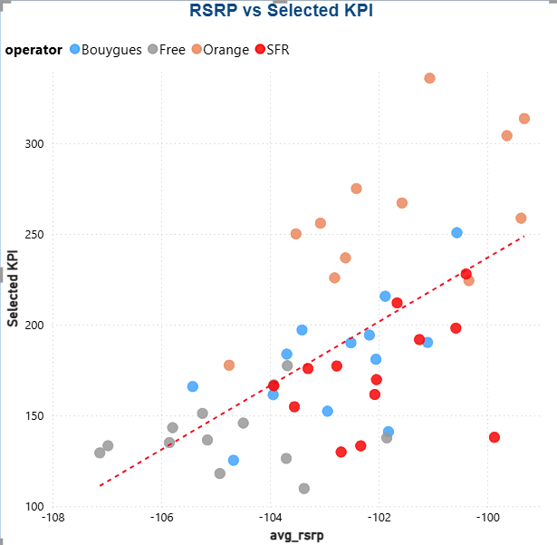
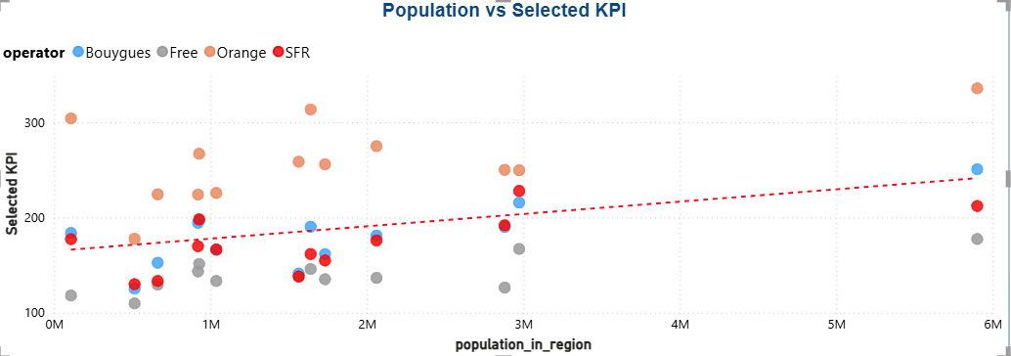
9. What Could Explain the Differences?
Which territorial and network factors are associated with 5G performance?
Notes:
Average download speed increases with population and, to a lesser extent, with the number of 5G sites, suggesting that network deployment and user concentration are associated with performance differences. The clearest relationship appears with RSRP: stronger signal levels are generally associated with higher download speeds across operators. Overall, performance disparities appear to result from a combination of deployment, population density and radio conditions rather than a single factor.
Let’s train two ML model (Linear regression and Decision tree) and see ho likely download speeds can be predicted.

Slide 14
9.1. Interpretation
Population
  Positive overall relationship with download speed
  More populated regions tend to show higher measured performance
  Yet operators remain clearly separated at similar population levels
📡 5G Deployment
  Positive relationship between the number of pure 5G sites and download performance
  Network infrastructure therefore appears to be an important factor
📶 Radio Conditions
  Better RSRP is associated with higher download performance
  Radio environment contributes to the observed differences
➔Performance is associated with both network and territorial factors, but operator-specific differences remain visible.

Slide 15
10. ML Process
Features selection: operator, rsrq, rsrp, population, nbr os sites
Targer: Download speed
Model | R² | MAE (Mbps)
Decision Tree | 0.478 | 81
Linear Regression | 0.385 | 99
The Decision Tree captures more of the variation than the linear model, suggesting that the relationship between network performance, infrastructure, population and radio conditions is not purely linear.
Notes:
R² → How much variation does the model explain?
MAE (Mean Absolute Error) → How wrong is it on average?
RMSE → How bad are the larger mistakes?
What we can say
The Decision Tree achieved R² = 0.478, meaning that the selected variables explain approximately 48% of the variation in download speed on the test communes.
Linear Regression achieved R² = 0.385.
The Decision Tree also produced lower MAE (81.11 Mbps) and RMSE (113.32 Mbps) than Linear Regression.
This suggests that the relationship between download performance and the selected variables is not purely linear and may involve interactions or threshold effects.
The models also show that the available explanatory variables capture part, but not all, of the territorial variation in 5G performance.

Slide 16
11. Final Conclusion
What did we learn?
1. Performance disparities exist:
  5G download performance differs significantly across operators and territories.
2. Several factors are associated with performance
  Territorial context: population
  Network infrastructure: pure 5G deployment
  Radio environment: RSRP
3. These factors do not tell the whole story
  Significant differences remain between operators under similar territorial or infrastructure conditions.
  This points to an important operator-specific component.

Slide 17
12. Challenges and Next Steps
Challenges:
  Data integration: Combining ARCEP QoS, mobile-site and INSEE datasets with different granularities and identifiers.
  Territorial granularity: QoS measurements are collected at specific locations (1610 communes), while population and infrastructure data are aggregated at most of the territory communes.
Next steps:
  Deeper territorial analysis: Extend the analysis from regions to departments or communes to identify more localized disparities.
  Operator-level investigation: Analyze why operators with different deployment strategies achieve different performance levels.

Slide 18
13. Power BI Dashboard

Slide 19
Merci Pour Votre Attention!

