Slide 1


5G Mobile Network Performance in France
Territorial disparities and potential explanatory factors
RNCP 37827 · Data Analyst Project
Ironhack Data Analytics
Zidène Aourdache
Sept. 2026

Slide 2
Agenda
01 — Business Question & Objectives
02 — Data Sources
03 — End-to-End Data Pipeline Architecture
04 — MySQL Relational Database
05 — BigQuery: Analytical Data Layer
06 — Measurement Coverage & Balance
07 — What Are the Performance Disparities?
08 — Statistical Evidence: Do the Differences Hold?
  09 — What Could Explain the Differences?
09.1 — Interpretation
10 — Final Conclusion
11 — Challenges & Next Steps

Slide 3
1. Business Question & Objectives
BUSINESS QUESTION:
Are there significant territorial inequalities in mobile network performance in France, and what can explain these disparities?
OBJECTIVES:
01 — Analyze
02 — Identify
03 — Explore
Potential factors associated with performance difference
5G network performance across key QoS indicators
Territorial and operator-level disparities
SCOPE:
Metropolitan France · 2025(T3) · 5G QoS · 4 operators

Slide 4



2. Data sources
ARCEP
ARCEP
File1: 5G_Mobile_QoS: 317,998
File2: Operators’ sites: 118,087
Source: "https://data.arcep.fr/mobile/mesures_qualite_arcep/2025/Metropole/"
Source:
"https://data.arcep.fr/mobile/sites/"
INSEE
INSEE
File3: Population
File3: Insee Geo: 34,875 com
Source: "https://api.insee.fr/melodi/data/
flat file ‘.csv’)
Source: "https://www.insee.fr/
Common Geographic key: insee_com

Slide 5
3. End-to-End Data Pipeline Architecture

Slide 6
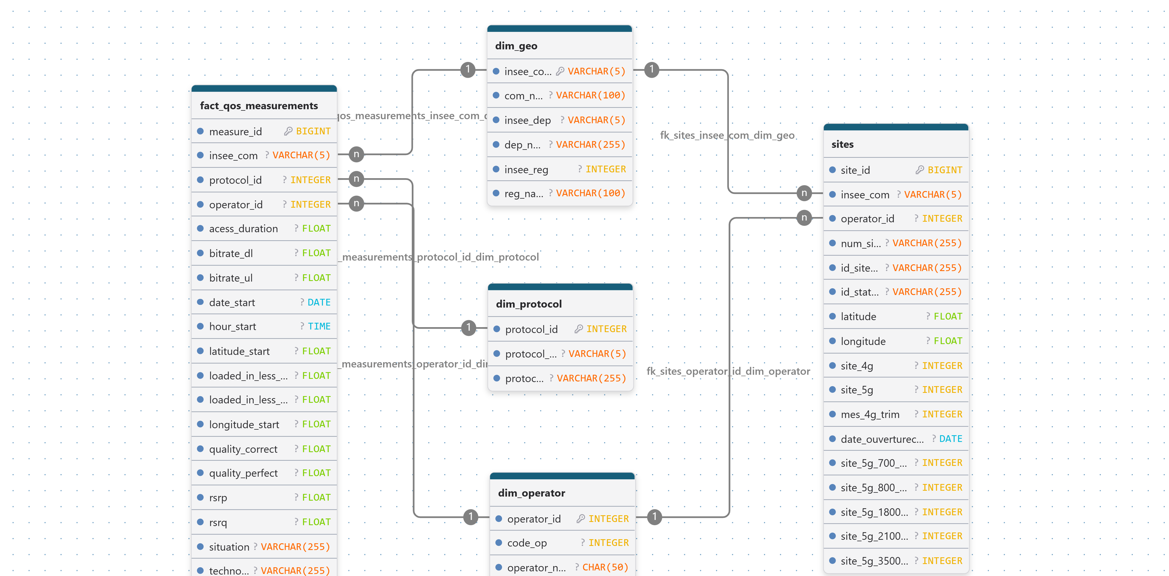
4. MySQL Relational Database
From clean data to relational database

Slide 7
5. BigQuery: Analytical Data Layer

Slide 8
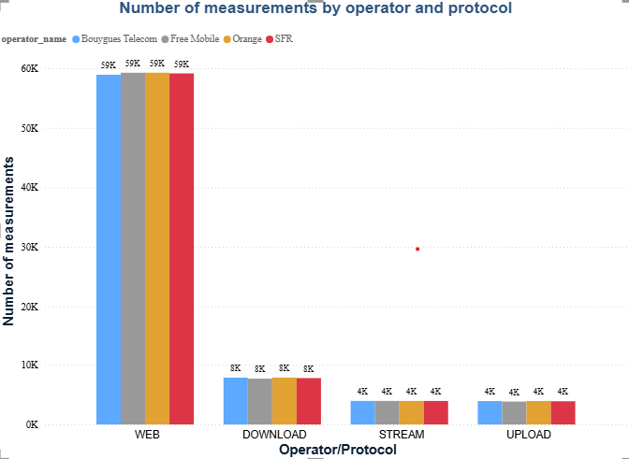
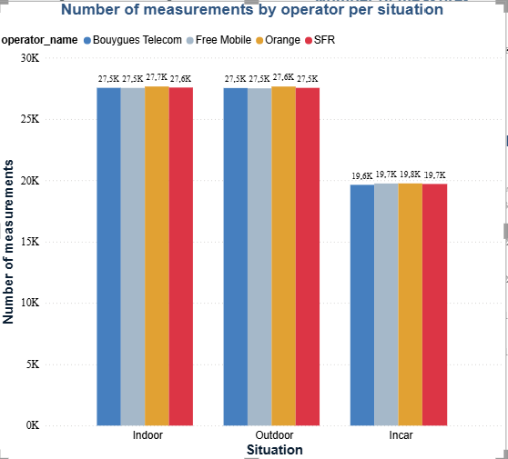
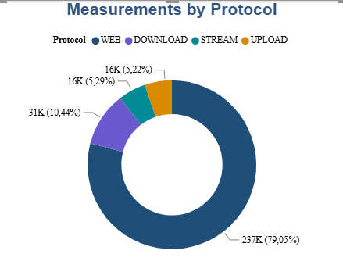
6. Measurement Coverage & Balance
1486 communes
299340
Measurements are evenly distributed on operators

Slide 9
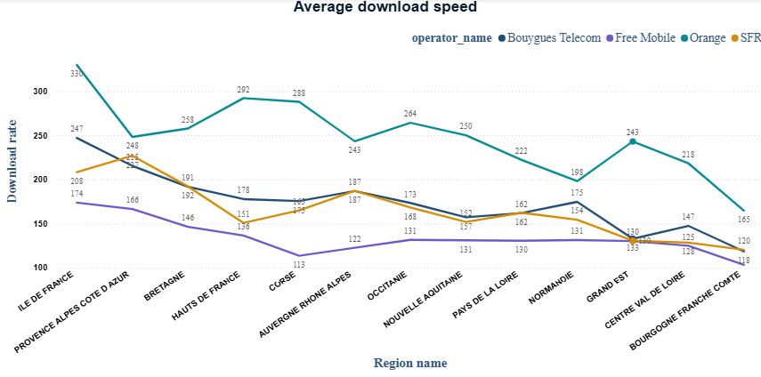
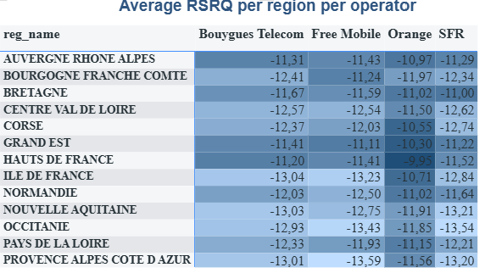
7. What Are the Performance Disparities?
Where do we observe differences in 5G performance?
01 — Operator disparities
02 — Territorial disparities
03 — Radio environment disparities
KEY OBSERVATION: 5G performance differs both between operators and across territories. Download speed is used as the main KPI for the next steps (explanatory analysis.)

Slide 10
“Do these observed differences between operators/territories hold statistically?”

Slide 11
8. Statistical Evidence: Do the Differences Hold?
1. Hypotheses
  H₀ — Null hypothesis: Mean download speed is equal across the four operators.
  H₁ — Alternative hypothesis At least one operator has a different mean download speed.
2. Main result
  Test: ANOVA: comparison between more than 3 means, independent observations
  F = 32.44
  p < 0.001
➔p < 0.05 → Reject H₀: There is statistically significant evidence that the four operators do not all have the same mean download speed

Slide 12
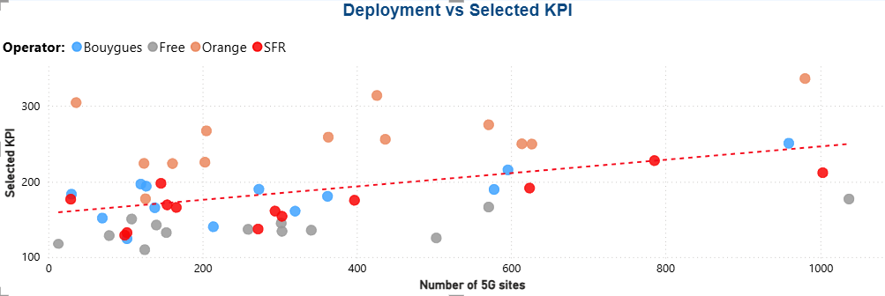
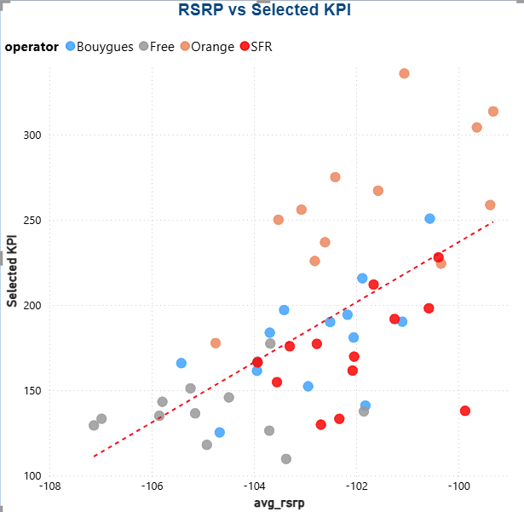
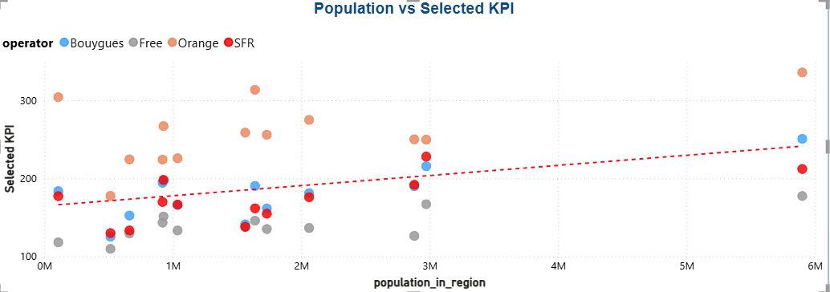
9. What Could Explain the Differences?
Which territorial and network factors are associated with 5G performance?

Slide 13
9.1. Interpretation
Population
  Positive overall relationship with download speed
  More populated regions tend to show higher measured performance
  Yet operators remain clearly separated at similar population levels
📡 5G Deployment
  Positive relationship between the number of pure 5G sites and download performance
  Network infrastructure therefore appears to be an important factor
📶 Radio Conditions
  Better RSRP is associated with higher download performance
  Radio environment contributes to the observed differences
➔Performance is associated with both network and territorial factors, but operator-specific differences remain visible.

Slide 14
10. Final Conclusion
What did we learn?
1. Performance disparities exist:
  5G download performance differs significantly across operators and territories.
2. Several factors are associated with performance
  Territorial context: population
  Network infrastructure: pure 5G deployment
  Radio environment: RSRP
3. These factors do not tell the whole story
  Significant differences remain between operators under similar territorial or infrastructure conditions.
  This points to an important operator-specific component.

Slide 15
11. Challenges and Next Steps
Challenges:
  Data integration: Combining ARCEP QoS, mobile-site and INSEE datasets with different granularities and identifiers.
  Territorial granularity: QoS measurements are collected at specific locations (1610 communes), while population and infrastructure data are aggregated at most of the territory communes.
Next steps:
  Deeper territorial analysis: Extend the analysis from regions to departments or communes to identify more localized disparities.
  Operator-level investigation: Analyze why operators with different deployment strategies achieve different performance levels.

Slide 16
Power BI Dashboard

Slide 17
Merci Pour Votre Attention!

