Slide 1
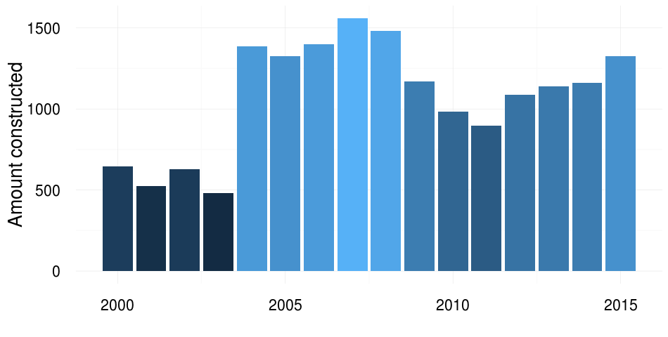
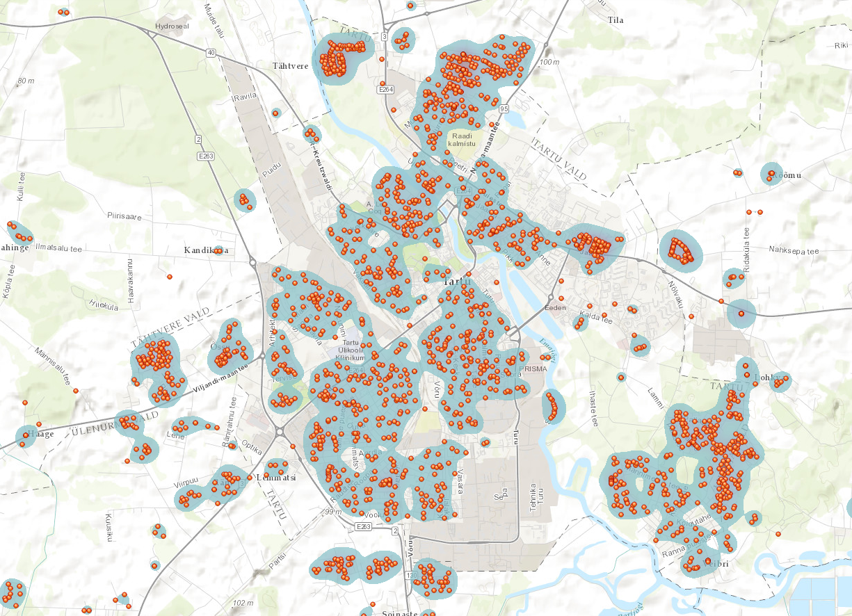
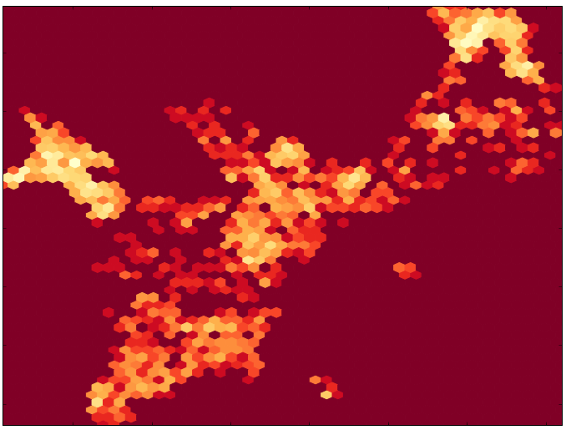
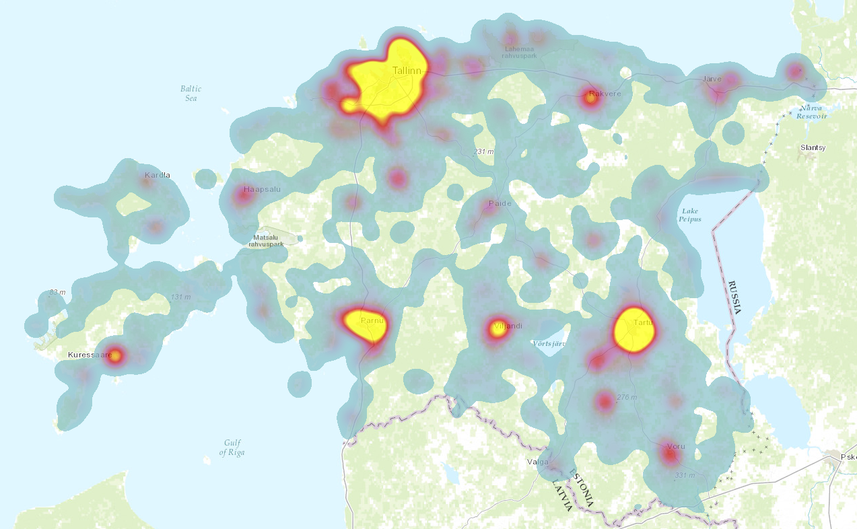


Idea Visualizing the construction of new housing in Estonia from 2000 to 2015. Finding the most attractive residential areas in Estonia.
Visualisation of new housing in Estonia
Mark Laane, Karli Oruste & Hanno Soo
Primary data source:
The Estonian Buildings Registry
datapoints
since year 2000
housing
950 000
85 000
17 893
Coordinates from address:
Google Geocoding API
Address
Geocoding API
Lat / Lon
Tartu on Interactive map
Heatmap of Tallinn
Interactive map

