Slide 1
Virtualization
"To understand why virtualization has had such a profound effect on today’s computing environment"

Slide 2


What is ISO?

Slide 3
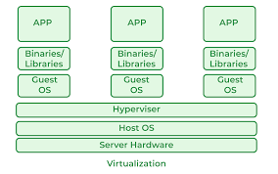
How are resources distributed?

Slide 4
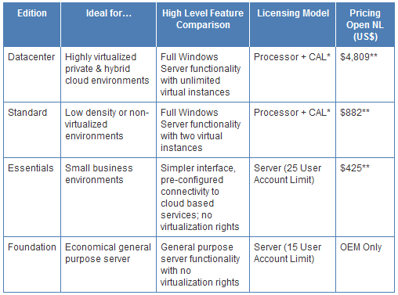
Windows Server Editions

Slide 5

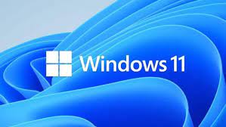
Windows Server and Windows 11

Slide 6
Most Used Windows Server Services
Active Directory
DHCP
DNS
IIS

Slide 7
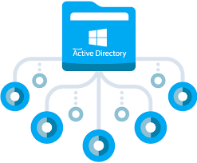
Active Directory
Storing Data of Objects:
Users
Computers
Groups
Other Objects(Printers, GPO)
Notes:
Easily organize users into groups and subgroups for permissions
Quickly manage file access

Slide 8
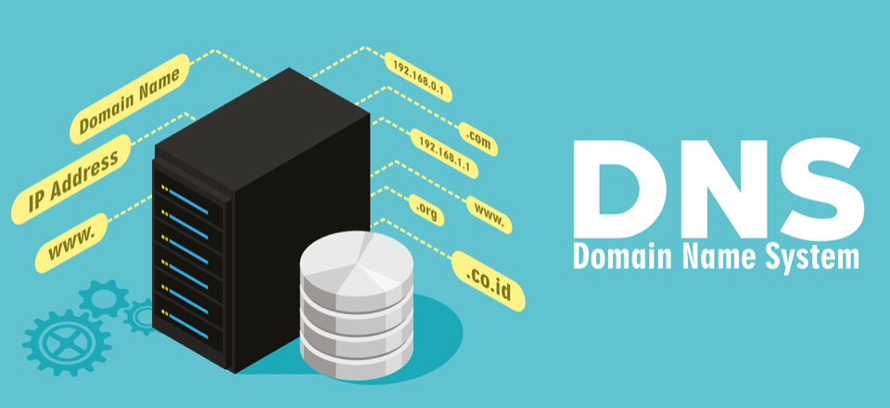
DNS

Slide 9
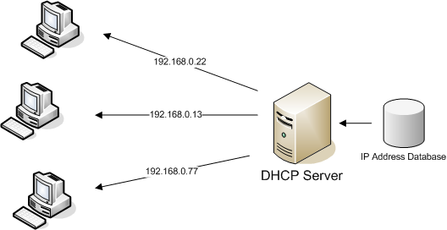
DHCP

Slide 10
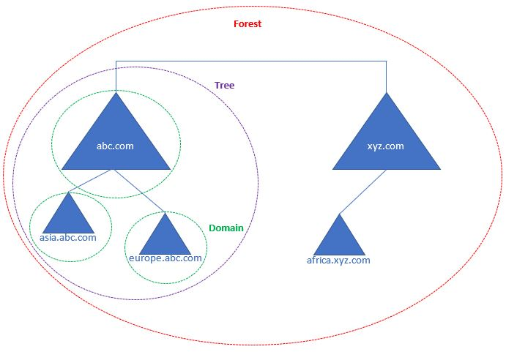
Forest Tree Domain
Notes:
Easily organize users into groups and subgroups for permissions
Quickly manage file access

Slide 11
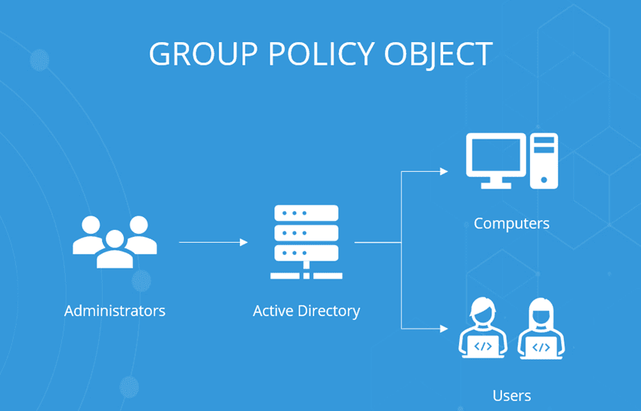
GPO

Slide 12

IIS

