Slide 1



Real Estate Market in “Ile de France”
Jan.11.2023
Amandine Rolland, Nathalie Guillou, Karim Mouzai, Zied Jouini

Slide 2
Context and goals
Company named after our Data Science Guru Peter StoneWall and his associate
MBaye Citizen Kane
Provide a complete dashboard with a global analysis of the real estate market in “Île-de-France”.
Develop a Machine Learning model capable of predicting housing prices

Slide 3





Technologies, techniques and tools
Platforms : AWS Cloud
Storage : Amazon S3
Data Collection : Open Data, webscrapping BeautifulSoup
Data cleaning & analysis : Python x Amazon Sagemaker Studio, Pandas
Modeling & Machine Learning : Scikit-Learn, Streamlit
Amazon Sagemaker Canvas
Data Visualization : Microsoft Power BI

Slide 4
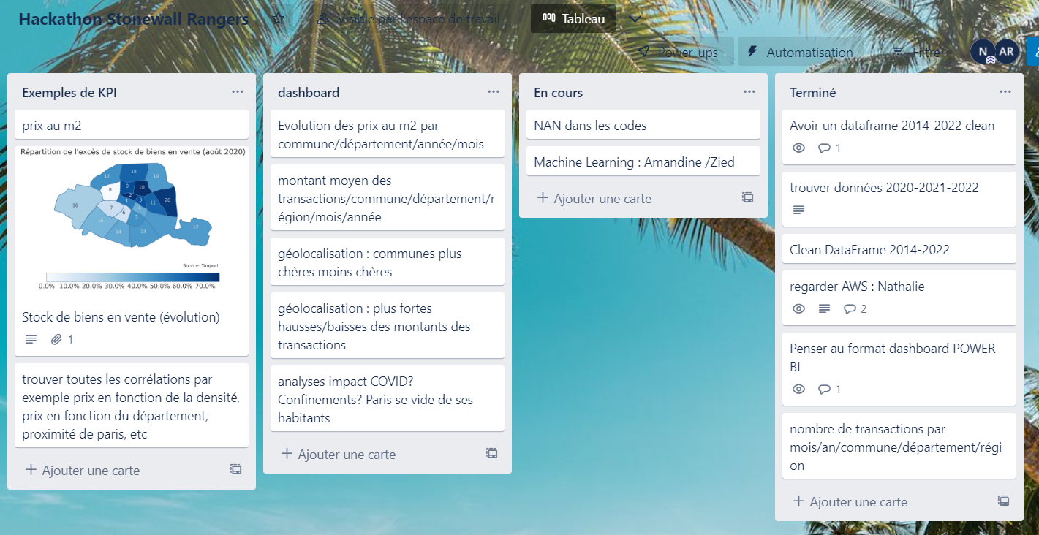
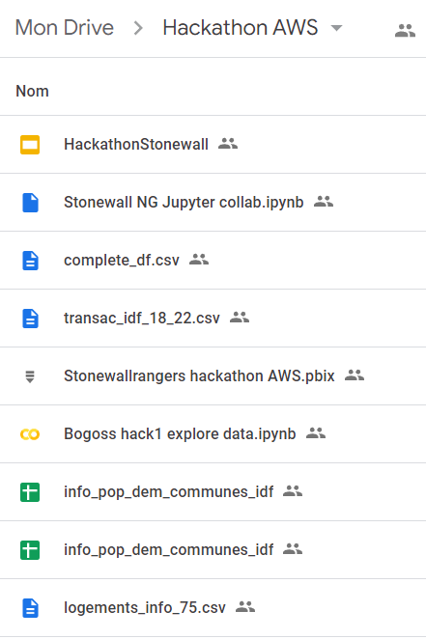
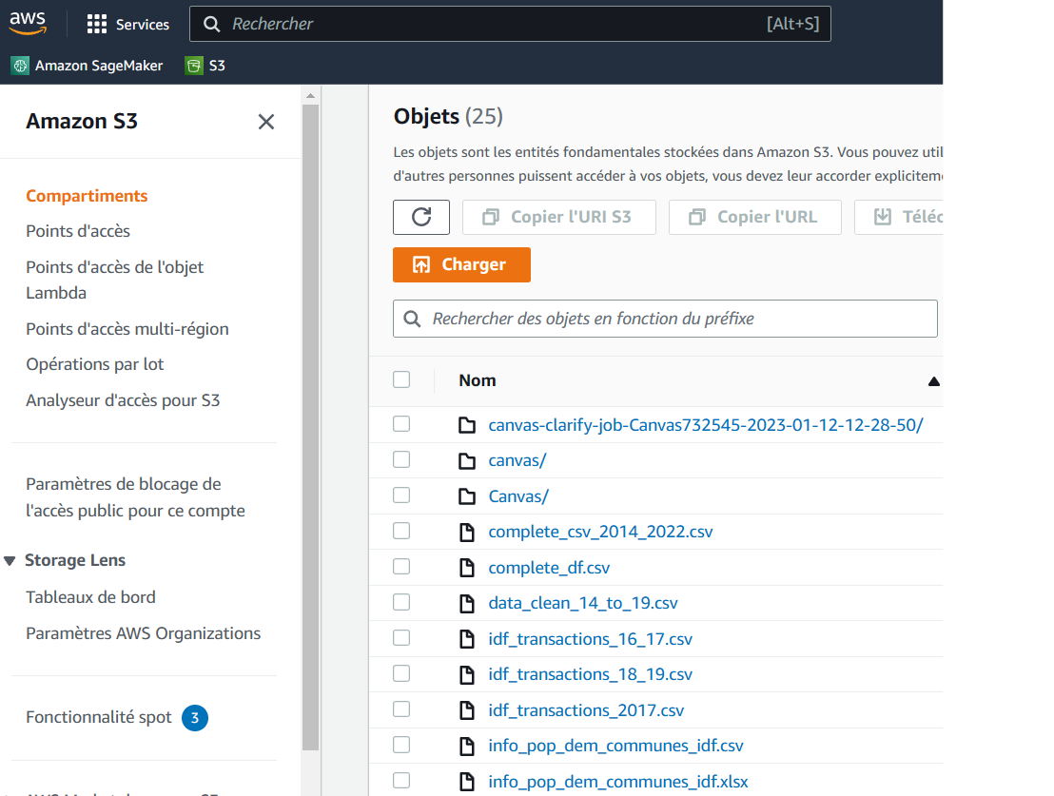

Collaborative work spaces
Trello Google Drive AWS S3
Jump to dashboard

Slide 5
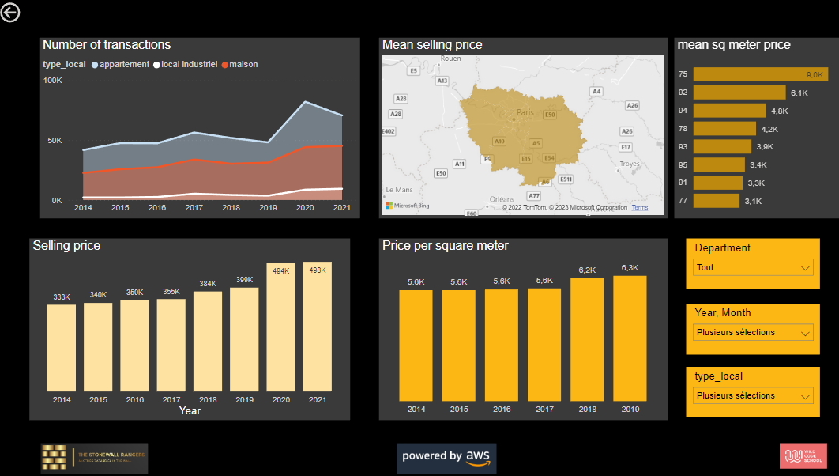
Dashboard

Slide 6
Prediction models
KNN regression : to fill NaN : nombre de pièces
Decision Tree Regression : price per square m (overfitting). Prix/m2
Use of Randomized Search to fine tune our model
Linear regression : to predict selling price
But the best prediction model would have been Time Series

Slide 7
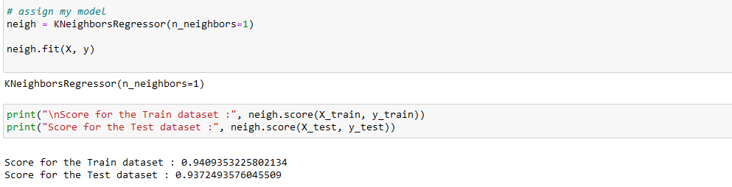
Prediction models : KNN Regressor / nb rooms

Slide 8
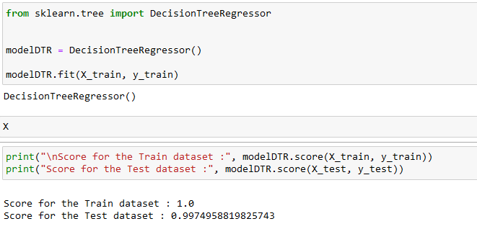
Prediction models : Decision Tree Regressor price/m2

Slide 9
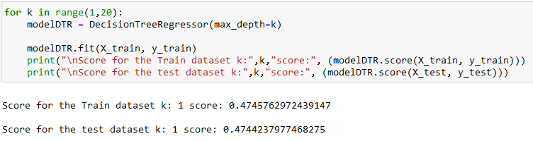

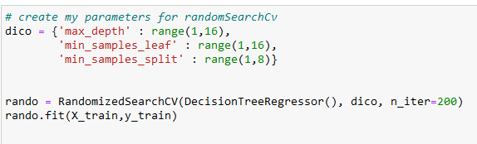
Fine tune with Randomized Search
Best for k=14

Slide 10

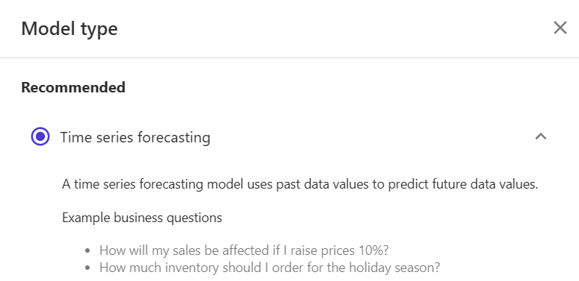
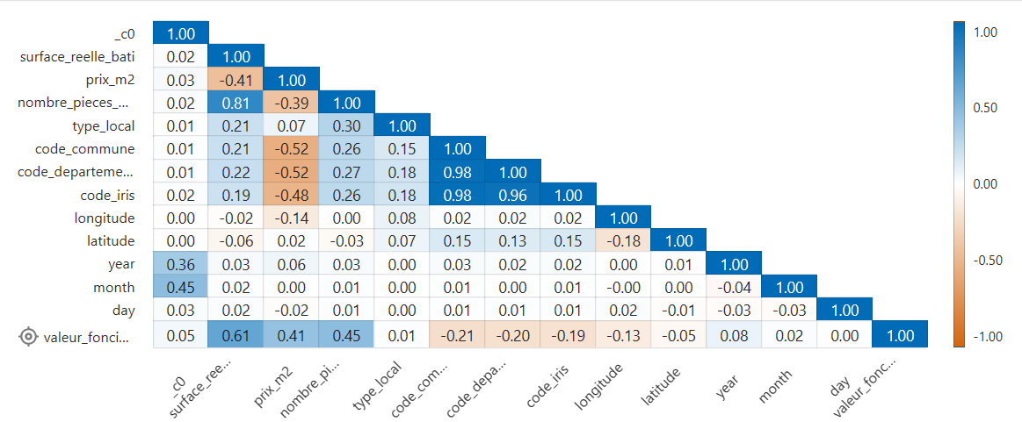
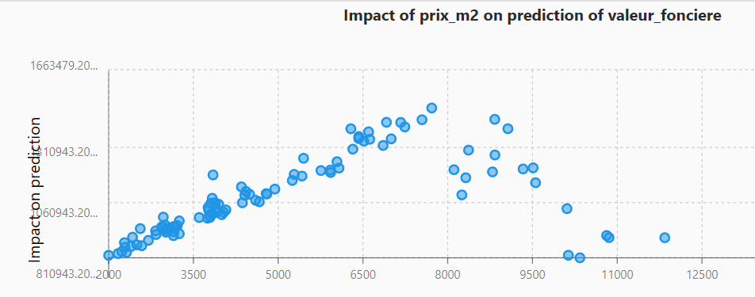
Sagemaker Canvas capabilities

Slide 11
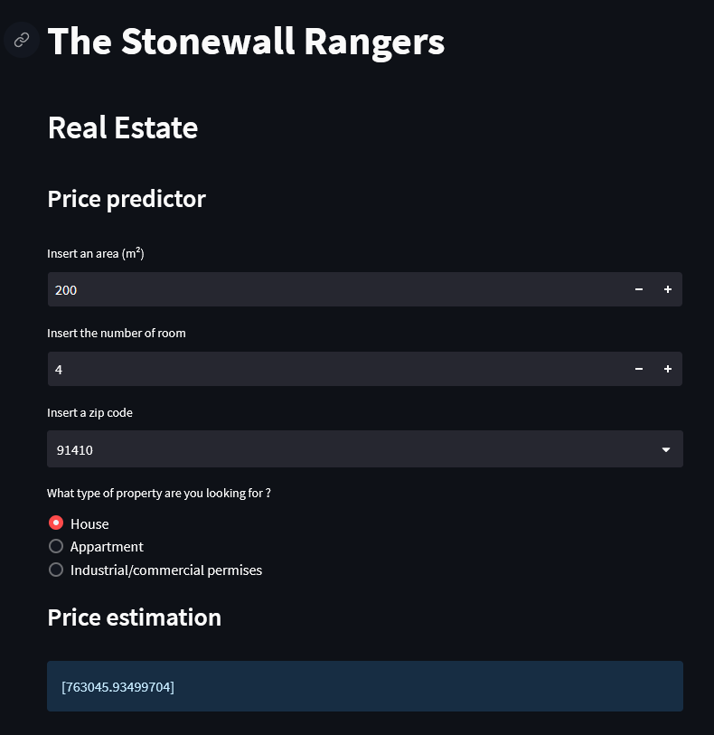
Predictions
Missing values df 2014-2019

Slide 12
Life of the project
Agile & Scrum methods
80% of the time on collecting and cleaning data
Poor quality of the data and difficulty to harmonize sources
Missing Values
Faced technical limits (kernel outage, deepnote DOS, Error 403)
Difficulties to fine tune the model
Trial of AWS platform and ML products
better scalability
better reliability
faster execution time
increase in calculation horsepower

Slide 13


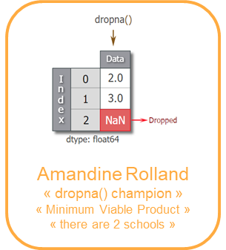

Questions ? Ask our team !

