Slide 1
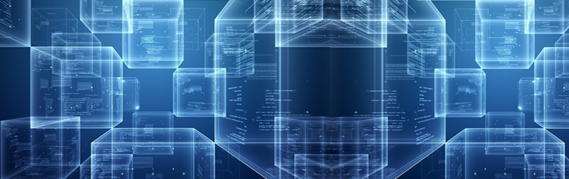


5. Blockchain Payment Channels: Introduction
Melanie Swan
Philosophy, Purdue University
melanie@BlockchainStudies.org
Slides: http://slideshare.net/LaBlogga

Slide 2
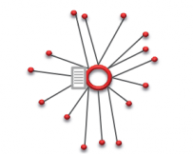
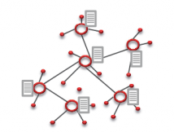
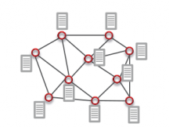
Distributed Networks
Radical implication: every node is a peer who can provide services to other peers
Centralized
Decentralized (based on hubs)
Distributed
(based on peers)
Source: http://www.amazon.com/Bitcoin-Blueprint-New-World-Currency/dp/1491920491

Slide 3
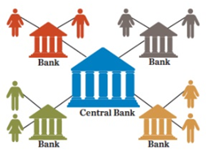
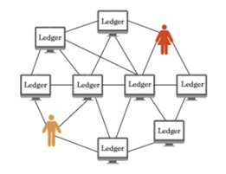
P2P Network Nodes provide services
Nodes deliver services to others, for a small fee
Transaction ledger hosting (~10,000 Bitcoind nodes)
Transaction confirmation and logging (mining)
News services (“decentralized Reddit”: Steemit, Yours)
Banking services (payment channels (netting offsets))
“Classic” Banking
Peer Banking
Centralized bank tracks payments between clients
Network nodes store transaction record settled by many individuals
Source: http://www.amazon.com/Bitcoin-Blueprint-New-World-Currency/dp/1491920491

Slide 4
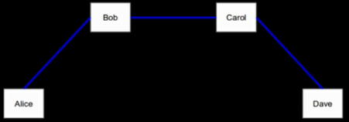
What is a Payment Channel?
One-to-one communication with another party
Anyone-to-anyone payments on any monetary system
Small group payments
Alice, Bob, bartender
Multi-hop payment graph
Smart network instantiates banking services directly

Slide 5

Payment Channel impact
Digitized money and payments, and activity securely forward-committed in payment contracts
Implication: economy could settle on the basis of net rather than gross flows
A net-clearings contracts-for-difference economy could rethink crippling monolithic debt structures with streaming money disgorged in much smaller chunks more closely tied to costs and repayment possibilities
Pre-paid consumption and 30-60-90 day vendor credit terms models could be offset to facilitate a directed payment graph economy of just-in-time money

Slide 6
5. Blockchain Payment Channels: Introduction
Melanie Swan
Philosophy, Purdue University
melanie@BlockchainStudies.org
Slides: http://slideshare.net/LaBlogga

