Slide 1


Exploitation notes on CVE-2014-0160

Slide 2
Exploitation notes on CVE-2014-0160
Heartbleed <3
The vulnerability is announced to the world 7th April 2014 by a website, OpenSSL Security Advisory and OpenSSL 1.0.1g release.
Discovered by Riku, Antti & Matti and Neel Mehta.
I searched the page for a web cart.
Shortly the next day ….
Jared Stafford released “ssltest.py”
Security community scrambled to fix.

Slide 3
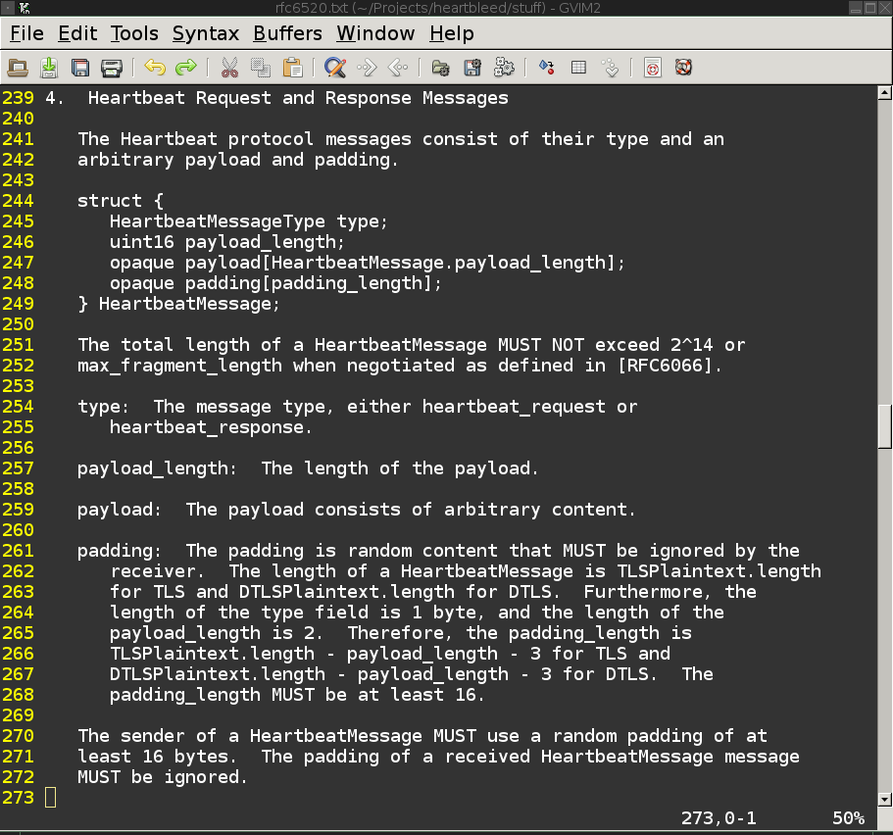
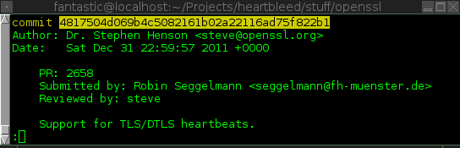
Exploitation notes on CVE-2014-0160
RFC-6520 Heartbeat Extension
Bug introduced to the world NYE 2011 during implementation of RFC-6520 in OpenSSL 1.0.1
Enabled by default in OpenSSL 1.0.1
Fixed in OpenSSL 1.0.1g & OpenSSL 1.0.2-beta1 still vulnerable – (git has fix.)
If you run beta code on production servers…

Slide 4
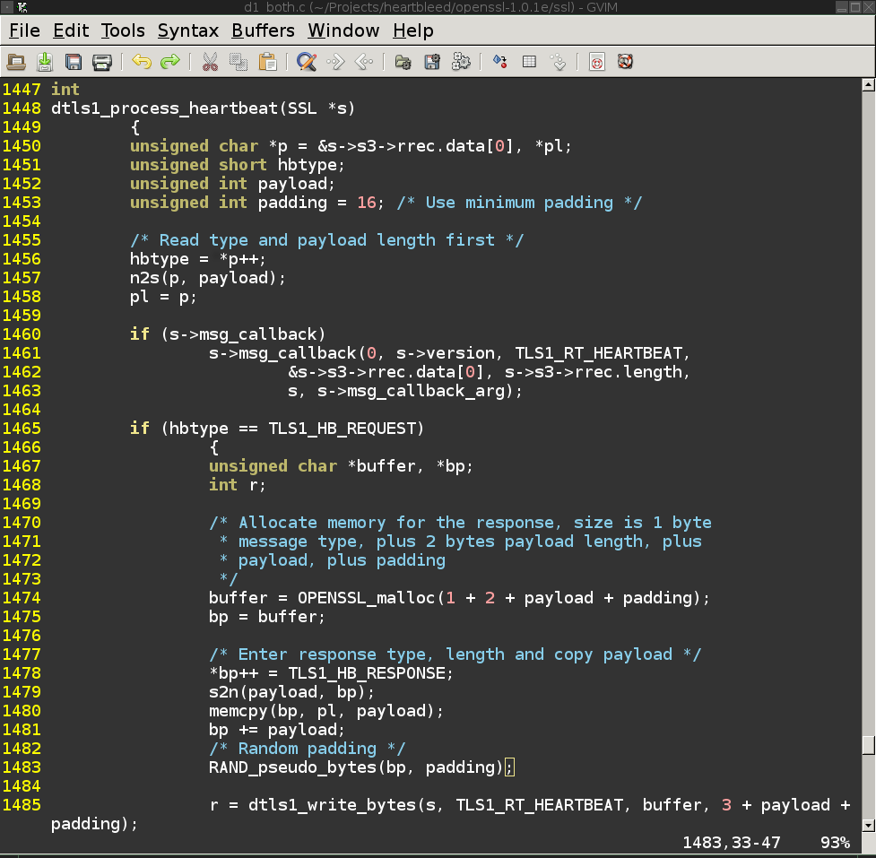
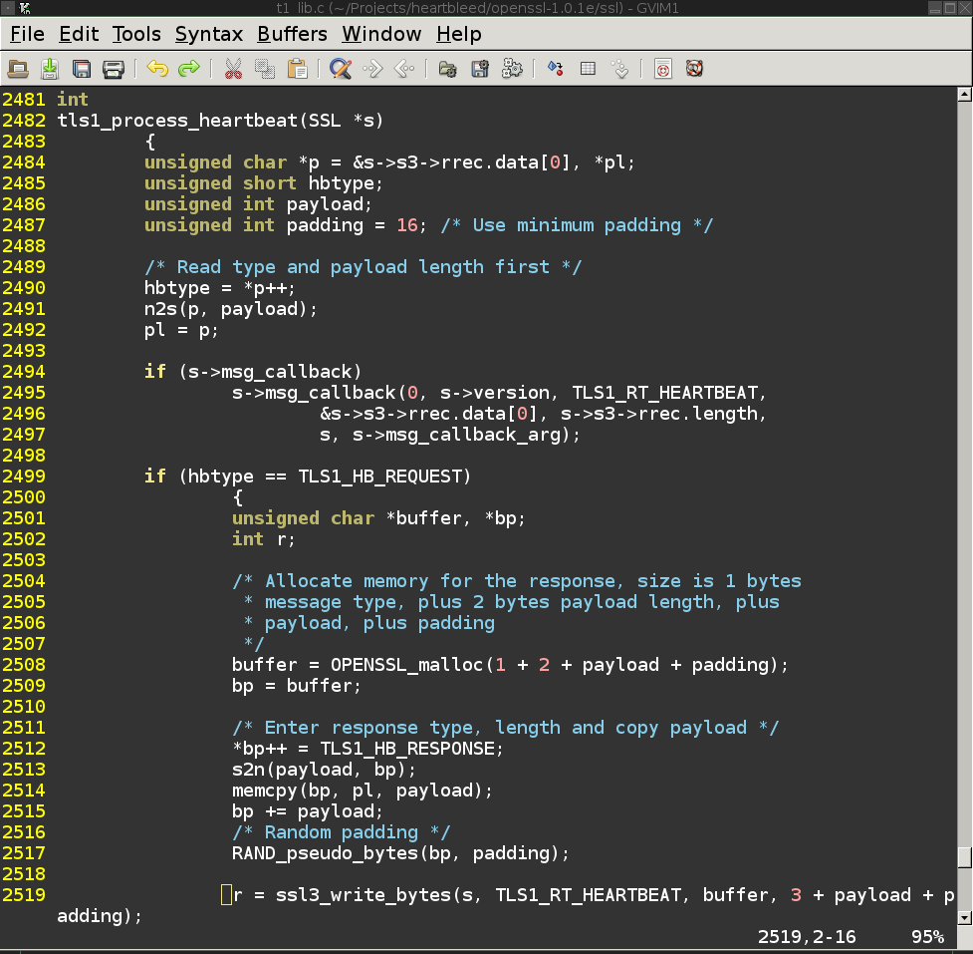
Exploitation notes on CVE-2014-0160
Vulnerability

Slide 5
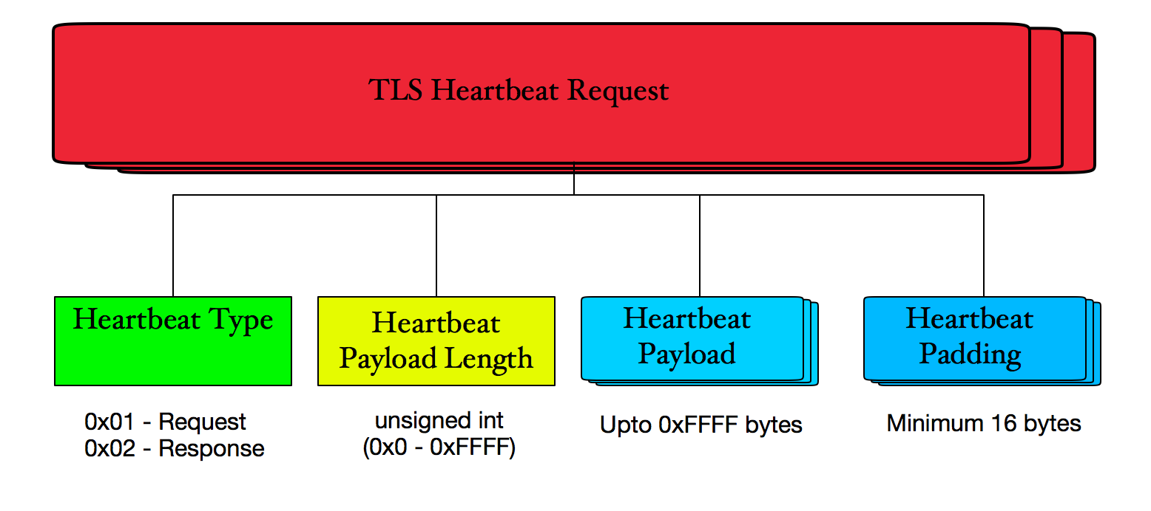
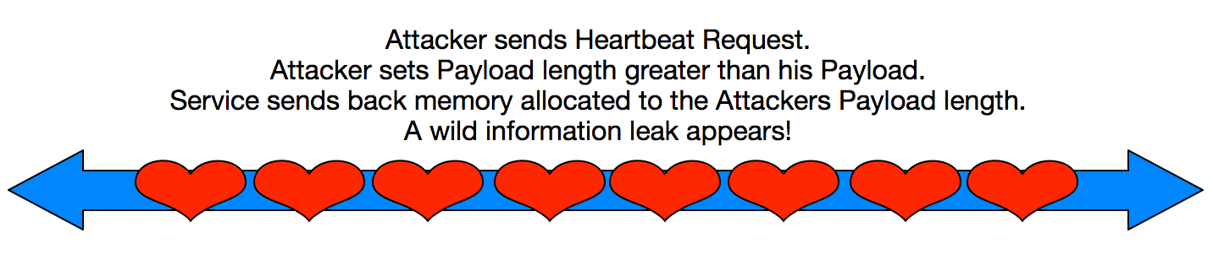
Exploitation notes on CVE-2014-0160
How does it work?

Slide 6
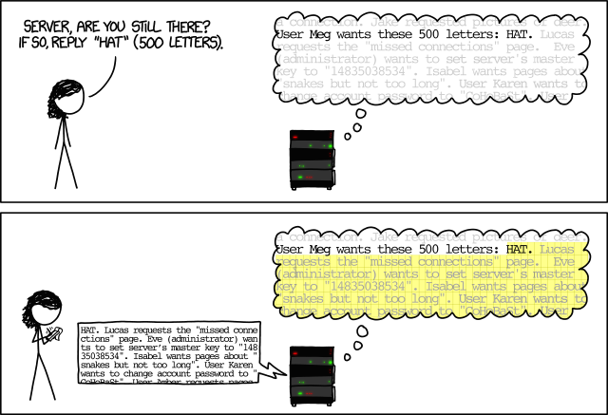
Exploitation notes on CVE-2014-0160
How does it work?

Slide 7
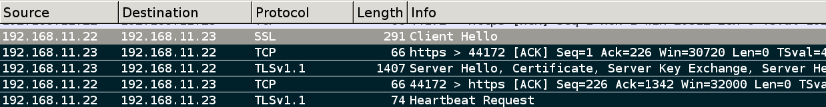
Exploitation notes on CVE-2014-0160
Let the games commence.
Sites ranging from the FBI, Russian Standard Bank, Yahoo!, OpenSSL, Belgian Intelligence Service and many more shown as leaking data.
Screen shots of “ssltest.py” dumping 16384 bytes of heap memory began to appear on social media sites. The content’s of the memory were alarming.
IDS/IPS and Security vendors began to release detection signatures & scanners.
Media frenzy ensued spreading confusing information e.g. #HeartbleedVirus
The vulnerability was still not fully realized. Misconceptions abound.

Slide 8
Exploitation notes on CVE-2014-0160
On The Wire
This is an unencrypted heartbleed attack transmitted on the wire.
The response is returned in unencrypted packets.

Slide 9
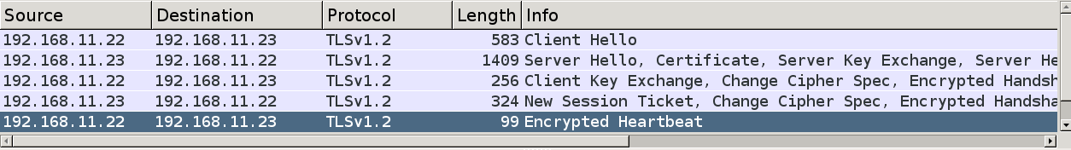
Exploitation notes on CVE-2014-0160
Attack SSL, Encrypt with SSL!
I wrote a stand-alone exploit in C using OpenSSL library to transmit the Heartbeat request in encrypted packet.
This was intentionally to bypass IPS/IDS signatures – it worked!
Encrypting attacks on OpenSSL with OpenSSL makes it difficult to detect….
IDS/IPS vendors began to develop alternative detection signatures.

Slide 10
Exploitation notes on CVE-2014-0160
On The Wire
This is an encrypted heartbleed attack transmitted on the wire.
The response is returned in encrypted packets.

Slide 11
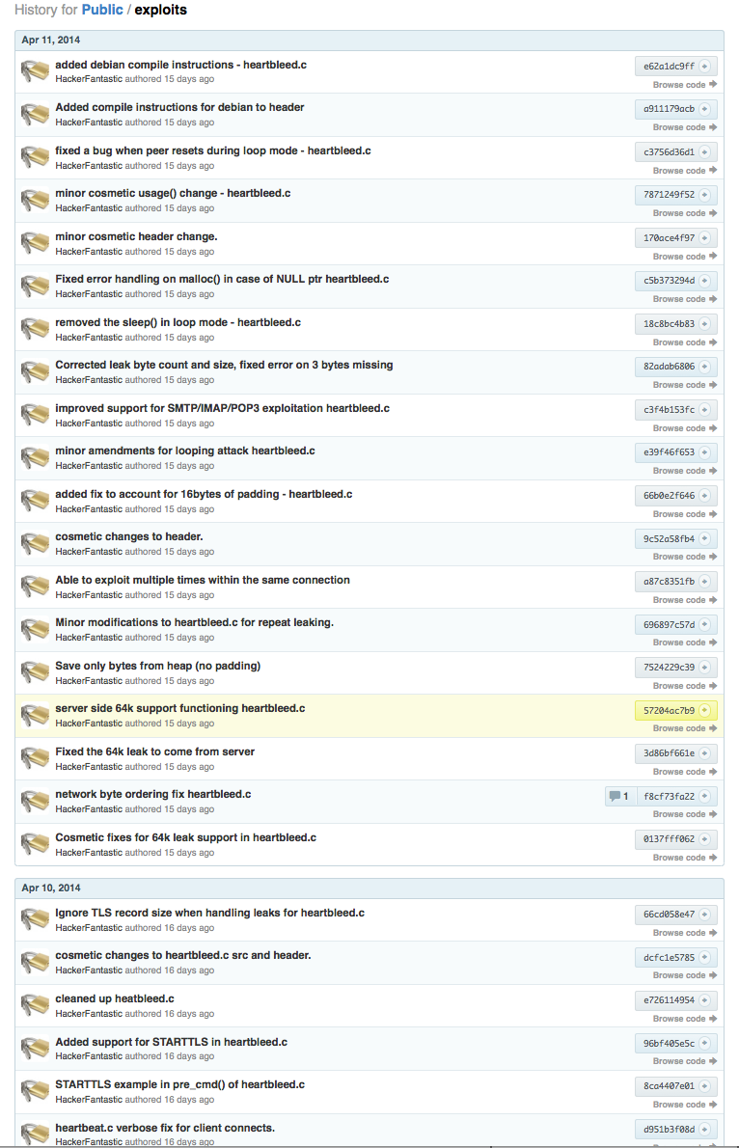
Exploitation notes on CVE-2014-0160
Exploit Fails & Lessons
I continued to push updates during the exploit development process.
I learnt not to commit code changes late at night without review and testing… No, I am not *THAT* OpenSSL developer!
Internet is awesome, people began to submit compile instructions for different Linux platforms. Builds on most Linux/OS-X.
Ayman Sagy added needed DTLS support.
Re-use the code! Patches are welcome!

Slide 12
Exploitation notes on CVE-2014-0160
RSA Private Key Recovery
Cloudflare announce secret key challenge for heartbleed.
Provide nginx-1.5.13 web server linked against OpenSSL 1.0.1.f on Ubuntu 13.10 x86_64.
Fedor Indutny solved the challenge first, others quickly followed.
“include/openssl/rsa.h:struct rsa_st” holds RSA variables (p & q) in memory.
RSA n := pq. We can use n to calculate if prime in memory is valid.
Search for key size primes in memory leak and use to determine remaining prime from modulo n (q % n == 0) – with p & q we generate RSA private key.

Slide 13
Exploitation notes on CVE-2014-0160
RSA Private Key Recovery
Obtain certificate “openssl s_client -connect 192.168.11.23:443 < http-get.txt | grep BEGIN –A n > out.pem”
Improved “keyscan.py” by Einar Otto Stangvik to produce valid RSA private keys instead of counting primes.
Run “keyscan.py” on a memory dump to test possible values against the certificate modulus n to identify if modulo is 0. The value and its division result by n are checked and if primes we have p & q.
We then generate the RSA private key from the prime values.
Metasploit module also supports dumping private keys.

Slide 14
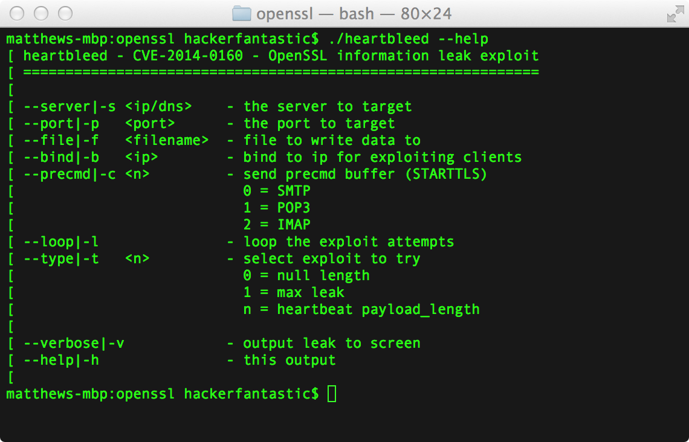
Exploitation notes on CVE-2014-0160
Heartbleed.c
Exploit works against vulnerable OpenSSL servers and clients.
Leaks upto 65535 bytes of heap data and 16 bytes of random padding.
Can re-use connection.
STARTTLS support.
Multiple SSL protocols.
Multiple ciphers.
Saves leak to file.

Slide 15
Exploitation notes on CVE-2014-0160
Demo
Demo.

Slide 16
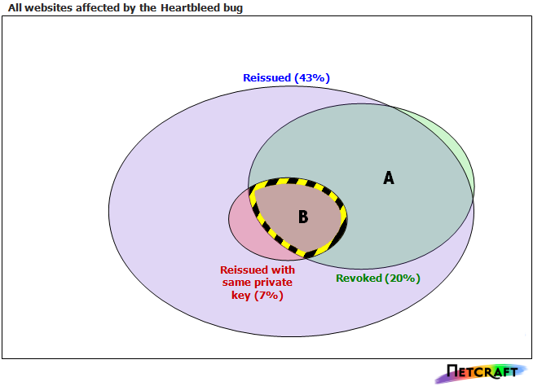
Exploitation notes on CVE-2014-0160
Netcraft post-heartbleed data

Slide 17
Exploitation notes on CVE-2014-0160
Conclusions
CVE-2014-0160 will exist in appliances & infrastructure for some time.
Affected servers and devices should be considered compromised.
Non-web services such as IMAP/SMTP/POP3 etc. are equally exposed.
Your IDS/IPS cannot always save you.
Enable Perfect Forward Secrecy.
Enable Two-Factor Authentication (e.g. X.509).
E-mail: matthew@mdsec.co.uk
Twitter: @HackerFantastic
https://github.com/hackerfantastic/public

