Slide 1
GSM Hacking
Wireless Mobile Phone Communication
30th January 2014

Slide 2
Introduction to GSM
June 2008 – 2.9 BILLION subscribers use GSM.
Replaced Analogue “Total Access Communication System” in the UK. (TACS)
GSM is a European Wide Standard started in 1982 by Groupe Spécial Mobile.
Digital standard with new Security attempting to address losses due to Fraud.
How vulnerable are GSM communications today?

Slide 3
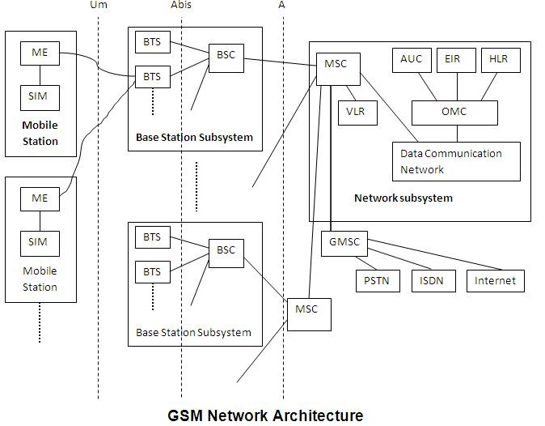
GSM Architecture – An Overview
Mobile Station is your phone.
BSS provides the air interface between network & phone.
Network Switching Subsystem (NSS) provides authentication, identity, billing and more.
The architecture here is a typical GSM environment.

Slide 4

What’s in a phone? Mobile Station (MS).
International mobile station equipment identity (IMEI)
Contains MS manufacturer & date made.
SIM card contains subscriber information.
International mobile subscriber identity (IMSI).
Mobile Country Code – MCC - 3 digits.
Mobile Network Code – MNC – 2 digits.
Mobile Subscriber Identification Number – MSIN – (max 10).
SIM card also holds encryption keys.
Your phone contains a baseband processor and RTOS used by GSM.

Slide 5
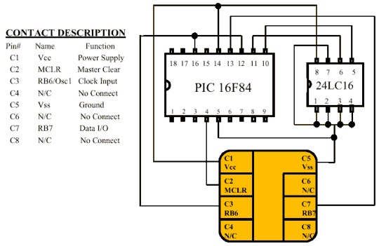
What is a SIM card?
Described in GSM 11.14.
Subscriber Identity Module.
Stores the IMSI and Ki key.
Ki key is needed for network authentication & Air encryption.
Programmable card can be used which has a writeable Ki key.
GSM test cards with a writeable Ki key can be bought online.

Slide 6
ISO7816, SIM Toolkit & weaknesses?
ISO7816 defines a physical smart card standard.
SIM Application Toolkit (STK) is implemented by GSM smart cards.
COMP128v1 is an encryption algorithm found to be flawed.
A “stop” condition was found that allows Ki to be brute forced.
COMP128v1 attack takes 12-24 hours and requires physical card.
COMP128v3 is used more widely today and COMP128v1 is rare.
Chinese vendors sell cheap COMP128v1 multi-SIM cards & cloner.
GSM application provides authentication APDU's.
For more information on SIM attacks THC have a SIM Toolkit Research Group project that contains a lot more information!

Slide 7
What’s a Base Transceiver System (BTS)?
Transmitter and receiver equipment, such as antennas and amplifiers.
Has components for doing digital signal processing (DSP)
Contains functions for Radio Resource management.
Provides the air (UM) interface to a MS.
This is part of a typical “cell tower” that is used by GSM.
BTS provides the radio signalling between a network and phone.
Base Station Subsystem (BSS) has additional component Base Station Controller that provides logic & intelligence.

Slide 8
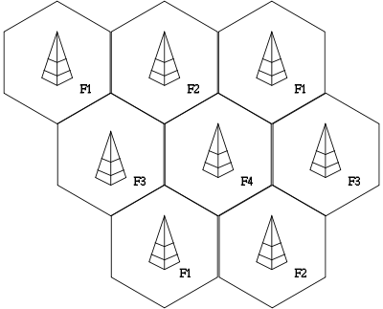
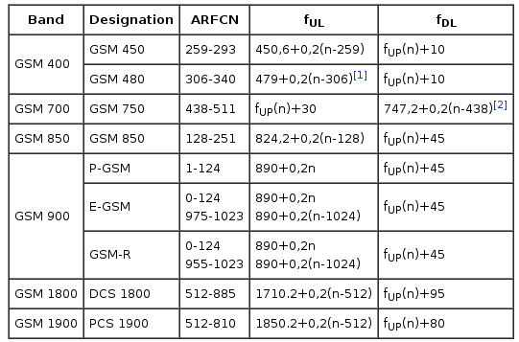
Radio & Cellular?
The spectrum is divided into “channels” with uplink and downlink frequencies.
GSM uses Absolute Radio Frequency Channel Number (ARFCN).
Cellular Network means channels can be re-used within different spatial areas.
This is how a small number of frequencies can provide a national network!

Slide 9
Radio & Cellular?
GSM communicates using Time Division Multiple Access / Frequency Division Multiple Access (TDMA/FDMA) principles.
Space Division Multiple Access gives the cellular concept.
Traffic is transmitted as “bursts”.
Radio modulation is using Gaussian Minimum Shift Keying (GMSK).

Slide 10
Network Switching Subsystem?
The GSM core network components often not visible to attacker.
Mobile Switching Centre (MSC).
Home Locality Registrar (HLR).
Visitor Locality Registrar (VLR).
Equipment Identity Registrar (EIR).
These are components or databases that handle subscribers information, IMSI/encryption keys and perform processes like billing.
Also where the call switching and routing takes place and connecting to other networks e.g. PSTN.

Slide 11
GSM Logical Channels
GSM implements logical channels to allow for signalling between handset and network.
There is a defined Traffic Channel (TCH) – Full-rate and Half-rate channels are available as TCH/F (Bm), TCH/H (Lm).
There are Signalling channels (Dm).
Many exploitable weaknesses in GSM are due to “inband” signalling.
This same weakness is what allows phreaker “blue boxes” to function and the same classification created “format string attacks.”
History repeats itself.

Slide 12
Broadcast Control Channel - BCH
The BCH is used by a MS to synchronize it’s oscillator and frequency with the BTS.
The BCH consists of sub-channels that assist with this process.
Broadcast Control - BCCH
Frequency Correction - FCCH
Synchronization - SCH
The channels are used during the preliminary stages of a MS being powered on and are integral part of “getting a signal”.

Slide 13
Common Control Channel - CCCH
The CCCH is used by MS and BTS for communicating requests for resources with network and handset.
Also has a number of sub-channels responsible for tasks such as indicating that a subscriber is attempting to make a call.
Random Access Channel - RACH
Access Grant Channel - AGCH
Paging Channel - PCH
Notification Channel - NCH
Temporary Mobile Subscriber Identity (TMSI) is used to help prevent tracking of a GSM user and can be frequently changed.
A TMSI access table exists on a BTS with a configurable lifetime.

Slide 14
Dedicated Control Channels - DCCH
The DCCH and it’s associated sub-channels perform authentication requests, cipher selection & signalling of call completion.
Standalone dedicated control - SDCCH
Slow associated control - SACCH
Fast associated control – FACCH
Summary of the three control channels and purpose of each.
Attacker could exploit GSM signalling weaknesses to access your data. We will look at this in more detail.

Slide 15
What about Over-the-Air Encryption?
A number of over-the-air encryption algorithms exist. These are used to encrypt *some* of the GSM logical channels data (such as TCH).
A5/1 – publicly broken, rainbow tables exist.
A5/2 – offers no real security.
A5/3 – KASUMI Cipher, although some man-in-the-middle attacks are known – it has not yet been publicly broken in GSM.
A3/A8 - used during the authentication process.
Attacker can attempt to “passively” analyse traffic looking for weak encryption or man-in-the-middle attacks to access data.

Slide 16
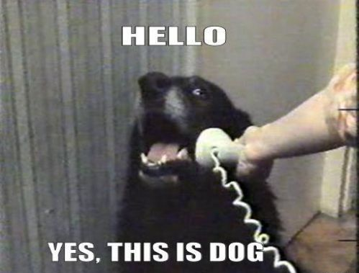
That was a lot of Theory!
The GSM standards are thousands of documents.
There are dozens of great books that can help in your learning.
Let’s take a look at some of the more practical and interesting parts of GSM.
If you were an attacker – how do you start attacking?

Slide 17
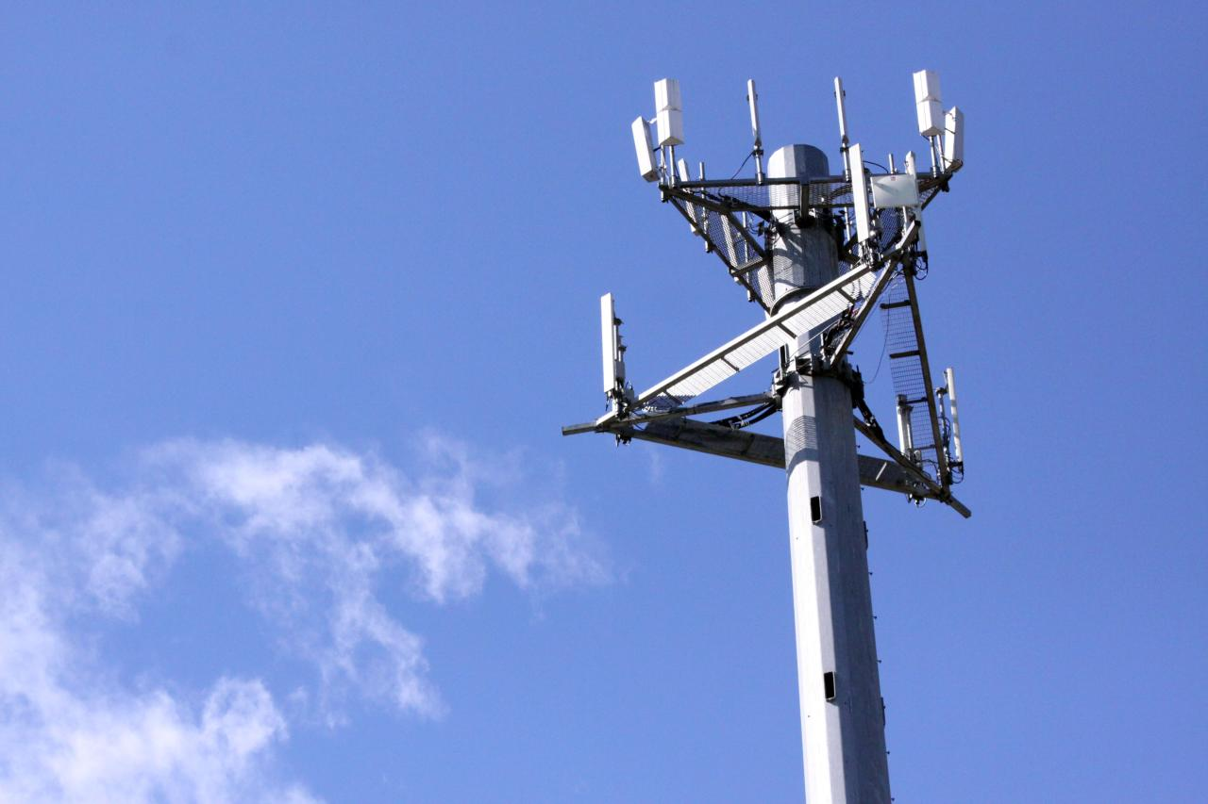
Cell Site Diagnostics!
Nokia Netmonitor
Dedicated Hardware
Osmocom-BB
Make your own!

Slide 18
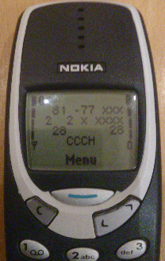
Nokia Netmonitor
Nokia shipped diagnostic tool in early phones.
Can be enabled on phone such as 3310 using cable.
Provides a cellular diagnostic tool!
ARFCN identification!
Signalling channel display!
Traffic capture!
Very cool “feature” of Nokia ;)

Slide 19
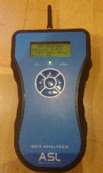
Dedicated Test Hardware
eBay is your friend.
GSM testing hardware prices vary wildly.
Open-source tools are now more flexible.
GSM testing hardware is often not very featured.
The price of dedicated hardware can be very high.

Slide 20
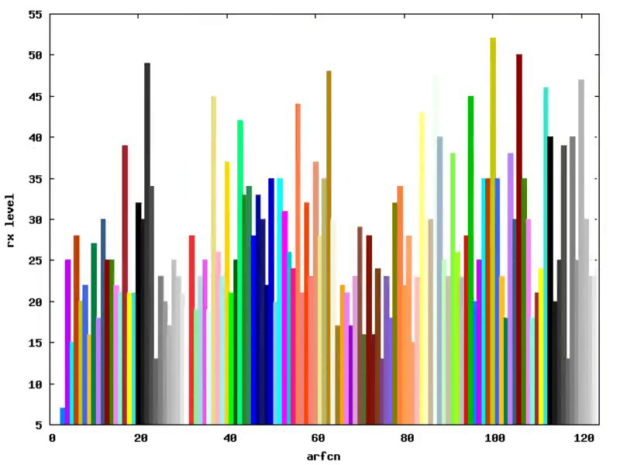
Osmocom-bb & GNU-Plot – make your own tools!
Osmocom-bb allows you to write tools for MS baseband.
Lots of useful diagnostics already available in the public repository.
You can extend the code to visually represent the GSM spectrum or perform more detailed analysis of a GSM cell tower.
Requires a <£30 phone to use.

Slide 21
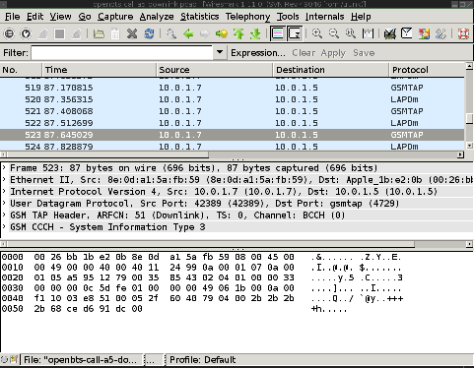
GSMTAP
Useful to debug the radio interface.
GSMTAP encapsulates RF information and transmits it in a UDP encapsulated packet.
This allows us to “see” the air interface traffic from a BTS or MS.
Extremely useful capability when analysing GSM.

Slide 22
Mobile Phone – Power-On Process
MS starts a search for BCCH carriers performing RSSI measurements.
After identifying the BCCH, the phone probes for presence of FCCH.
The phone “syncs” and obtains information about the BTS it has identified.
The phone now knows to monitor “neighbour cells” it has decoded from the transmission.
This process is what is exploited by IMSI capture devices and fake BTS attack tools.

Slide 23
IMSI Capture & Detection
During a Public Land Network Mobile (PLNM) Search(PLNMS) this is trivial. Only performed during MS Power-on & if no service can be found.
MS has path loss criterion C1 and reselection criterion C2. These are dynamic variables used by the phone to determine if a “neighbour cell” has better radio conditions. These variables are taken dynamically and frequently.
Manipulating C1 and C2 can force an MS to join our BTS without requiring the phone to perform a PLMNS.
The network can also request an IMEI during this update location request.

Slide 24
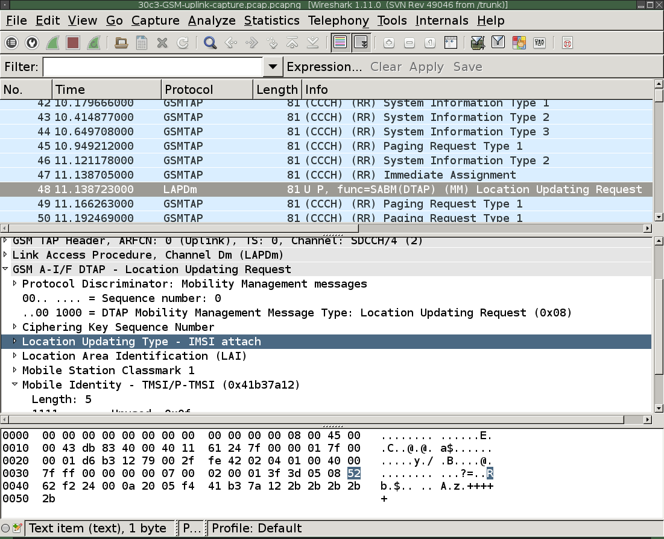
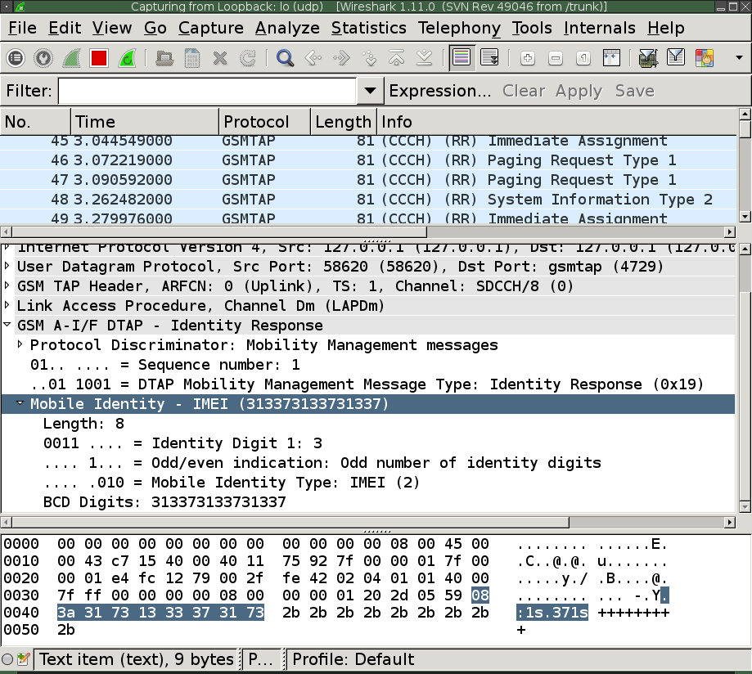
IMSI Capture – Packet Analysis

Slide 25
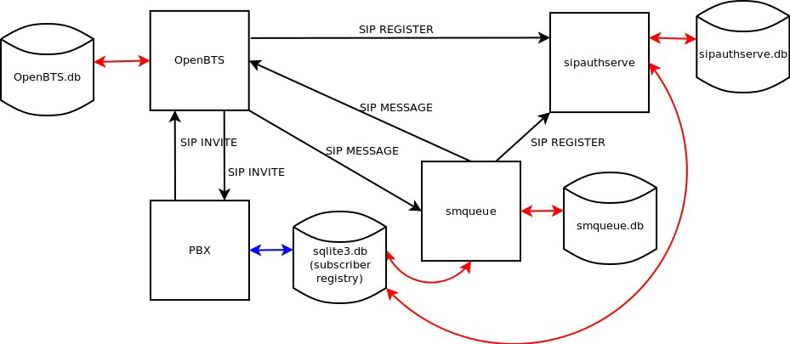
OpenBTS - Architecture

Slide 26
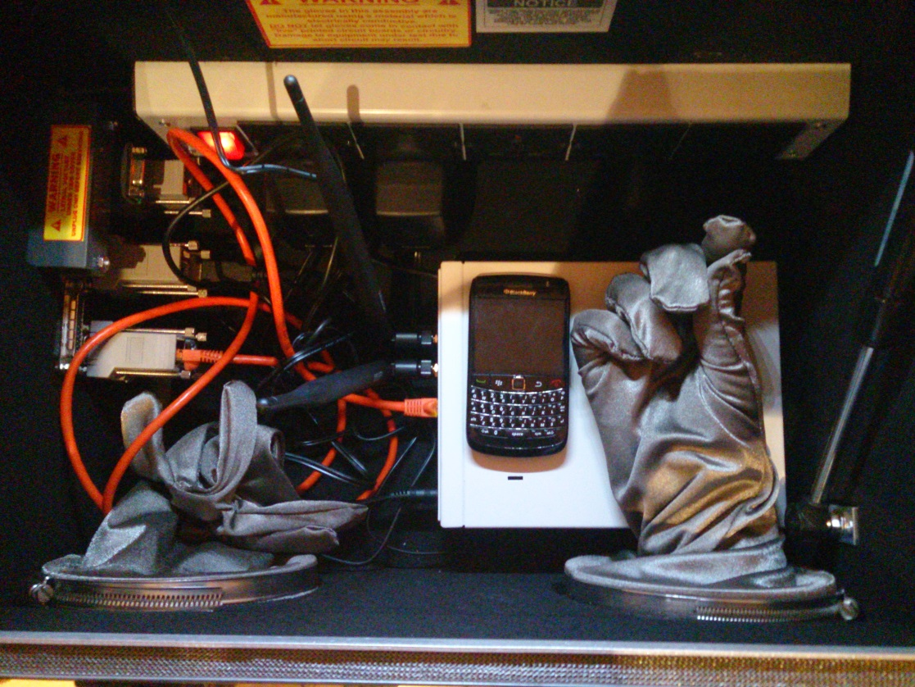
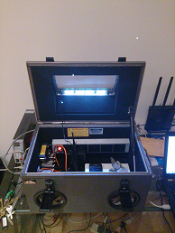
RF shielding - (R&D at MWR)

Slide 27
GreedyBTSv3.img - USRP E100 firmware image.
OpenBTS w/Real-Time Asterisk configured to run on a USRP E100.
I modified and built several packages from source to improve support for the E100 platform.
Minor patches to OpenBTS to remove unwanted features such as message alerting.
A console interface script is provided to simplify the process of attacking an MS from a BTS by watching syslog and creating SQLite entries.
Any captured phone call & SMS are “autorecorded” to E100.
If internet is available to the E100, GPRS and data is auto configured. Packet analysis tools (libpcap/tcpdump) and netfilter support are also compiled into the image.
Fully embedded solution requires only an E100 and network connection.

Slide 28
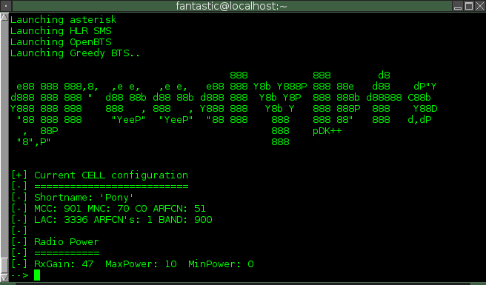

Slide 29

Greedy BTS – Live Demo.

Slide 30
MS -> BTS Active Attacks
Osmocom-bb allows for full control of the baseband!
Attacker can attempt MS -> BTS injection attacks.
Osmocom-bb provides a full-featured console mobile phone app!
You can perform uplink sniffing as well as injection of traffic.
A very flexible tool that can be repurposed for attack and analysis.

Slide 31
RACH & TMSI Paging Attacks
Random Access requests have a finite resource.
Attacker can continually request resources via RACH preventing users being able to place new calls once all available resources are consumed.
TMSI is vulnerable to a race condition when the BTS is paging, attacker can answer all pages preventing legitimate communication.
An attacker responds to pages made by the BTS to identify a particular phone causing the original request to be unanswered.
Both attacks can be implemented in osmocom-bb.
Both attacks could be used to perform a “DoS” of a BTS.

Slide 32
Passive & Sniffing Attacks
GNU/Radio is used to capture the RF of a GSM ARFCN.
GSM receiver and toolkit exists for doing capture of GSM bursts & decoding of the data.
Software Defined Radio is drastically reducing in price point.
£20< RTLSDR dongles can be used to capture GSM traffic.
Purely passive analysis allows for identification of call requests. TCH channel uses encryption.
Kraken tool can decrypt A5/1, requires 1.6TB rainbow tables.
A5/2 is very weak encryption & rarely enabled.

Slide 33
Conclusion
Information sent over your mobile phone may not be as secure as you think.
Detection of GSM attacks is still in it’s infancy, some tools are beginning to surface which detect greedy-BTS but they will require “active” use.
If you are transmitting sensitive information such as usernames or passwords consider using a non-wireless technology.
2G GSM technology has a number of weaknesses that means the technology cannot be trusted for sensitive data.

Slide 34
Questions
Thank you for all the hard work done by members of the open-source and security research communities in making GSM more accessible for analysis.

