Slide 1
Organizing Your Research Project: DATA
Claudia Neuhauser
University of Minnesota Informatics Institute

Slide 2
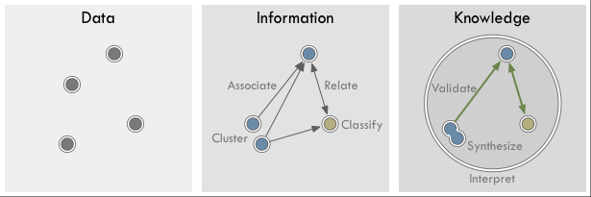
From Data to Knowledge…
Data
Text
Numbers
Images
Information
Processed data
categorization
Knowledge
Understood by the human mind
Context
Source (Image): http://www.nickdiakopoulos.com/2011/12/16/data-information-knowledge-visualization/

Slide 3
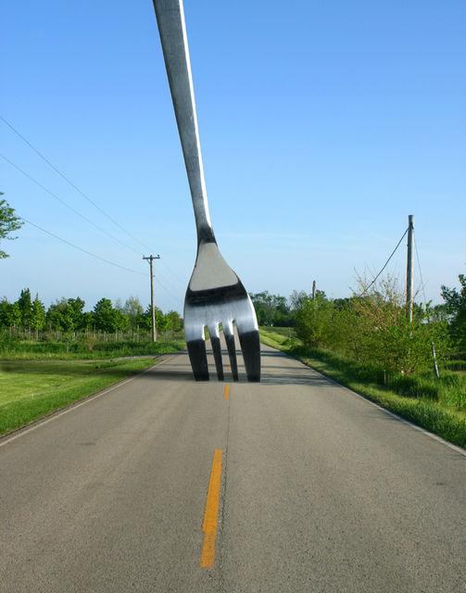
…to Decision Making
Using evidence from big (or small) data to make decisions
Education
Community engagement
Smart cities
Transportation
Energy
Precision health care
Precision agriculture
Procurement
…
Source: http://momentsinmyhead.files.wordpress.com/2010/02/fork_in_road.jpg

Slide 4

Big Data
Volume
Data size
“Each day, we create more than 70 times the amount of information in the Library of Congress.” (D. Walton, 2014)
Lots of small data…
Velocity
Streaming data from sensors
Real-time analysis
Variety
Data sources
Structured and unstructured data
http://ad-exchange.fr/wp-content/uploads/2013/06/big-data.jpg

Slide 5
Big versus Small Data
Most data are small
Similar management but different challenges
Data Life Cycle
Data Management Guide for Public Participation in Scientific Research
https://www.dataone.org/sites/all/documents/DataONE-PPSR-DataManagementGuide.pdf
Tools at the Libraries
Data Management Plan
Metadata
Repositories
https://www.lib.umn.edu/datamanagement/tools
Plan
Collect
Assure
Describe
Preserve
Discover
Integrate
Analyze
Figure Source: DataOne (https://www.dataone.org/best-practices)

Slide 6

Planning Your Research Project: Learning from Design
Treat it like a design problem
Identify gap and need
Define the problem
Ask “Why?” repeatedly so that you don’t end up solving a problem that does not fill the gap
Explore the solution space
Identify constraints
Iterate
Prototype
Excel may be a good start—use it if it does the job to get you going
More sophisticated tools may eventually be needed
Start at the end
Don’t build a database before you know what you want to do
Communication gap between data science and domain expertise
You start where you feel comfortable
Data science: build a database
Domain expert: what’s the gap in knowledge

Slide 7
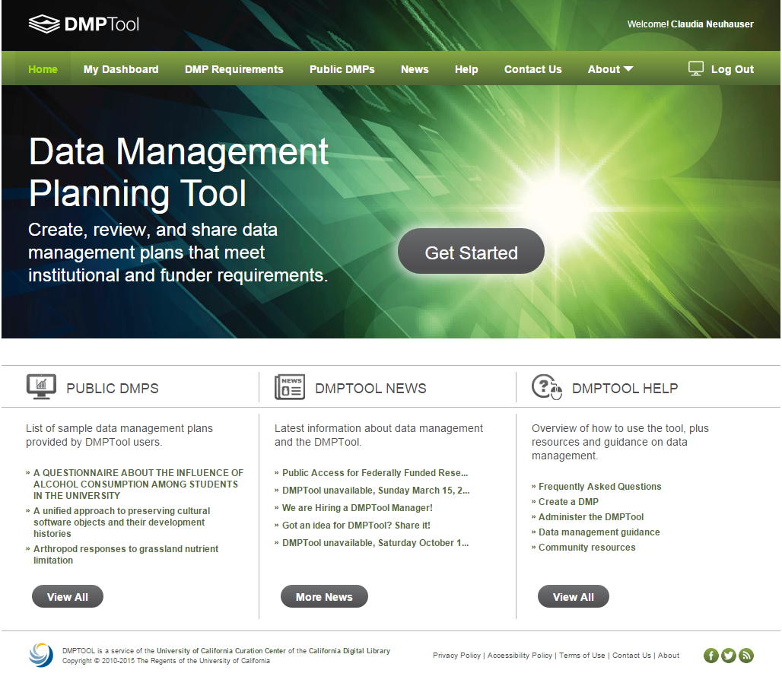
Planning Your Research Project: Managing your Data
Data management plan
Assign roles and responsibilities
Determine types of data and format
Sharing of data
Expected schedule
Method of sharing
agreements
Confidentiality of data
IRB approval
Long-term preservation
Metadata
Reusing vs. acquiring new data

Slide 8
Collaboration
Communication among team members
Trust
Integrity
Identifying roles
Project management
Personal recommendation: Check out Asana
Practical issues
Who owns the data?
Who can use the data for publications and how are team members acknowledged?
Who will access the data?
What happens if a member leaves the team?
Can different people access the data at the same time?
Who pays for data storage?
What happens to the data after the team disbands?

Slide 9
Data Processing
“80% of the work in any data project is cleaning the data.”
D.J. Patil, U.S. Chief Data Scientist
Quality control is essential
Integrating different data sets can be very difficult and time consuming
Plan for it
Metadata is essential during merging of data sets and re-use of data
Missing and incomplete data
Document what you did—you will forget the details
Data modeling
Relationships among the different data tables
Notes:
http://www.nytimes.com/2014/08/18/technology/for-big-data-scientists-hurdle-to-insights-is-janitor-work.html?_r=0

Slide 10
Analyzing Data
“It’s an absolute myth that you can send an algorithm over raw data and have insights pop up.”
Jeffrey Heer, University of Washington and co-founder of Trifacta
Don’t be afraid to explore data with user-friendly tools
Excel PowerPivot
Tableau
Be aware of erroneous patterns in your data
Multiple hypothesis testing
Notes:
http://blog.revolutionanalytics.com/2014/08/data-cleaning-is-a-critical-part-of-the-data-science-process.html

Slide 11
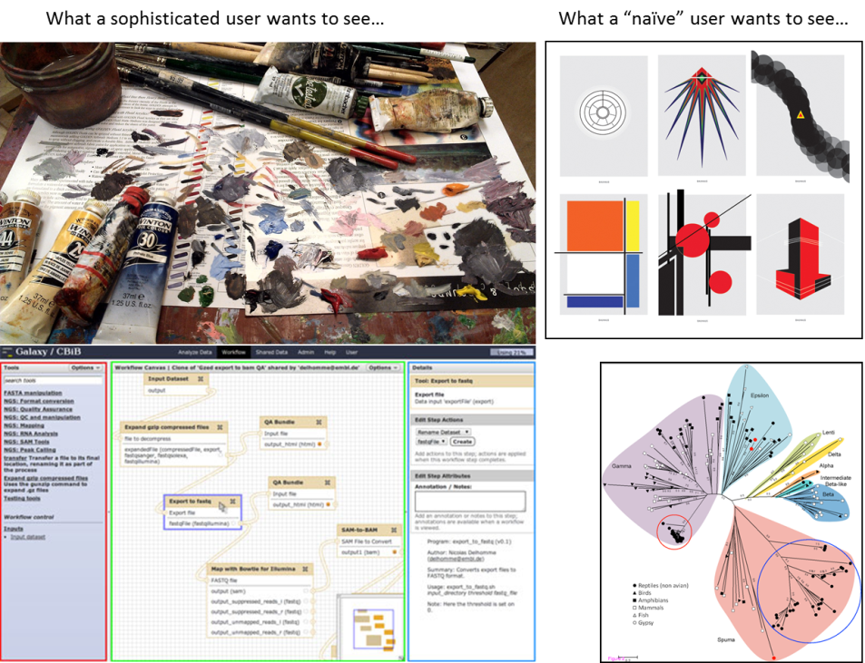
Communicating Results
What a technical user wants to see…
What a stakeholder wants to see…

Slide 12
Research Data Management Policy
New policy (January 2015)
Uwide Policy Library
Research Data Management: Archiving, Ownership, Retention, Security, Storage, and Transfer
establishes high level guidance for coordinating the institution’s efforts to satisfy the research data storage and infrastructure needs
clarifies ownership and stewardship of research data
Students data ownership similar to copyright
PI as steward of data
Use Case Categorization Scheme Committee

Slide 13
Research Data
Recorded factual material commonly accepted in the scientific or scholarly community as necessary to validate research findings, excluding preliminary analyses, drafts of scholarly or scientific work, plans for future research, peer reviews, communications with colleagues and physical objects (e.g., laboratory samples).

Slide 14
Ownership (Policy)
Unless superseded by specific terms of sponsorship or other agreements or University policy (e.g., Copyright), the University owns all research data generated or acquired by University employees (faculty and staff) or non-student trainees or fellows (not employed by the University) through research projects conducted at or under the auspices of the University of Minnesota, regardless of funding source.
Students own research data that they generate or acquire in their academic work, unless the research data are:
generated or acquired within the scope of their employment at the University;
generated or acquired through use of substantial University resources; or
subject to other agreements that supersede this right (e.g., Research Data Ownership Acknowledgment form signed by student and PI).
Research data generated or acquired by students outside of their academic work or by volunteers through research projects conducted at or under the auspices of the University of Minnesota, regardless of funding source, are owned by the University unless superseded by specific terms of sponsorship or other agreements.

Slide 15
Stewardship (Policy)
Principal Investigator (PI)
Determines what needs to be retained in sufficient detail and for an adequate period of time.
Manages access to research data.
Selects the vehicle for publication or presentation of the data.
Shares research data, including placing research data in public repositories, unless specific terms of sponsorship or other agreements supersede these rights.
Is responsible for ensuring that critical, high-value research data under their stewardship are preserved.
Educates all participants in the research project about their obligations regarding research data.
Alerts Sponsored Projects Administration (SPA) if a grant or contract may require management of research data that go beyond standard requirements.

Slide 16
Retaining and Archiving Data
PIs are responsible for ensuring that critical, high-value research data under their stewardship are preserved.
The PI is responsible for determining what needs to be retained in sufficient detail and for an adequate period of time to enable appropriate responses to questions about accuracy, authenticity, primacy, and compliance with laws and regulations governing the conduct of research.
PIs must retain research data for at least the minimum period required by applicable laws and regulations, sponsorship requirements, or other agreements. PIs may choose to retain the data beyond the minimum period, up to any deadline specified by laws, regulations or other agreements.
PIs must destroy research data when required by laws, regulations, or other agreements, on or before a specified deadline, and follow the applicable process for destroying research data

