Slide 1
Managing Chaos
poorly...

Slide 2
My expertise
“high resolution” small N data sets
Sensors
Individual outcome data
Behavioral observations
Provider outcomes
Clinical data
Test data
Satisfaction/process indicators
Single case behavioral data

Slide 3
Where does Chaos Lurk?
Small projects:
dissertation studies/single publications
Little continuity in University settings
Results need to be reproducible (collaboration, replication)
Methods and results are important within and between labs
Constant change in tools

Slide 4
General suggestions

Slide 5
Highly Chaotic areas
Extant data sets
Other people are not you
Missing values
Mistakes in data entry
Data manipulation mistakes

Slide 6
Suggestion 1:Leave a trail
Use Markdown & scripts as documents
Written for others to read
‘lab notebook’
Track your reasoning and your actions
Code for clarity (not for speed)

Slide 7
Suggestion 2:think, then do...
Don’t get caught in package choice morass.
Check your analysis idea with others before you start running

Slide 8
Specific tools/tips
A Daily Working Relationship with Chaos

Slide 9
Working Steps
Start R Studio Project
Check the incoming data
During work session
Write & test in the Console window
Paste into RMD document
Annotate the document (headings, comments)
Knit the document
Close R studio, backup to google drive
Updates others with html or pdf files from your browser

Slide 10
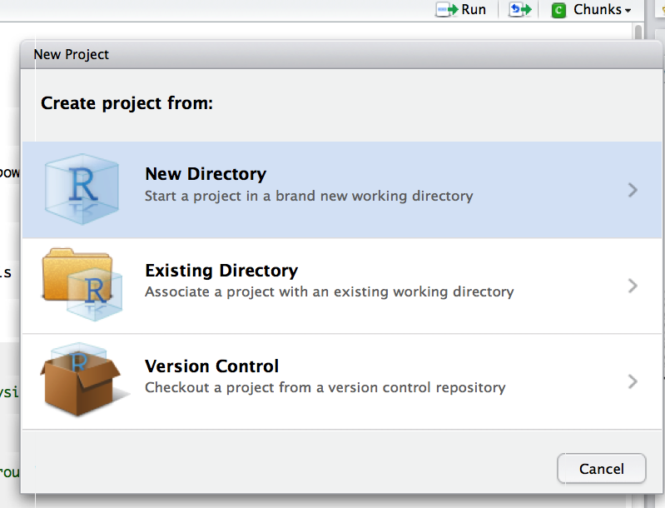
Start an “R studio project”
WHY: makes a new folder with everything you need to replicate an analysis
Scripts, outputs, data files
All file references will “move” with the project file
File—>”New Project”
Use references to folders WITHIN this folder when you need to call to data files, save outputs

Slide 11
Reproducible documents
Separate analysis from data cleaning
Separate analyses of the same data into different documents
Loops to process, documents to communicate

Slide 12
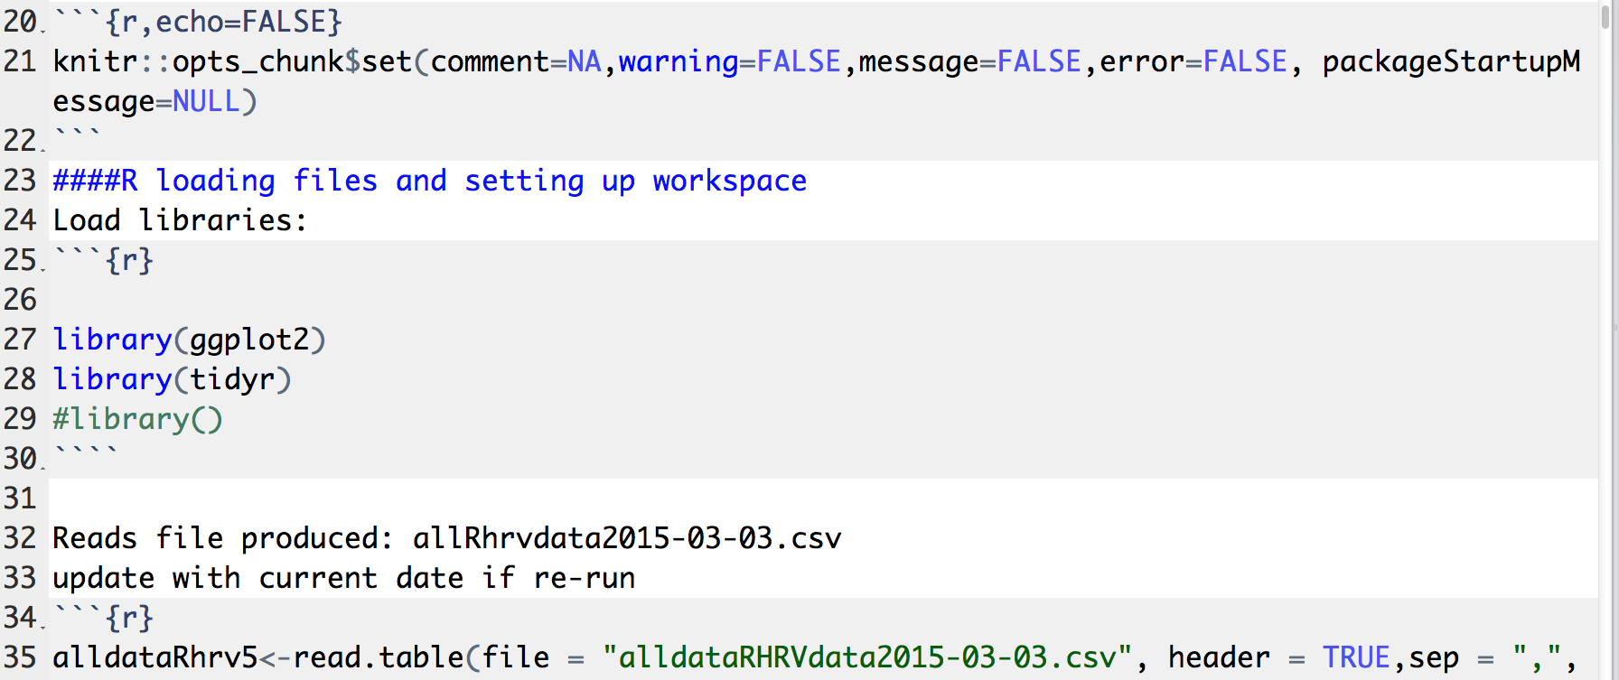
Set up a document for reproducibility

Slide 13
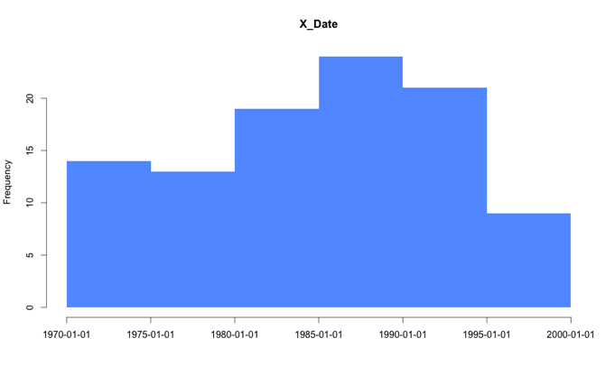
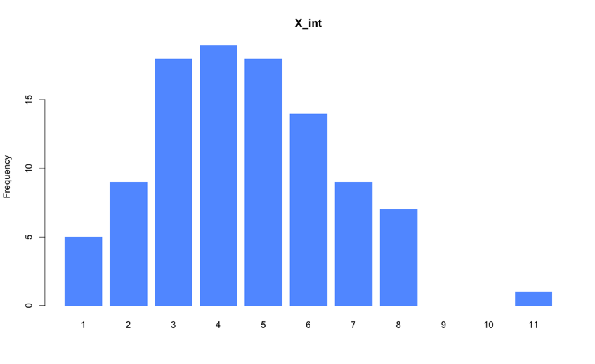
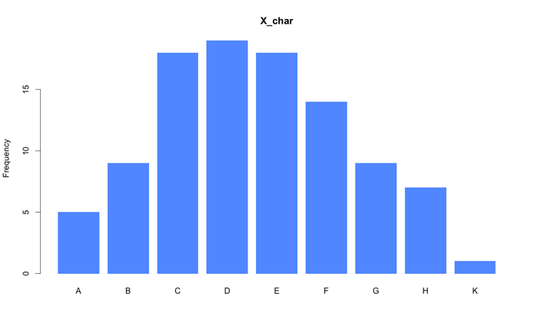
Plot everything
Pithr
https://github.com/NickSalkowski/pithr/tree/master
>library(pithr)
>pith(iris)
>pithy(..)

Slide 14
Check for common sources of Chaos
NA values when coming from SPSS?
Dates
Posix decoded: http://www.stat.berkeley.edu/~s133/dates.html
Check Factor levels and labels
str(), head(), summary()

Slide 15
Data wrangling cheat sheet
http://www.rstudio.com/wp-content/uploads/2015/02/data-wrangling-cheatsheet.pdf

Slide 16
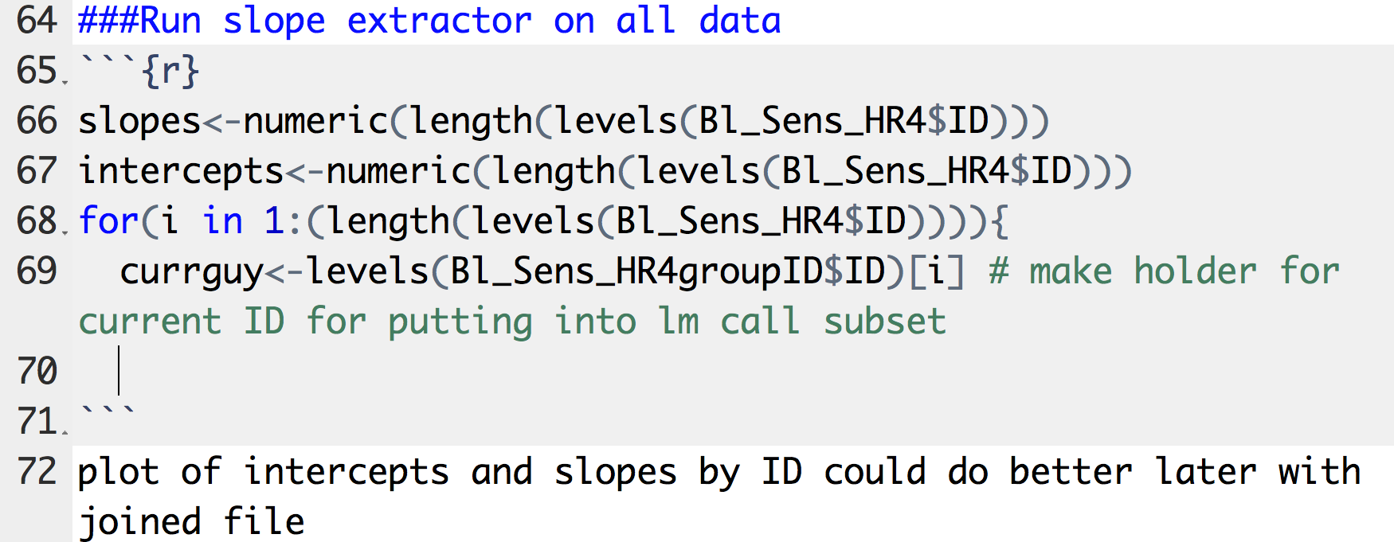
Thinking made explicit
Headings in RMD
#,##,###,#### end up in TOC
Text between chunks explains your thinking/reasoning, conclusions
Comments in scripts tells you mechanisms of code
Echo=TRUE/echo=FALSE

Slide 17
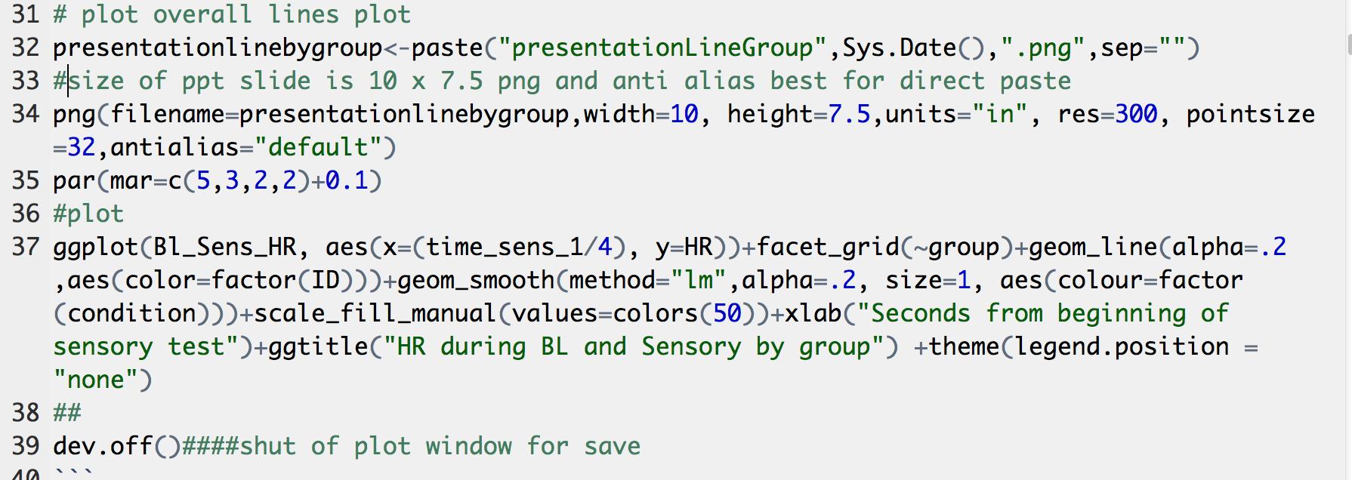
Chaotic outputs

Slide 18
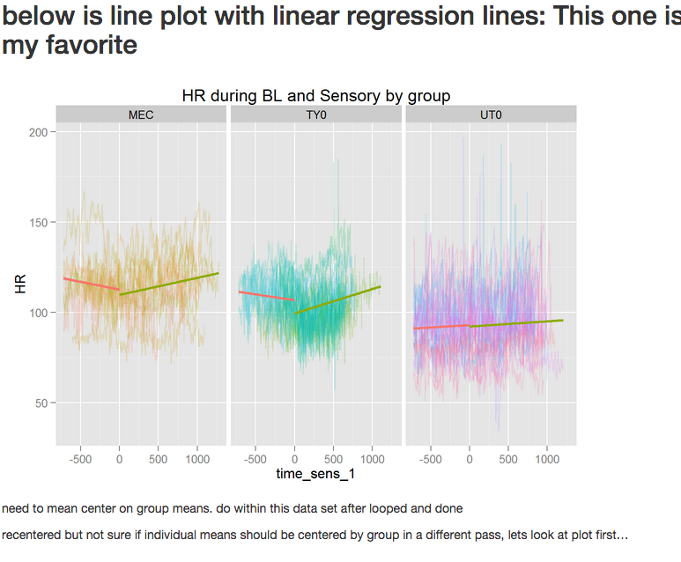
Sharing with others
Knit to html
(toc on/off in header, echo=TRUE/FALSE)
Open in browser and resave as either .pdf/html

Slide 19
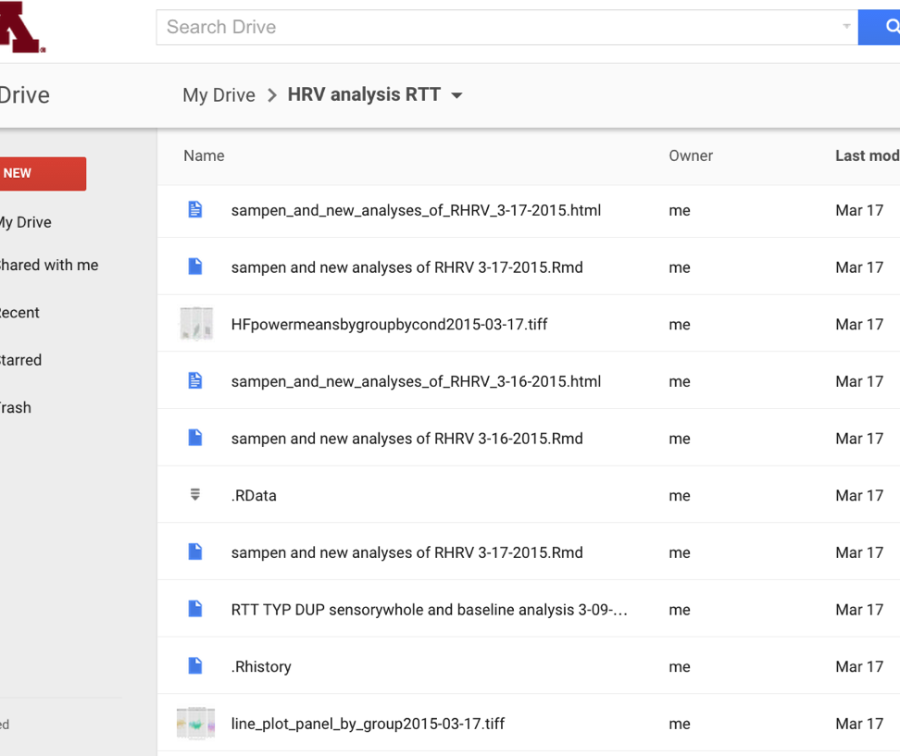
Backup to Google Drive
Finish working, save and close out of R studio
Drag anything that changed today into folder
Keep old versions

Slide 20
Towards less Chaos

Slide 21
future tools
Server installations of R
OR at least use Packrat
Github version control
Coach & give immediate feedback to data creators
Upload/ display widgets in Shiny

Slide 22
Thanks!
hoch0048@umn.edu

