Slide 1

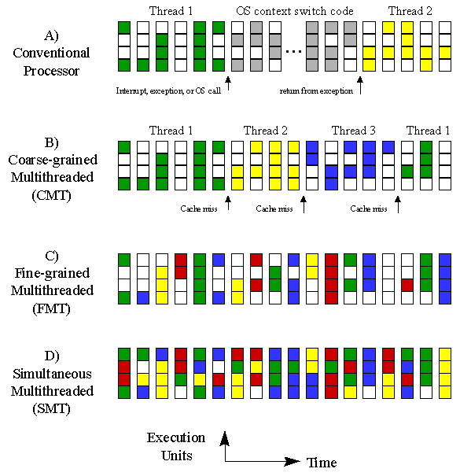
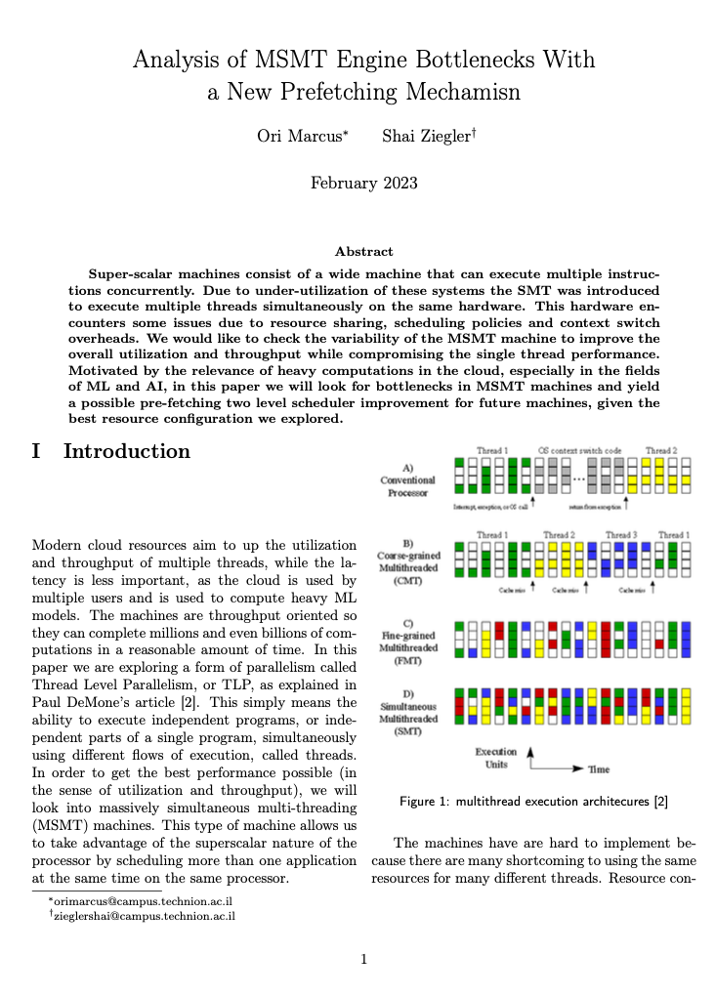
Analysis of MSMT Engine Bottlenecks With a New Prefetching Mechanism
Ori Marcus
Shai Ziegler
Mentor: Prof. Gabbay

Slide 2
Table of content
Background
Proposition
Methodology
Results
Conclusion & Discussion
Future work

Slide 3
Table of content
Background
Proposition
Methodology
Results
Conclusion & Discussion
Future work

Slide 4
What is MSMT?
Modern cloud resources aim to up the utilization and throughput of multiple threads, while the latency is less important
The cloud is used by multiple users and is used to compute heavy ML models.
The machines are throughput oriented so they can complete millions and even billions of computations in a reasonable amount of time.
We are exploring a form of parallelism called Thread Level Parallelism, or TLP
This type of machine allows us to take advantage of the superscalar nature of the processor by scheduling more than one application at the same time on the same processor.

Slide 5
MSMT Shortcomings
There are many shortcoming to using the same resources for many different threads.
Resource contamination introduces higher cache miss rates with many threads
Scheduling policies try to get the best throughput out of the machine
There is an overhead for each context switch and allocating resources in a smart way is hard when the scheduler doesn't have much information about the thread.
We will present interesting bottlenecks in the MSMT machine, that impact the utilization and throughput of the machine, and will propose a new two-level scheduler with prefetching that can improve performance.

Slide 6
Table of content
Background
Proposition
Methodology
Results
Conclusion & Discussion
Future work

Slide 7
Initial Research Stages
Phase 1: Find the best MSMT architecture configuration for maximum throughput and utilization
Find a bottleneck after which adding more threads will not improve performance.
Find the best instruction window size configuration, so that not to use unnecessary hardware, but still get good results.

Slide 8
New Scheduler Proposition
Phase 2: Propose a new scheduler architecture to get better throughput and less wasted cycles on SOE
This scheduler will be based on a two-level scheduler which switches threads on cache miss events, to bring a new thread from the L2 pool in FCFS method.
The scheduler prefetches configurable number of ready threads from L2 to minimize the SOE time to the L1 pool.
Simulate and find a bottleneck after which the performance-hardware tradeoff will not warrant more hardware.

Slide 9
Table of content
Background
Proposition
Methodology
Results
Conclusion & Discussion
Future work

Slide 10
Methodology- simulator
Python simulator with configurable architecture configurations:
Number of each type of execution unit and their latency
Cache miss rate and penalty
Branch miss rate and penalty
Instruction window size
Number of threads and the type of benchmark for each one
Scheduling policy and its appropriate parameters.

Slide 11
Methodology- simulations
number of threads - we will see how the thread count affects the throughput and utilization, while considering that more threads means a higher cache miss rate.
thread instruction window size - In theory, a larger window size increases utilization until a certain point, since the number physical units is fixed, and after a certain window size there won't be any further affect. In addition, there are instruction dependencies which will prevent a large window from being useful.
cache miss rate - the cache rate has a linear relationship with the number of threads.
scheduling policy – we are presenting a new scheduler and thus we must run all the benchmarks with the typical scheduler and the new one, in order to show the improvements.

Slide 12
Evaluation Methods
Throughput – For these machines, a higher throughput is most important
Utilization – This is a good way to see if we are taking advantage of the hardware
Worst Single Thread Latency – what is the worst affect of a single thread? What is the general affect on a single thread? Not A Priority!

Slide 13
Table of content
Background
Proposition
Methodology
Results
Conclusion & discussion
Future work

Slide 14
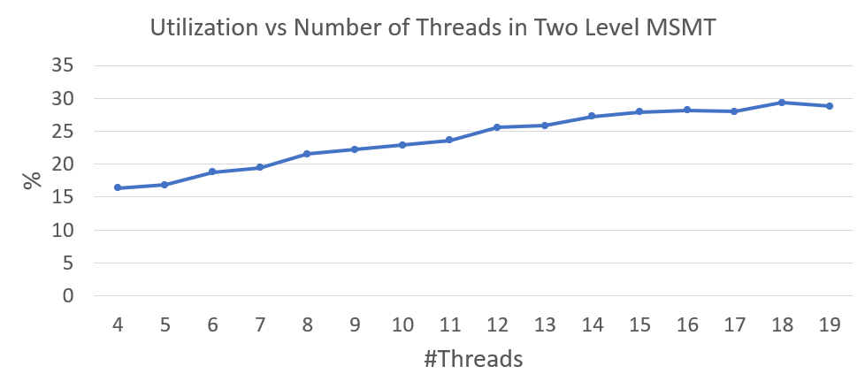
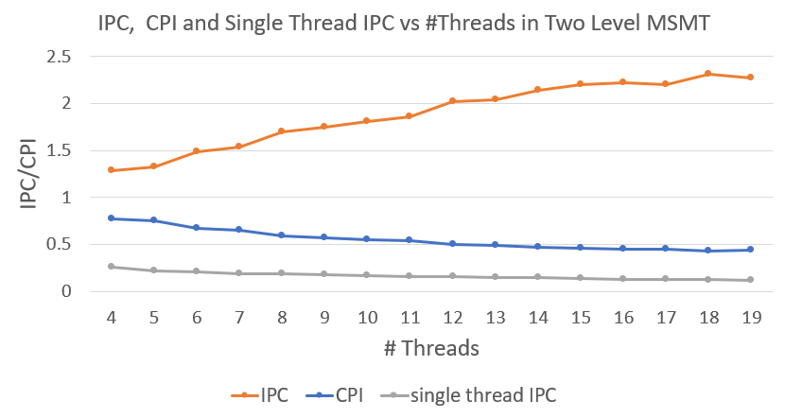
Thread Count Results
The CPU performance flattens after around 15 threads.
The cache miss rate increases with the threads.
Higher likelihood of a ready thread as thread count increases.
Over this thread count bottleneck , the penalty for a cache miss gets masked as there are enough ready threads so that there is most likely a ready thread that has been there for a while.
Notes:
we learned that for a typical machine, with 4 executions units of each kind (ALU, LD/ST, branch), the CPU's performs flattens around 15 threads. This matches what we predicted, since the penalty for a cache miss gets masked as there are enough threads in the L2 pool so that there is most likely a ready thread that has been there for a while. Over this thread count bottleneck, we get more cache miss rates, and thus the higher masking probability gets canceled out by the higher probability of a cache miss (thus we have more penalties and more masking). We can note at this point that using more threads slightly hurt our single thread performance, but as this machine is intended for very intensive tasks, such as training a DNN. The single thread performance isn't as important to us, and the overall performance that we gained is a good tradeoff with this small decrease in the single thread performance, especially since there are many instructions in the tasks that this machine is intended for, and a single thread would take a long time anyway (and one thread finishing isn't important, we need them all)

Slide 15
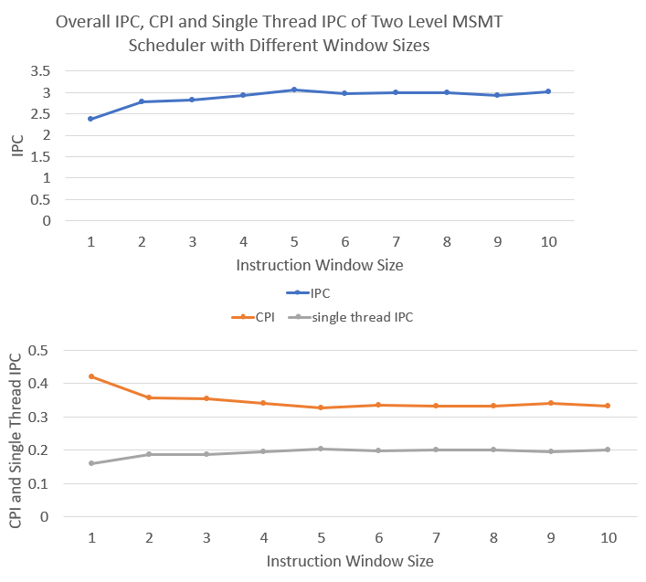
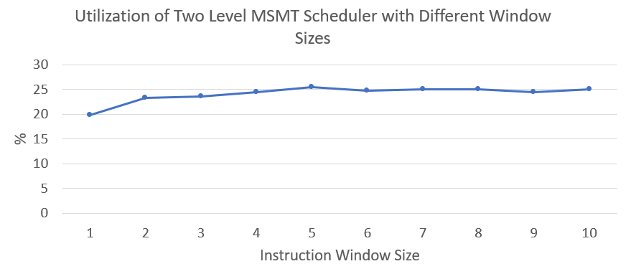
Window Size Results
We used the same configuration of execution units and fixed our thread count to 15
The performance got better as the window size increased, and it flattened at a window size of 4 instructions.
the overall IPC also increased until a window size of 4, and after that point, it flattened as well.
The single thread performance behaved in the same way, thus insuring we will not hurt the single thread performance.

Slide 16
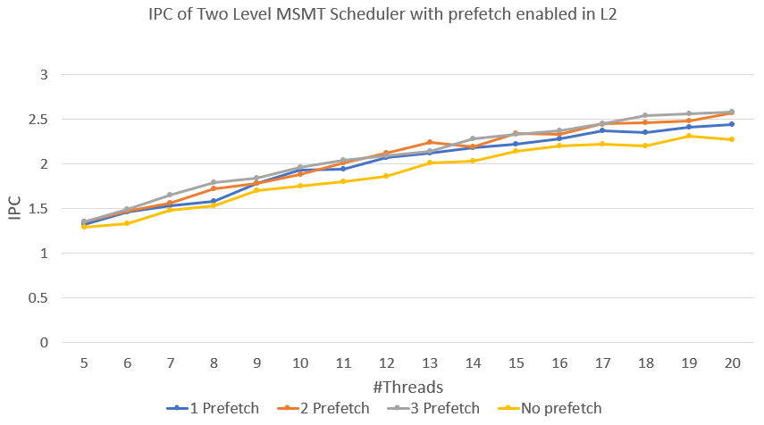
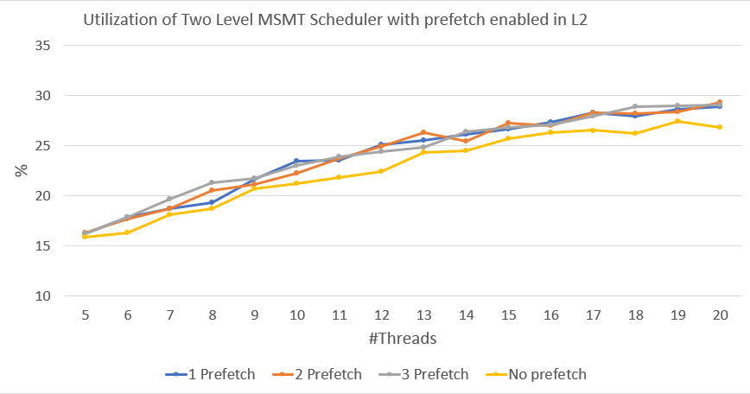
Proposed Scheduler Results
In phase 2 we used our results from the previous research stage
with a very small number of threads, the impact of the prefetching mechanism is near to none.
As the thread count increases there is higher probability of the prefetching mechanism being used.
After about 17 threads we can see that no more performance is gained.
Larger simultaneous prefetching didn’t necessarily help!
Notes:
with a very small number of threads, the impact of the prefetching mechanism is near to none.
This makes a lot of sense, since with a small number of threads, and a large cache miss rate penalty the L1 will need a thread from the L2 before there is a ready thread that has returned from memory, and the prefetching won't do anything.
As the thread count increases, there are more threads waiting in the L2 pool, and the probability of having a ready thread in that pool gets higher, thus having a higher probability of the prefetching mechanism being used. After about 17 threads we can see that no more performance is gained. This makes a lot of sense, because after a certain number of threads, we expect there to be more ready threads in the L2 pool, and thus filling the maximum prefetching capacity, and more threads won't impact the performance.

Slide 17

Table of content
Background
Proposition
Methodology
Results
Conclusion & Discussion
Future work

Slide 18
Conclusion & Discussion
Increasing thread count: as we increased the thread count, we achieved higher throughput until we reached a plateau at approximately 15 threads. Thus 15 threads is the optimal size for best performance without wasting real estate.
Increasing window size: as we increased the instruction window size, we achieved higher throughput until we reached a plateau at approximately 4 instructions, thus 4-instruction window is the optimal size for best performance without wasting real estate.
Two level prefetching scheduler: this paper proposes a new scheduler. After using the results from the initial stages of the research, the new scheduler's results show an increase of about 12% over the same MSMT configuration without the prefetching mechanism!
Using this scheduler, we would need to use more hardware. Since these machines are meant to be used in the cloud with very heavy tasks, a performance gain of 12% is very significant.
Notes:
Increasing thread count: when looking at the overall throughput and utilization, as we increased the thread count, we achieved higher throughput until we reached a plateau in the performance at approximately 15 threads. This means that for a typical MSMT machine, 15 threads is the optimal size for best performance without wasting real estate.
Increasing window size: when looking at the overall throughput and utilization, as we increased the instruction window size, we achieved higher throughput until we reached a plateau in the performance at approximately 4 instructions. This means that for a typical MSMT machine, a 4 instruction window is the optimal size for best performance without wasting real estate.
Two level prefetching scheduler: this paper proposes a new scheduler, with an optimal prefething thread count of two threads for a typical MSMT machine. After using the results from the initial stages of the research, the new scheduler's results show an increase of about 12% over the same MSMT configuration without the prefetching mechanism. Using this scheduler, we would need to use more hardware. Since these machines are meant to be used in the cloud with very heavy tasks, a performance gain of 12% is very significant.

Slide 19
Table of content
Background
Proposition
Methodology
Results
Conclusion
Future work

Slide 20
Future Work
The simulator used in this paper was based on an in-order scheme, and we would be interested in seeing the impact of the prefetching mechanism on an out-of-order machine.
It is interesting to see just how much more power our new scheduler uses, as we tried to use the smallest amount of prefetched threads so that not to consume too much power.
In addition, We would recommend looking into the amount of real estate this mechanism would take up and are interested in seeing if it is worth implementing this over fewer threads.

Slide 21
Thanks For Listening!

