Slide 1
ATM
Radosław Zieliński 2019

Slide 2
Table of content
Overall architecture
Client App
App Server architecture
App Server details
Database
Documentation

Slide 3
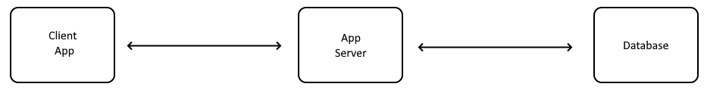
Overall architecture

Slide 4
Client App
.NET Core 2.4
Vue.js components
Bootstrap 4
SASS
RWD
Node.js as application builder
Ajax communication with App Server

Slide 5
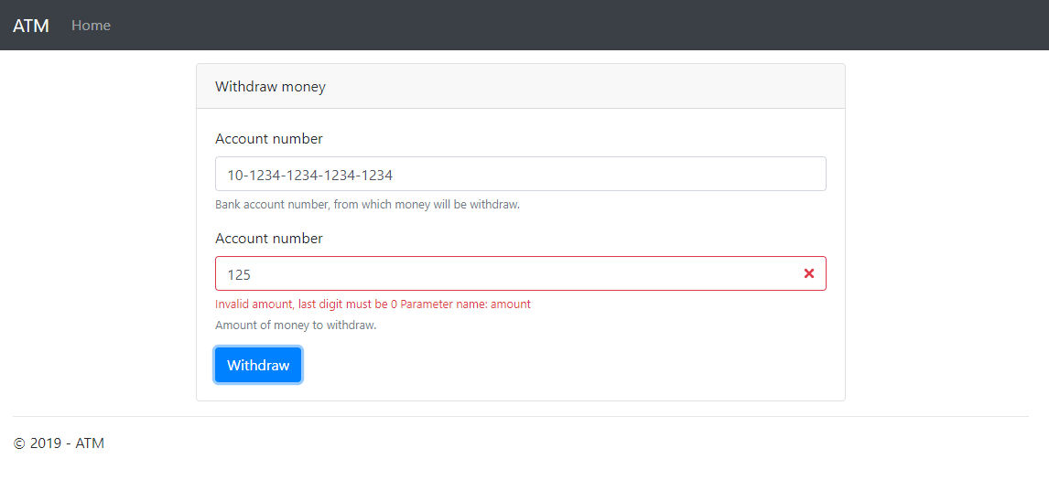
Client App

Slide 6
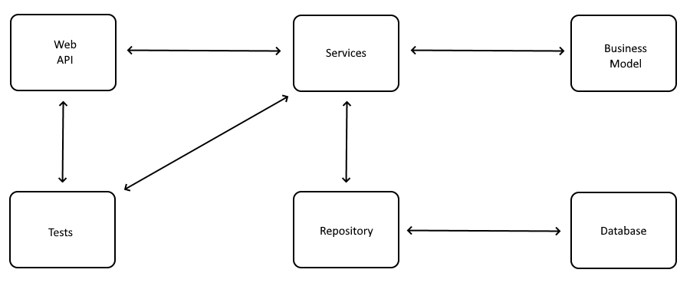
App Server architecture

Slide 7
Server App details
.NET Core 2.4
Entity Framework Core
WebApi – MVC pattern
Repository pattern
Middlewares
Test Driven Development
3/4 REST maturity level
Self explanatory code
Greedy algorithm

Slide 8
Database
MS SQL
Entity Framework Core
Code First approach
Migrations
GUIDS

Slide 9
Documentation
Swagger

Slide 10
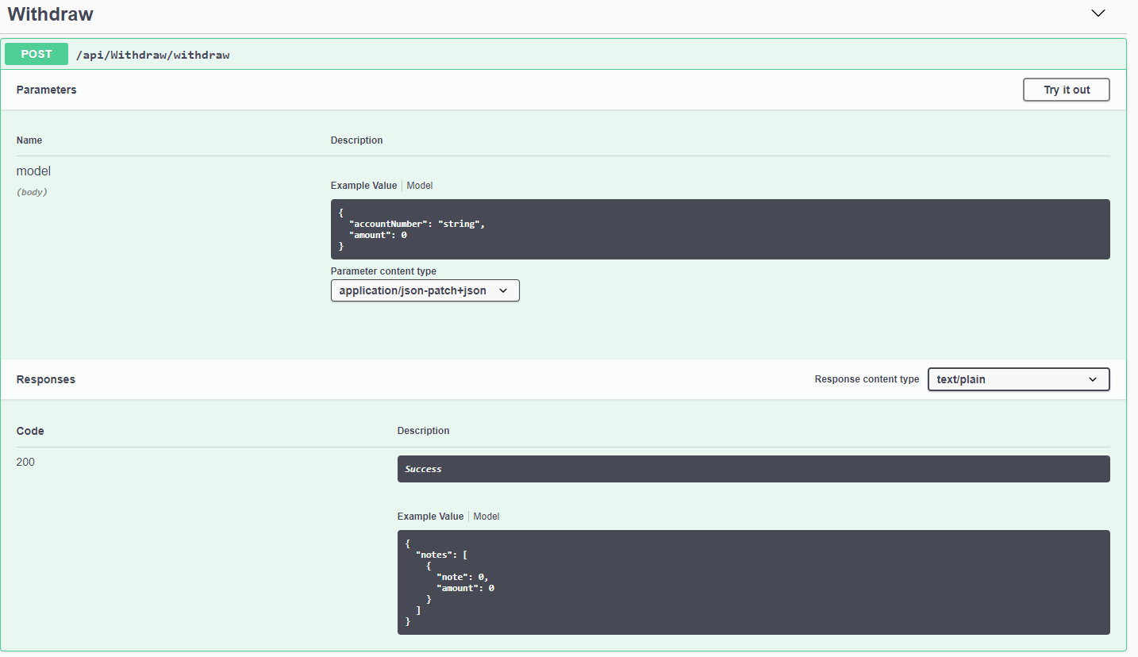
Documentation

Slide 11
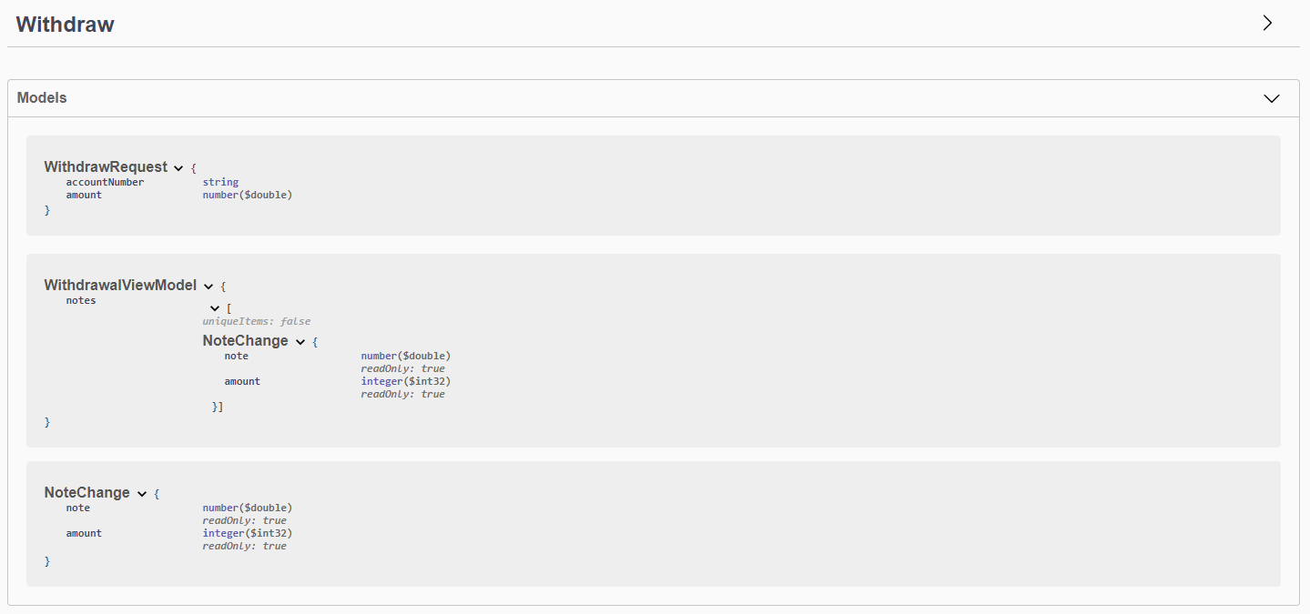
Documentation

Slide 12
ATM
Thank You
Radosław Zieliński 2019

