Slide 1
ATM
Radosław Zieliński 2019

Slide 2
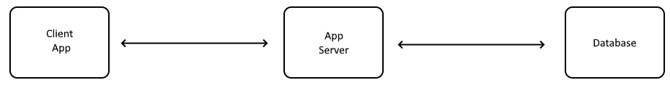
Overall architecture

Slide 3
Client App
.NET Core 2.4
Vue.js components
Bootstrap 4
Node.js as application builder
Ajax communication with App Server

Slide 4
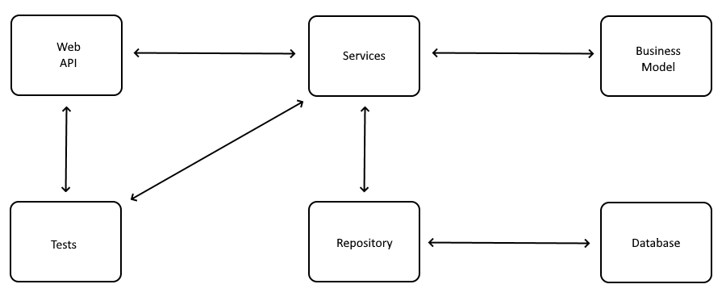
App Server architecture

Slide 5
Server App
.NET Core 2.4
Entity Framework Core
WebApi – MVC pattern
Repository pattern
Middlewares
Test Driven Development
3/4 REST maturity level

Slide 6
Database
MS SQL
Entity Framework Core
Code First approach
Migrations
GUIDS

Slide 7
ATM
Thank You
Radosław Zieliński 2019

