Slide 1


FAKE NEWS DETECTOR
LIVE
Hyprid Bilingual Fake News Detection Using ML,Web scraping and Gemini AI

Slide 2
CONTENTS OF THE PROJECT
Problem and objective | Understanding the fakenews problem and the project goal
Dataset and preproocessing | How to collect,cleaned and prepared arabic dataset
ML model | Train the Fake news classification model using TF-IDF and Naïve Bayes
MultiLayer Detection System | Dataset Matching→ Youm7 verification→ Gemini AI analysis
UserInterface | Building a Bilingual interactive interface using streamlit
Reesults and insights | Accurracy, total anayzed …etc

Slide 3
01
INTRODUCTION
LIVE

Slide 4
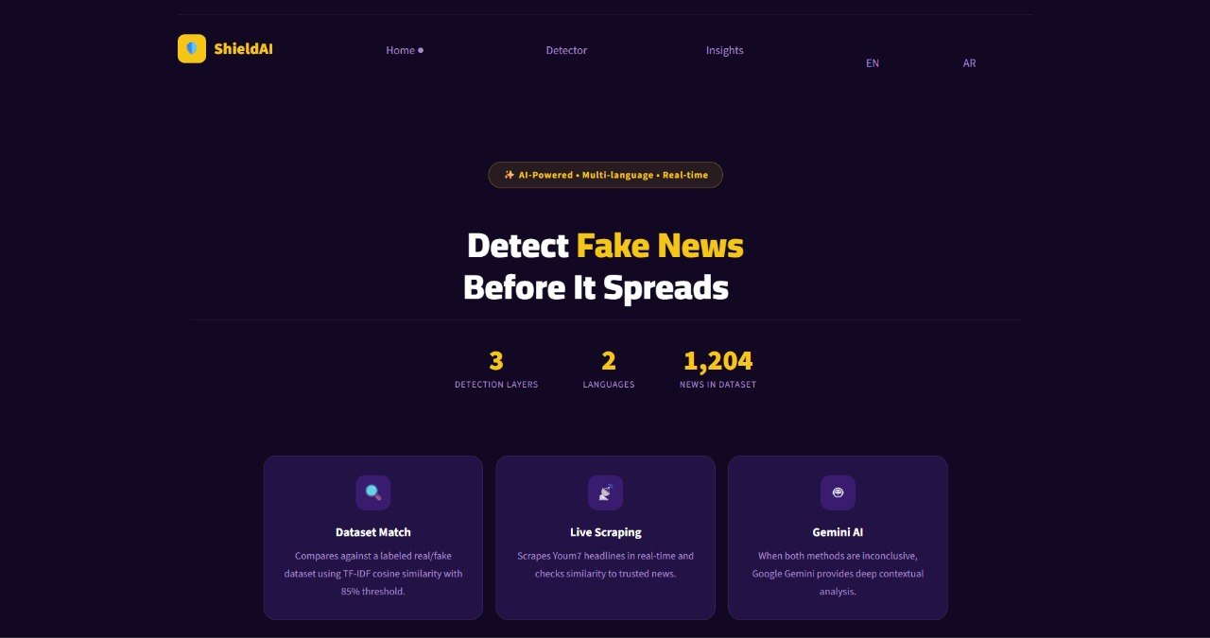
ANNOUNCEMENT
Fake News Problem
Fake news has become one of the biggest challenges on social media and online platforms. False information spreads rapidly and can influence public opinion, especially when shared without verification.
Most existing fake news detection systems:
Focus mainly on English content
Depend on a single detection technique
Do not verify news using live trusted sources

Slide 5
02
Project idea
LIVE

Slide 6
Project overview
The system analyzes news articles using a multi-layer detection process to improve prediction reliability.
Detection Layers
Dataset Similarity Matching
Live Verification using Youm7 Headlines
Gemini AI Contextual Analysis
The system starts with fast similarity checking and gradually moves to deeper AI analysis if needed.

Slide 7
Dataset
LIVE

Slide 8
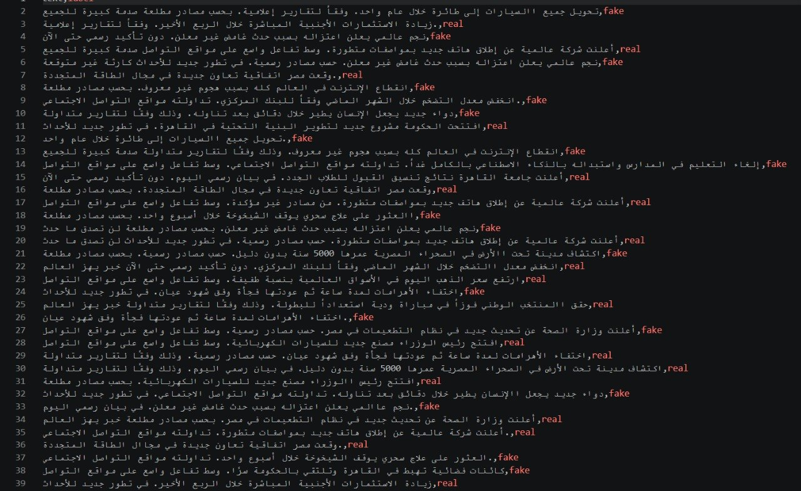
Dataset Creation
To support Arabic fake news detection, we created our own dataset containing both real and fake news articles.
Dataset Features:
Arabic-focused news content
Real and fake labeled articles
Different news categories
Balanced and cleaned data
Dataset Preparation:
News collection
Data labeling
Removing duplicates
Data shuffling
Text cleaning

Slide 9
03
Data Preprocessing
LIVE

Slide 10
Data preprocessing
Before training the model, the news articles were cleaned and normalized to improve model performance.
Preprocessing steps: Removing URLs, Removing special characters and punctuation Arabic text normalization Cleaning unnecessary symbols Preparing text for vectorization
TF-IDF Vectorization : TF-IDF was used to convert textual data into numerical vectors that can be processed by the machine learning model.

Slide 11
04
Machine Learning
LIVE
System uses multinomial Naïve Bayes algoorithm for FNC

Slide 12
Why multinomial Naïve Bayes
Fast and efficient
Performs well with TF-IDF vectors
Requires low computational cost
Suitable for text classification
Training process
Splitting the dataset into training and testing sets
Applying TF-IDF vectorization
Training the model
Predicting new labels

Slide 13
05
Application Interface

Slide 14
Home Page
Detector Page
Insights Page

Slide 15




Pages
Home page:
Project introduction
Detection system overview
Main System Features
Navigation Buttons
Bilingual Language support
Key features displayed:
AI-powered detection
Multi-layer verification
Real-Time analysis
Arabic and English support
Detector page:
User enters a new article
The system processes the text
Similarity matching starts
Trusted sources verification is started
Gemini AI analyzes uncertain news
Final prediction is displayed
Output:
Real or fake prediction
Similarity scores
Score used for prediction
A random article from youm7
Insights Page:
Total analyzed data
Real vs fake statistics
Average similarity scores
Detection history
Used verification sources
Purpose:
The insights page helps user understand system performance and monitor previous analysis

Slide 16
Bilingual support
Arabic and English support
The system was defined to support both Arabic and English languages
features
Dynamic language switching
Arabic ui support
English ui support
RTL support for Arabic text
Translated labels and messages
importance
Supporting Arabic was a major focus because Arabic fake mews datasets and
detection system are limited compared to English systems

Slide 17
06
Ui design

Slide 18
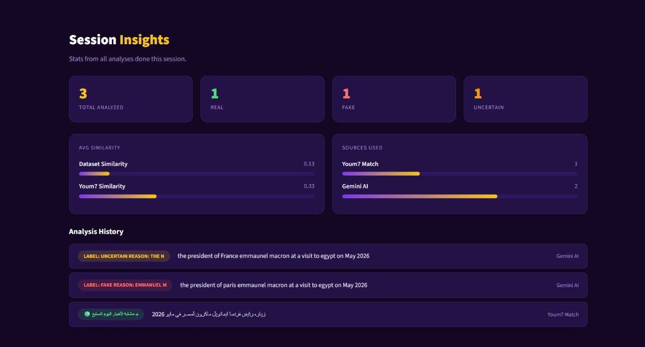
NEWS WEBSITE
Technologies used:
Streamlit
HTML/CSS styling
Custom CSS components

Slide 19
System overflow inside steamlit
User-input
Dataset similarity matching
youm7
Gemini
Final-decision
Detection Logic:
Fast verification is applied first
Ai analysis is used only when necessary
Multiple layers improve system accuracy and reliability

Slide 20
Team members
Farida khaled
Malak khaled
Nancy Ehab
Ziena elsayed
Marsel hakeem
2405425
2405422
2405435
2405450
2405478

