Slide 1
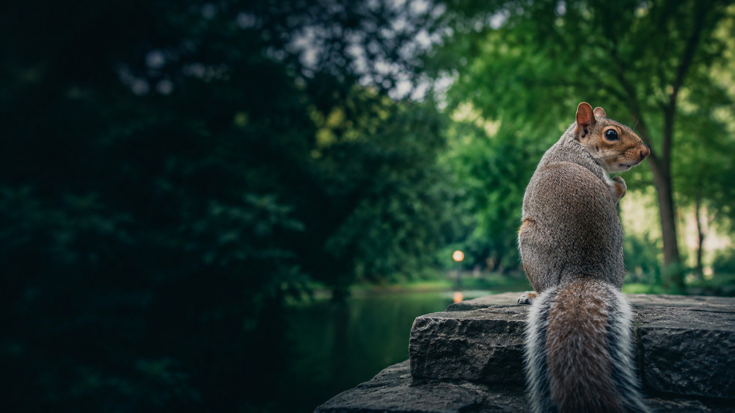
Can We Predict Which
Central Park Squirrels
Ignore Humans?
2018 Central Park Squirrel Census
Zifan Yang · CSS Bootcamp Final Project
Notes:
Hi everyone.
Have you ever tried to get a squirrel's attention and been completely ignored?
This project starts with a simple question: Can we predict whether a Central Park squirrel will be recorded as indifferent to humans?
To answer this question, I used data from the 2018 Central Park Squirrel Census. I first explored several patterns in the data, and then compared two machine-learning models.
[Sources]
- Cover image: AI-generated for this presentation using OpenAI image generation, 2026-09-04.
- NYC Open Data, 2018 Central Park Squirrel Census: https://data.cityofnewyork.us/api/views/vfnx-vebw/rows.csv?accessType=DOWNLOAD

Slide 2
CLUE 1 · THE DATA
3,014 Sightings Became a Prediction Problem
3,023
700
→
3,014
48.1%
+
squirrel sightings
observation sessions
matched observations
recorded as
indifferent
What went into the prediction?
TRAITS
BEHAVIORS
CONTEXT
age · fur color
foraging · climbing · eating
location · time · conditions
Target was nearly balanced: 48.1% indifferent · 51.9% not indifferent
Source: NYC Open Data
Notes:
The original squirrel dataset contained 3,023 sightings. It included information about each squirrel's traits, location, and behaviors.
I also used a second dataset containing 700 observation-session records. This dataset included environmental information, such as the hectare conditions and the number of people collecting data.
I merged the two datasets using the hectare, date, and time shift. After the merge, I had 3,014 matched observations.
My outcome variable was called “Indifferent.” About 48.1 percent of the squirrels were recorded as indifferent, while 51.9 percent were not. Because the two categories were nearly balanced, always predicting the majority category produced a baseline accuracy of 51.9 percent.
My predictors included age, fur color, location, time of day, coordinates, environmental conditions, and behaviors such as running, climbing, eating, and foraging.
I excluded variables such as “Approaches” and “Runs from” because they already directly described the squirrel's response to humans. Including them would make the prediction problem too easy and less meaningful.
[Sources]
- NYC Open Data, squirrel observations: https://data.cityofnewyork.us/api/views/vfnx-vebw/rows.csv?accessType=DOWNLOAD
- NYC Open Data, hectare/session records: https://data.cityofnewyork.us/api/views/ej9h-v6g2/rows.csv?accessType=DOWNLOAD

Slide 3
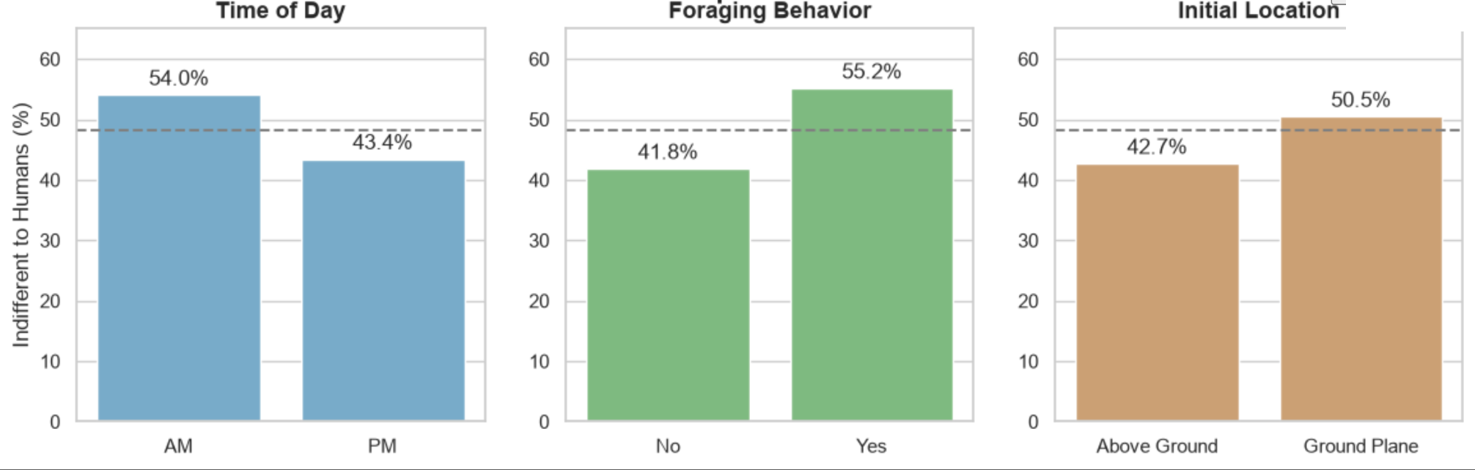
CLUE 2 · THE PATTERNS
Foraging Was the Strongest Clue
+10.6 pp
+13.3 pp
+7.8 pp
morning vs. afternoon
foraging vs. not foraging
ground vs. above ground
Associations—not proof of causation.
Notes:
Before building the models, I explored how indifference was related to three variables.
First, time of day appeared to matter. About 54 percent of squirrels observed in the morning were indifferent, compared with 43.4 percent in the afternoon.
Second, foraging had an even larger relationship with indifference. About 55.2 percent of foraging squirrels were indifferent, compared with only 41.8 percent of squirrels that were not foraging.
Apparently, squirrels with snacks have less time for humans.
Finally, about 50.5 percent of squirrels observed on the ground were indifferent, compared with 42.7 percent of squirrels observed above the ground.
These results suggest that behavior and context may contain useful predictive information. However, these are only associations. They do not prove that time, foraging, or location caused the squirrels to become indifferent.
[Sources]
- User-created analysis chart based on NYC Open Data, 2018 Central Park Squirrel Census: https://data.cityofnewyork.us/api/views/vfnx-vebw/rows.csv?accessType=DOWNLOAD

Slide 4
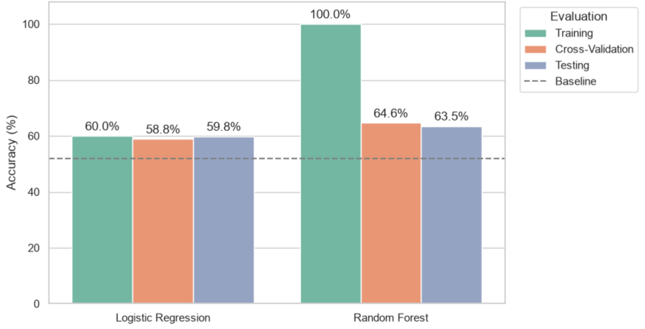
THE TEST · MACHINE LEARNING
Random Forest Performed Best—but It Overfit
Notes:
Next, I prepared the data for machine learning. I converted the categorical variables into dummy variables and divided the data into a training set and a testing set.
I compared logistic regression with random forest. I also used five-fold cross-validation to check whether the results were stable across different parts of the training data.
Logistic regression achieved 59.8 percent testing accuracy, compared with the 51.9 percent baseline.
Random forest performed better, with 63.5 percent testing accuracy. Its mean cross-validation accuracy was also similar, at 64.6 percent.
Random forest was a natural choice for this project because we are studying squirrels, trees, and forests.
However, the random forest achieved 100 percent training accuracy. This suggests overfitting. It basically hoarded the training data like a squirrel hoards nuts.
Even with this overfitting, the similar cross-validation and testing scores suggest that the testing result was probably not caused only by one lucky data split.
[Sources]
- User-created model comparison chart based on NYC Open Data, 2018 Central Park Squirrel Census: https://data.cityofnewyork.us/api/views/vfnx-vebw/rows.csv?accessType=DOWNLOAD

Slide 5
FINAL ANSWER
63.5%
YES—
but only somewhat.
best testing accuracy
Squirrel traits, behaviors, and context contained useful information—
but indifference remained difficult to predict reliably.
+11.6 pp
above the baseline
275 / 754
test sightings misclassified
LIMITATIONS
Subjective labels · Citizen-science data · Observational study
Squirrel indifference was somewhat predictable.
Notes:
So, can we predict whether a Central Park squirrel will ignore humans?
The answer is yes, but only somewhat.
The random forest improved testing accuracy by 11.6 percentage points over the baseline. It correctly classified 479 of the 754 testing observations, but it still misclassified 275.
This project also has several limitations. “Indifferent” was based on the volunteers' interpretation of squirrel behavior. Some information was missing, and sightings collected during the same observation session may not have been completely independent. Because this was observational data, the results also cannot establish causation.
Overall, squirrel traits, behaviors, and environmental context contained useful information, but squirrel indifference was still difficult to predict reliably.
So, if a squirrel ignores you, do not take it personally. Our best model is still wrong more than one-third of the time.
Thank you.
[Sources]
- Analysis results derived from NYC Open Data, 2018 Central Park Squirrel Census: https://data.cityofnewyork.us/api/views/vfnx-vebw/rows.csv?accessType=DOWNLOAD

