Slide 1



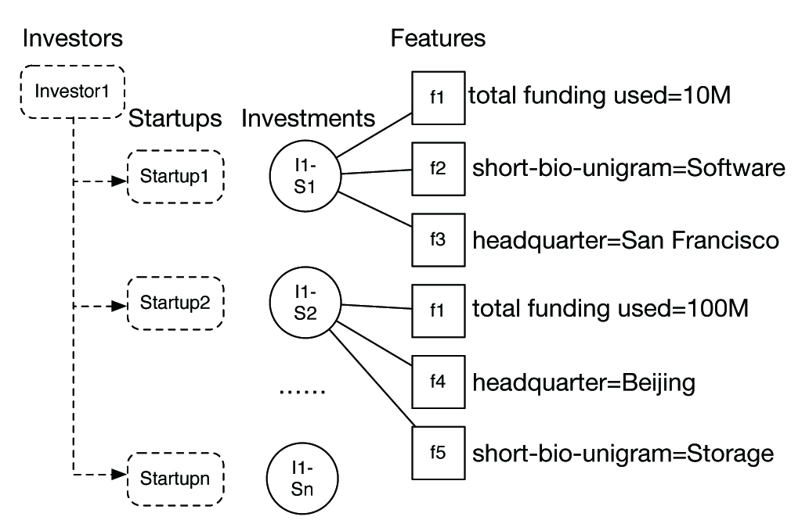



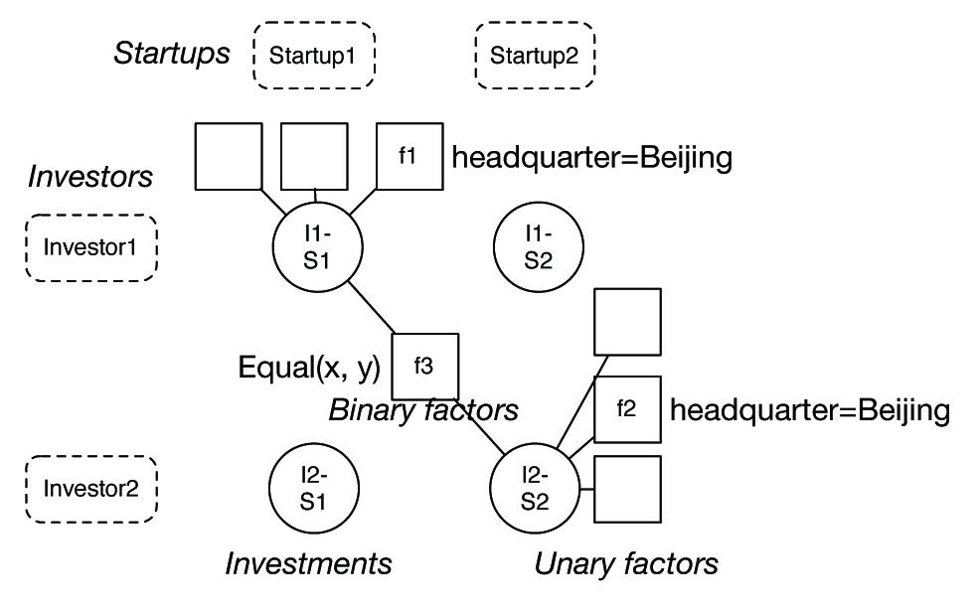

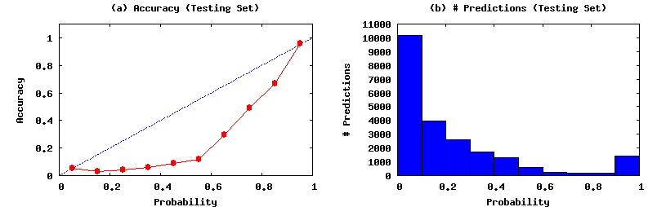



Capital Crunch: Predicting Investments in Tech Companies
Zifei Shan, Haowen Cao and Qianying Lin
{zifei, caohw, qlin1}@stanford.edu
Department of Computer Science, Stanford University
Introduction
Features
Evaluation
Motivation: find patterns in investment behavior from major investors and successful startup strategies.
Problem: predict whether an investor would potentially invest in a startup.
Contribution:
Understanding investment strategies and behaviors of investors
Give startups ideas on where to seek potential investment and how to attract potential investors.
Basic attributes
People attributes
Linguistic attributes
For evaluation, we compute precision, recall and F1 score on the test set, for different models and feature combinations. We choose decision boundaries to optimize F1.
Feature combinations: we cluster all features into basic / people / linguistic, and try different combination of features.
Baseline: simply predicting all true for every test example. Has F1 of 0.263.
Oracle: Logistic Regression with all features plus information about number of funding rounds and total funding raised. Has F1 of 0.879.
These features in oracle are directly indicative of whether a startup has been invested, and will not be usable in real cases.
Results: Table 3 shows the results for different models and feature combinations. LR with best features has F1 0.707, much better than baseline 0.263, close to oracle 0.879.
Good features: basic attributes and linguistic attributes. Especially: Headquarter, category, lemmatized nouns in description.
Bad features: people attributes
CRF does not work well: CRF model does not generalize to test set, possibly because of overfitting, or the underlying assumptions is not valid.
Headquarter (e.g. SF)
Category (e.g. software)
Founded year
Number of Competitors
Number of websites
For founders and CEOs:
Names
University of graduation
Company worked in
Has obtained MBA
#degrees obtained
NLP features from description of start-ups:
Location phrases
Unigram of lemmatized nouns
Feature Analysis: Table 2 shows the most indicative features of investor Sequoia Capital, according to learned weights from our system.
Top Positive Features | Top Negative Features
location=China | noun-1gram=VitaCig
headquarter=San Francisco | num_websites=2
headquarter=Beijing | founded_on_year=2014
Data Model
Data source: CrunchBase
Entities: Organization, person, product…
Relations: investment, acquisition, founder…
Data Processing
Categorize organizations to start-ups and investors
Data Model
Startup(startupId, [attributes…])
Investor(investorId, [attributes…])
Investment(investorId, startupId, isTrue)
Table 2: Top features for Sequoia Capital
Algorithms
Logistic Regression (LR) model: we train an independent logistic regressor for each investor, which takes a feature vector of a start-up and predicts a label.
This model cannot utilize investor-based attributes.
Factor graph (CRF) model: we introduce a binary factor to utilize attributes of investors.
A factor Equal(I₁S₁, I₂S₂) is applied if I₁ and I₂ has a common attribute a_{i}, and S₁ and S₂ has a common attribute a_{s}, and the weight (coefficient) is determined by (a_{i}, a_{s}).
Intuitively, investors that have similar interest would prefer to invest in similar startups, and the degree is determined by the specific attributes.
Annotations in Figure 1 / 2:
Circle: variables. Square: factors
Each Investment relation is a boolean variable, and the features are unary factors.
Note that Figure 1 only represents the factor graph for one investor.
Model | Features | Decision bounary | Precision | Recall | F1
Baseline | N/A | N/A | 0.151 | 1.000 | 0.263
LR | basic-only | 0.6 | 0.856 | 0.480 | 0.615
 | people-only | 0.6 | 0.753 | 0.218 | 0.338
 | nlp-only | 0.8 | 0.896 | 0.409 | 0.562
 | no-basic | 0.6 | 0.788 | 0.525 | 0.630
 | no-people | 0.7 | 0.880 | 0.591 | 0.707
 | no-nlp | 0.6 | 0.852 | 0.504 | 0.633
 | all features | 0.7 | 0.889 | 0.585 | 0.706
CRF | all features | 0.9 | 0.495 | 0.527 | 0.510
Oracle | all + funding_rounds +total_funding | 0.3 | 0.864 | 0.894 | 0.879
Getting Labeled Data
Positive Examples
Use ground truth investments in CrunchBase:
if an investor I has invested in a startup S, we obtain a training example (I, S, true) in Investment relation.
Negative Examples
Take startups that satisfies both following conditions:
Have been founded more than 6 months
Have not been invested or acquired.
For each startup S among these, randomly generate edges with known investors in I, to obtain negative examples (I, S, false).
Train / Test split
We hold out investment edges for 25% startups from all labeled data as test set. Table 1 shows statistics for the training set and testing set.
Table 3: Results for different features applied to the model
Figure 3 shows the calibration plot of the best feature selection (no-people).
Most predictions has very low / very high probabilities.
Confident predictions are reliable: error rate is 5.5% when predicted probability < 0.1, 4.0% when predicted probability > 0.9
Example | Positive example | Negative example
Total | 7749 | 43207
Training | 5831 | 32462
Testing | 1918 | 10745
Table 1: Dataset statistics
Figure 1: Logistic regression model (for one investor)
Figure 2: Factor graph model that captures similarity
Figure 3: Calibration plot for the best feature selection
Notes:
1. 在introduction里面大概介绍一些brainstorming，以及我们报告第一段提到的那三个observation，"ideas build on each other", etc.
3. 算法这部分文字有点多，在后面多添加一些我们算法细节。可以删减一下，另外，把model里面那张图移到System overview怎么样？
6. 把我们的邮箱地址和Kaleidoscope的URL都放到我们的名字以下怎么样？
7. Evaluation results我们的结果不用highlight了，毕竟也不是特别impressive。但可以考虑加上报告里面的Figure 4，以及报告中列出的那七条thinking patterns，"1. Design features for your favorite online application", etc....

