Slide 1
GameRank: Ranking and Analyzing Baseball Network
Zifei Shan, Shiyingxue Li, Yafei Dai
{shanzifei,lsyx09,dyf}@pku.edu.cn

Slide 2
Outline
Introduction
Algorithm and Evaluation
Analysis and Visualization
Future work and conclusion

Slide 3
Introduction

Slide 4
Background
A baseball game:
two teams, take turns to attack and defend.
Players are batters in attacking phase, and pitchers/fielders in defending phase.
Major League Baseball: the most attendance of any sports league. More than 70 million fans.
Most previous research focuses on game video analysis.
Full game records available on the Internet.

Slide 5
Questions
How to rank baseball players?
How to construct networks out of baseball games?
What’s special of baseball networks?
What can we know from baseball network analysis?
How about other sports networks?

Slide 6
Ranking Assumption
Ranking players’ pitching and batting ability separately:
a player is good at batting if he wins over good pitchers;
a player is good at pitching if he wins over good batters.
A good batter doesn’t necessarily make (and usually isn’t) a good pitcher.

Slide 7
Traditional Rankings
Traditional Baseball Ranking:
Based on statistics
Hard to reflect the relationship of players.
E.g. Batting average:
Hits / at bats

Slide 8
Stonger Weaker
AVG:
0.66
AVG:
0.66

Slide 9
So we want a model to take the relationships between players into consideration --- A network.

Slide 10
Network Construction
Nodes ← Players
Two attributes: pitching ability, batting ability
A player can be a pitcher as well as a batter
Links ← Win-lose relationships between players
Two types of links:
Pitching link A->B: A wins B when A is pitching
Batting link A->B: A wins B when A is batting

Slide 11
P: current pitcher
Orange link: batting link
Blue link: pitching link
Red node: Player of Team 1
Green node: Player of Team 2
White boarder: Pitcher
Black boarder: Non-pitcher
P
P
P
Offensive

Slide 12
Player Ranking: PageRank?
PageRank?
Fail to separate two abilities: only have one indicator!
See sample:

Slide 13
Orange link: batting link
Blue link: pitching link
Red node: Player of Team 1
Green node: Player of Team 2
White boarder: Pitcher
Black boarder: Batter
Got a PR for each player.
How to see their Pitching / Batting
ability separately?

Slide 14
Player Ranking: Two PageRanks?
Separate PageRank in two networks?
Fail to describe the interplay between pitching and batting!
See the following Sample:

Slide 15
A
X
B
Y
Node size for green nodes: batting ability
Node size for red nodes: pitching ability
Orange link: batting link
Blue link: pitching link
Red node: Player of Team 1 (all pitchers)
Green node: Player of Team 2 (all batters)
White boarder: Pitcher
Black boarder: Batter
C
Z

Slide 16
Cannot distinct batters’ abilities!

Slide 17
Player Ranking: HITS?
We need a stronger ranking algorithm!
HITS!
HITS: Hubs and authorities in Web
Good hubs links to good authorities
Good authorities are linked by good hubs
Similarly, baseball network:
Good pitchers wins good batters
Good batters wins good pitchers

Slide 18
Why not use HITS?
We want two indicators that has sound probabilistic meaning.
A random walk model like PageRank!

Slide 19
Algorithm: GameRank

Slide 20
GameRank: Overview
We use the intuition of HITS, and build random walk models across the two (pitching and batting) networks.

Slide 21
Intuition: Random Walk
Random walk in baseball (teams) network:
A baseball fan Ellie is trying to find the strongest player, by watching single plays through win-over relation (pitching/batting links) of players.
She starts randomly from batter A, and randomly picks a pitcher B who has won over A. And pick batter C who has won over pitcher B, etc.
If she finds a batter (pitcher) X that no one wins X, she will jump to a random pitcher (batter).
Sometimes she gets bored with the batter (pitcher) she’s currently watching, and randomly picks another pitcher (batter).
We can calculate The probability that she is watching a batter/pitcher after a long time = The frequency that she watches the player after a long time

Slide 22
A
X
GR | It1B | It1P | It2B | It2P | It3B | It3P
BA | 1 |  | 0.5 |  | 0.375
PA
BB |  |  | 0.5 |  | 0.625
PB
BX
PX |  | 1 |  | 0.75 |  | 0.687
BY
PY |  |  |  | 0.25 |  | 0.313
B
Y
Orange link: batting link
Blue link: pitching link
Red node: Player of Team 1 (all pitchers)
Green node: Player of Team 2 (all batters)
White boarder: Pitcher
Black boarder: Batter

Slide 23
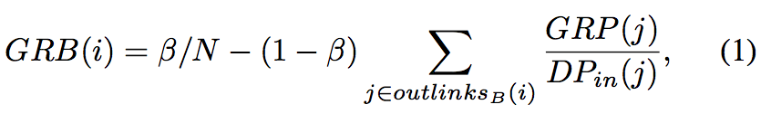
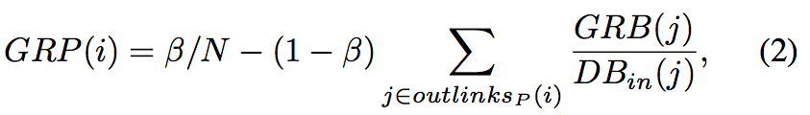
Definition
Our formula:
β = 0.15

Slide 24
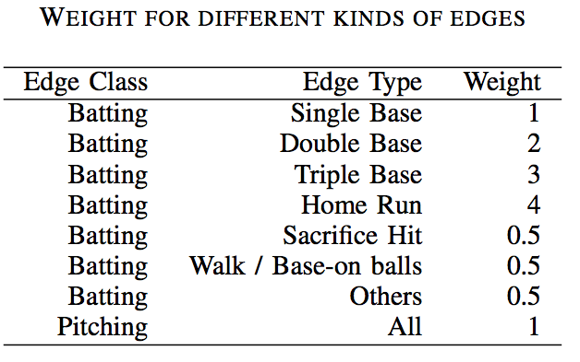
For Weighted Network
Add edge weights
By modifying edge weights, we can make the rankings more precise with domain-specific knowledge

Slide 25
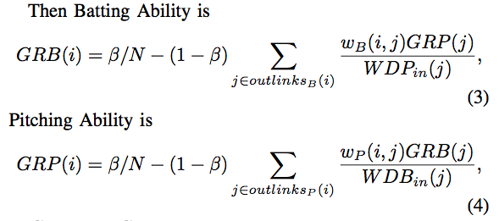
Formula for weighted network

Slide 26
Computation
Start from a initial distribution, then iterately calculate GRB, GRP based on above formula.
Will converge no matter what the initial distribution looks like.
Can be easily parallelized with MapReduce model, similar to PageRank.

Slide 27
Evaluation

Slide 28
Evaluation
We evaluate our ranking algorithm in real-world, open-source MLB game records on retrosheet.org.
We compare our result to ESPN Ratings, a prestigious ranking system.

Slide 29
Network of MLB data
Pick year 2011 for evaluation
1295 nodes
~80000 aggregated edges
Generate rankings for pitchers and batters with GameRank for 2011
Get the ESPN ranks for 2011 from Internet

Slide 30
ESPN Ratings Algorithm
ESPN Ratings uses a complex set of statistics.
E.g. the ESPN rating of batters includes the following factors: batting bases accumulated, runs produced, OBP, BA, HRs, RBIs, runs, hits, net steals, team win percentage, difficulty of defensive position, etc.
Hard to reflect relationships between players
Not every player can get a ESPN score.

Slide 31
Comparison: Ranked Players
Ranking Algorithm | Ranked Batters | Ranked Pitchers
GameRank | 823 | 659
ESPN | 310 | 161

Slide 32
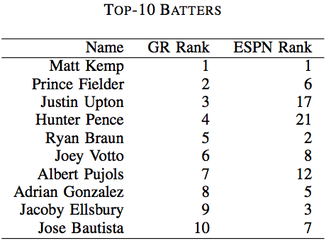
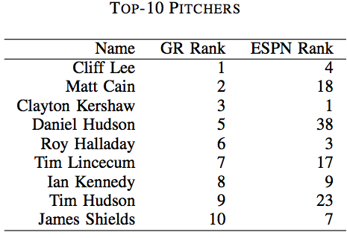
Comparison: top players
Top batters and pitchers found by GR, and their ESPN ranks.

Slide 33
Comparison: Difference
Batting Pitching
(Scatter of difference between GR and ESPN)

Slide 34
Comparison: Abs. Difference CDF

Slide 35
More comparison
We already see that GR rankings achieves similar results with ESPN rankings.
Now we want to prove that GR has better results than ESPN, with the intuition: players with better rankings should have higher probability to win in games.
if a ranking system is good, then under this system:
Pitchers with high ranks are more likely to win than pitchers with low ranks, and vise versa.
Pitchers at similar ranks are more likely to win batters with low ranks than with high ranks.

Slide 36
Comparison: Wining Rate
GR Rank ESPN Rank
Frequency for pitchers to win batters at different rank levels in GameRank/ESPN. Pitcher ranks are divided by 10; batter ranks are divided by 20.

Slide 37
Evaluation: Conclusion
GameRank achieves at least similar results with ESPN rankings
GameRank is even better than ESPN in terms of batting rankings, if we set the criteria as wining frequency.
GameRank can rank more (all) players.
GameRank has a stronger model considering relationships between players.

Slide 38
Analysis / Data Mining

Slide 39
Analysis conclusions
We analyze the networks with GR ranks, and found interesting results:
By studying the network’s out-degree distribution in different years, we found that recent players are getting closer in their skills than before.
By analyzing the pitchers’ GR batting values, we found that:
good pitchers are better than normal pitchers at batting.
Some bottom pitchers are great batters, because they do not usually pitch.

Slide 40
Analysis: out-degree distribution

Slide 41
Analysis: Pitchers’ batting ability
Better pitchers bat better.

Slide 42
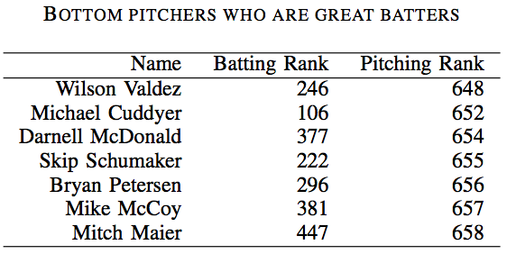
Analysis: bottom pitchers who bats well
Among the bottom pitchers, there are 7 pitchers who bats really well.
We manually check them and found: most of them do not take pitchers as their major fielding positions, although they once pitched in 2011 regular season.

Slide 43
Visualization: MLBIllustrator
http://mlbillustrator.com

Slide 44
Visualization
We built an online website MLBillustrator to visualize the network and GameRank values for players:
http://mlbillustrator.com
Then we do simple and initial analysis based on visualization.

Slide 45
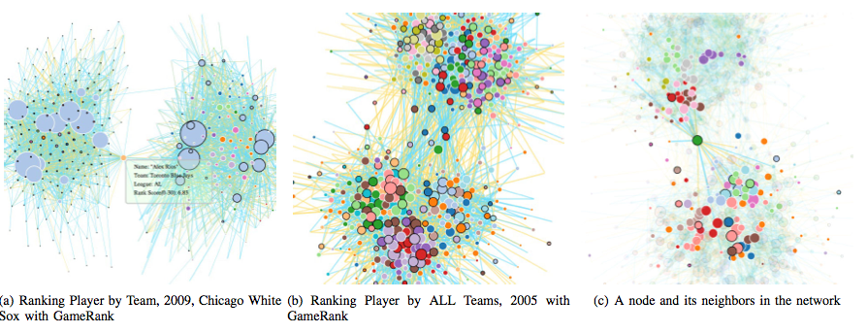
Visualization

Slide 46
Visual Analysis
In every year, the network consists of two large communities.
Because in MLB there is American League (AL) and National League (NL), and the two clusters are almost exactly AL and NL communities.
Both AL and NL play more inside themselves, but less across leagues.
Players in the middle of two communities: change teams across the league during the year.

Slide 47
Other use cases / Future work / Conclusion

Slide 48
Other Use Cases
GameRank algorithm is applicable for ranking networks with multiple indicators interplaying with each other.
Other sports networks
Soccer
Volleyball
Basketball

Slide 49
Future work
More analysis: find players that are overvalued/undervalued, etc.
Test the robustness of each team in the network of in-team supports.
Put players and teams into one heterogeneous network, and discover relationships between players and teams.
Use specific knowledge in baseball games to optimize the parameters (edge weights).

Slide 50
Contribution
We propose a ranking algorithm for networks with multiple indicators interplaying with each other.
We initially regard baseball games as a network, and rank the pitching and batting ability of players.
We analyze the baseball network and find interesting results.

