Slide 1
Custom Firmware for xDot
Group: Zifan Wang, Yuhan Qiu

Slide 2
Outline
xDot Hello World program
xDot Temperature Reading program
xDot Audio Detection program

Slide 3
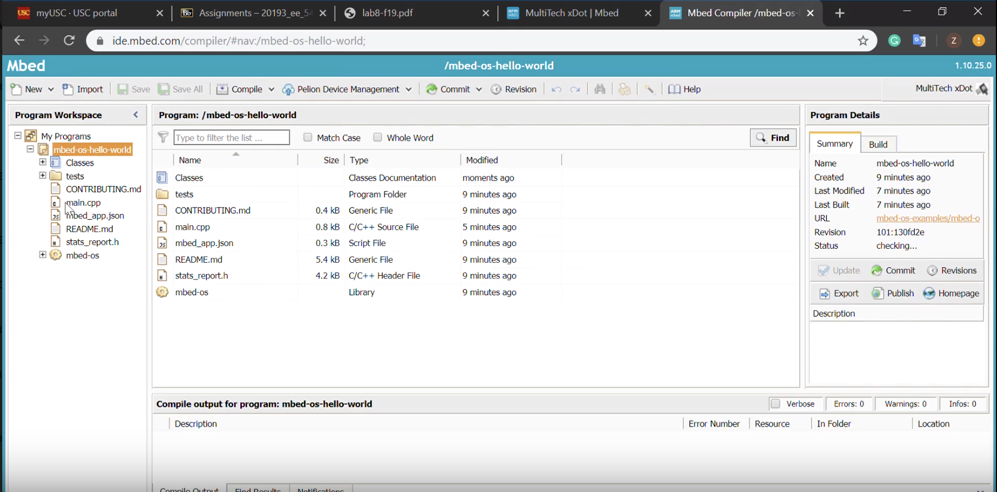
Hello World Program
Import mbed-os-example-blinky
Compile code
Download .bin file to xDot
After transmission, reset the xDot

Slide 4
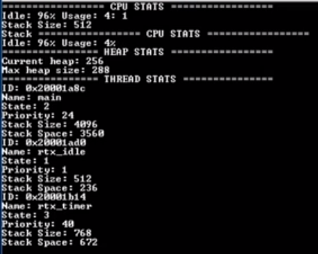
Hello World Program
Result:
The following figure shows the hello world program result. They shows the xDot system info.

Slide 5
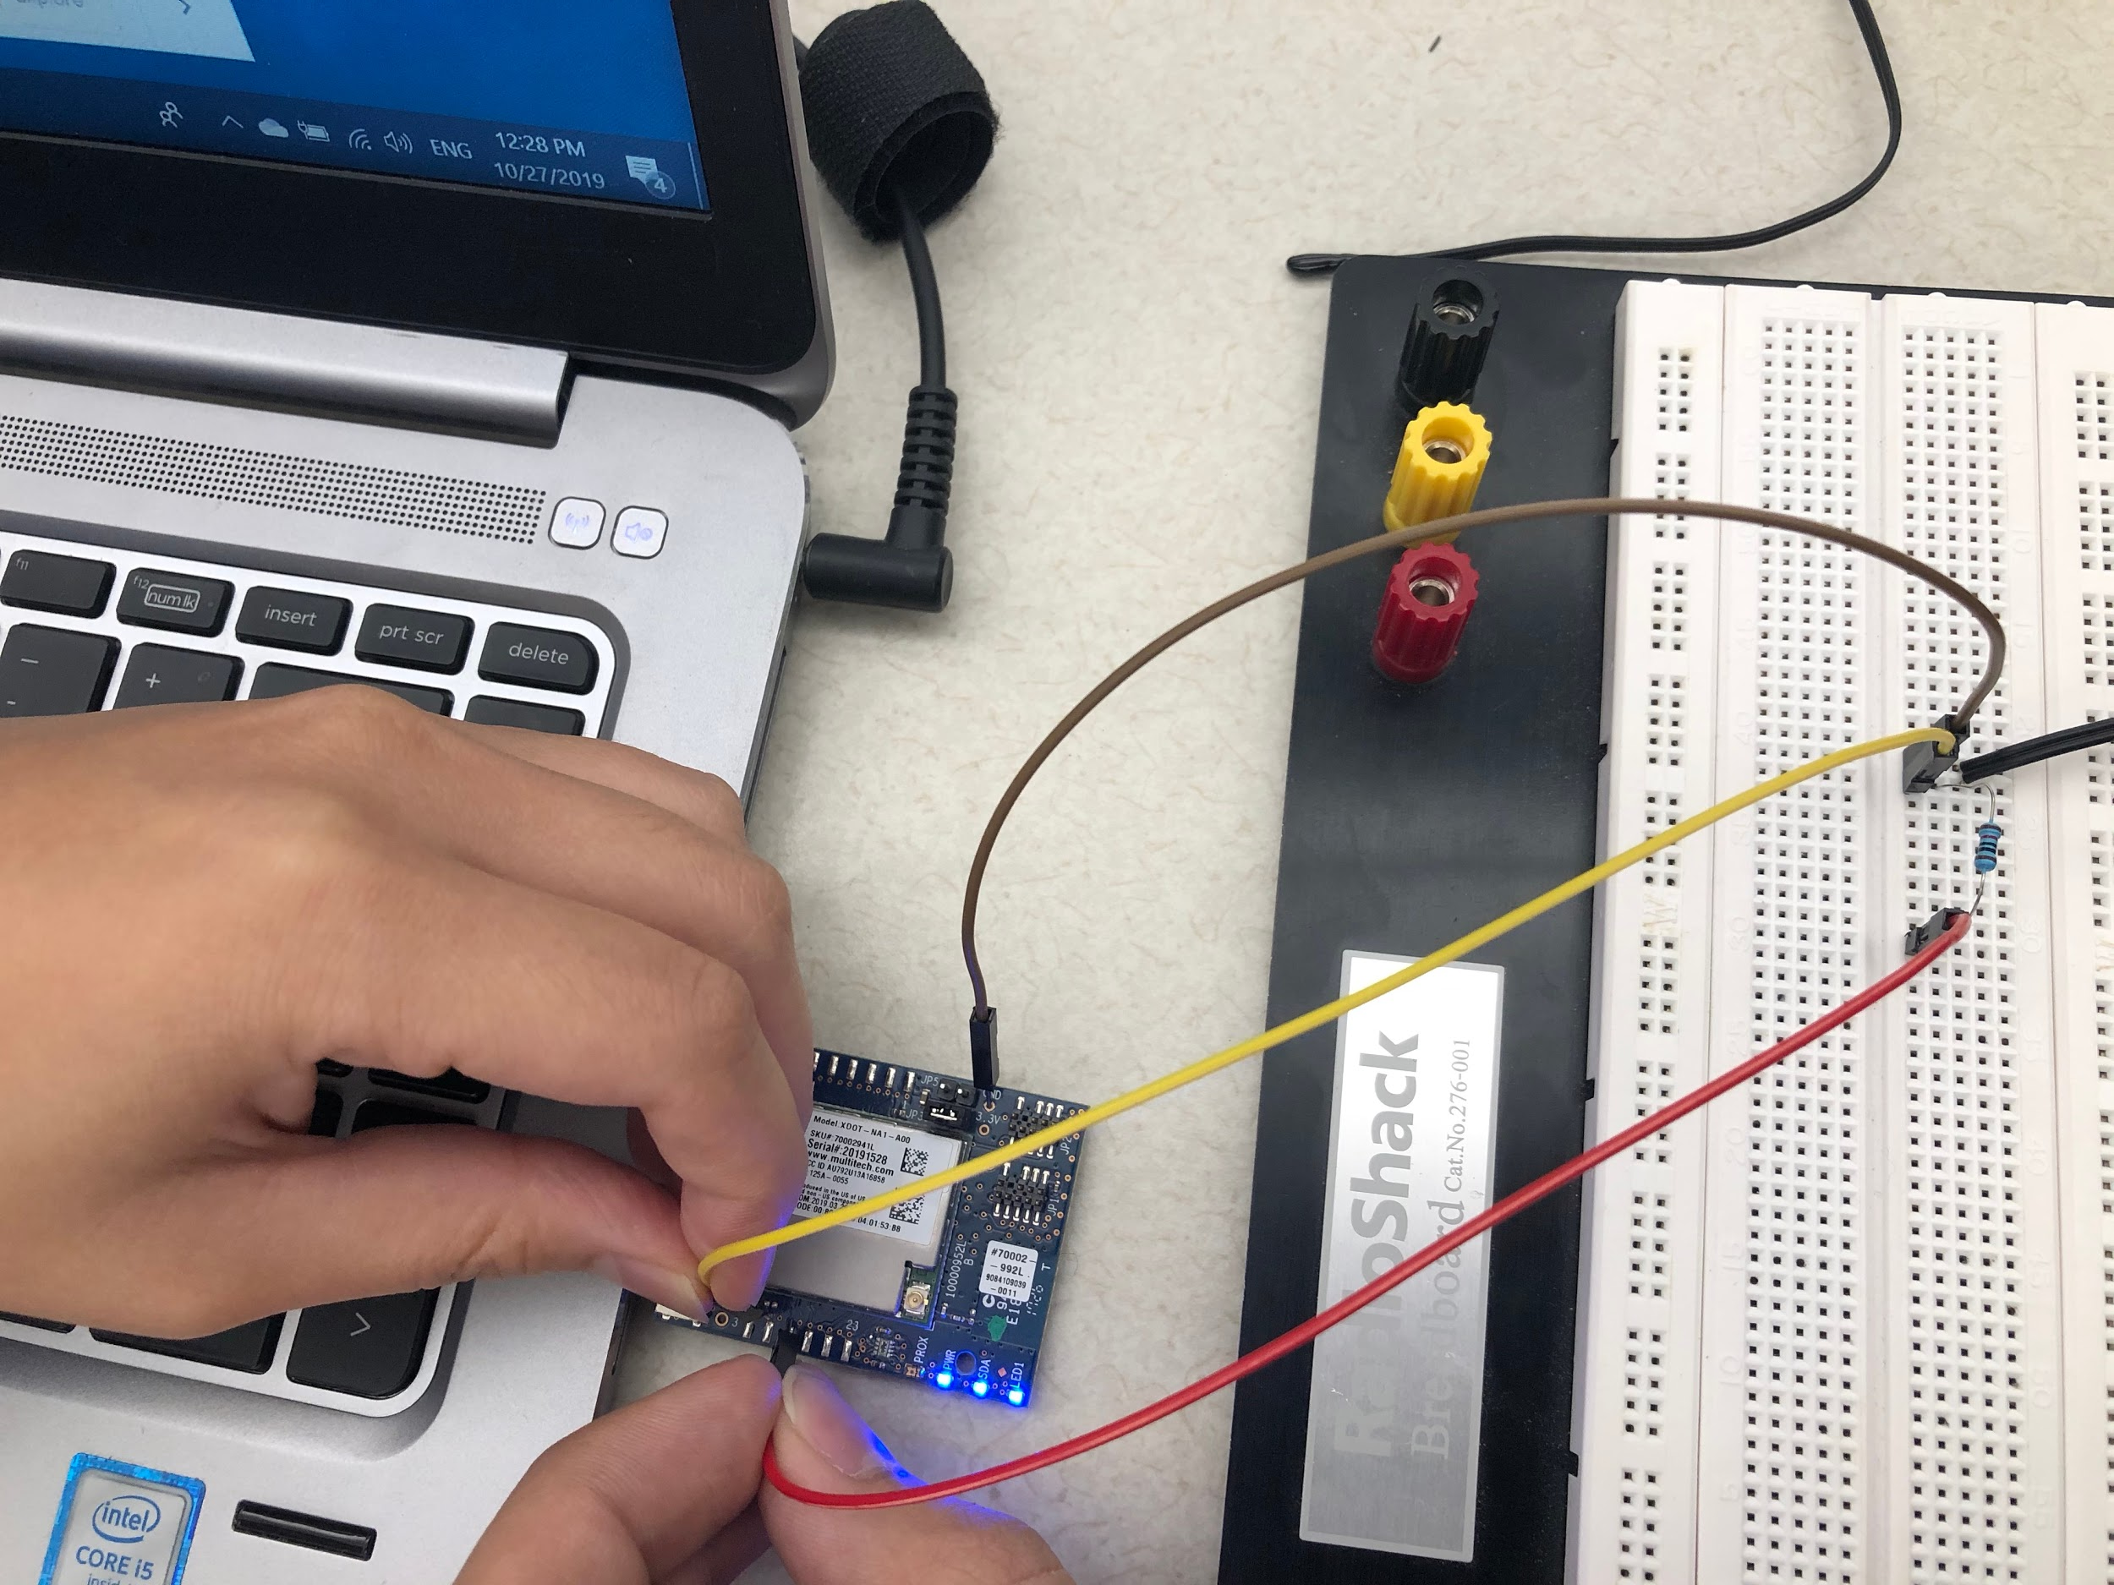
Temperature Reading Program
Steps:
Based on https://learn.adafruit.com/thermistor/using-a-thermistor, connect thermistor to xDot. We define Pin GND as ground port, Pin 15 (GPIO 2) as data capturing port, and Pin 17 (GPIO_0) as power provider which is 5v. The following figure shows our connection.

Slide 6
Temperature Reading Program
Steps:
2. In xDot program, define GPIO_2 as AnalogIn sensor and GPIO_0 as DigitalOut vcc.
3. In xDot program, convert the read-in value from GPIO_2 port to temperature in Celcius.
4. In xDot program, print out this value.
5. Upload this program to xDot.
7. Open Tera Term to see temperature readings.

Slide 7
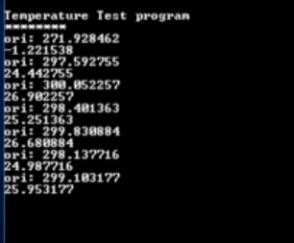
Temperature Reading Program
Result:
The following figure shows the result of our temperature reading program:

Slide 8
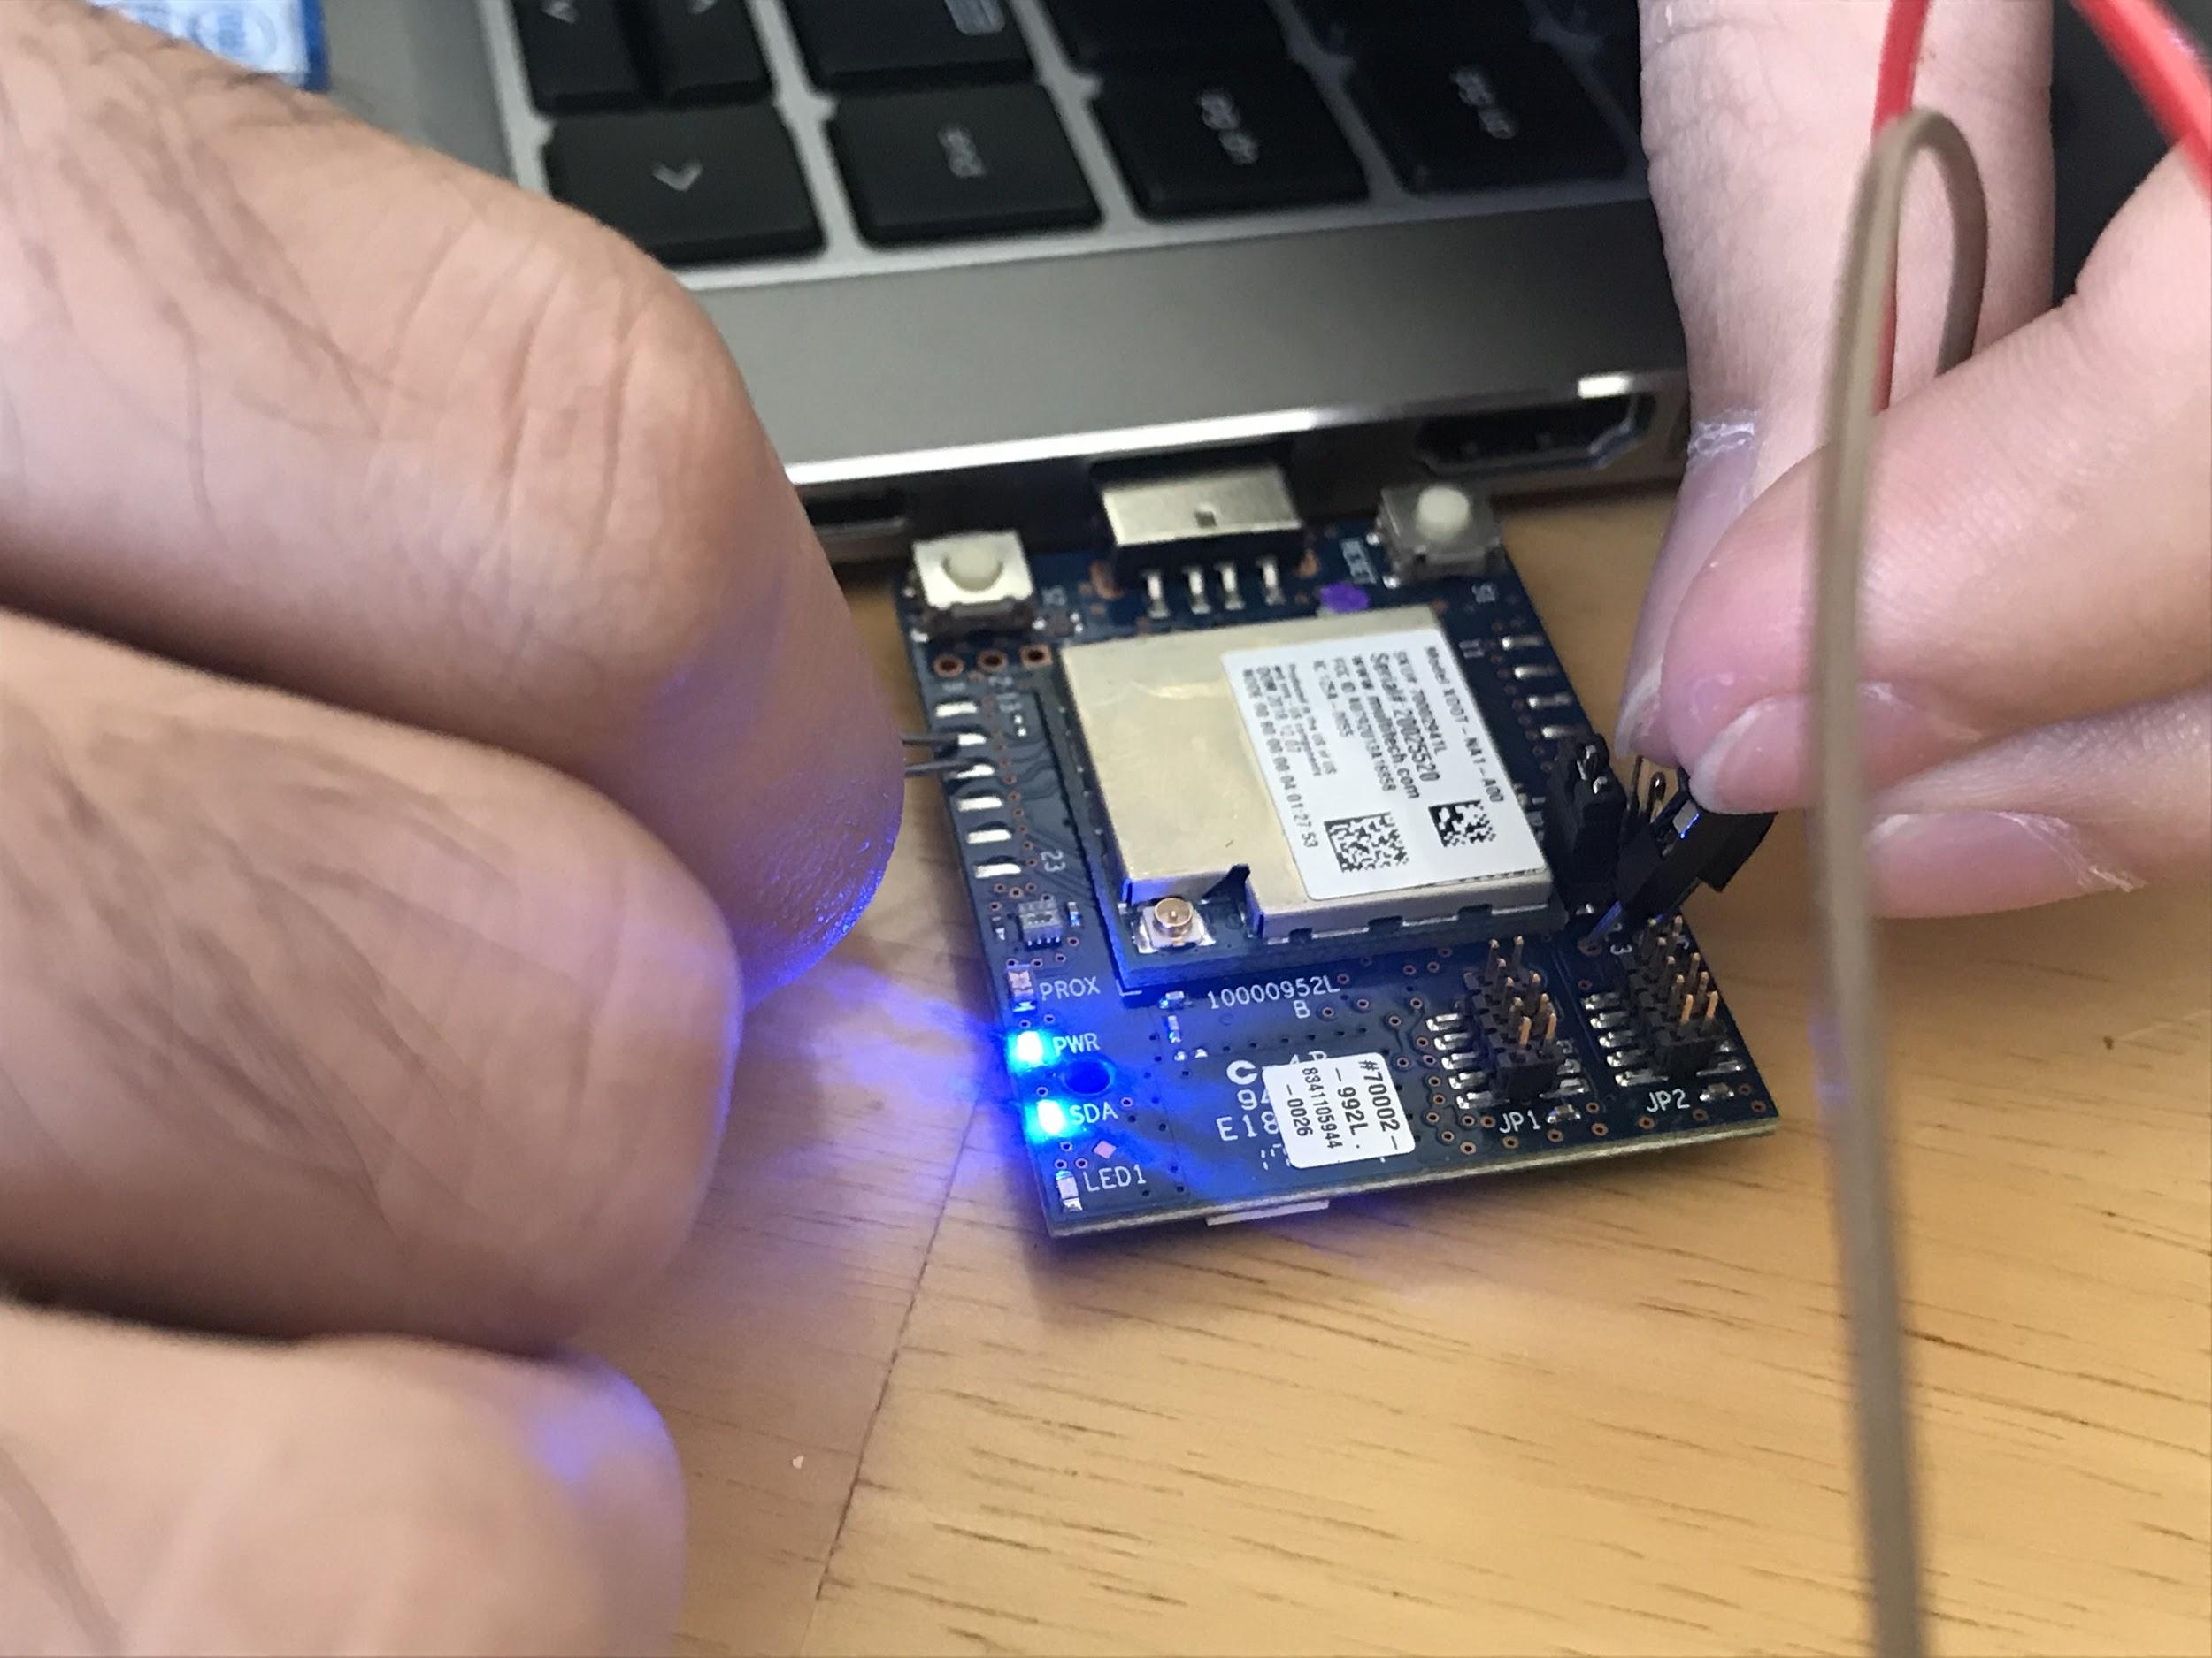
xDot Audio Detection Program
Steps:
Left audio input Gpio0
Right audio input : Gpio2
Ground connected to GND
Voltage connected to 3.3V
Circuit diagram on right side.

Slide 9
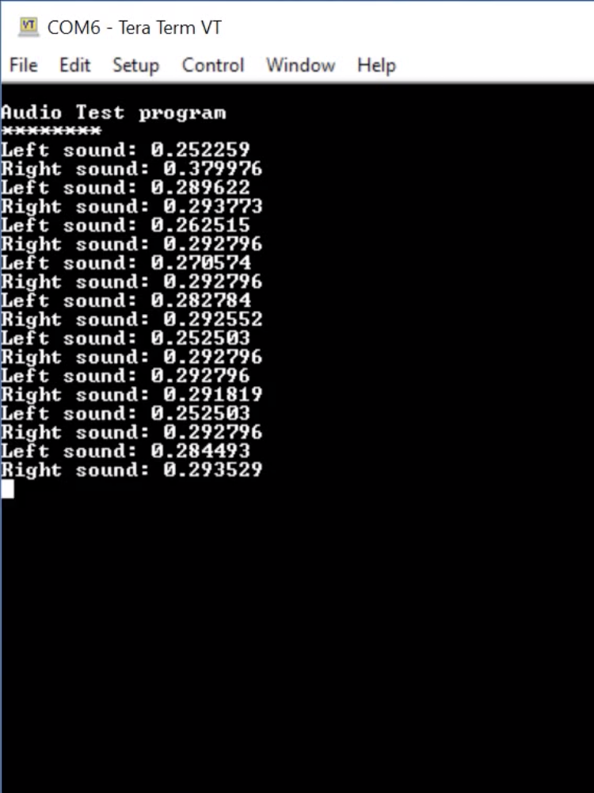
xDot Audio Detection Program Result

