Slide 1
Android Phone based IoT interactions with Node-Red and AWS IoT
Group: Zifan Wang, Yuhan Qiu

Slide 2
Outline
Install Termux & Termux API
Install Node-RED & Termux API Module on Termux
Launch Node-RED
See All the Sensors
Filter Light Sensor
AWS IoT Setup
Post Data From the Phone to AWS IoT
Visualize Data in AWS IoT

Slide 3
Install Termux & Termux API
In Google play, download Termux and Termux API.
https://play.google.com/store/apps/details?id=com.termux
https://play.google.com/store/apps/details?id=com.termux.api

Slide 4
Install Node-RED & Termux API Module on Termux
Using following command to install Termux API and Node-RED on Termux:
apt update
apt upgrade
apt install termux-api
apt install coreutils nodejs
apt-get install yarn
yarn global add npm
npm i -g --unsafe-perm node-red

Slide 5
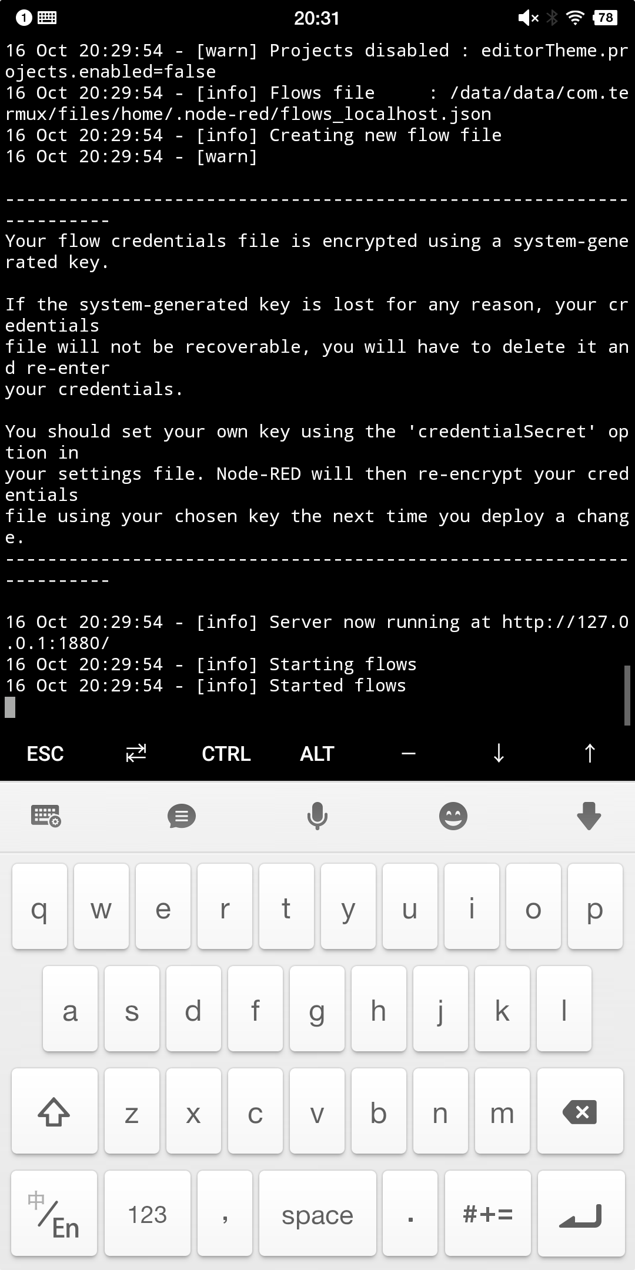
Launch Node-RED
In Termux, use “ifconfig” to find ip address of Android phone and launch Node-RED by “node-red” command. The following figure shows Node-RED is successfully launched in phone.

Slide 6
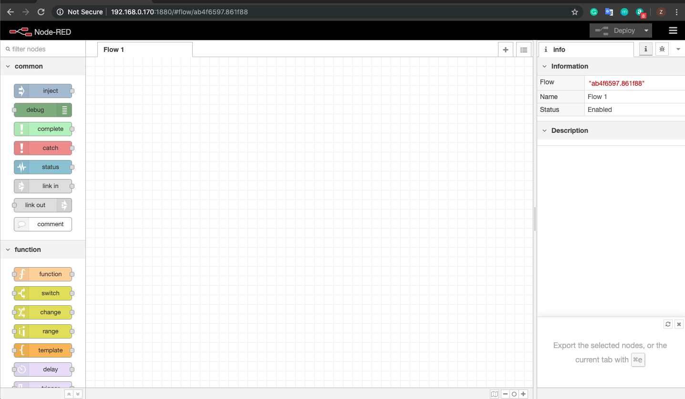
Launch Node-RED
In laptop, open an Internet browser and use phone’s ip address + “:1880” as ip address to connect with Node-RED in Android phone. For example, the ip address in my case is 192.168.0.170:1880. The following figure shows the successful launching of Node-RED in browser.

Slide 7
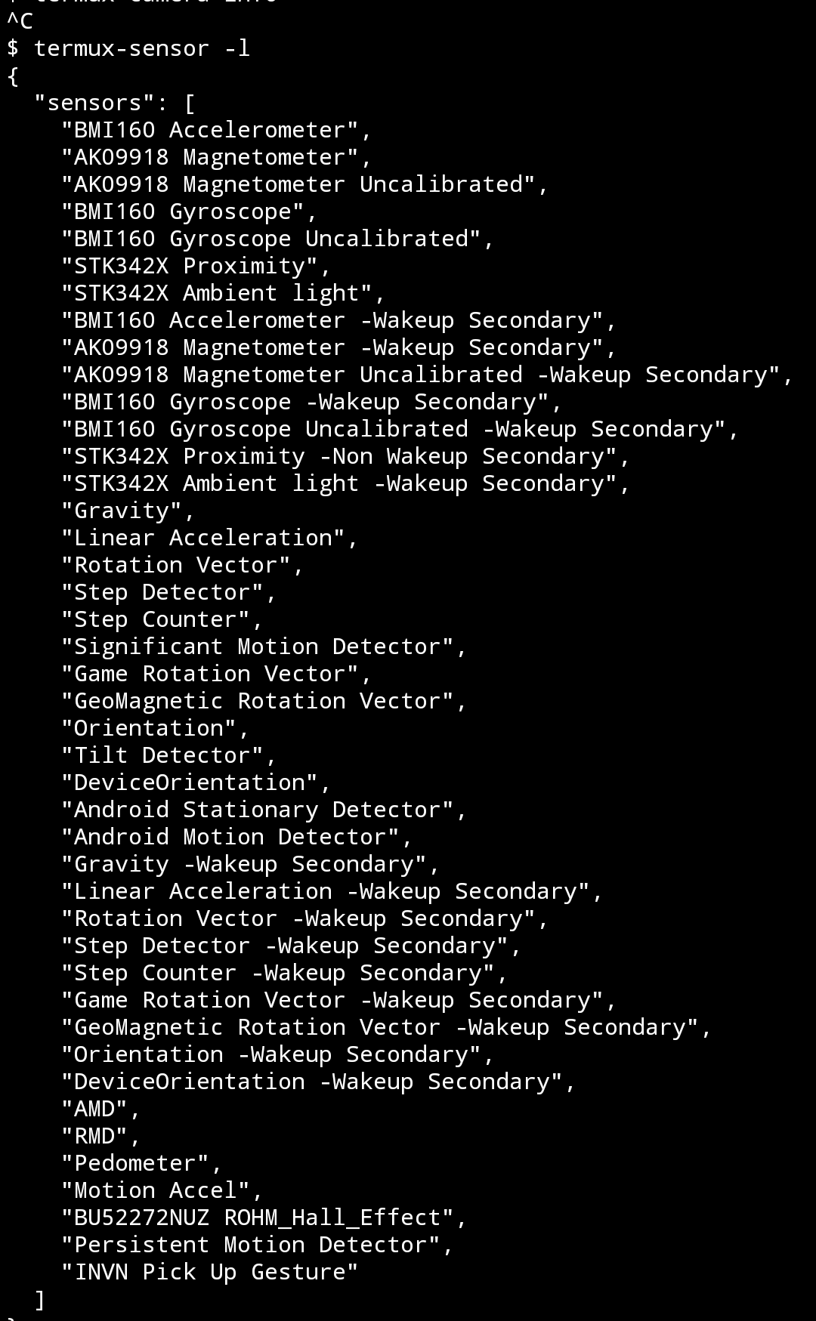
See All the Sensors
In Termux, use following command, “termux-sensor -l”, to print out all available sensors in Android phone. The following figure shows termux output of all available sensors.

Slide 8
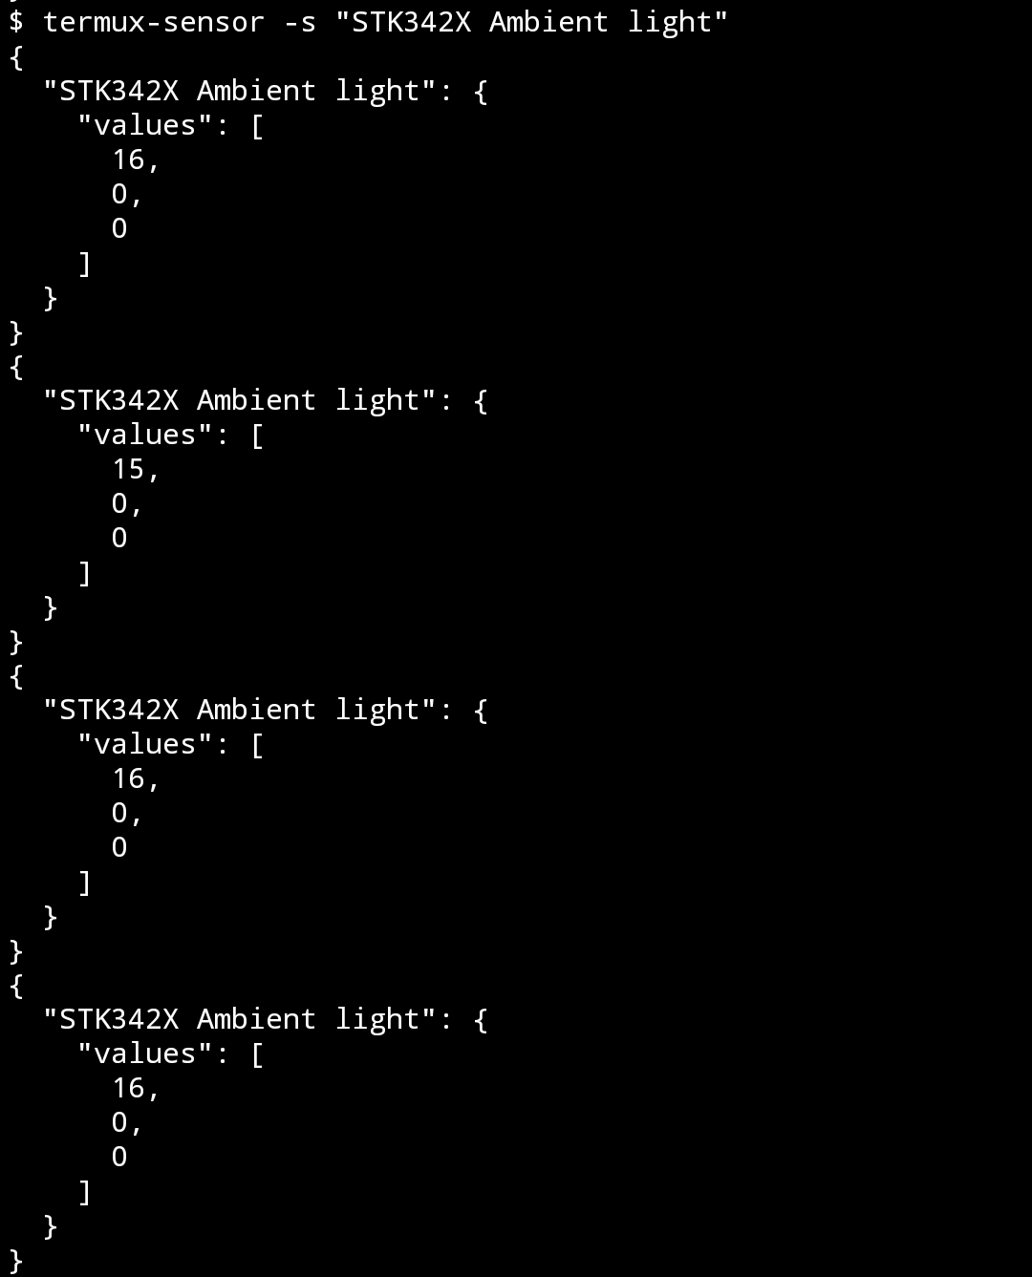
Filter Light Sensor
In termux, using “termux-sensor -s “Light Sensors” “to display the light sensor data. In out case, the light sensor is “STK342X Ambient light”. The following figure shows the light sensor data.

Slide 9
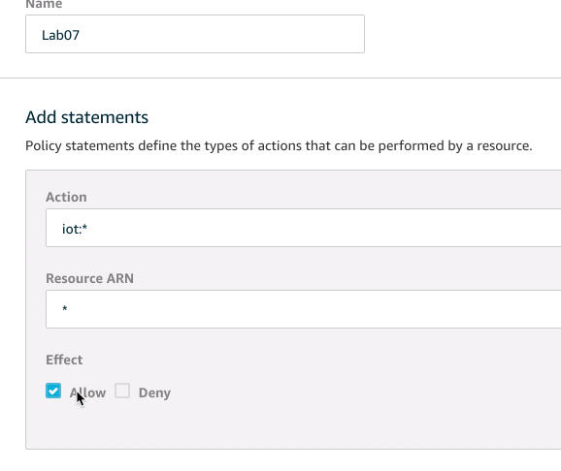
AWS IoT Setup
In AWS IoT Core console, create a new policy in the “Policies” tab under “Secure”. In the “Action field, enter: "iot:*" for all IoT actions, and under the “Resource ARN” field, enter "*" for all devices and topics. Check “Allow” for the “Effect” field. The following figure shows the setting of new policy.

Slide 10
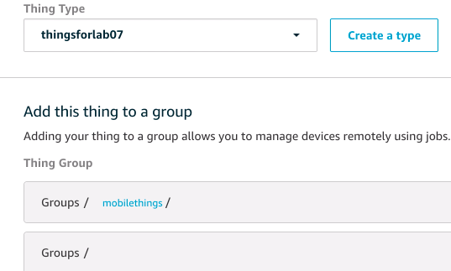
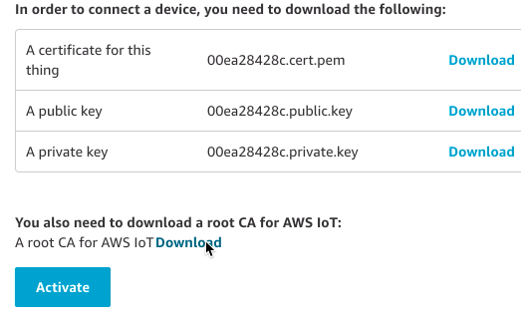
AWS IoT Setup
In the AWS IoT Core console, create a new device in the “Things” tab under “Manage”. Name your device, create a new type, and a new group for your IoT device. Select “One-click certificate creation” and download your certificate, public, and private keys for your device. Make sure to click on “Activate” for your root certificate.

Slide 11
Post Data From the Phone to AWS IoT
Setting up data flow architecture in Node-RED by using import in Hamburger Menu on the Top Right. The following json language is used to import external data flow
[{"id":"c12e9e18.651ae","type":"tab","label":"Flow 3","disabled":false,"info":""},
{"id":"bec0b05.54ba45","type":"inject","z":"c12e9e18.651ae","name":"","topic":"","payload":"","payloadType":"date","repeat":"1","crontab":"","once":true,"onceDelay":"","x":170,"y":200,"wires":[["a9c3b25c.f6cc1"]]}, {"id":"a9c3b25c.f6cc1","type":"exec","z":"c12e9e18.651ae","command":"","addpay":true,"append":"","useSpawn":"false","timer":"","oldrc":false,"name":"","x":210,"y":300,"wires":[["dda5983.8467f68"],[],[]]},
{"id":"dda5983.8467f68","type":"json","z":"c12e9e18.651ae","name":"","property":"payload","action":"","pretty":false,"x":550,"y":380,"wires":[["3fed63c8.f80ccc"]]},
{"id":"3fed63c8.f80ccc","type":"function","z":"c12e9e18.651ae","name":"Get the number","func":"msg.payload.light_sensor = msg.payload[\"STK342X Ambient light\"][\"values\"][0];\nreturn msg","outputs":1,"noerr":0,"x":610,"y":260,"wires":[["a8cd33f3.1c049"]]},{"id":"6d1fabef.8f4bf4","type":"http request","z":"c12e9e18.651ae","name":"","method":"POST","ret":"txt","url":"","tls":"","x":370,"y":60,"wires":[["e7c0faa5.356a38"]]},{"id":"a8cd33f3.1c049","type":"function","z":"c12e9e18.651ae","name":"Format for PowerBI Stream","func":"var timestamp = new Date()\nmsg.payload = JSON.stringify([{\"light_sensor\":msg.payload.light_sensor,\"datetime\":timestamp}]);\nreturn msg;","outputs":1,"noerr":0,"x":500,"y":140,"wires":[["6d1fabef.8f4bf4"]]},
{"id":"e7c0faa5.356a38","type":"debug","z":"c12e9e18.651ae","name":"","active":true,"tosidebar":true,"console":true,"tostatus":false,"complete":"payload","x":640,"y":60,"wires":[]}]

Slide 12
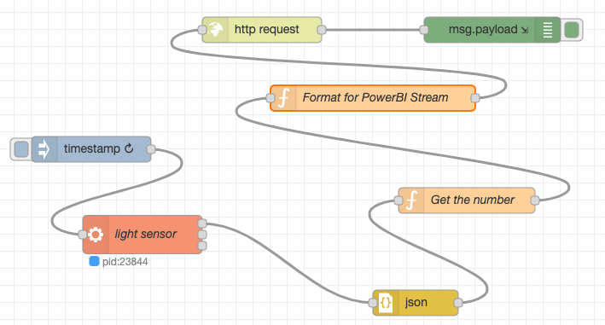
Post Data From the Phone to AWS IoT
After the previous process, the following data flow architecture should be in the Node-RED.

Slide 13
Post Data From the Phone to AWS IoT
Click on exec node and put in termux-sensor -s "Light Sensor Name"-n 1. In my case, the "Light Sensor Name" is “STK342X Ambient light”
Modify the "Get the number" node to the name of your light sensor.
In the HTTP request node, set method to "Post" and paste the endpoint URL that we got from AWS IoT. URL example: XXXX-ats.iot.us-east-1.amazonaws.com:8443/topics/myTopic?qos=1.
Check the box for “Enable secure SSL/TLS connection” and leave it as a TLS connection. Click on the pencil to open the “Properties” menu. Upload the root certificate, private key, and certificate files for your device in the fields listed. Save your changes to the node and exit the configuration menu.
Deploy the data flow architecture and run this architecture.

Slide 14
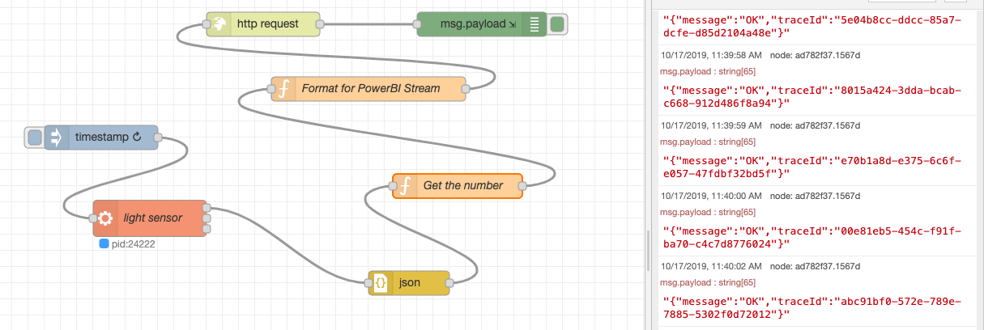
Post Data From the Phone to AWS IoT
The following figure show a successful deployed data flow architecture

Slide 15
Visualize Data in AWS IoT
Create AWS EC2 instance and follow the link to install ThingsBoard CE on EC2 instance.
https://thingsboard.io/docs/user-guide/install/ubuntu/
Create a Device configuration in Thingsboard and get access token. For example, in our case, the access token is:
EeZWk8EaVVZJNsWgjDW1
Change the address of http request in the Node-RED to the AWS EC2 instance public DNS. For example, in our case:
http://ec2-54-215-190-81.us-west-1.compute.amazonaws.com:8080/api/v1/EeZWk8EaVVZJNsWgjDW1/telemetry

Slide 16
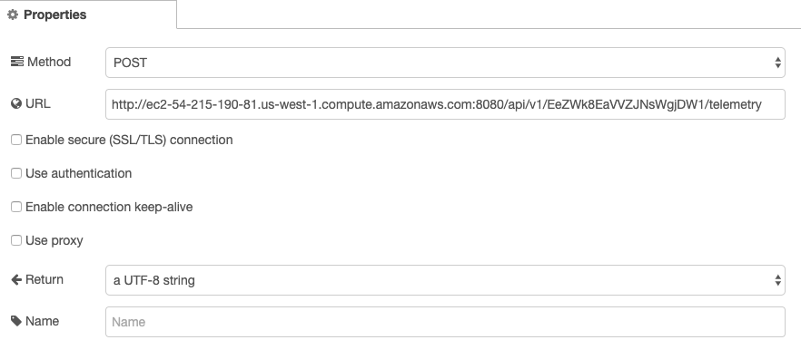
Visualize Data in AWS IoT
The following figure shows how to change http request address

Slide 17
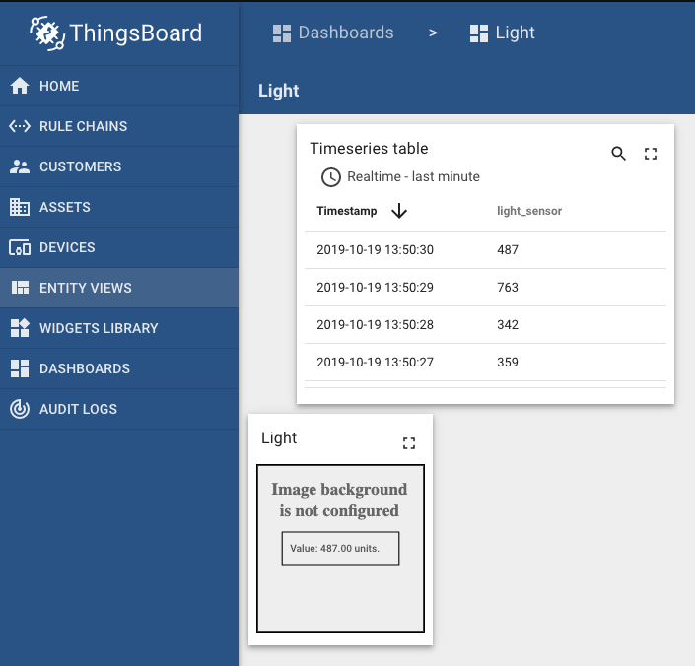
Visualize Data in AWS IoT
The following figure shows the real-time illuminant level change in the Thingsboard.

