Slide 1
Lab 02 Report
Group: Yuhan Qiu, Zifan Wang

Slide 2
Outline
Exploring Bandwidth and Throughput
Bandwidth-Delay Product
Connect Linux computers with 1 Gbps router
Latency experiments
Link speed experiments
Send/Receive windows to 2 Mbyte
TCP Send/Receive windows experiments
Result
Bandwidth, Delay, and Loss
RTT
Bandwidth-delay product
Performance
Scale the send/receive windows
Set the send/receive windows values to small value
Result
Packet Loss Experiment
iPerf hints
Report the highest bandwidth possible with no packet loss.
Secure Copy
RTT & Bandwidth-delay product
Explain commands
Transfer throughput
Explore RTT delays at least up to 50ms.
SCP
Loss experiment in file transfer
The delay and loss from Los Angeles to Switzerland.

Slide 3
1.1 Bandwidth-Delay Product Experiment
Connect Linux computers with 1 Gbps router
Latency experiments
Link speed experiments
Send/Receive windows to 2 Mbyte
TCP Send/Receive windows experiments
Result

Slide 4
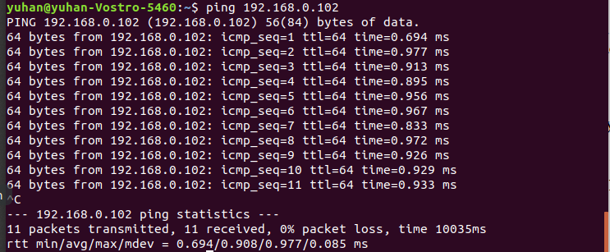
Connect Linux computers with 1Gbps router
Measure the round-trip delay between two machines by PING tool.
RTT = 0.920 ms

Slide 5
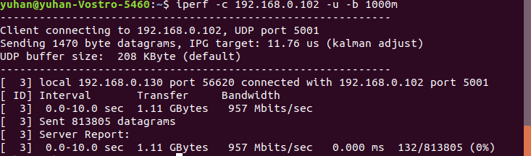
Connect Linux computers with 1Gbps router
Measure the maximum bandwidth by using iperf in UDP mode.
Bandwidth = 957 Mbps

Slide 6
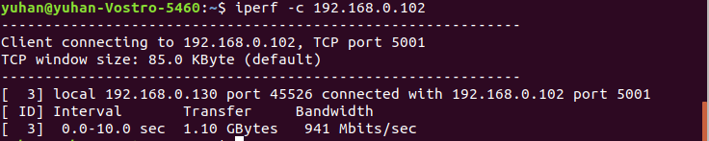
Connect Linux computers with 1Gbps router
Measure the TCP throughput by using iperf.
Throughput = 941 Mbps

Slide 7
Latency Experiment
‘Netem’ Experiment Steps:
Find port number by using ‘ip address’ in Linux terminal. The port number is enx70886b8730e8
Setting 100ms delay by using sudo tc qdisc add dev enx70886b8730e8 root netem delay 100ms
Experiment with other 4 delays (10ms, 50ms, 200ms, 500 ms)

Slide 8

Latency Experiment
Latency Experiment Result:

Slide 9
Link Speed Experiment
Link Speed Experiment Steps:
Use the following command to change both computers maximum speed of Ethernet link to 10Mbps: # sudo ethtool -s eth0 speed 10 , here eth0 stands for network link in computer
Experiment with speed 10 Mbps, 100 Mbps, 1000 Mbps

Slide 10
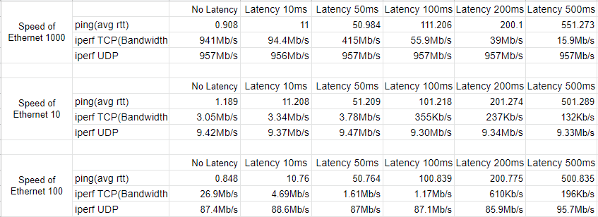
Link Speed Experiment
Link Speed Experiment Results:

Slide 11
Link Speed Experiment
Link Speed Experiment Results Comments:
The link speed would affect TCP’s throughput and UDP’s bandwidth dramatically. However, the average round trip delay was not influenced largely. The link speed determined the maximum number of speed computers can used to deliver the packets. Higher speed, more packets could be spent. Therefore, TCP’s throughput and UDP’s bandwidth would increase. The surprising part was the average RTT does not change very much.

Slide 12

Link Speed Experiment
Receive and send network buffer sizes

Slide 13

Send/Receive windows to 2 Mbyte
Change the send and receive windows to 2 Mbyte

Slide 14
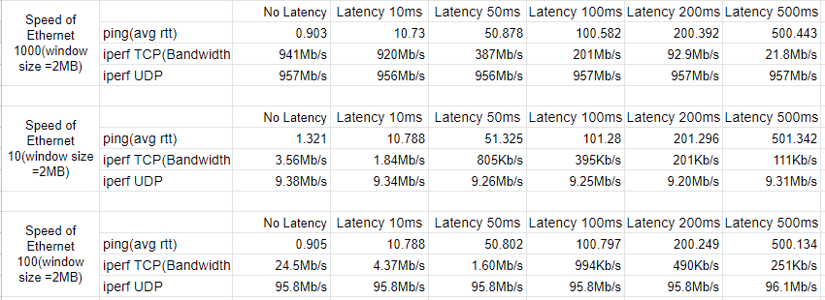
Send/Receive windows to 2 Mbyte
Results:

Slide 15
Send/Receive windows to 2 Mbyte
Comments:
From the results in the previous slide and in link speed experiment, we found when we decreased the maximum size of send and receive windows, the rtt increased, TCP’ s throughput decreased, and UDP’s bandwidth decreased. Decreasing the send and receive windows’ size could cause less bytes could be sent or read by computers. Therefore, it could cause the situation shown in the results.

Slide 16
TCP Send and Receive Windows Experiment
Steps:
Use the following command in both computers to change the send and receive windows’ size:
Server: iperf -s -w 65535
Client: iperf -c serverIPAddress -w 65535 -r

Slide 17
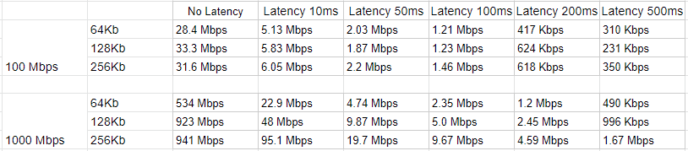
TCP Send and Receive Windows Experiment
Results:

Slide 18
Bandwidth-Delay Product Results
Comments:
From the experiment result, we could notice that the link speed, send/receive windows size, and latency could affect the TCP throughput. The higher link speed, the larger TCP throughput. The lower latency, the larger TCP throughput. The optimal send/receive windows size which can be calculated by bandwidth and delay could return the best TCP throughput.

Slide 19

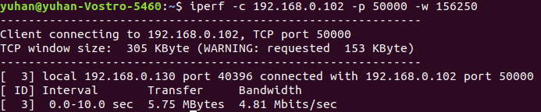
Bandwidth-Delay Product Results
At 100Mbit/s and 25ms of delay, what is the theoretically optimal send/receive window size?
If you run your experiment at this size, do you get 100Mbit/s of throughput?
No, we did not get 100Mbit/s throughput
If yes, why? If not, what could cause your link to run at less than full bandwidth?
We believe this is caused by the delay. The delay caused congestion and therefore caused loss packets.

Slide 20
1.2 Bandwidth, Delay, and Loss Experiment
In this experiment, the network operates at 1Gbps with 25ms delay by using following commands
sudo ethtool -s eth0 autoneg off speed 1000
sudo tc qdisc add dev eth0 root netem delay 25ms
RTT
Bandwidth-delay product
Performance
Scale the send/receive windows
Set the send/receive windows values to small value
Result
Packet Loss Experiment

Slide 21
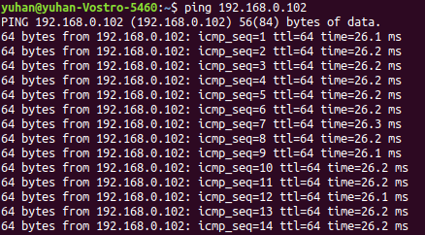
RTT between computers
RTT = 26.2 ms

Slide 22
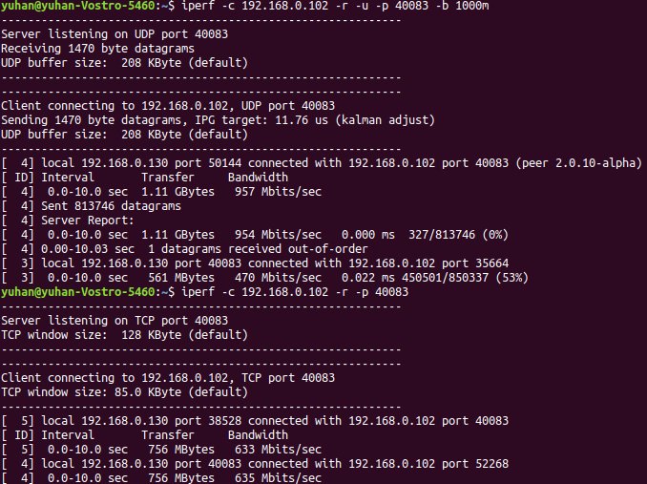
Bandwidth-Delay Product
Bandwidth-Delay Product = Bandwidth * Delay = 1Gbps * 25ms = 3.125 Mbyte
Iperf UDP in the following graph
Iperf TCP in the following graph

Slide 23
Performance
If you left the send/receive windows at their default values, would this link perform well?
From the previous slide, in the default situation, the UDP’s bandwidth could still achieve 957 Mbps and the TCP’s throughput could still reach 633Mbps. We believe the send and receive windows at their default values perform well.

Slide 24
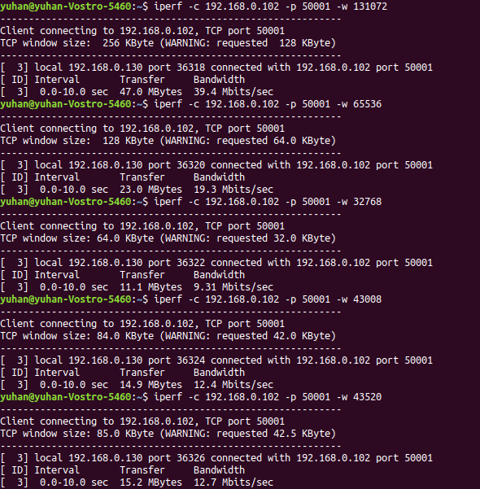
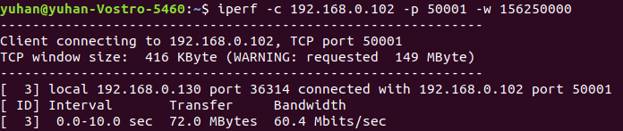
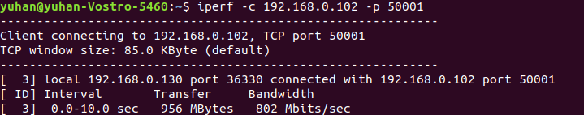
Scale the Send/receive Windows
The send and receive windows’ size could affect the throughput of TCP connection. Therefore we can scale the send and receive windows to see the effect of a bandwidth-delay product and TCP window size mismatch. The following graphs shows how changing the send and receive windows’ size could influence TCP’s throughput:

Slide 25
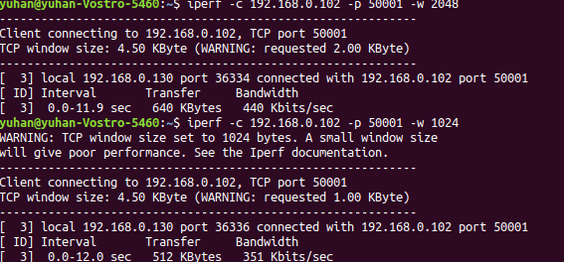
Set the Send/receive Windows to Small Values
Set the send/receive window values to something too small. Now measure the TCP throughput. What happened?
In this experiment, we changed our TCP’s windows size to 4.5 KByte. And use iperf to measure the throughput. The following graph is what we got from experiment. According to the graph, we also saw a dramatically decreased throughput comparing to the previous one.

Slide 26
Result
As the experiment results shown, the send and receive window size could affect the TCP throughput. When the delay happens, the optimal send and receive window size is able to return the best TCP throughput.

Slide 27
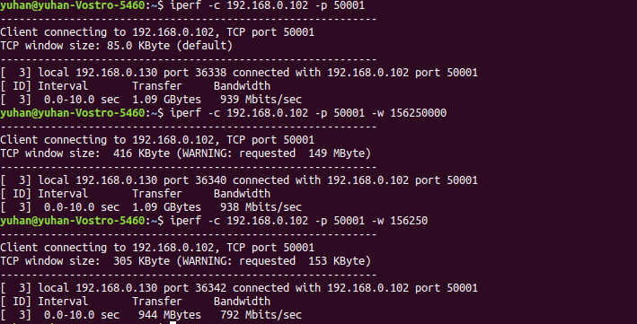
Result
Experiment results of
One gigabit speed link with 1ms delay.

Slide 28
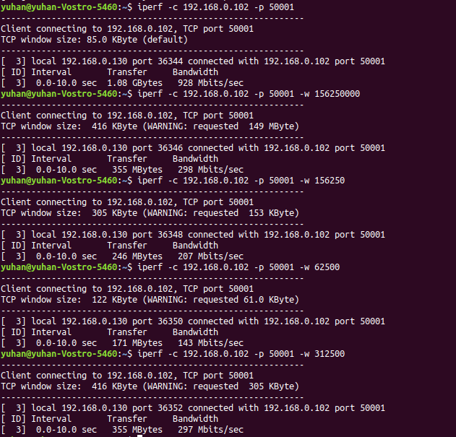
Result
Experiment results of
One gigabit speed link with 5ms delay.

Slide 29
Result
Specifically, what happens if we have a gigabit speed link with 1ms of delay? 5ms?
The theoretical optimal send and receive window size should be the largest hardware can support.
However, when use the default TCP window size in iperf, could also return the best throughput.
Would you be happy with a 1GB DSL connection knowing you can only control the receive window size (hint: the RTT to the east coast of the US from Los Angeles can be 50ms or greater)?
No, we would not be happy since we only can control the receive window size. The optimal TCP throughput is also affected by the send window size. If the send window size much larger than the receive window size, the TCP throughput can be low.

Slide 30
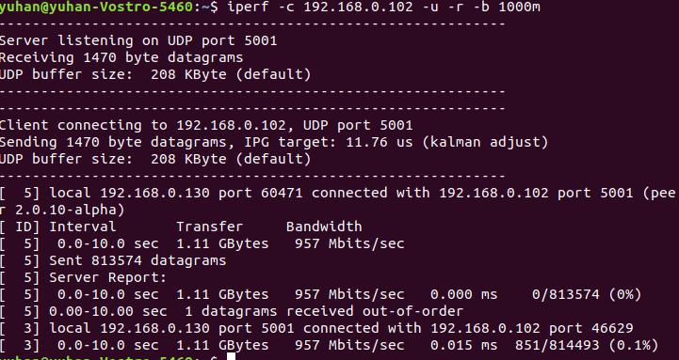
Packet Loss Experiment
The ‘netem’ could be also used to set a packet loss to linux computer. The following command provides such function: sudo tc qdisc change dev eth0 root netem loss 0.1%. This would cause 1 out of 1000 packets to be randomly dropped.
Experiment Results:

Slide 31
1.3 Iperf Hints
Report the highest bandwidth possible with no packet loss:
From all the experiment in the first section, we found the highest bandwidth possible with no packet loss was 50 Mbps

Slide 32
2. Secure Copy
1.First thing we did is to set the network operate at 100Mbp/s.
2.install openssh server and client package on each device.
3.In yuhan’s laptop, we created a random 200MB file in /mnt using “cd /mnt” to locate at mnt and using “dd if=/dev/urandom of=data.bin bs=1M count=200” command to create the file. For dd command, “dev/urandom” is input and “data.bin” is output. Bs is used to set unit of block and count is used to set the size of the block.(Answer for Q5)
4.Using “scp data.bin zifwang@192.168.0.112:~/mnt “ to copy this data.bin file to zifan’s laptop, and allocate this file at /mnt.

Slide 33
Q7 What transfer throughput do you get?
Throughput is 2.9MB/s.

Slide 34
Q8.Throughput when we increase dealy
1. Check the throughput when we set the delay to 25ms and window size is default. We took the screenshot after the throughput went stable. It’s 337.68KB/s
2.Maximum window size
Maximum window size doesn’t work very well because default window size is already big enough which is close to maximum size.

Slide 35
Q9.scp built-in limitation
Scp uses ssh protocol to transfer. SSH has protocol implementation and encryption overhead that based on the amount of CPU processor and memory (used in internal flow control buffers) resources given to that transfer session. The buffers and limited availability of resources often end up become a bottleneck for network throughput of SCP, especially on long and high bandwidth network links.

Slide 36
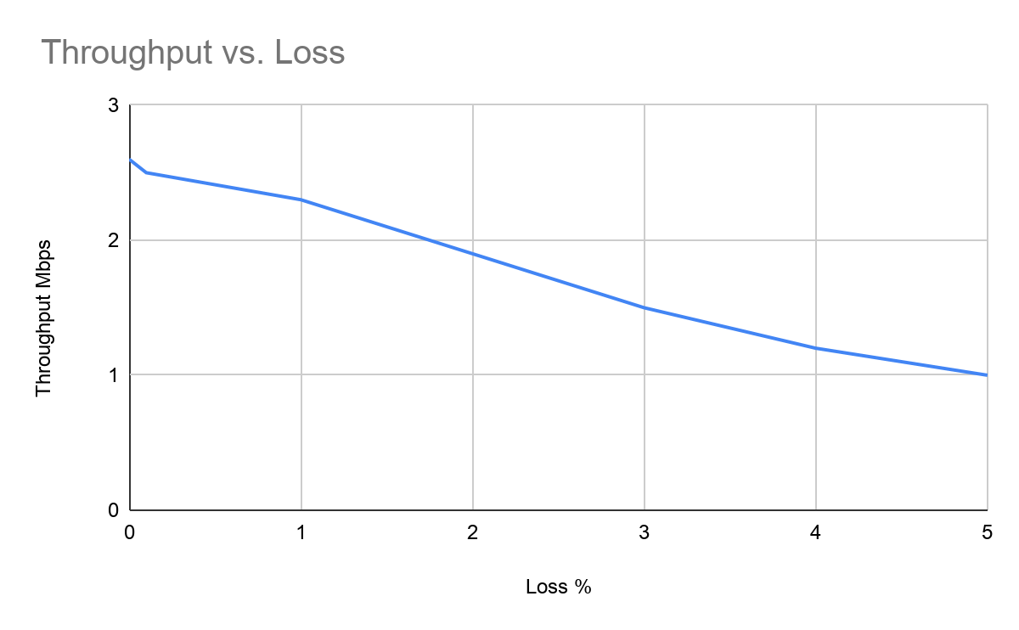
Q10.Set different packet-loss situation
From the result chart we can see that along with the packet-loss percentage goes up, throughput goes down. It’s not very extreme. In this case, if the number of loss-packets increase, TCP protocol will resent these packets to ensure nothing is left. That’s TCP property. Therefore, for the same size of file high percentage loss condition will request more time to finish the job, which leads to low throughput.

Slide 37
Q11.Delay and Loss between Los Angeles and Switzerland.
1.Distance between these two place is 9549 kilometers.
Delay = Distance/ lightspeed= 9549000/3*10^8 =0.03s=30ms.
But the delay in practice will be larger than this value because files are not transferred in straight line,
2.It’s hard to estimate the loss because data we are transferring will get through so many different routers and unpredictable circumstance like link congestion, bad cable, loose connection and duplex mismatch. We need more information like what kind of network he will use such as wired or wireless.

