Slide 1
Spark Programming
Group: Zifan Wang, Yuhan Qiu

Slide 2
Outline:
PySpark
AWS Elastic MapReduce

Slide 3
PySpark
Install docker, pyspark in the local machine or AWS EC2 machine
sudo apt-get update
sudo apt-get install \ apt-transport-https \ ca-certificates \ curl \ gnupg-agent \ software-properties-common
curl -fsSL https://download.docker.com/linux/ubuntu/gpg | sudo apt-key add -
sudo apt-key fingerprint 0EBFCD88
sudo add-apt-repository \ "deb [arch=amd64] https://download.docker.com/linux/ubuntu \ $(lsb_release -cs) \ stable"
sudo apt-get update
sudo apt-get install docker-ce docker-ce-cli containerd.io
sudo docker run hello-world #testworking
sudo pip3 install pyspark #testworking

Slide 4
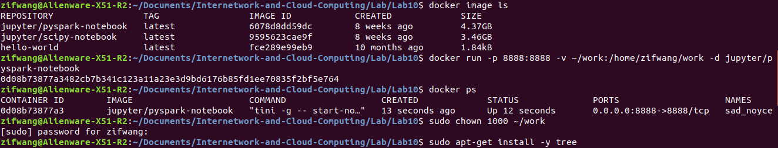
PySpark
Install Docker image with PySpark Notebook
Show docker’s container and start PySpark Jupyter-notebook:

Slide 5
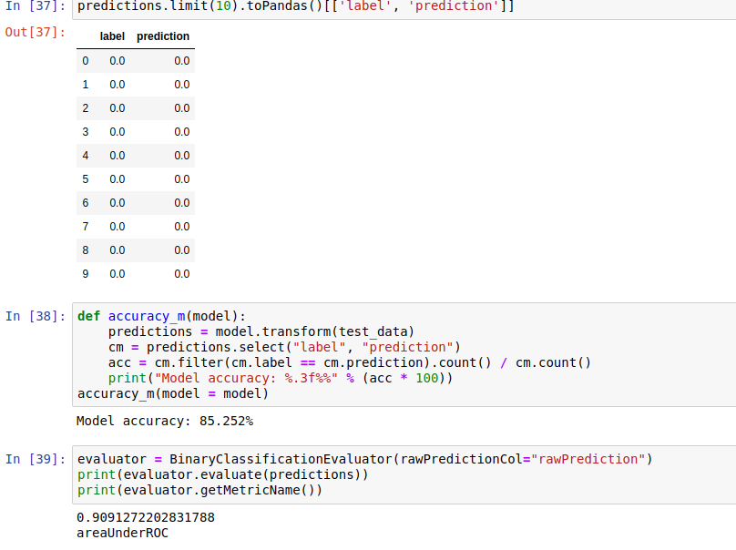
PySpark
Machine Learning PySpark Introduction Tutorial Result:

Slide 6
PySpark
Machine Learning on “Smartphone-Based Recognition of Human Activities and Postural Transitions Data Set”:
Load and parse data
Build Random Forest classifier
Evaluate model

Slide 7
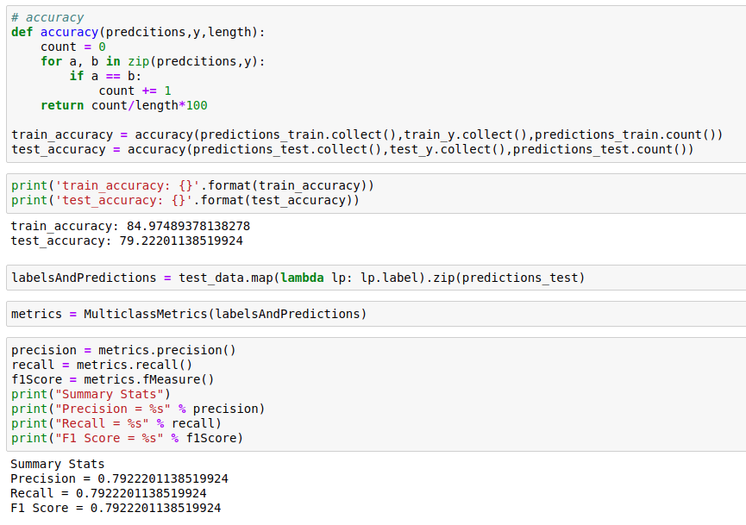
PySpark
Machine Learning on “Smartphone-Based Recognition of Human Activities and Postural Transitions Data Set” — Result:

Slide 8
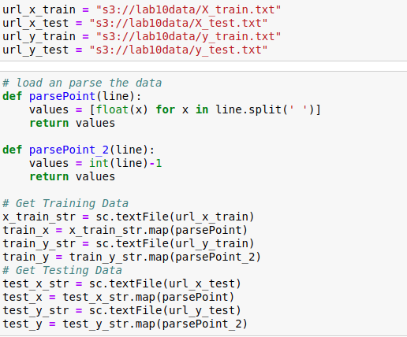
AWS Elastic MapReduce
Upload the smartphone data from the previous part into an S3 bucket
Go to EMR in the AWS console and click on the “Notebook” tab. Create a new notebook with a two node cluster of instance type c5.xlarge.
In EMR, your SparkContext object is already created so you don’t have to declare it. You can reference it using “sc” as usual. You will also have to reference files from S3 instead of a local file directory. The following figure shows example of getting data from S3:

Slide 9
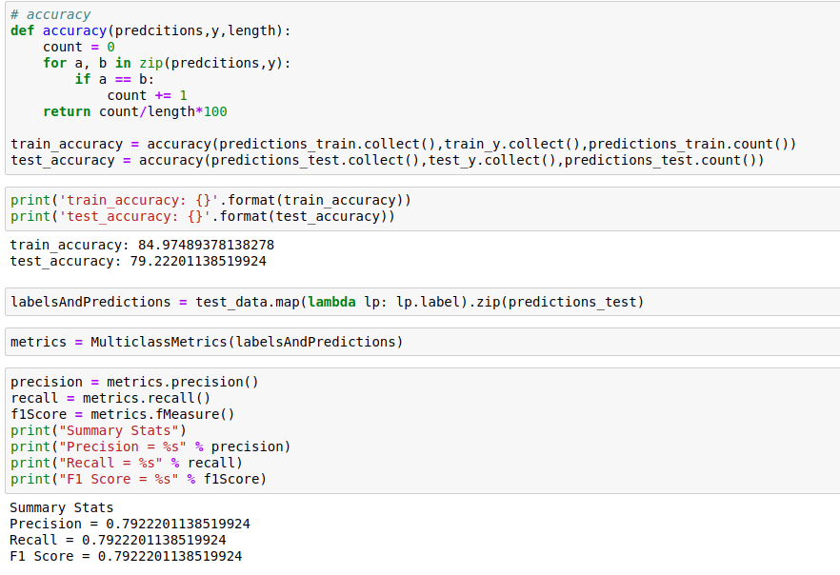
AWS Elastic MapReduce
Result:

Slide 10
AWS Elastic MapReduce
Questions:
Some of your code may have run slower in a cluster than in local mode. Why is that? When does it make sense to use Spark for an application? Answer with respect to your instance type and dataset.
Processing data in cluster may have following questions: slow data cluster and fail data cluster. In addition, the I/O operations would also cause slow running. These are possible reasons that code may run slower in a cluster. When we facing a very large dataset and intractable scalability issues, choosing spark is a good idea. Also, if we want to increase our training time, the spark is also good to use.

Slide 11
AWS Elastic MapReduce
Questions:
It is ever useful to use Spark in local mode? Why might you choose to use PySpark over some library like Pandas in combination with a different ML framework in local mode? When does it make sense to use one over the other?
Yes, we think Spark is useful in the local mode. Pandas data frames are in-memory, single-server. So their size is limited by your computer memory, and you will process them with the power of single computer in local. Spark data frames are distributed on the spark cluster. So their size is determined by memory size and hard-drive size. If we have a very large dataset which the size is more than memory size, the Pandas cannot processing these data. However, the Spark can handle it.
In conclusion, when facing intractable scalability issues, use Spark. When data is simple and no need for a cluster, use Pandas because it is more flexible, more libraries, and easier to implement complex algorithm.

