Slide 1
Machine Learning Deep Learning
Group: Zifan Wang, Yuhan Qiu

Slide 2
Outline
AWS SageMaker
Set up SageMaker
Exploratory data analysis
Selection of a suitable machine learning algorithm
Build machine learning model
Results
Deep Learning AMI
Set up EC2
Build deep learning model
Results

Slide 3
AWS SageMaker - Set up
Enter the AWS SageMaker console
Create an AWS SageMaker notebook instance:
In the IAM role field, choose Create a new role to have Amazon SageMaker create a role with the required permissions and assign it to the instance
In the Create an IAM role box, select Any S3 bucket. This allows AWS SageMaker instance to access all S3 buckets.
Prepare the data:
Choose Open Jupyter and the choose conda_python3 kernel
Define IAM role in your jupyter notebook
Create an S3 bucket that will store data
Download the data to Amazon SageMaker instance and load it into a dataframe
The following slide demonstrates how to define IAM role, create an S3 bucket, and download data to AWS SageMaker

Slide 4
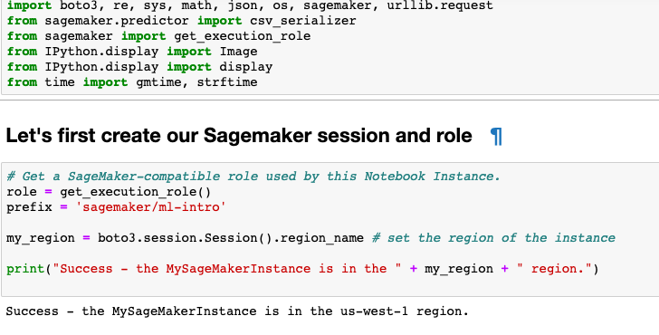
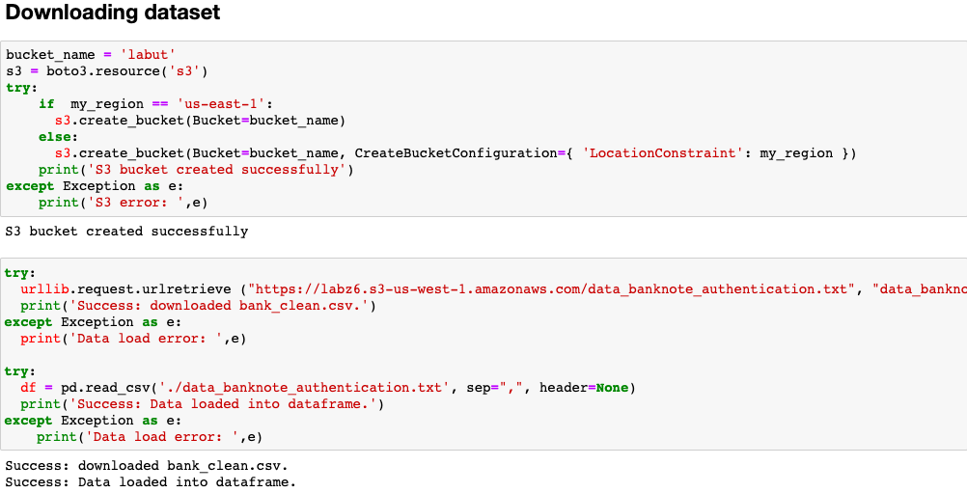
AWS SageMaker - Set up
Figure: Define IAM Role
Figure: Download data and Load into program

Slide 5
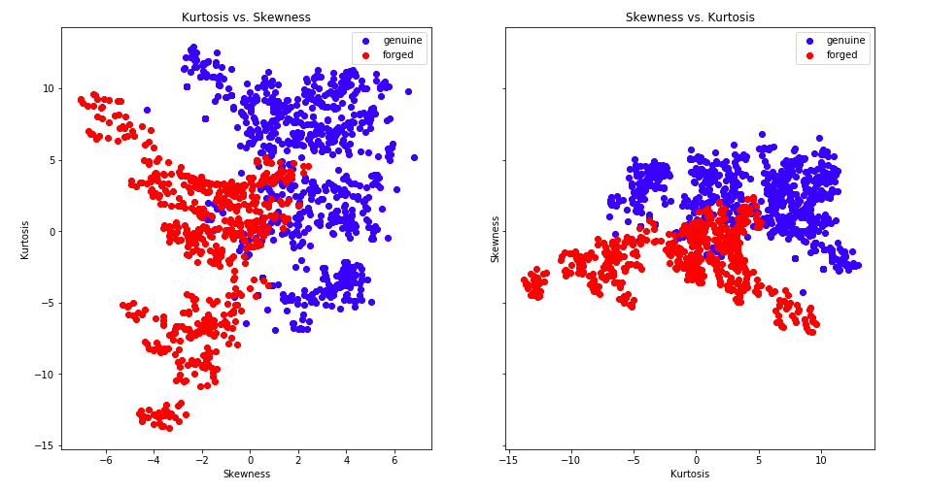
AWS SageMaker - Exploratory data analysis
Make Scatter plots of features (of all possible permutations) and use different colors to represent class 0 (genuine) and 1 (forged)
Skewness & Kurtosis

Slide 6
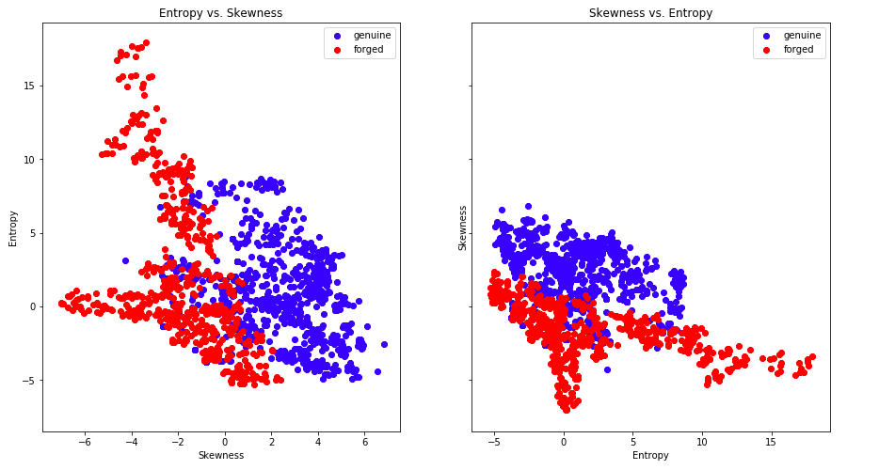
AWS SageMaker - Exploratory data analysis
Make Scatter plots of features (of all possible permutations) and use different colors to represent class 0 (genuine) and 1 (forged)
Skewness & Entropy

Slide 7
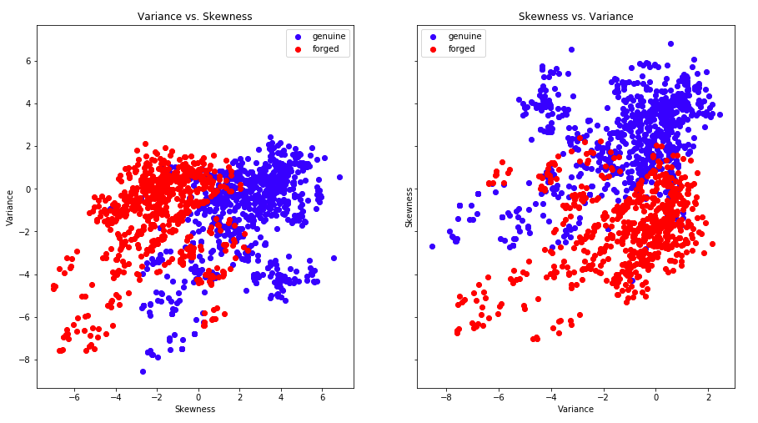
AWS SageMaker - Exploratory data analysis
Make Scatter plots of features (of all possible permutations) and use different colors to represent class 0 (genuine) and 1 (forged)
Skewness & Variance

Slide 8
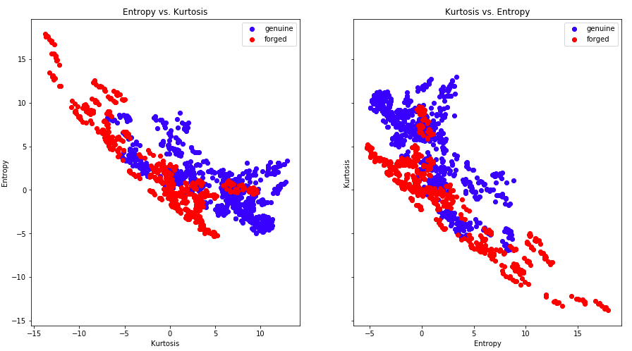
AWS SageMaker - Exploratory data analysis
Make Scatter plots of features (of all possible permutations) and use different colors to represent class 0 (genuine) and 1 (forged)
Kurtosis & Entropy

Slide 9
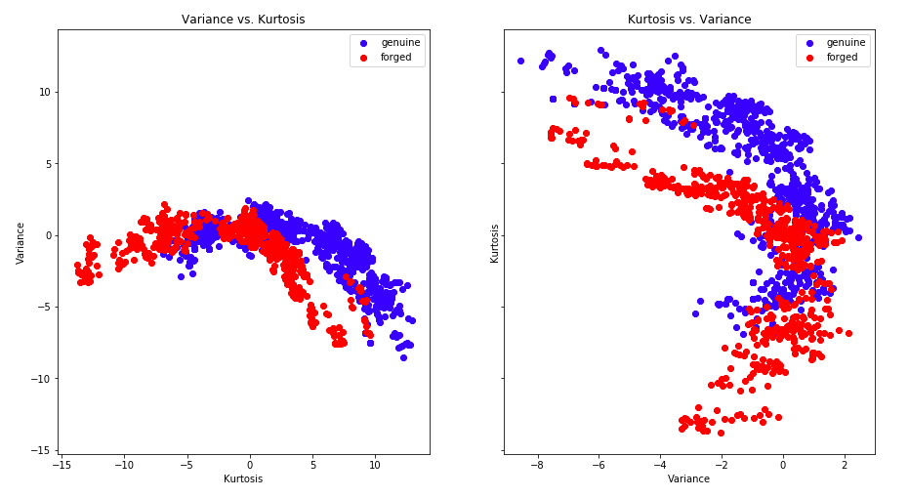
AWS SageMaker - Exploratory data analysis
Make Scatter plots of features (of all possible permutations) and use different colors to represent class 0 (genuine) and 1 (forged)
Kurtosis & Variance

Slide 10
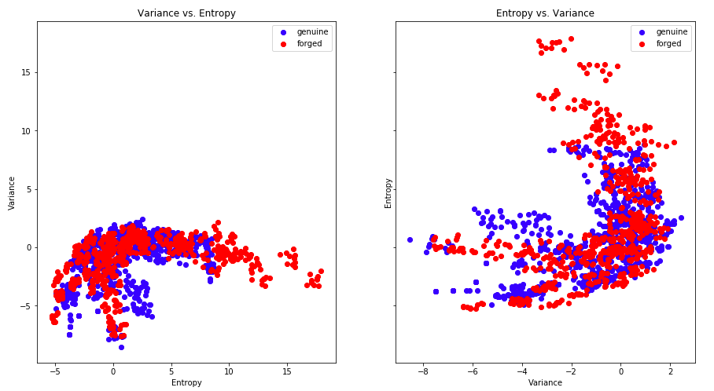
AWS SageMaker - Exploratory data analysis
Make Scatter plots of features (of all possible permutations) and use different colors to represent class 0 (genuine) and 1 (forged)
Variance & Entropy

Slide 11
AWS SageMaker - Machine Learning algorithm
Logistic Regression
Logistic regression is best suited for binary classification: data sets where y = 0 or 1, where 1 denotes the default class. For example, in predicting whether an event will occur or not, there are only two possibilities: that it occurs (which we denote as 1) or that it does not (0). So if we were predicting whether a patient was sick, we would label sick patients using the value of 1 in our data set.

Slide 12
AWS SageMaker - Machine Learning algorithm
Support Vector Machines (SVM)
A Support Vector Machine (SVM) is a discriminative classifier formally defined by a separating hyperplane. In other words, given labeled training data (supervised learning), the algorithm outputs an optimal hyperplane which categorizes new examples. In two dimensional space this hyperplane is a line dividing a plane in two parts where in each class lay in either side.

Slide 13
AWS SageMaker - Machine Learning algorithm
Bayesian classifiers
A Bayesian classifier is based on the idea that the role of a (natural) class is to predict the values of features for members of that class. Examples are grouped in classes because they have common values for the features. Such classes are often called natural kinds. In this section, the target feature corresponds to a discrete class, which is not necessarily binary.
The idea behind a Bayesian classifier is that, if an agent knows the class, it can predict the values of the other features. If it does not know the class, Bayes' rule can be used to predict the class given (some of) the feature values. In a Bayesian classifier, the learning agent builds a probabilistic model of the features and uses that model to predict the classification of a new example.

Slide 14
AWS SageMaker - Machine Learning algorithm
We decide to choose SVM as the algorithm to use in this problem. There are four advantages of using SVM:
1. Effective in high dimensional spaces. (We have a 4 dimensional data)
2. Still effective in cases where number of dimensions is greater than the number of samples
3. Uses a subset of training points in the decision function (called support vectors), so it is also memory efficient.
4. Versatile: different Kernel functions can be specified for the decision function. Common kernels are provided, but it is also possible to specify custom kernels.

Slide 15
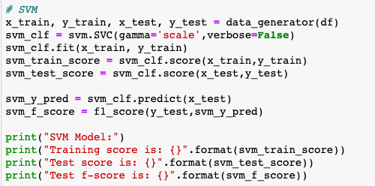
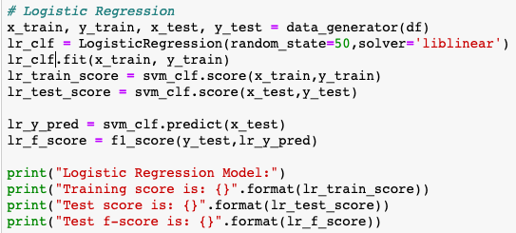
AWS SageMaker - Build Machine Learning Model
Training and testing data generation
Build machine learning model by sklearn library
Figure: SVM
Figure: LR

Slide 16


AWS SageMaker - Result
Figure: LR Results
Figure: SVM Results

Slide 17
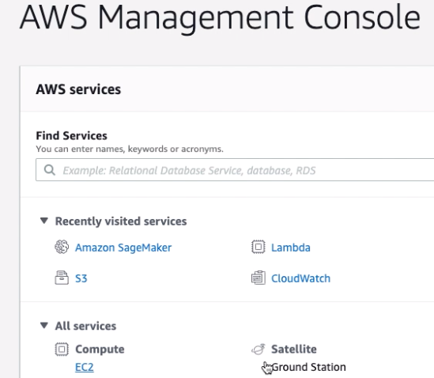
Deep Learning AMI - Set up EC2
Open EC2 Console

Slide 18
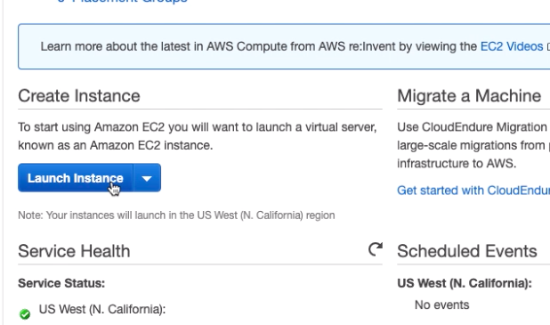
Deep Learning AMI - Set up EC2
Configure instance
Choose the Launch Instance

Slide 19
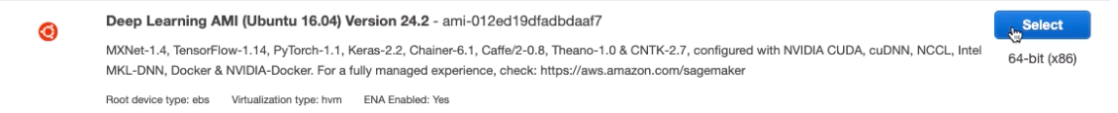
Deep Learning AMI - Set up EC2
Configure instance
Select AWS Deep

Slide 20
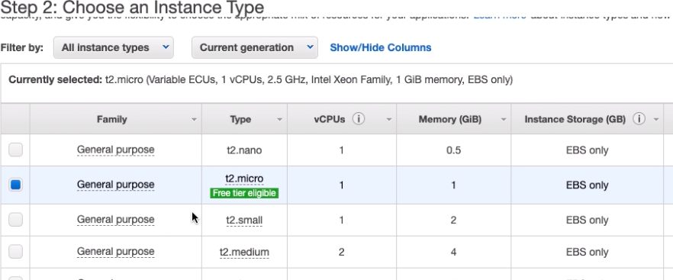
Deep Learning AMI - Set up EC2
Configure instance
Choose an Instance Type and click Review and Launch

Slide 21
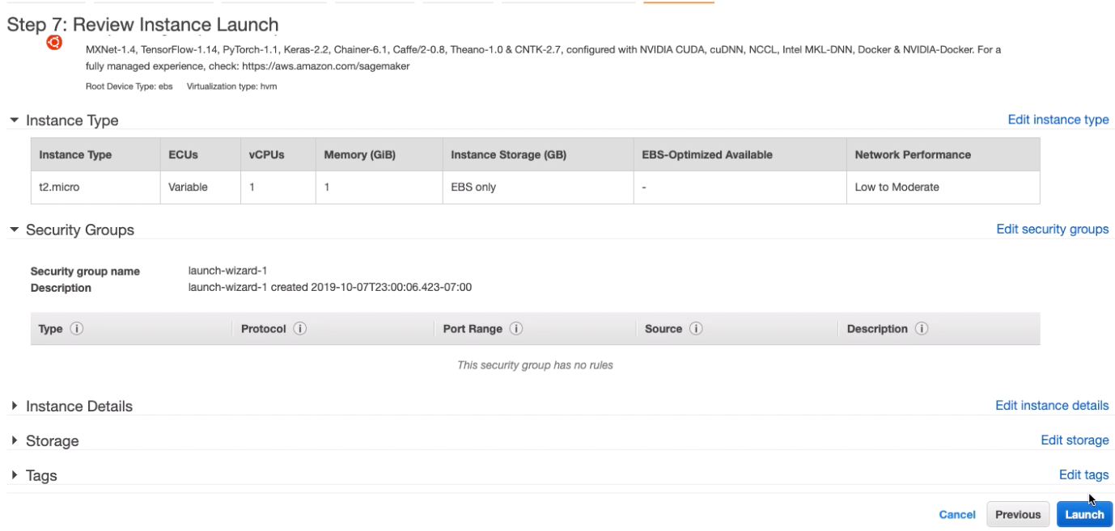
Deep Learning AMI - Set up EC2
Configure instance
Review Instance Launch and Choose Launch

Slide 22
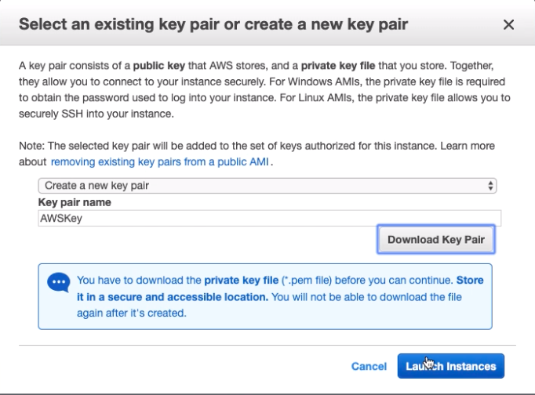
Deep Learning AMI - Set up EC2
Configure instance
Select key pair

Slide 23
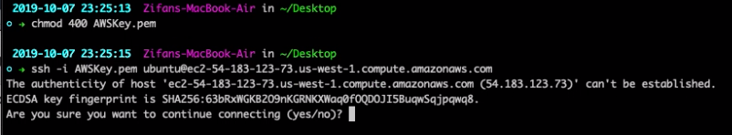
Deep Learning AMI - Set up EC2
Connect to EC2

Slide 24

Deep Learning AMI - Set up EC2
Activate TensorFlow(+keras2) with Python3 source
After source: we will in the tensorflow_p36 environment

Slide 25
Deep Learning AMI - Build deep learning model
Create python file
Create python file: touch fileName.py
Edit python file: vim fileName.py

Slide 26
Deep Learning AMI - Build deep learning model
Create python file
Create python file: touch fileName.py
Edit python file: vim fileName.py
Create data file
Create data file: touch data.txt
Edit data file: vim data.txt
Easier Way:
scp -i “AWSKey.pem” file ubuntu@AWS_IP:~/

Slide 27
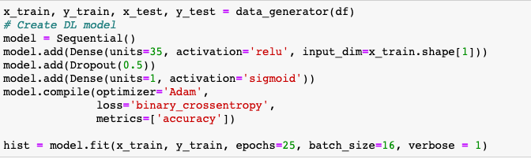
Deep Learning AMI - Build deep learning model
Generate training and testing data
Use Keras Library to build classifier
2 layers neural network
1st layer activation function is ‘relu’ with 35 units
Dropout layer with p = 0.5
2rd layer activation function is ‘sigmoid’ with 1 unit
Choose optimizer to be Adam and loss function to be binary_crossentropy

Slide 28
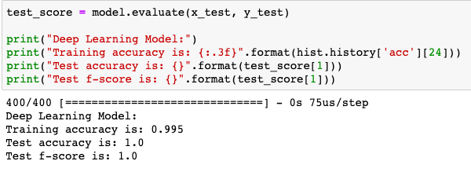
Deep Learning AMI - Results

