Slide 1
Amazon Web Services Tutorial
Group: Zifan Wang, Yuhan Qiu

Slide 2
Outline
Amazon EC2
Amazon S3
Amazon RDS
Amazon Lambda

Slide 3
EC2
Learn about Amazon EC2 container service and create the IAM (Identity and Access Management) user and group.
EC2 container Service:
Amazon Elastic Container Service is a highly scalable, fast, container management service that makes it easy to run, stop, and manage Docker containers on a cluster.
IAM:
IAM stands for Identity and Access Management which is a web service that helps people securely access to AWS resources for users. Use IAM to control who can use AWS resources (authentication) and what resources people can use.

Slide 4
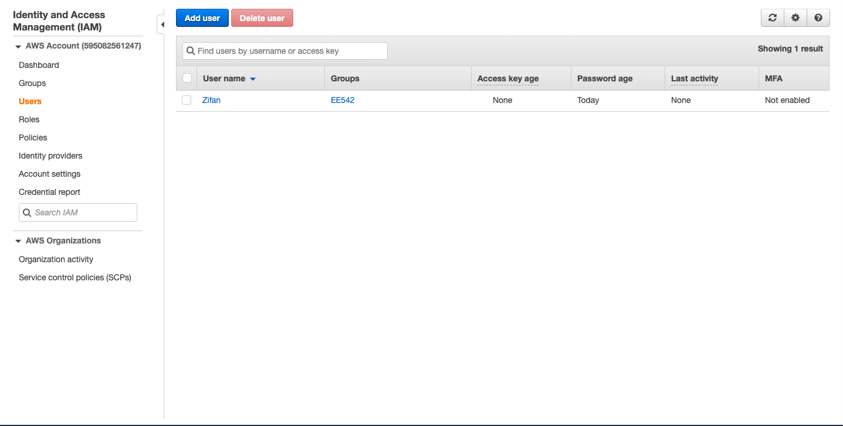
EC2
IAM Illustration. Create a group and give some users permission to use.

Slide 5
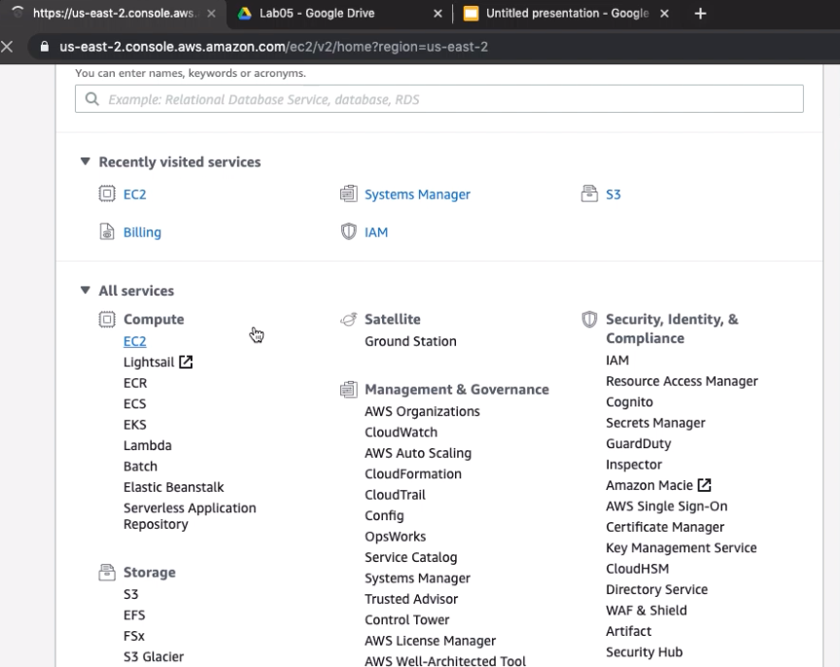
EC2
2. Launch a Linux virtual machine instance of type ‘micro’ .
Step by Step Build EC2:
In AWS console page, choose EC2

Slide 6
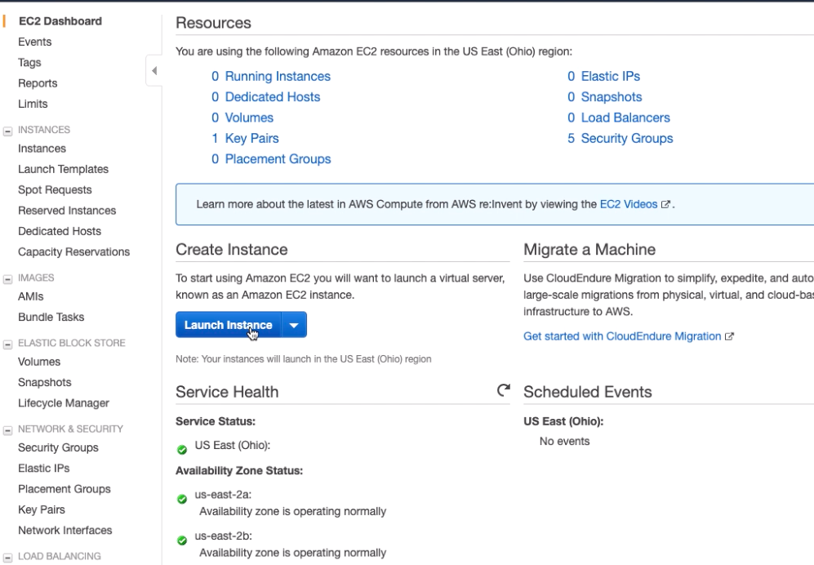
EC2
2. Launch a Linux virtual machine instance of type ‘micro’ .
Step by Step Build EC2:
2. After that, select launch instance

Slide 7
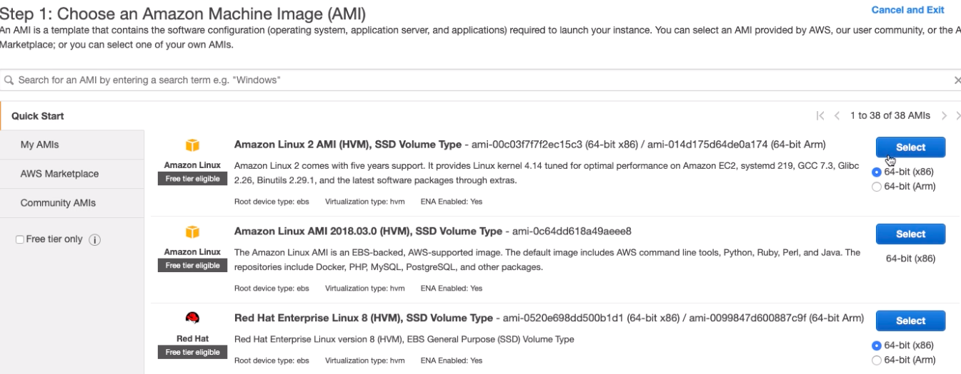
EC2
2. Launch a Linux virtual machine instance of type ‘micro’ .
Step by Step Build EC2:
3. Next, choose an amazon machine image. Here, we use the basic one

Slide 8
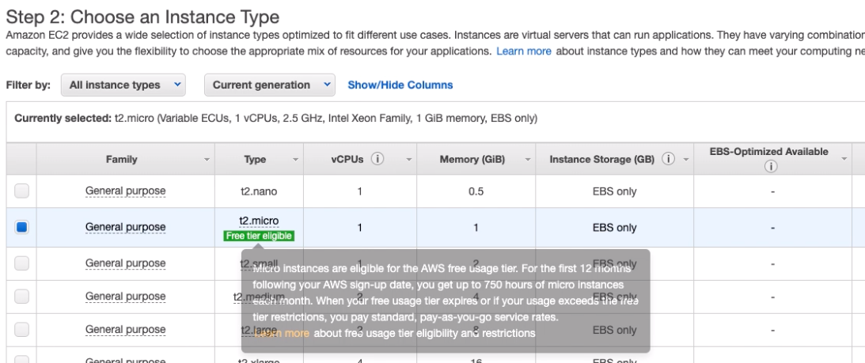
EC2
2. Launch a Linux virtual machine instance of type ‘micro’ .
Step by Step Build EC2:
4. Then, choose a Instance Type (which determine the hardware)

Slide 9
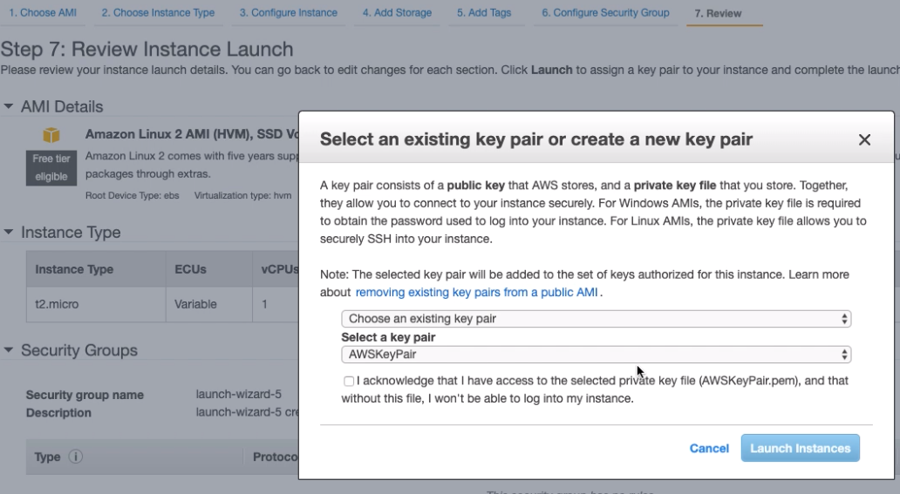
EC2
2. Launch a Linux virtual machine instance of type ‘micro’ .
Step by Step Build EC2:
5. Last, review and launch. In addition, we need to choose key pair here. If do not have key pair, generate a new one.

Slide 10
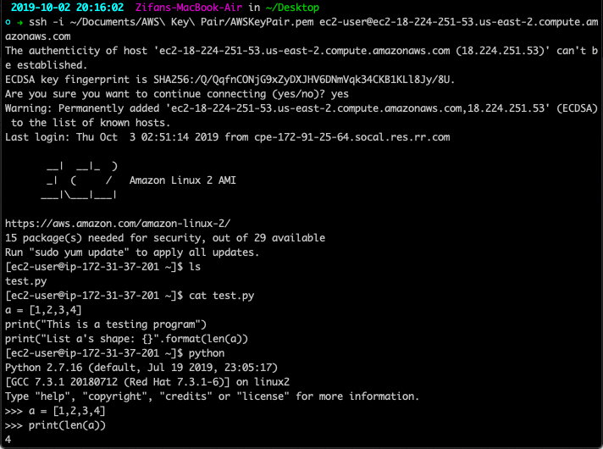
EC2
The following figure is the illustration of how to connect to AWS in terminal and run the program.

Slide 11
S3 and SNS - Photo uploads to Amazon S3
Steps of uploading photos or files to Amazon S3:
Select S3 in the AWS console page
Then, select create bucket in the coming page. Give your bucket a name and select region. Then go through the configure options and set permissions to finish the bucket creation.
After creating bucket, select the new bucket in your S3 main page. In the coming website, select Upload to upload your selected photos or files into this bucket. In addition, use the Access key and security key credentials provided for the user.
Last, select the newly uploaded image in the bucket and make it public by selecting Make public bottom to ensure people can use Object URL to view it.

Slide 12
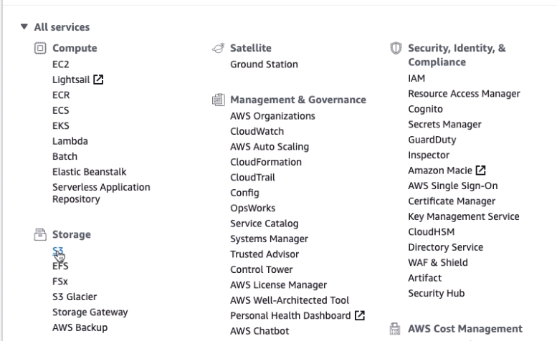
S3 and SNS - Photo uploads to Amazon S3
Selecting S3

Slide 13
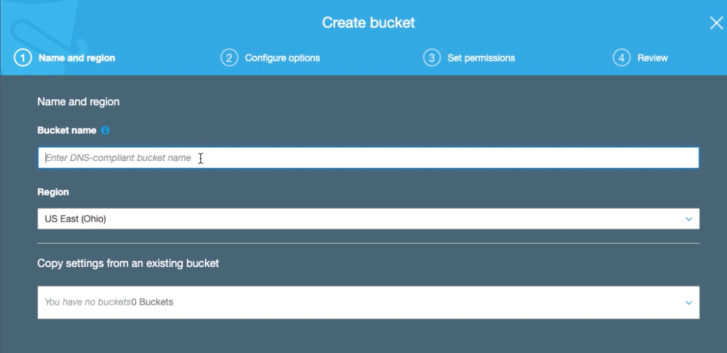
S3 and SNS - Photo uploads to Amazon S3
2. Create bucket

Slide 14
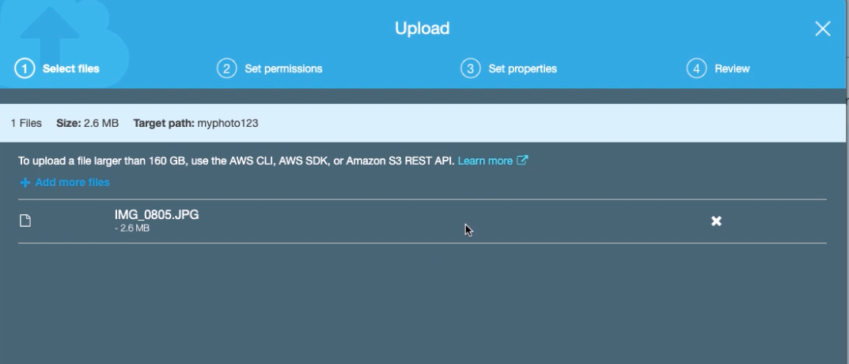
S3 and SNS - Photo uploads to Amazon S3
3. Upload photo

Slide 15
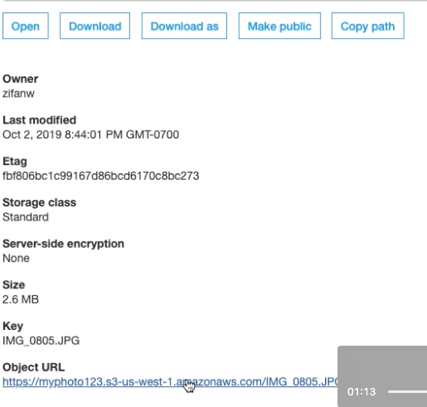
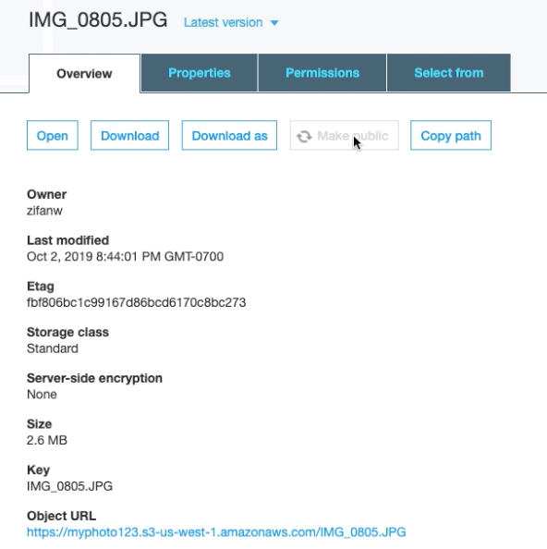
S3 and SNS - Photo uploads to Amazon S3
4. Make public and review image

Slide 16
S3 and SNS - Photo uploads to Amazon S3
Comments:
The Amazon S3 storage makes data communication be possible online. For example, some outside sensors can collect data and store it on Amazon S3 and people can pull these data from the Amazon S3. In addition, some mobile apps can be benefited from Amazon S3 by storing data. In other words, the users’ apps does not require any data storage. When users want to view somethings, the apps can pull data from Amazon S3.

Slide 17
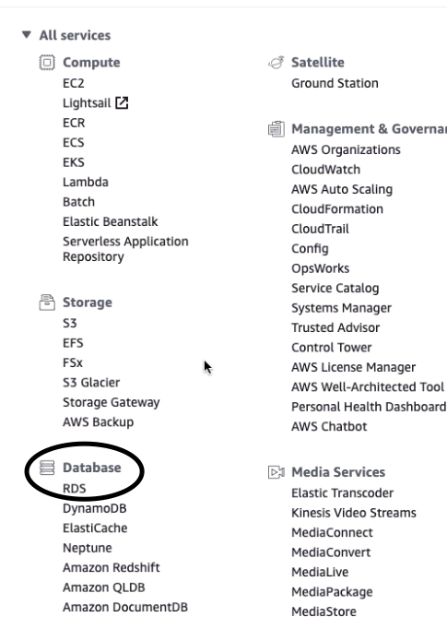
Amazon RDS
Select RDS in AWS main console:

Slide 18
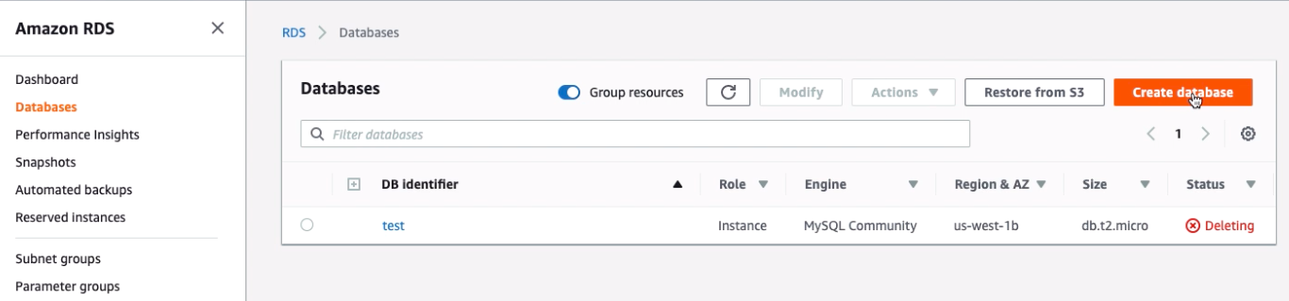
Amazon RDS
2. In RDS console, select databases and then click Create database

Slide 19
Amazon RDS
2. In RDS console, select databases and then click Create database

Slide 20
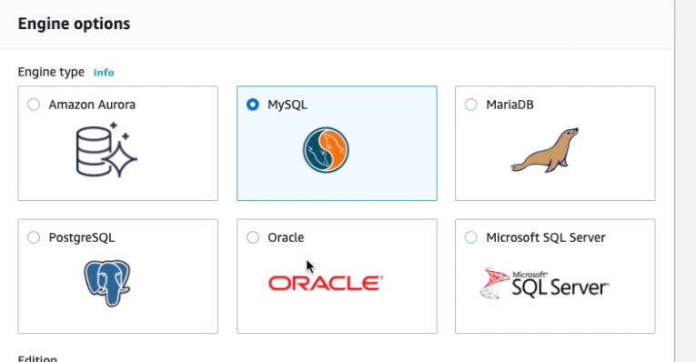
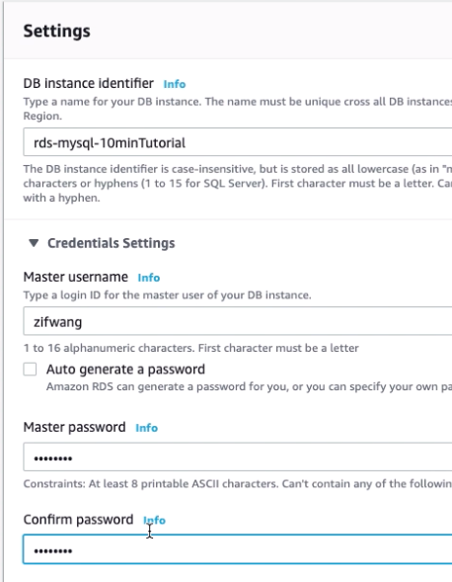
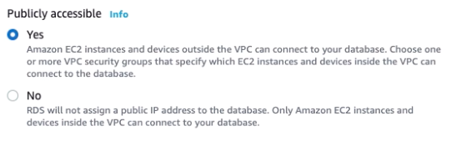
Amazon RDS
3. Setting up your RDS, first select the database to use and then in setting set DB name, master name, and password. The last step is enabling public access.

Slide 21
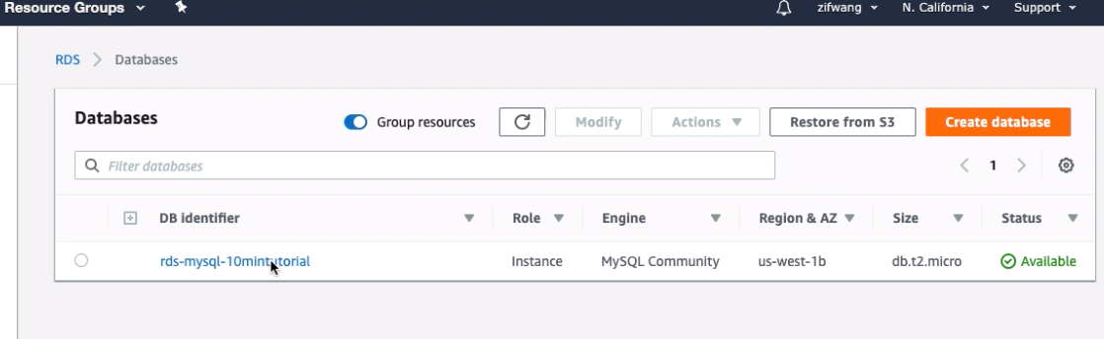
Amazon RDS
4. After creating the database, the following figure should in your Amazon RDS console and clicked into this database:

Slide 22
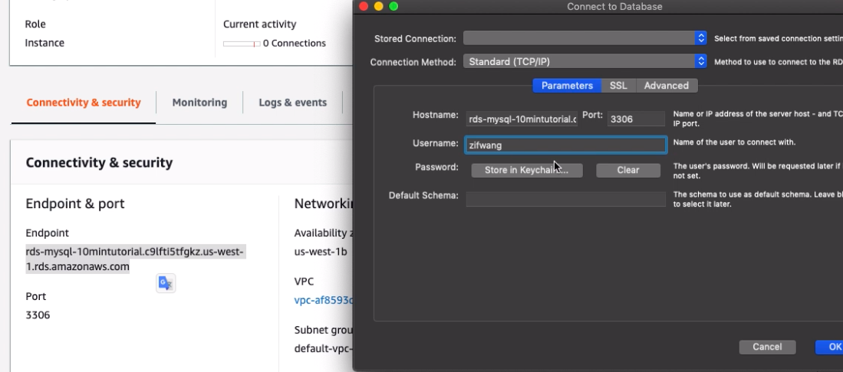
Amazon RDS
5. Connect to this database by using MySQL Workbench. Copy the Endpoint into hostname, use the same port number, enter the username, and password to connect to the created database.

Slide 23
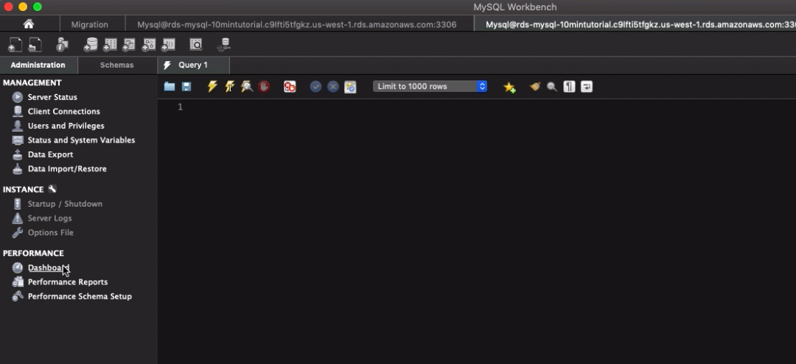
Amazon RDS
6. View in MySQL Workbench after logging into RDS.

Slide 24
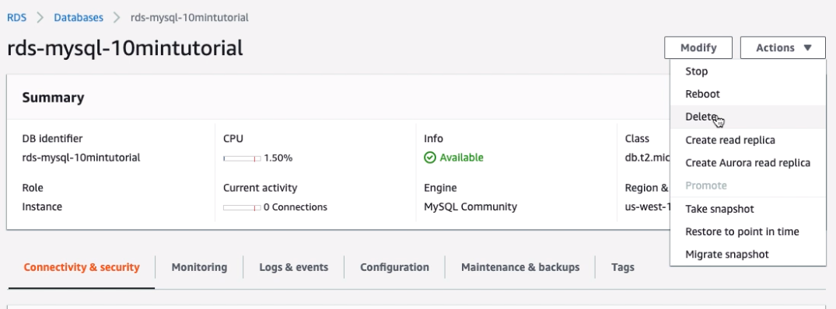
Amazon RDS
7. Delete database: In the RDS console, select Actions and the click on Delete to delete this database.

Slide 25
Amazon Lambda
Introduction:
AWS Lambda lets people run code without provisioning or managing servers. With Lambda, people can run code for virtually any type of application or backend service - all with zero administration. Just upload code and Lambda takes care of everything required to run and scale your code with high availability. People can set up code to automatically trigger from other AWS services or call it directly from any web or mobile app. -- Reference from https://aws.amazon.com/lambda/

Slide 26
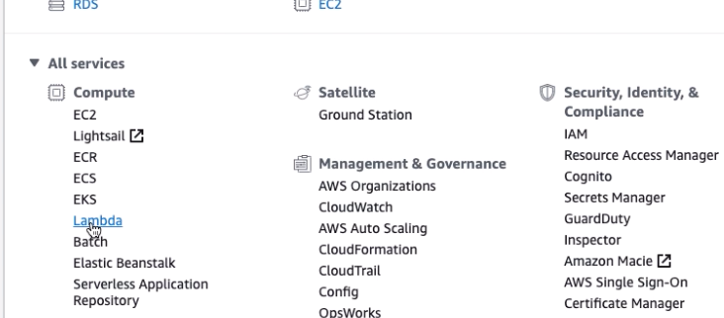
Amazon Lambda
Setting up Amazon Lambda:
Select Lambda in Console:

Slide 27
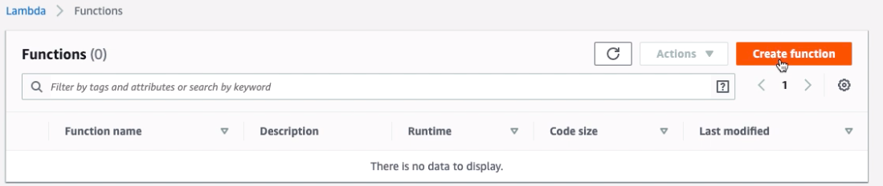
Amazon Lambda
Setting up Amazon Lambda:
Select Lambda in Console to enter Lambda service and click Create function:

Slide 28
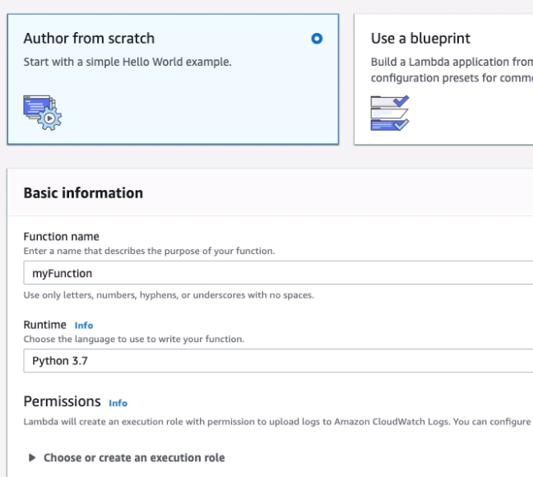
Amazon Lambda
Setting up Amazon Lambda:
2. Give Lambda function a name, and select runtime environment:

Slide 29
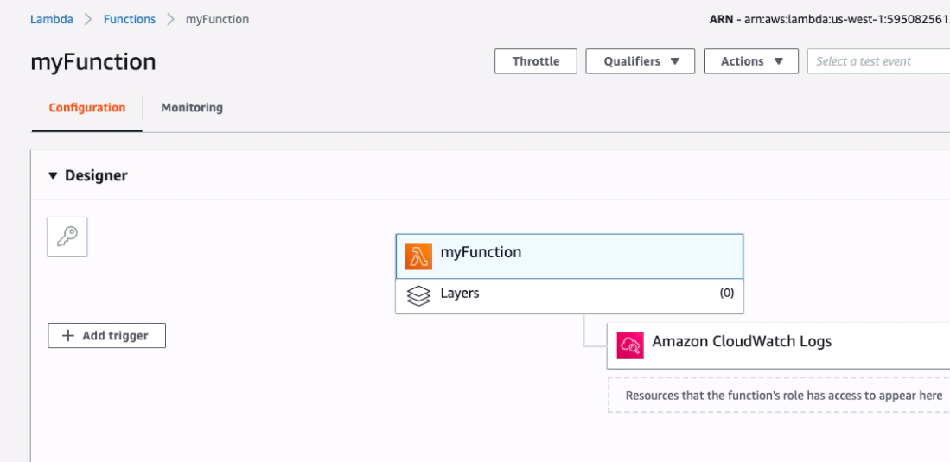
Amazon Lambda
Setting up Amazon Lambda:
3. Lambda function looks like in Lambda console:

Slide 30
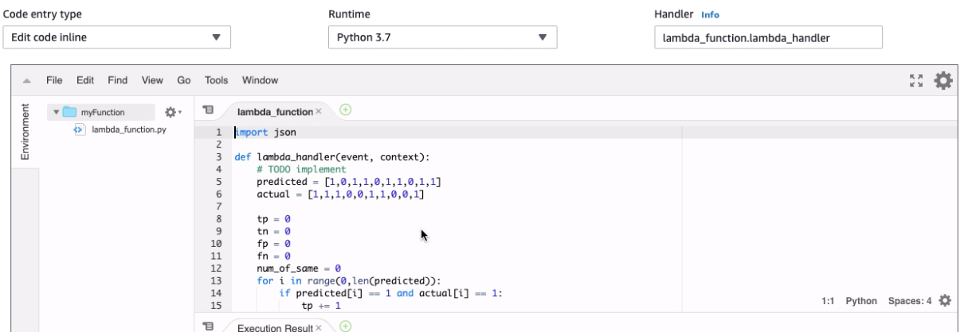
Amazon Lambda
Setting up Amazon Lambda:
4. Write Lambda function and test it:

Slide 31
Amazon Lambda
Setting up Amazon Lambda:
5. Configuration information:
Timeout: 3sec
Memory: 128 MB
IAM role

Slide 32
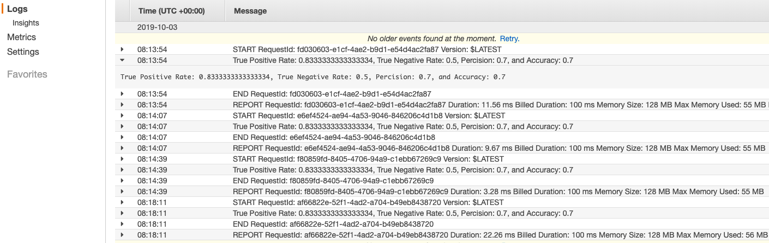
Amazon Lambda
Results:
Figure: Result
Figure: Log

Slide 33
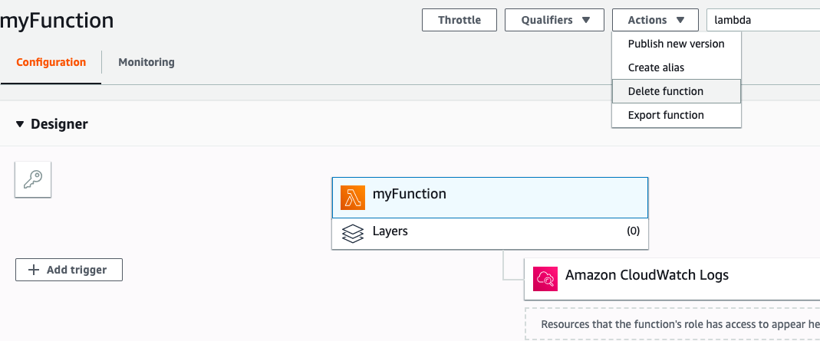
Amazon Lambda
Delete Lambda:

