Slide 1

Big Mountain Resort
Ticket Price Analysis

Slide 2
Problem Statement
How can Big Mountain Resort more accurately price their passes to represent the value of their facilities?
Context: Big Mountain Resort is a ski resort located in Montana which caters to about 350,000 guests a year. Recently, to help increase the distribution of guests around the mountain, they invested in a new chairlift that increases their OPEX by $1,540,000.
Criteria for success: Based on data sample of US ski resorts, find a pricing strategy that will accurately reflect the value of a pass at the Big Mountain Resort.
Scope of solution space: Using the data available, compare Bog Mountain’s offerings to the competition and price their passes accordingly. E.g. comparing #runs, #lifts, skiable terrain, etc. compared to price of passes
Constraints: There could be added data related to the costs associated with the scenarios management wants analyzed.
Stakeholder insight:
Key data sources: CSV file containing the US ski resort information

Slide 3
Recommendation & Key Findings
Based on the analysis explained below, we recommend an increase in the price of Big Mountain resort tickets from $81 to $91.39. With an average 530,000 expected visitors and an average stay of 5 days, totals $ 242,183,500 compared to $214,650,000 before the increase.
Big Mountain could further increase price by $1.31 / ticket by increasing the vertical drop and adding a run to a point 150 feet lower down (requiring the installation of an additional chair). This could be expected to amount to $2,300,926 in added revenue per season. This scenario merits further consideration.

Slide 4
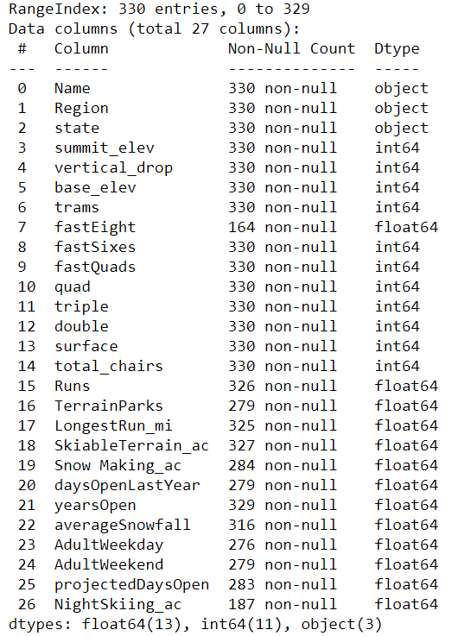
Modelling part 1
The first step was to explore the data, remove missing values or features that brought no value to the model, and finally sense checking data that was incorrect. Starting with 330 rows x 27 columns, we ended up with 279 rows x 25 columns.

Slide 5
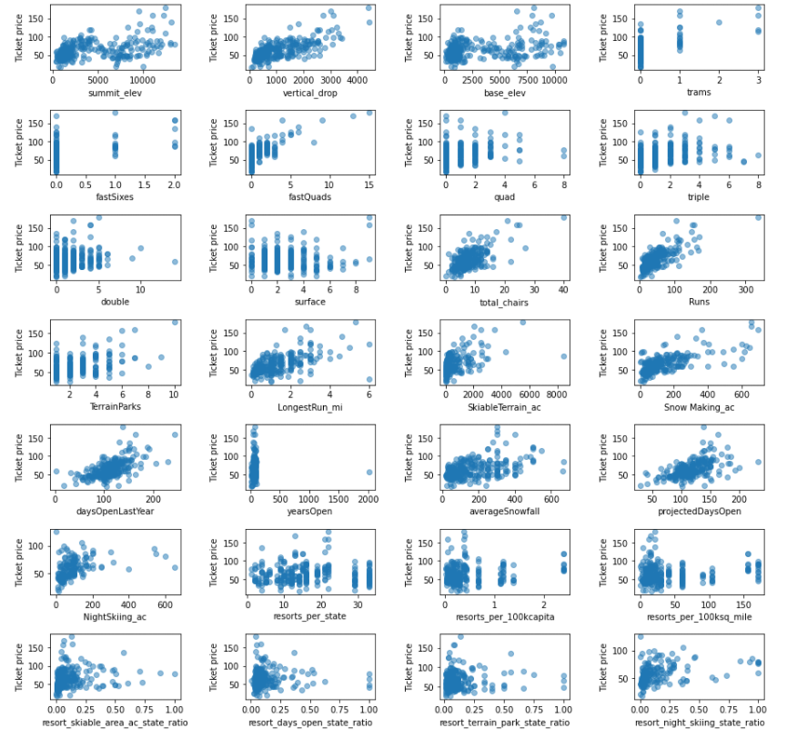
Modeling Part 2
Next, we spent time exploring the data to find out what features we should include in our model.
We determined that the state information was not important and dropped it.
We then split the data into training and test sets to find the best parameters Using GridSearchCV, pipelines, Random Forest, and cross validation we ended up choosing: Vertical Drop, Snow Making, Total chairs, Fast Quads, Runs, Longest Run, Trams, and Skiable Terrain.

Slide 6
Modeling Part 3
We then ran the model on all the data without Big Mountain Resort data in order to calculate the expected ticket price for the resort. Surprised by the results we checked to validate where Big Mountain fits in terms of facilities against all others.
Finally, we tested a variety of scenarios that management was considering. Details can be found in the accompanying word doc. The scenario that made financial sense was the second scenario: Increase the vertical drop by adding a run to a point 150 feet lower down but requiring the installation of an additional chair lift to bring skiers back up, without additional snow making coverage
This scenario supports a price increase of $1.31 / ticket and could be expected to amount to $2,300,926 in added revenue per season. This scenario merits further consideration.

Slide 7
Conclusion
Big Mountain Resort should increase ticket price to $91.39. With an average 530,000 expected visitors and an average stay of 5 days, this would result in a 12.8% increase in revenue.
We could also consider increasing vertical drop through an added chair lift. The model predicts that this would warrant an additional price increase of $1.31 per ticket or $2,300,926 in added revenue per season.

