Slide 1
Лекции по Oracle SQL Колесников Сергей, инженер-разработчик NetCracker
Лекция 3
DDL and DML operators. Oracle objects. Transactions

Slide 2
Part 2. DML operators

Slide 3
2.1. Data Manipulation Language
A DML statement is executed when you:
Add new rows to a table
Modify existing rows in a table
Remove existing rows from a table
Basic DML statements:
INSERT INTO ... VALUES ...
UPDATE ... SET ... [WHERE …]
DELETE FROM ... [WHERE …]
Additional Oracle DML statements:
MERGE
INSERT ALL
INSERT FIRST|ALL WHEN

Slide 4
2.2. The INSERT Statement Syntax
Add new rows to a table by using the INSERT statement.
Only one row is inserted at a time with this syntax
INSERT INTO table [(col1, ….)]
VALUES (val1, …);

Slide 5

2.3. Inserting New Rows
Insert a new row containing values for each column.
List values in the default order of the columns in the table.
Optionally, list the columns in the INSERT clause.

Slide 6
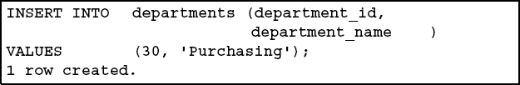

2.4. Inserting Rows with Null Values
Implicit method: Omit the column from the column list.
Explicit method: Specify the NULL keyword in the VALUES clause.

Slide 7
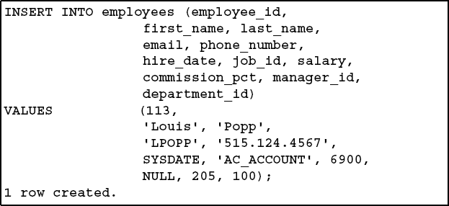
2.5. Inserting Special Values
The SYSDATE function records the current date and time.

Slide 8
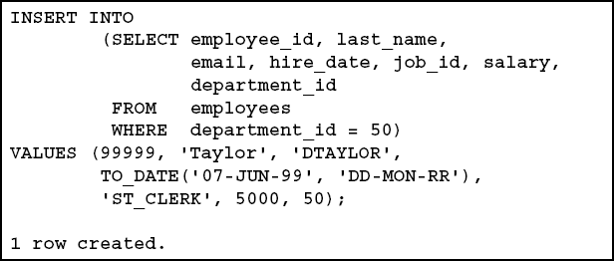
2.6. Using a Subquery in an INSERT Statement
You can use subquery instead of enumerating of columns.

Slide 9
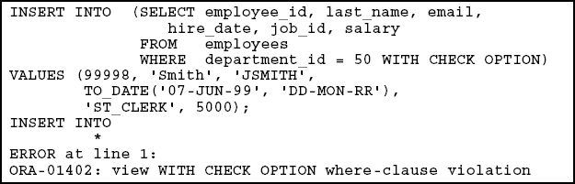
2.7. Using the WITH CHECK OPTION Keyword on DML Statements
A subquery is used to identify the table and columns of the DML statement.
The WITH CHECK OPTION keyword prohibits you from changing rows that are not in the subquery.

Slide 10

2.8. The UPDATE Statement Syntax
Modify existing rows with the UPDATE statement.
Update more than one row at a time, if required.

Slide 11


2.9. Updating Rows in a Table
Specific row or rows are modified if you specify the WHERE clause.
All rows in the table are modified if you omit the WHERE clause.

Slide 12
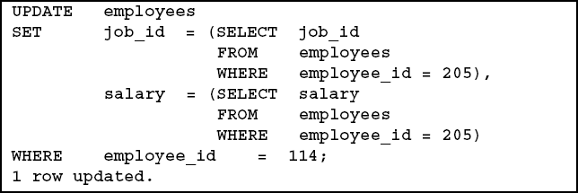
2.10. Updating Two Columns with a Subquery
Update employee 114’s job and department to match that of employee 205.

Slide 13


2.11. The DELETE Statement
You can remove rows from a table by using the DELETE statement.
Specific rows are deleted if you specify the WHERE clause.
All rows in the table are deleted if you omit the WHERE clause.

Slide 14

2.12. Explicit Default Feature
With the explicit default feature, you can use the DEFAULT keyword as a column value where the column default is desired
To allow this, DEFAULT option should have been used in CREATE TABLE
This enables control when a default value should be applied to data
Explicit defaults can be used in INSERT and UPDATE statements
Example of DEFAULT with INSERT:

Slide 15
2.13. The MERGE Statement
Provides the ability to conditionally update or insert data into a database table
Performs an UPDATE if the row exists and an INSERT if it is a new row:
Avoids separate updates
Increases performance and ease of use
Is useful in data warehousing applications

Slide 16
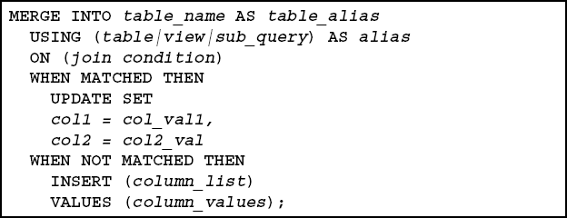
2.14. MERGE Statement Syntax
You can conditionally insert or update rows in a table by using the MERGE statement.

Slide 17
2.15. Delete clause in merge statement
Specify the DELETE where_clause to clean up data in a table while populating or updating it.
The only rows affected by this clause are those rows in the destination table that are updated by the merge operation. That is, the DELETE WHERE condition evaluates the updated value, not the original value that was evaluated by the UPDATE SET ...WHERE condition.

Slide 18
2.16. INSERT ALL Operator
Specify ALL to perform a conditional multitable insert
INSERT ALL
INTO table1 (col1,col2, col3)
values (s.col1, s.col2, s.col3)
INTO table2 (col1,col2, col3, col4)
values (s.col1, s.col2, s.col3, s.col4)
SELECT col1, col2, col3, col4
FROM source_table;

Slide 19
2.17. INSERT FIRST|ALL WHEN Operator
If you specify ALL, the default value, then the database evaluates each WHEN clause regardless of the results of the evaluation of any other WHEN clause.
If you specify FIRST, then the database evaluates each WHEN clause in the order in which it appears in the statement.
INSERT {FIRST|ALL}
WHEN col1=‘CAT’ THEN
INTO table_cat (col2, col3)
values (col2, col3)
…
ELSE
INTO table_animal (col1, col2, col3, col4)
values (col1, col2, col3, col4)
SELECT col1, col2, col3, col4
FROM animal_table;

