Slide 1
Лекции по Oracle SQL Колесников Сергей, инженер-разработчик NetCracker
Лекция 3
DDL and DML operators. Oracle objects. Transactions

Slide 2
Part 3. Transactions

Slide 3
3.1. Database Transactions
A transaction is a logical, atomic unit of work that contains one or more SQL statements
Transaction could be
Committed
Rolled back
All Oracle transactions comply with the ACID properties
Atomicity
Consistency
Isolation
Durability

Slide 4
3.2. Beginning/End of Transactions
Transaction begins when executes
DML statement
DDL statement
Transaction end when executed
COMMIT or ROLLBACK statement without a SAVEPOINT clause
DDL statement
Client application terminates (a)normally

Slide 5
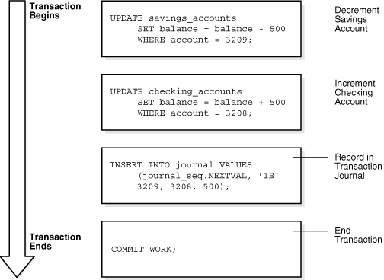
3.3. Transactions example

Slide 6
3.4. Controlling Transactions
V$TRANSACTION view
SET TRANSACTION NAME ‘TRANSACTION NAME’;
SAVEPOINT - identifies a point in a transaction to which you can later roll back
COMMIT - makes all changes performed in the transaction permanent
ROLLBACK - reverses the work done in the current transaction

Slide 7
3.5. State of the Data Before COMMIT or ROLLBACK
The previous state of the data can be recovered.
The current user can review the results of the DML operations by using the SELECT statement.
Other users cannot view the results of the DML statements by the current user.
The affected rows be locked: other users cannot change the data in the affected rows.

Slide 8
3.6. Savepoints
User-declared intermediate marker within the context of a transaction, which divide a long transaction into smaller parts
SAVEPOINT savepoint_name;
ROLLBACK TO A SAVEPOINT savepoint_name
Undo any changes made after the specified savepoint
Does not mean a rollback of the transaction itself

Slide 9
3.7. Controlling Transactions
Time
COMMIT
Transaction
DELETE
SAVEPOINT A
INSERT
UPDATE
SAVEPOINT B
INSERT
ROLLBACK
to SAVEPOINT B
ROLLBACK
to SAVEPOINT A
ROLLBACK

Slide 10
3.8. Rollback of Transactions
Undoes all changes made by all the SQL statements in the transaction
Releases all the locks of data held by the transaction
Erases all savepoints in the transaction
Ends the transaction

Slide 11
3.9. Committing Transactions
Makes all changes permanent
Releases locks held on rows and tables
Deletes savepoints
Marks the transaction complete
All users can view the results.

Slide 12
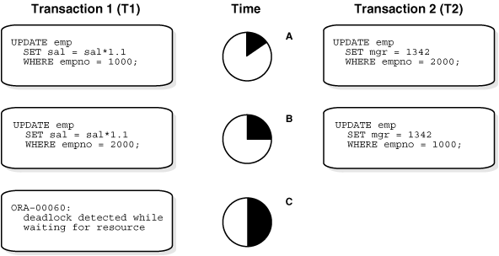
3.10. Locks during Transactions
Transactions lock rows and tables
Other transactions have to wait while lock will be released
Deadlocks

Slide 13
3.11. Transactions Isolation
Problems
Dirty read
Non-repeatable read
Phantom read
Isolation levels prevents these problems
SQL92 standard defines four levels
Read uncommitted
Read committed(default)
Repeatable read
Serializable

Slide 14
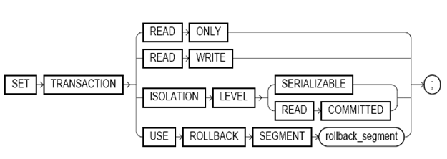
3.12. Transactions Isolation
Oracle Isolation levels
Serializable
Read committed
Read only
Isolation Level | Dirty Read | Non-repeatable Read | Phantom Read
Read uncommitted | Possible | Possible | Possible
Read committed | Not possible | Possible | Possible
Repeatable read | Not possible | Not possible | Possible
Serializable | Not possible | Not possible | Not possible

