Slide 1
Лекции по Oracle SQL Харичкин Александр, Performance Support Manager, NetCracker
Лекция 5: Oracle SQL Tuning
1. Data storage, rowid, disc access, access paths. Indexes
2. Join methods. Execution plans. Hints

Slide 2
Agenda
Questions to discuss
Basic concepts of data storage and access (by Oracle)
Oracle B*Tree Indexes
Index structure and storage
Index access paths
Query Execution plan
Obtaining and interpretation
Execution statistics
Join methods
Access paths vs Filters
NetCracker Database Structure
Basic tables && indexes
Generic principals of query building in NetCracker
Examples, examples, examples…
Required knowledge
To have idea what SQL is
Add and multiply numbers

Slide 3
Part 1: Data storage, rowid, disc access, access paths. Indexes

Slide 4
Data Storage Structures
Logical Structure
Physical Structure
A row is held inside a block, a logical structure representing the minimum quantum of data storage and access
Blocks are united to constitute a segment. The segment segment reflects some kind of Data Object.
Segments are placed into tablespaces.
Physically, rows fill up a 8kilobytes (typically) block, stored on a disc.
A sequence of continuous blocks form an extent. Several physical extents correspond to a segment.
Extents are kept in a datafile. A tablespace typically contains of several datafiles.
Typical block size is 8 kilobytes
One block holds 100 rows in average
Block is a minimal volume of information that can be read from disc at time. To read a row one has to read a block that contains this row.

Slide 5
Rowid pseudocolumn
A rowid is a unique address of a row in a database. Internally, the rowid is a structure that holds information that the database needs to access a row.
A rowid is not physically stored in the database, but is inferred from the file and block on which the data is stored.
The fastest way to get a row is to get it by rowid, as soon as rowid contains all necessary information to locate a row.
One can obtain a rowid of particular row:
SQL> SELECT ROWID FROM nc_objects WHERE object_id= 111;
ROWID
------------------
AAAPecAAFAAAABSAAA

Slide 6
Rowid pseudocolumn: Structure
A rowid is displayed in a radix 64 (A-Za-z0-9+/), a four-piece format, OOOOOOFFFBBBBBBRRR, with the format divided into the following components:
OOOOOO (6 symbols, 32 bits)
The data object number identifies the segment (data object AAAPec). A data object number is assigned to every database segment. Schema objects in the same segment, such as a table cluster, have the same data object number.
FFF (3 symbols, 10 bits)
The tablespace-relative data file number identifies the data file that contains the row (file AAF).
BBBBBB (6 symbols, 22 bits)
The data block number identifies the block that contains the row (block AAAABS). Block numbers are relative to their data file, not their tablespace. Thus, two rows with identical block numbers could reside in different data files of the same tablespace.
RRR (3 symbols, 16 bits)
The row number identifies the row in the block (row AAA ).

Slide 7

Rowid pseudocolumn: treatment
SQL> select DBMS_ROWID.ROWID_OBJECT(rowid) "OBJECT",
2 DBMS_ROWID.ROWID_RELATIVE_FNO(rowid) "FILE",
3 DBMS_ROWID.ROWID_BLOCK_NUMBER(rowid) "BLOCK",
4 DBMS_ROWID.ROWID_ROW_NUMBER(rowid) "ROW",
5 rowid "RID"
6 from dual
7 /
OBJECT FILE BLOCK ROW RID
---------- ---------- ---------- ---------- ------------------
63388 5 82 0 AAAPecAAFAAAABSAAA
Note: the exact output numbers and values can (and will!) vary from database to database. ROWID is not kept ‘as is’ while exporting/importing database dumps.

Slide 8
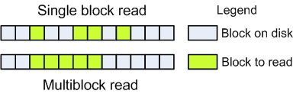
Disc access methods
There are two common ways to get a physical data block from disc:
Single block read (random read, db file sequential read)
Multiblock read (db file scattered read). Applicable only for adjacent (sequential) blocks
Typical access rate for a single HDD:
Single block read – 100-200 blocks/sec(1.5 Mb/sec, 10 000-20 000 rows/sec).
Multiblock read – 10 000-20 000 blocks/sec (150 Mb/sec, 1-2 mln rows/sec).

Slide 9
Table Access Paths
Full Table Scan.
Preconditions:
Absence of indexes
Parallel execution
hint/*+ FULL(table_alias) */
Consequences
Multi-block access, fast read rates.
The fastest way to read a whole segment
Access by ROWID
Preconditions: a rowid must be known in advance
Consequences: the fastest way to get a single row
Access by Index ROWID
To be defined later…

Slide 10
Oracle Index
Index is a accessory data structure on disk.
There are several types of indexes
B*Tree (balanced tree) index – The most wide-spread type. The main feature of such an index is the balance: all indexed keys are located on the same hirarchy level in an index tree.
Bitmap indexes – rarely used (due to license limitations) and mostly ineffective.
User-defined indexes
Fulltext indexes
Domain indexes
Etc…

Slide 11
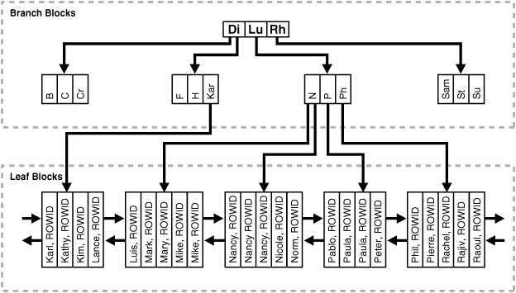
Index Storage Structure

Slide 12
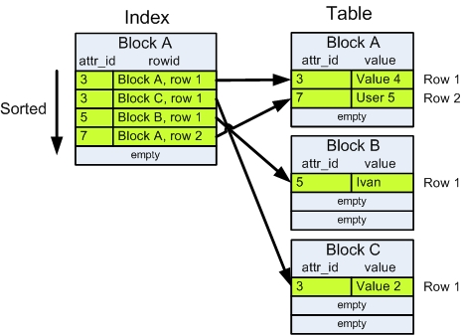
Index Storage Structure

Slide 13
Pros and cons
Advantages
Significantly reduces data access speed in majority of cases
Disadvantages
Resides on a physical disc
Requires to be updated every time a piece of indexed data is modified (deleted/updated/inserted)

Slide 14
Index Scans
Unique Scan
Possible if resulting number of rows returned by condition is 0 or 1
Range Scan
The most widespread path
Full Scan
Ordered scan of leaf blocks
Fast Full Scan
Sequential (i.e. multi-block) scan of the whole index segment
Skip Scan
Etc…

Slide 15
Indexing correct tables and columns
Create an index if you frequently want to retrieve less than 15% of the rows in a large table. The percentage varies greatly according to the relative speed of a table scan and how the distribution of the row data in relation to the index key. The faster the table scan, the lower the percentage; the more clustered the row data, the higher the percentage.
To improve performance on joins of multiple tables, index columns used for joins.
Note: Primary and unique keys automatically have indexes, but you might want to create an index on a foreign key.
Small tables do not require indexes.

Slide 16
Column order in creating index
The order of columns in the CREATE INDEX statement can affect query performance. In general, specify the most frequently used columns first.
Columns in join clauses (WHERE condition) must be ordered as in CREATE INDEX for multi-column index statement, else the index is omitted

Slide 17
Examples
BIG_TABLE
Содержит около 5 млн записей. Некоторые колонки проиндексированы
Select * from big_table where id = 1000
???
Select * from big_table where name= ‘Blah-Blah’
???
Select id from big_table
Order by 1
Desc
???

Slide 18
Part 2: Join methods. Execution plans. Hints

Slide 19
Join methods
NESTED LOOPS
Последовательное сравнение элементов двух (и более) row source
HASH JOIN
Сравнение значений hash двух (и более) выборок
SORT MERGE
Сравнение отсортированных значений
CARTESIAN MERGE
Декартово (полное) произведение выборок

Slide 20
Examples
Выбрать всех пользователей системы вместе с датой создания
Выбрать всех объектов с именем 01 и объектным типом – наследником Port
...

Slide 21
What is a query plan?
A query plan is an interpretation of programmatic algorithm derived by Oracle Optimizer in order to satisfy the requirements of declarative query statement.
Ways to obtain a query plan may vary depending on one’s available paths to access a database:
Via SQL*Plus – Explain plan utility + dbms_xplan package
Via IDE – integrated Explan Plan tools
Via db150.jsp – via “explain plan” function
explain plan for
select * from nc_objects;
select * from table (dbms_xplan.display);
PLAN_TABLE_OUTPUT
Plan hash value: 1628935849
--------------------------------------------------------------------------------
| Id | Operation | Name | Rows | Bytes | Cost (%CPU)| Time |
--------------------------------------------------------------------------------
| 0 | SELECT STATEMENT | | 1146K| 109M| 3527 (1)| 00:00:43 |
| 1 | TABLE ACCESS FULL| NC_OBJECTS | 1146K| 109M| 3527 (1)| 00:00:43 |
--------------------------------------------------------------------------------

Slide 22
Optimizer hints
Hints allow you to make decisions usually made by the optimizer. You can use hints to specify the following:
The access path for a table accessed by the statement
The join order for a join statement
A join operation in a join statement
The optimization approach for a SQL statement
The goal of the cost-based optimizer for a SQL statement

Slide 23
Hints
Синтаксис
select /*+ hint(argument) */ from table …
Пример
select /*+ INDEX(people AGE_NDX) */ * from people join managers on people.people_id=managers.people_id where people.age

Slide 24
Hints types
Access method
Join order
Join operation
General
Parallel execution
Query transformation
Optimizer approaches

Slide 25
Access method hints
FULL
INDEX
INDEX_ASC
INDEX_COMBINE
INDEX_DESC
INDEX_FFS
INDEX_JOIN
NO_INDEX

Slide 26
INDEX
Explicitly chooses an index scan for the specified table.
Example:
SELECT /*+ INDEX(customers ix_customers_gender) */ * FROM customers WHERE gender = 'M';

Slide 27
Join Order
ORDERED
The ORDERED hint causes Oracle to join tables in the order in which they appear in the FROM clause.
LEADING
Tables are joined as dictated by the hint.
Be Careful: sometimes can affect negatively (for example, in calculable attributes with CalculateByQuery2() adapter)

Slide 28
Join Operations
USE_NL
USE_MERGE
USE_HASH
HASH_AJ, MERGE_AJ, and NL_AJ
HASH_SJ, MERGE_SJ, and NL_SJ

Slide 29
USE_NL
The USE_NL hint causes Oracle to join each specified table to another row source with a nested loops join using the specified table as the inner table.
SELECT /*+ ORDERED USE_NL(customers) to get first row faster */ accounts.balance, customers.last_name, customers.first_name
FROM accounts, customers
WHERE accounts.custno = customers.custno;

Slide 30
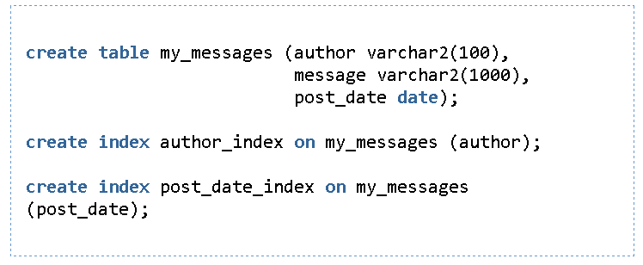
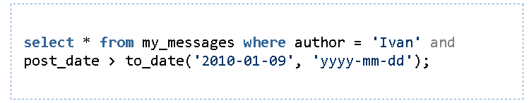
Несколько индексов на таблице

Slide 31
Let’s do some maths
Данные:
100 000 (000) записей
2000 (000) уникальных авторов
50 000 (000)уникальных Post Date
Варианты
использовать full table scan таблицы с последующей фильтрацией строк, не попадающих под условия выборки
использовать index range scan по индексу author_index; получив rowid строк таблицы, обратиться к таблице и отфильтровать те строки, что не подпадают под условие на post_date.
использовать index range scan по индексу post_date_index; получив rowid строк таблицы, обратиться к таблице и отфильтровать те строки, чте не подпадают под условие на author.

