Slide 1

Rook endgames – similar positions
The task on the following pages is as follows.
Select a position that is the most similar
to the one in the example given.
Each position is accompanied by moves that indicate a possible sensible continuation.
For each example, please write down:
example number
your choice (A, B, or C)

Slide 2
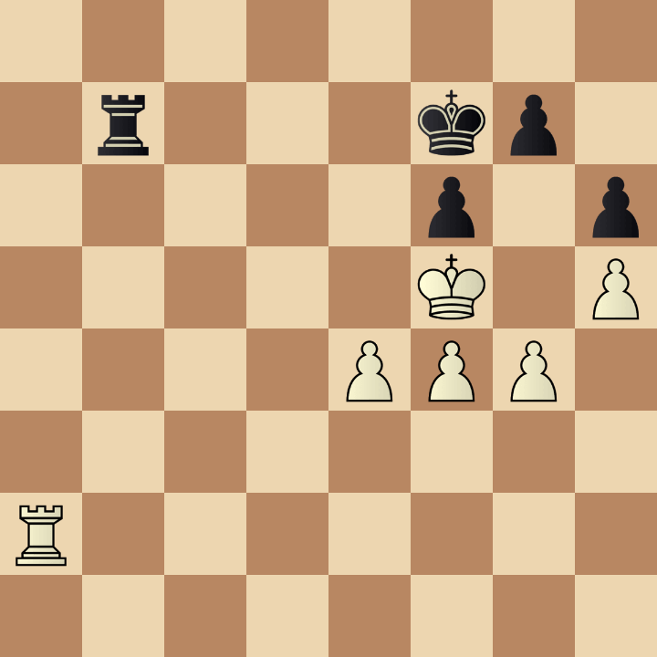
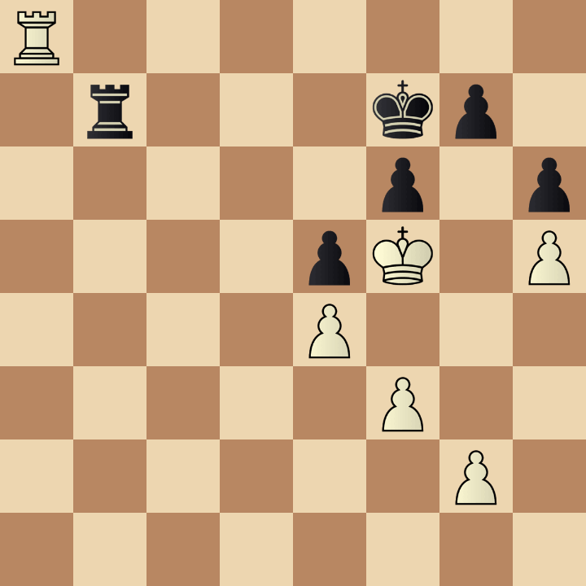
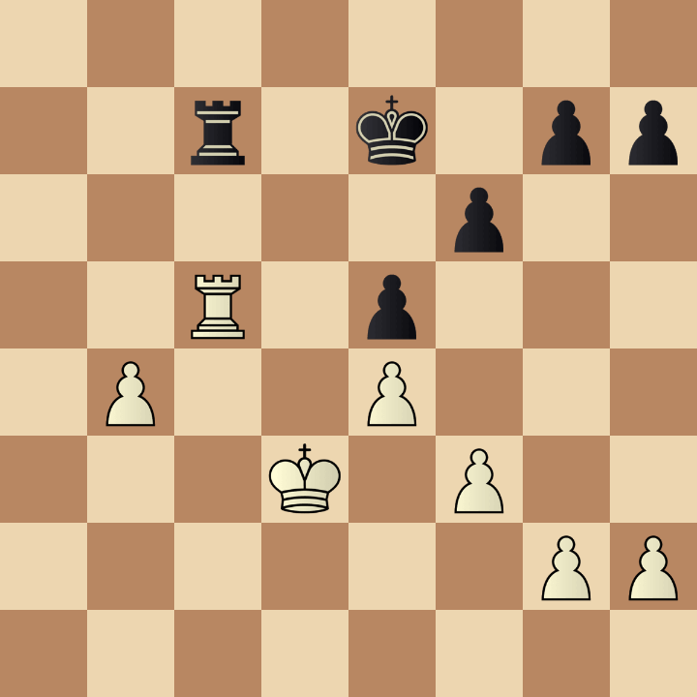
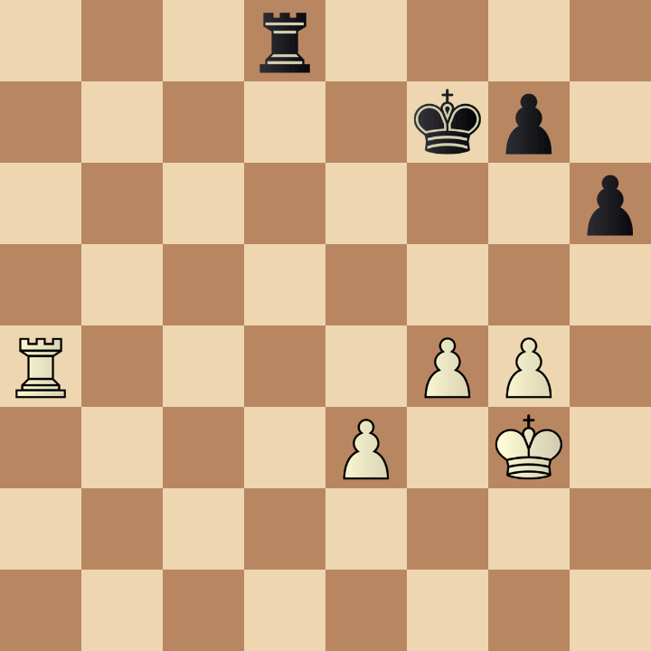
Example 1
Which position is the most similar
to the one in the given example: A, B, or C?
1. Ra6 Rc7 2. Rb6 Ra7 3. Rd6 Rb7 4. Ra6 Rb5+
A
B
C
50... Re7 51. Ra6 Rd7 52. Ra5 Rb7 53. Ra1
63... Rd7+ 64. Kc4 h5 65. Rd5 Rc7+ 66. Rc5
50... Rd3 51. Ra7+ Kf6 52. Kf2 Rd2+ 53. Kg3

Slide 3
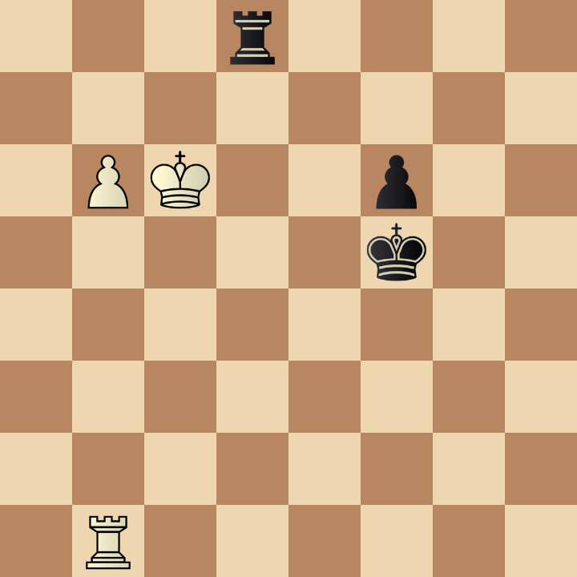
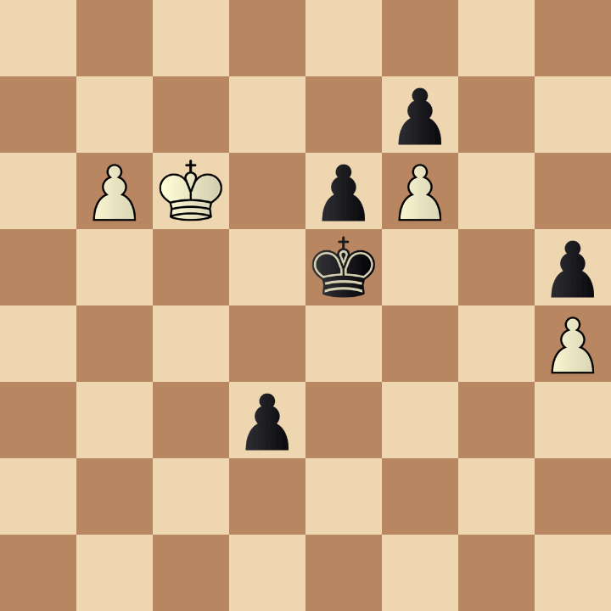
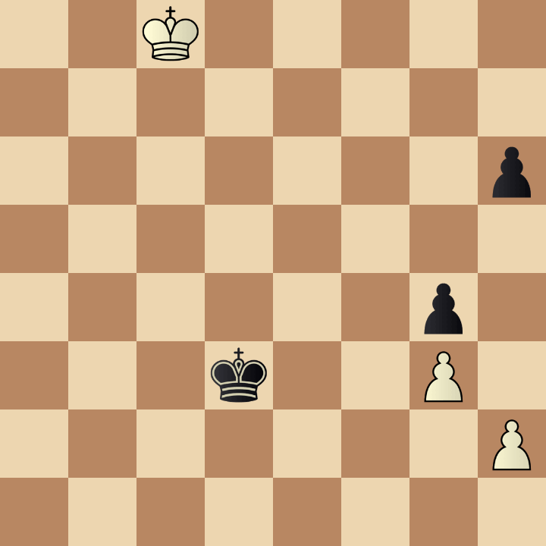
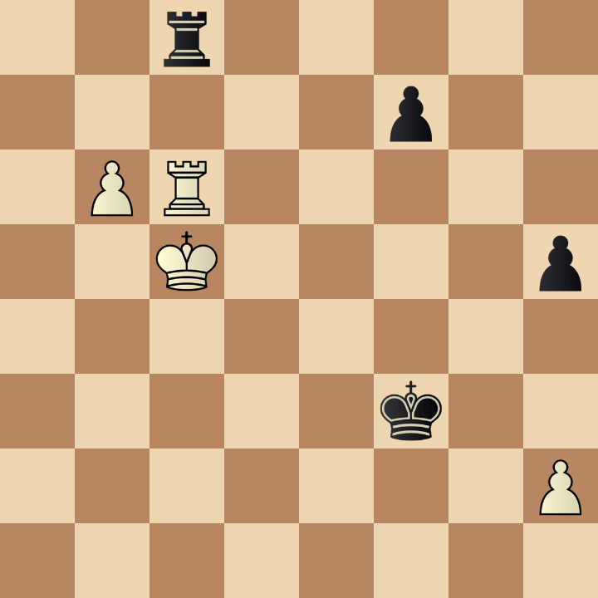
Example 2
Which position is the most similar
to the one in the given example: A, B, or C?
1... Rc8+ 2. Kd6 Rd8+ 3. Kc7 Rf8 4. Kd6 Rd8+ 5. Ke7
A
B
C
62... Kxf6 63. b7 d2 64. b8=Q d1=Q 65. Qb2+
69... Ke2 70. Kc7 Kf1 71. Kd8 Kg2 72. Ke7
48... Rg8 49. Kd6 Rd8+ 50. Kc7 Re8 51. b7

Slide 4
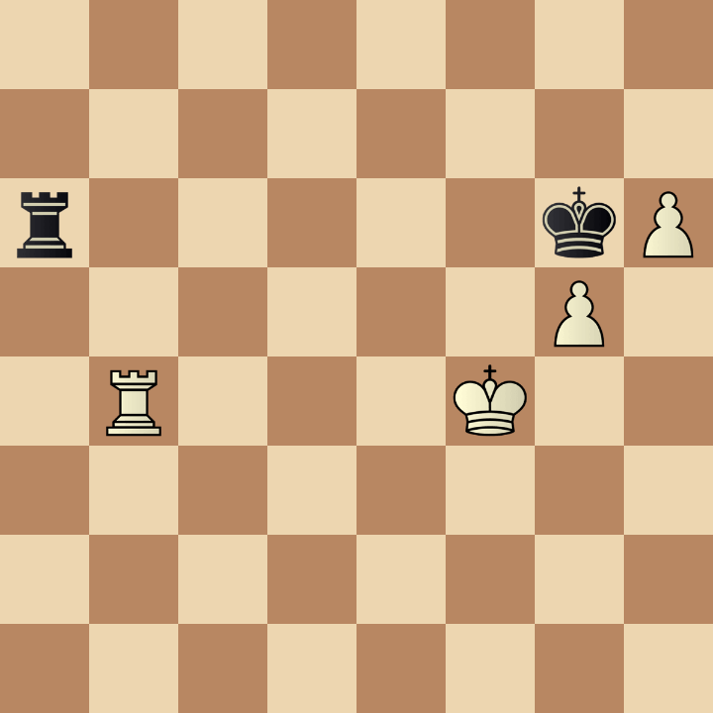
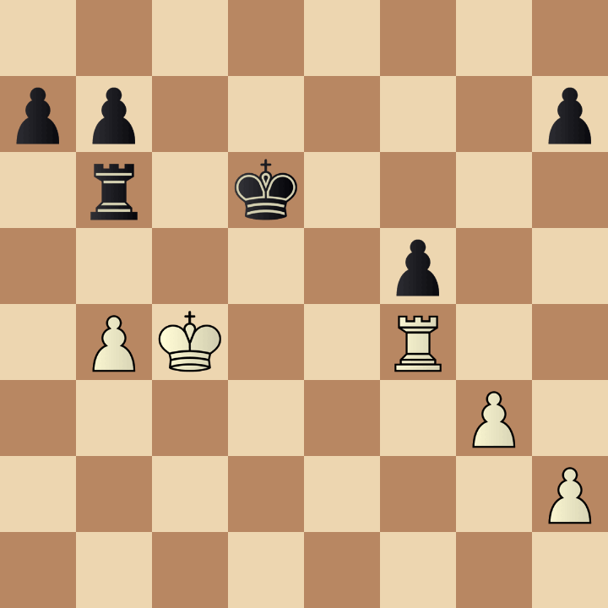
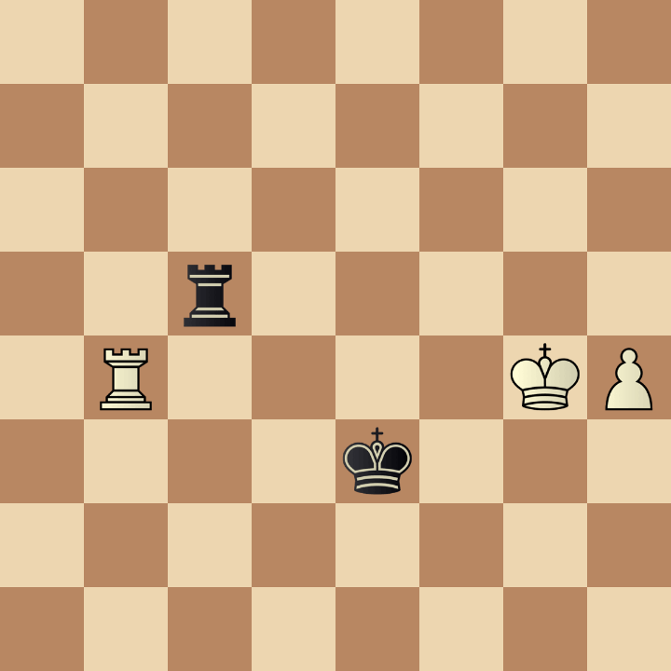
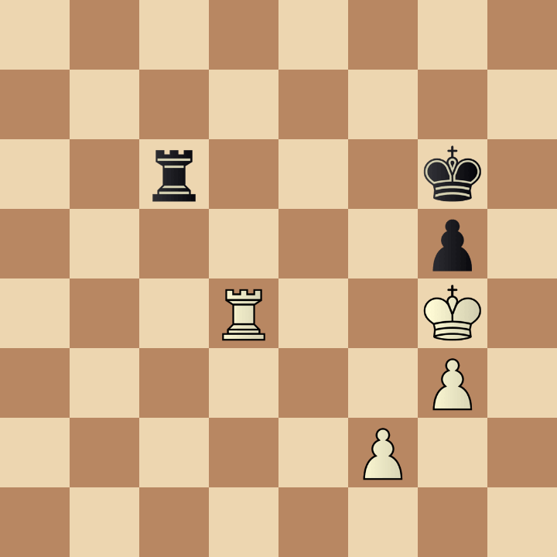
Example 3
Which position is the most similar
to the one in the given example: A, B, or C?
1. Rc4 Rb6 2. Ra4 Rc6 3. Re4 Ra6
A
B
C
44... Rc6+ 45. Kd3 Ke5 46. Rh4 Rb6 47. Kc4
47. Ra4 Rc8 48. h5 Rg8+ 49. Kh4 Rh8
54... Rb6 55. Re4 Rc6 56. Re5 Rc4+ 57. Kh3

Slide 5
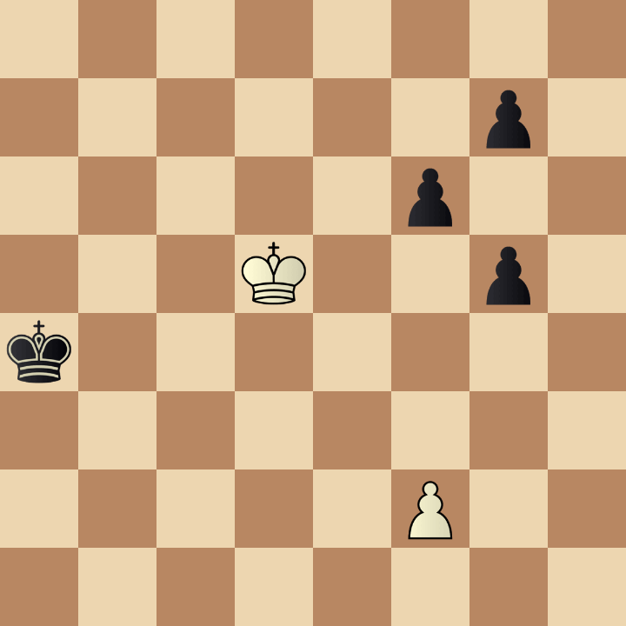
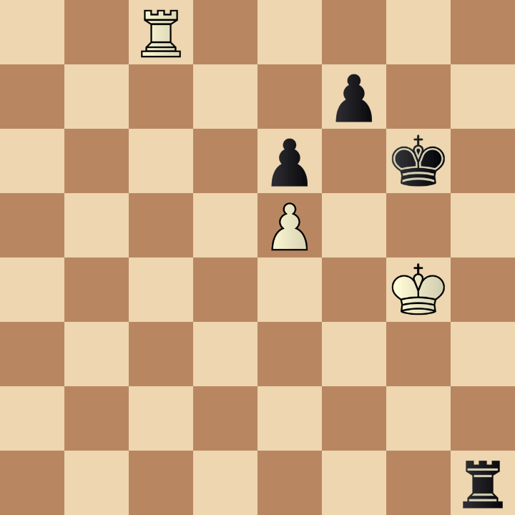
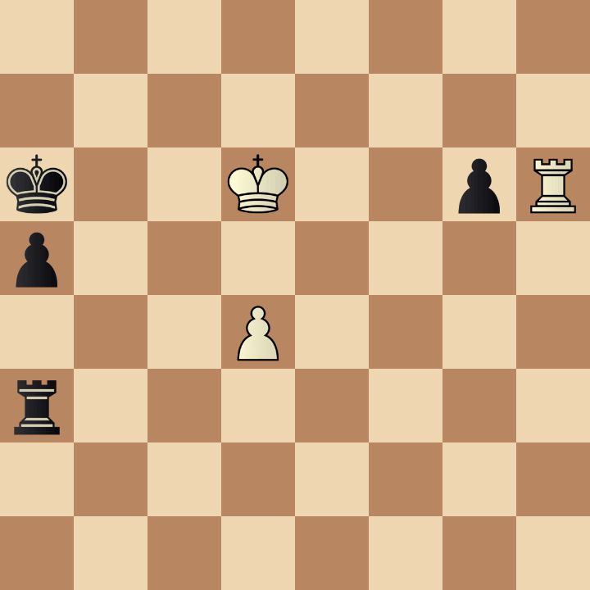
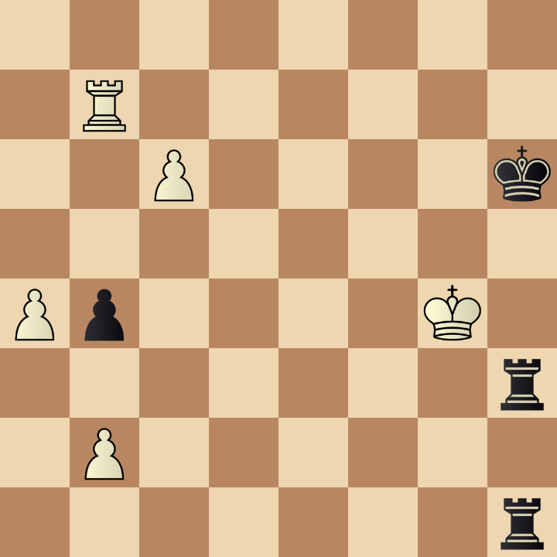
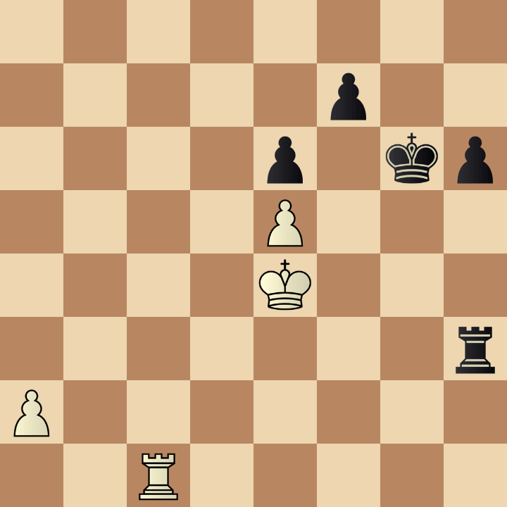
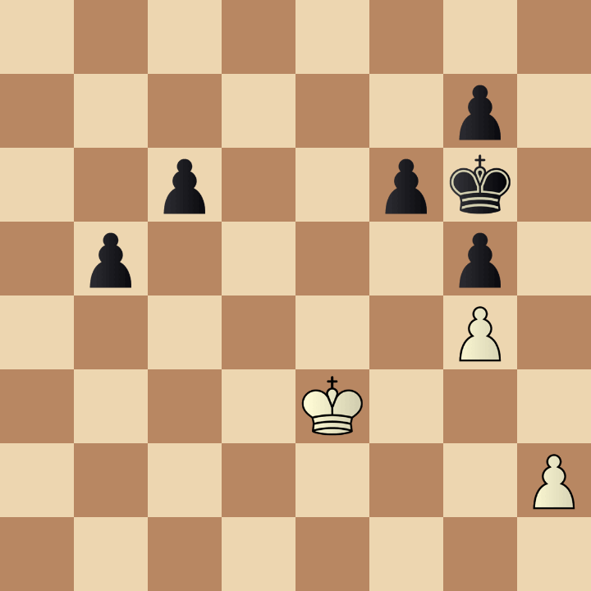
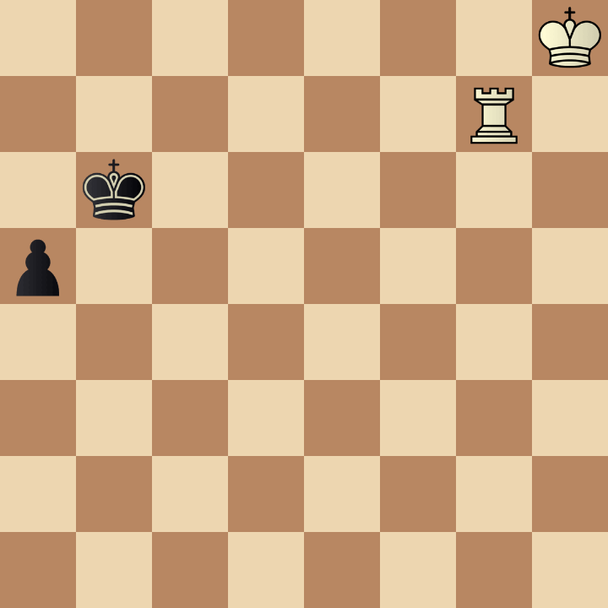
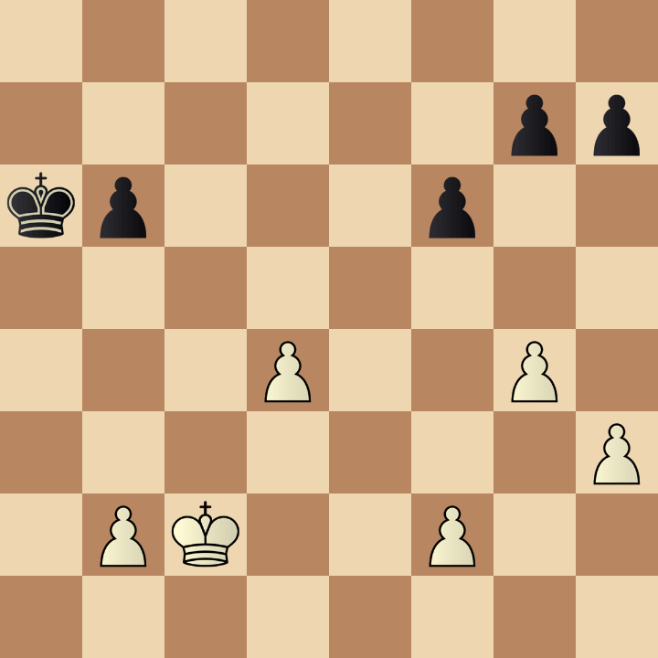
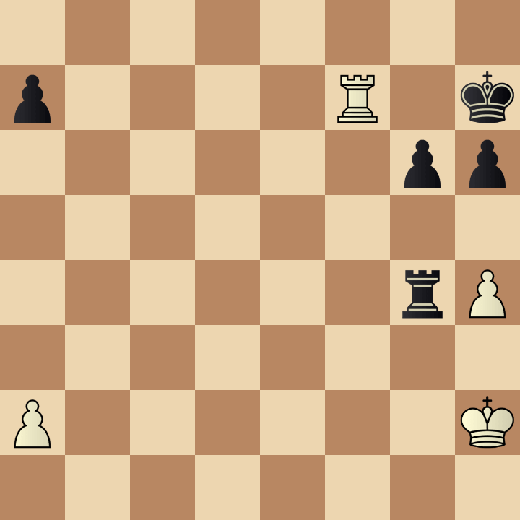
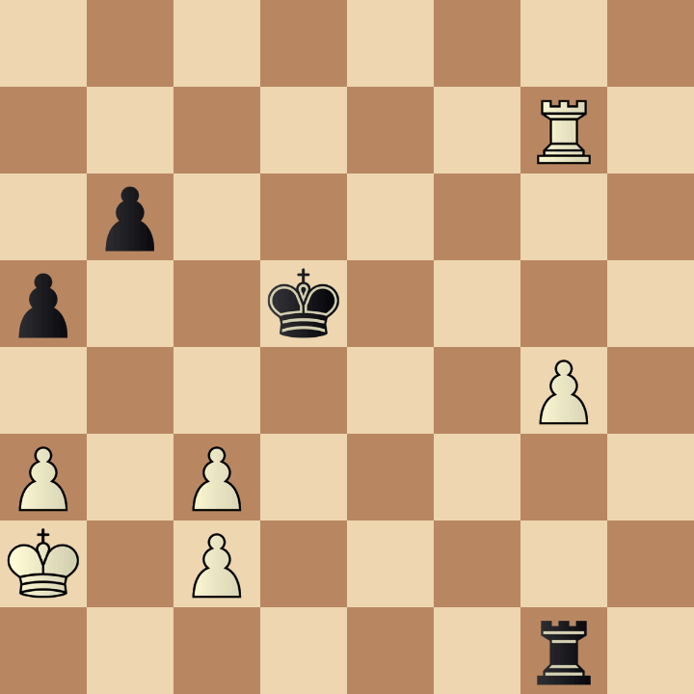
Example 4
Which position is the most similar
to the one in the given example: A, B, or C?
72. Rb8 Rf1 73. Rb3 Kg7 74. Rh3 Rf5 75. Re3 Kf8
A
B
C
52. c7 Rh4+ 53. Kf5 Rc1 54. Ke6 Rd4
47... Ra3 48. Rg1+ Kh7 49. Rg2 Ra4+ 50. Ke3
50... Kh8 51. h5 Rh4+ 52. Kg3 Rxh5 53. Rxa7

Slide 6
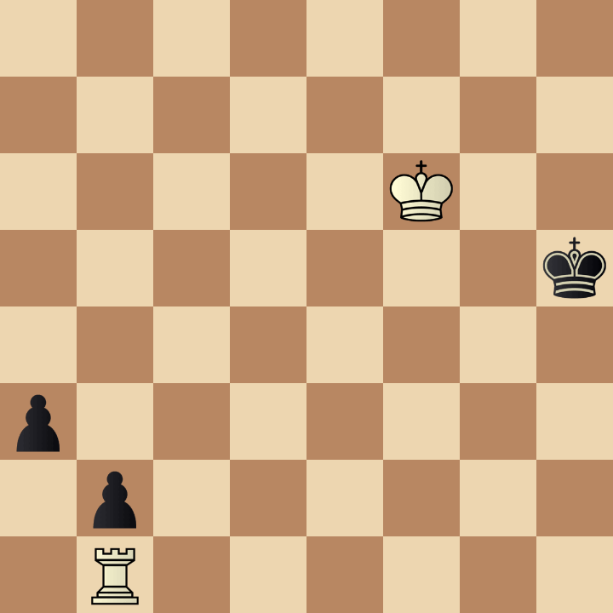
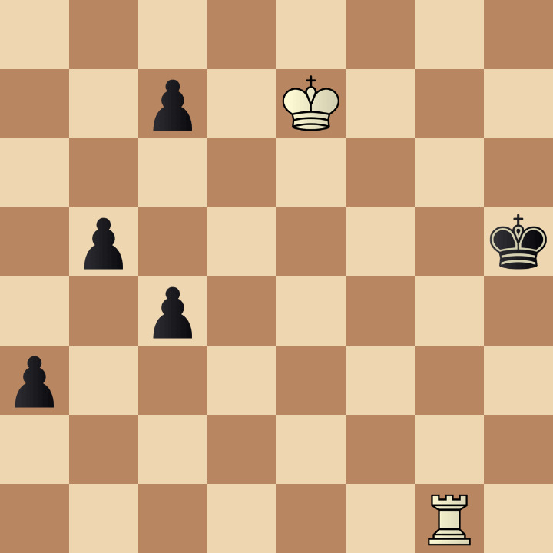
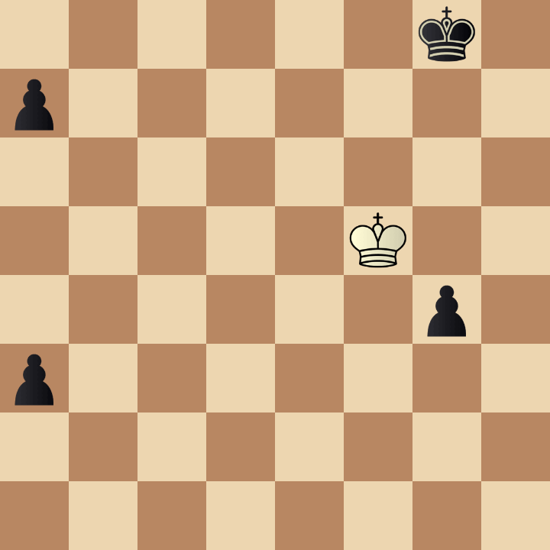
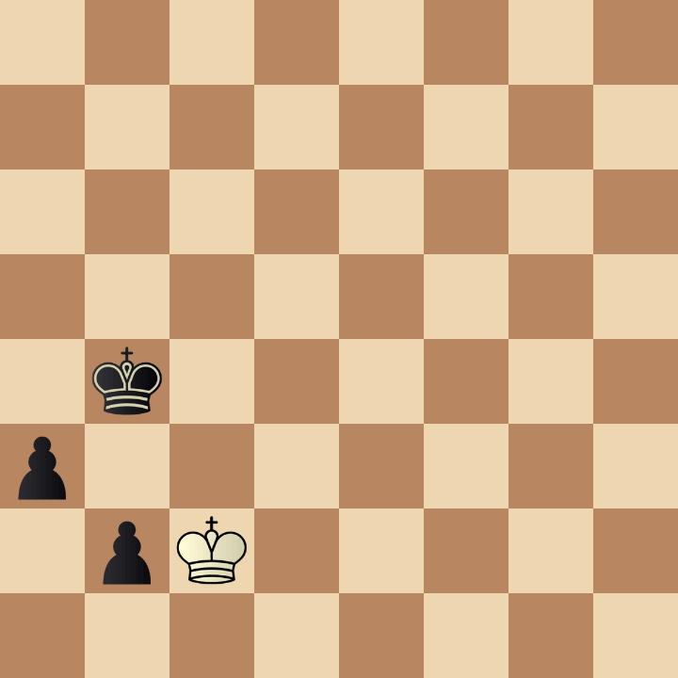
Example 5
Which position is the most similar
to the one in the given example: A, B, or C?
1. Ke6 Kg5 2. Kd6 Kg4 3. Kd5 Kh5 4. Kc4 a2
A
B
C
70... a2 71. Ke6 b4 72. Kf5 Kh4 73. Kf4
49... a5 50. Kxg4 a4 51. Kf3 a2 52. Kf4
78. Kd2 a2 79. Kd3 a1=Q 80. Ke3 b1=Q

Slide 7
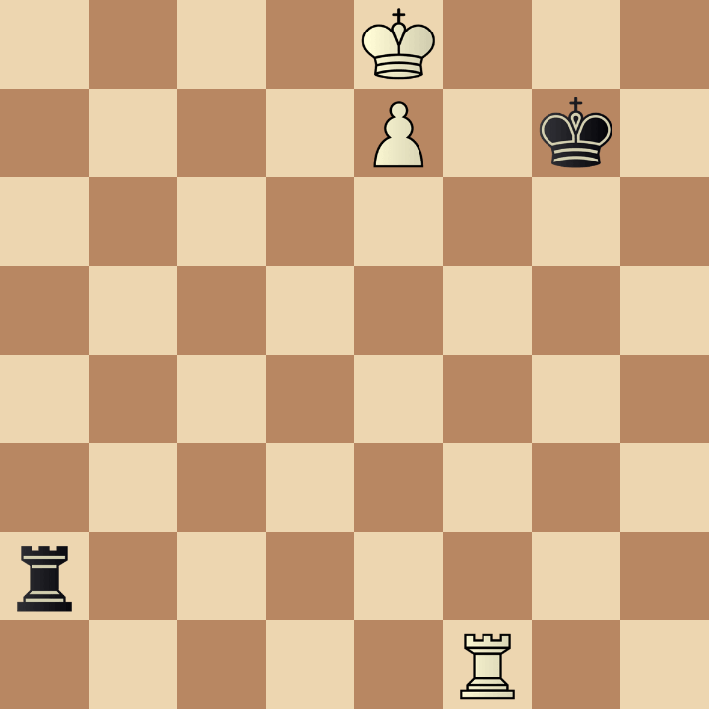
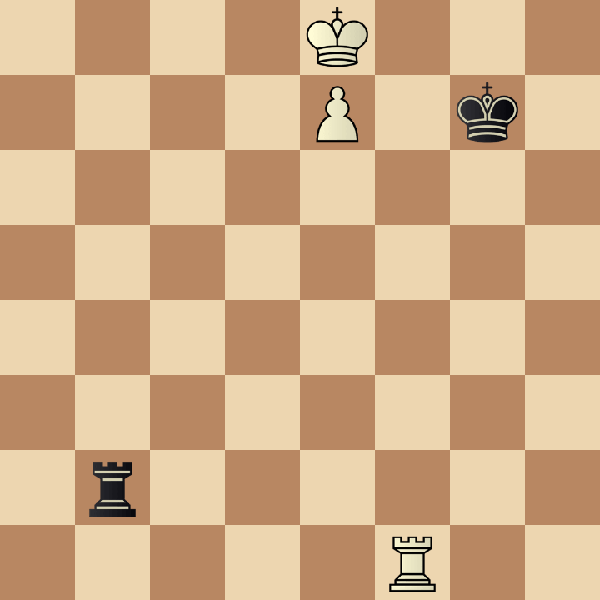
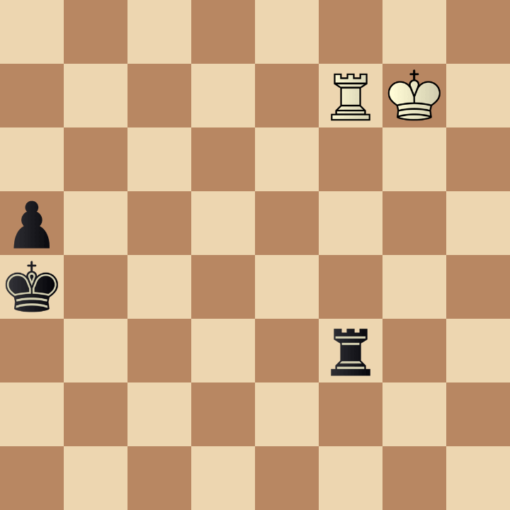
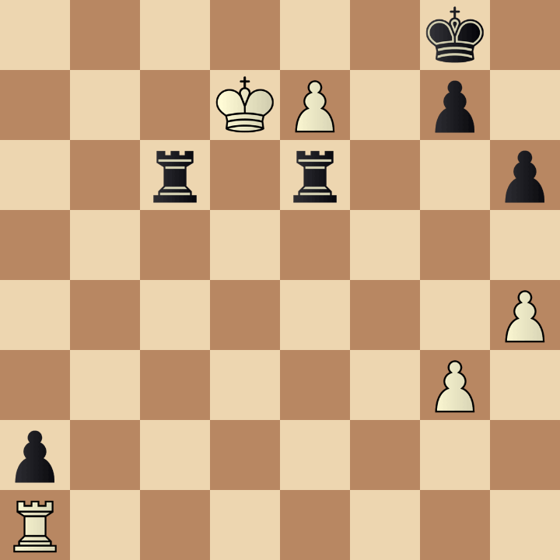
Example 6
Which position is the most similar
to the one in the given example: A, B, or C?
1. Rd1 Ra8+ 2. Kd7 Ra7+ 3. Ke6 Ra6+ 4. Rd6 Ra8
A
B
C
55. e8=Q+ Rxe8 56. Kxc6 Ra8 57. Kd6 Ra6+
74... Rg3+ 75. Kf8 Ka3 76. Ke8 a4 77. Rb7
1... Re2 2. Rd1 Ra2 3. Kd7 Ra8 4. Ke6

Slide 8
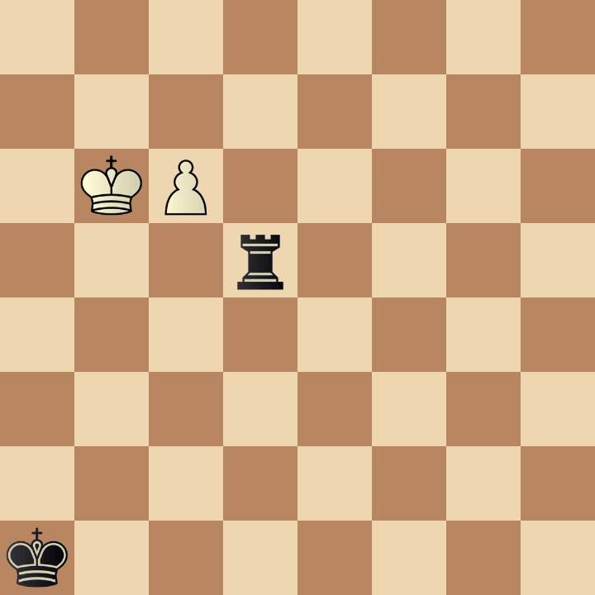
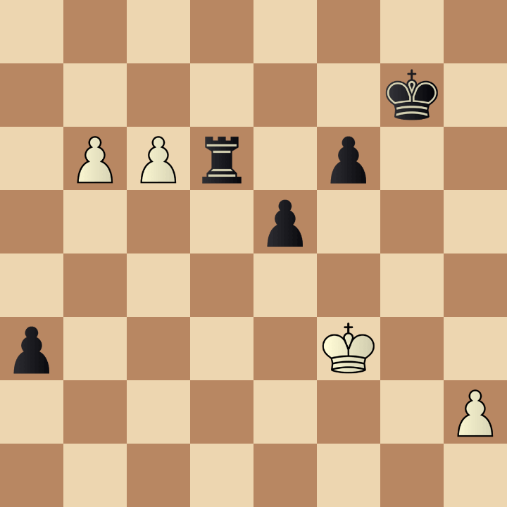
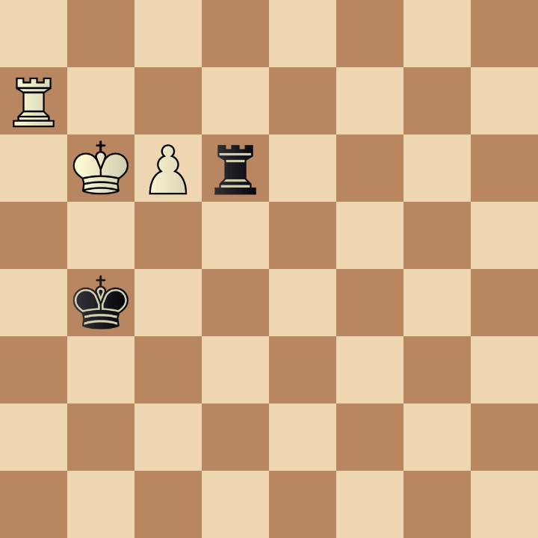
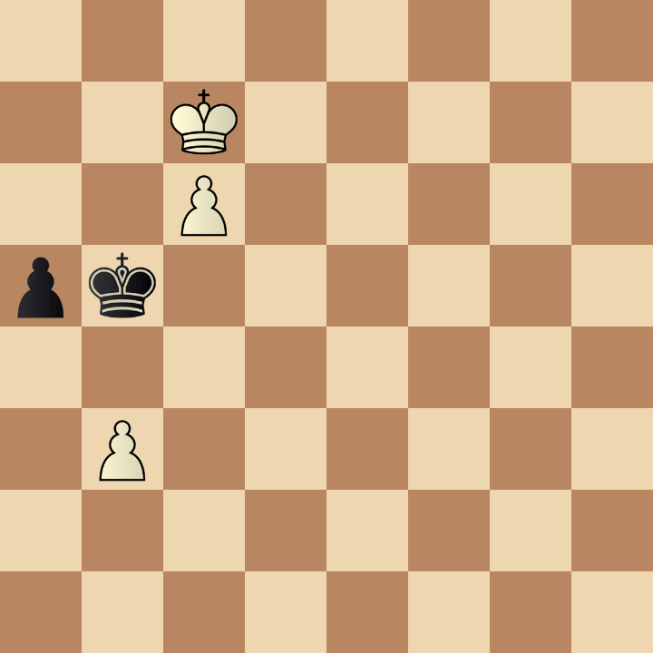
Example 7
Which position is the most similar
to the one in the given example: A, B, or C?
1. Ka6 Rc5 2. Kb6 Rc3 3. Kb7 Rxc6 4. Kxc6 Kb1
A
B
C
55. b7 Rd3+ 56. Ke2 Rb3 57. c7 a2
64. Rd7 Rxc6+ 65. Kxc6 Kc4 66. Kb6 Kb4
62... Kb4 63. Kb6 Kxb3 64. Kxa5 Kc4 65. Ka6

Slide 9
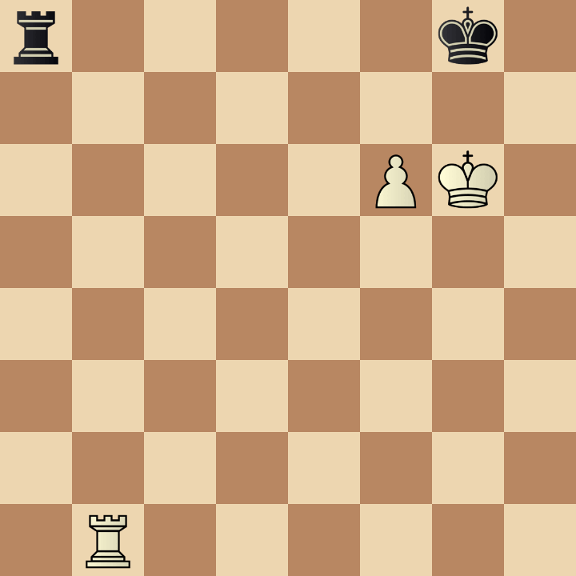
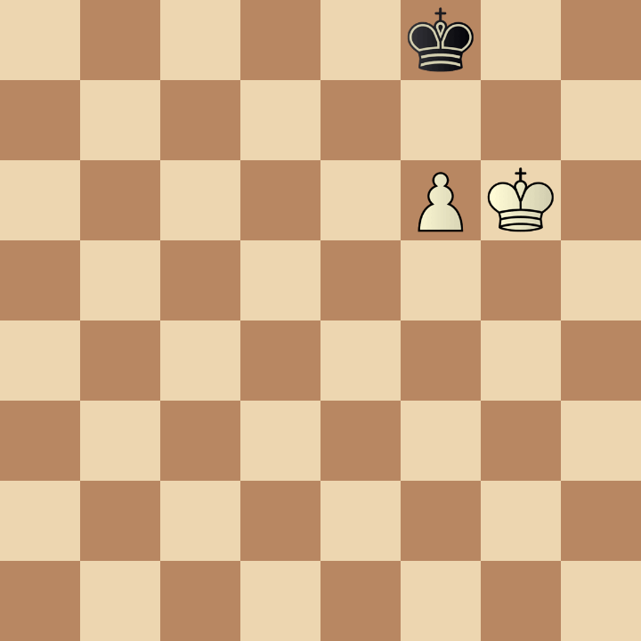
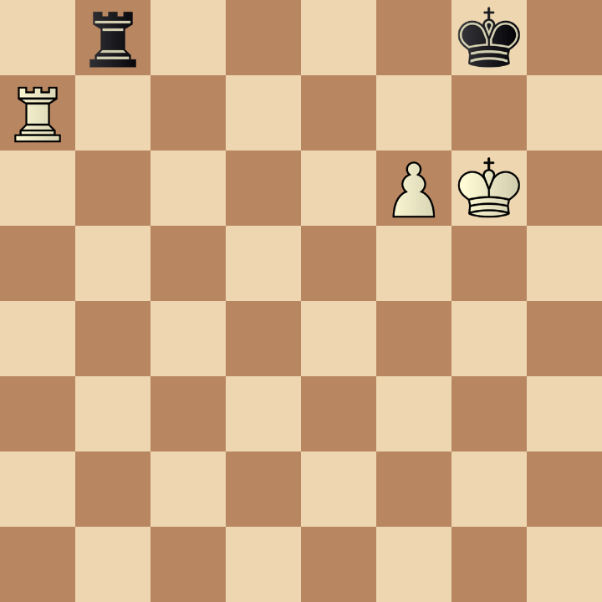
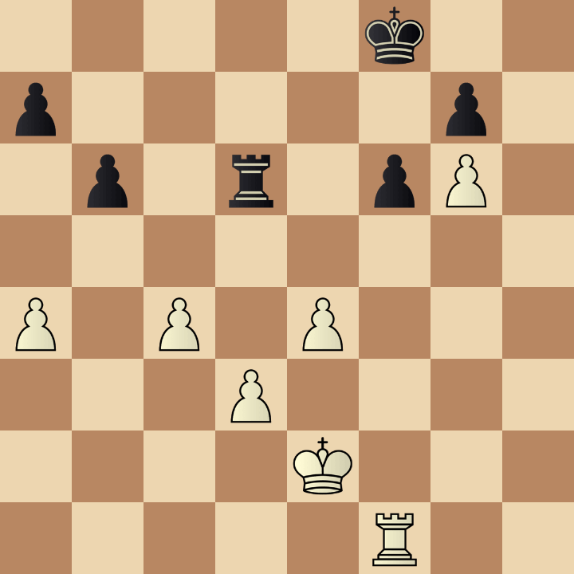
Example 8
Which position is the most similar
to the one in the given example: A, B, or C?
1. Rb3 Rc8 2. Rb5 Kf8 3. Rh5 Ke8 4. Rh8+ Kd7
A
B
C
58... Ke8 59. Kg7 Kd7 60. Kg6 Ke6 61. Kg7
1. Rd7 Rc8 2. Rg7+ Kf8 3. Rh7 Ke8
38. Rh1 Rd7 39. Rh8+ Ke7 40. Rg8 Ke6

Slide 10
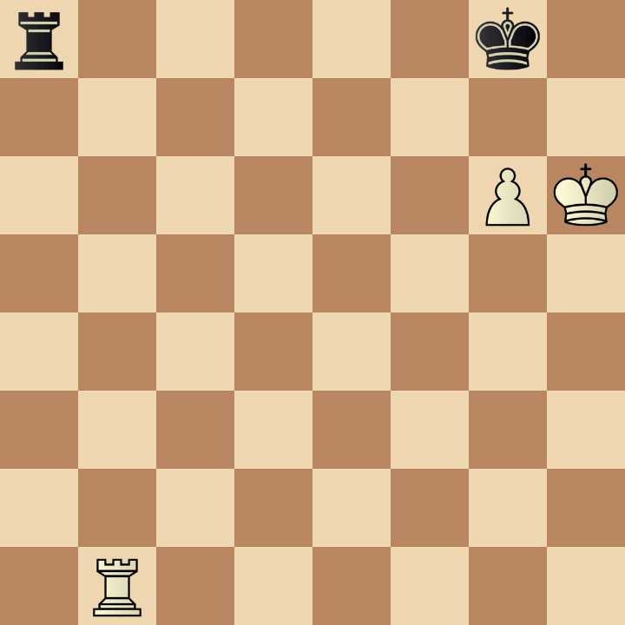
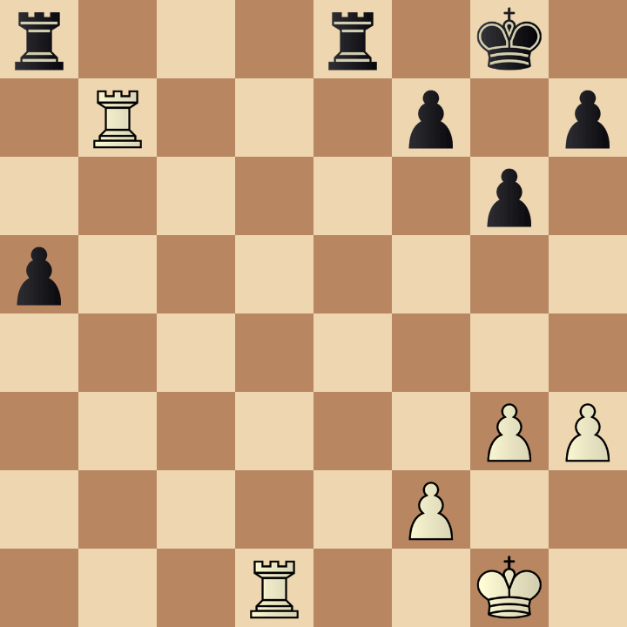
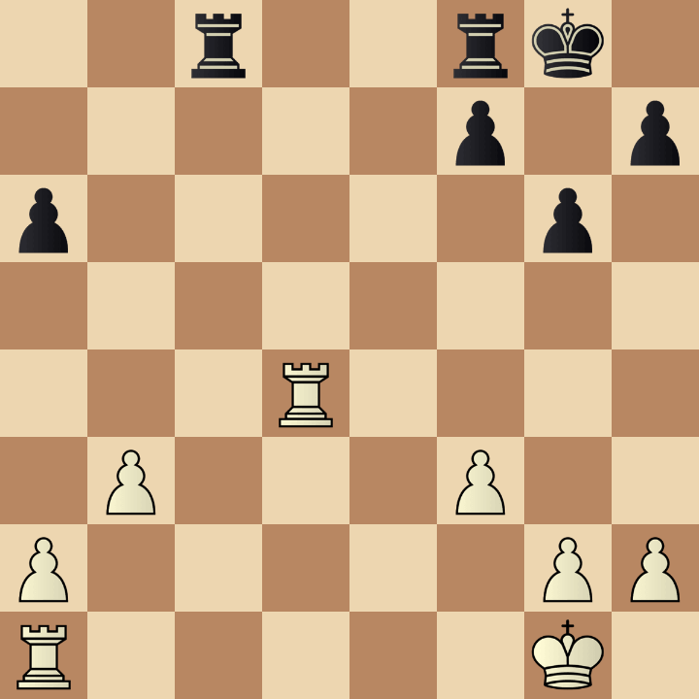
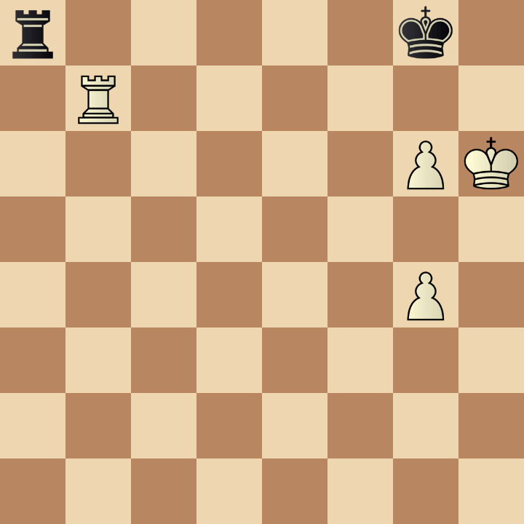
Example 9
Which position is the most similar
to the one in the given example: A, B, or C?
1. Rb7 Rd8 2. Rc7 Re8 3. Ra7 Rd8 4. Ra6 Re8
A
B
C
39. Kg2 Reb8 40. Re7 Re8 41. Rc7 Red8
24... Rfe8 25. Rd2 Rcd8 26. Rc2 Rc8 27. Rd2
1. Rb6 Re8 2. g5 Ra8 3. Rc6 Re8

Slide 11
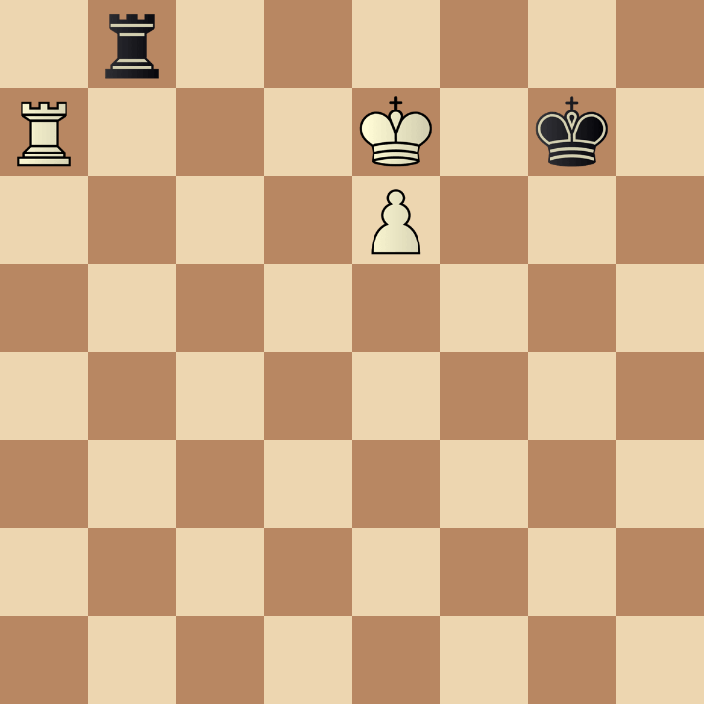
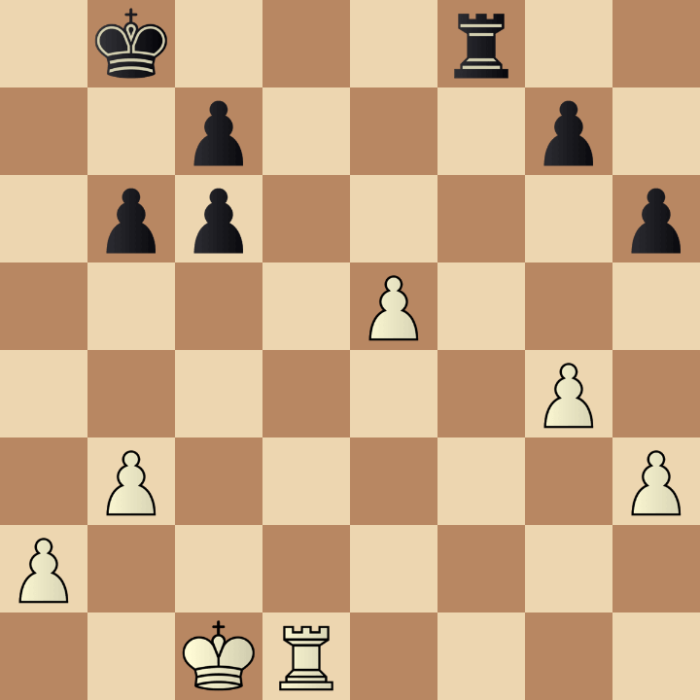
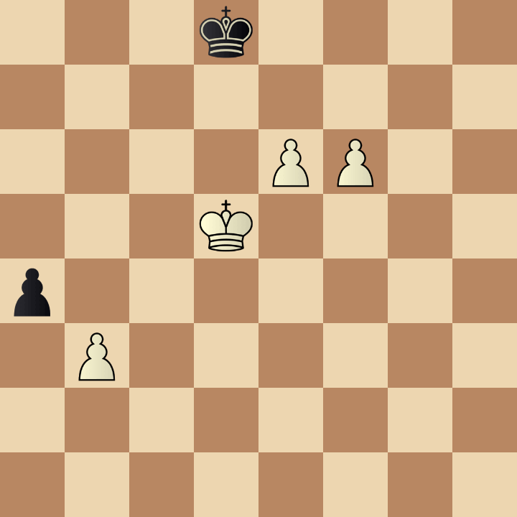
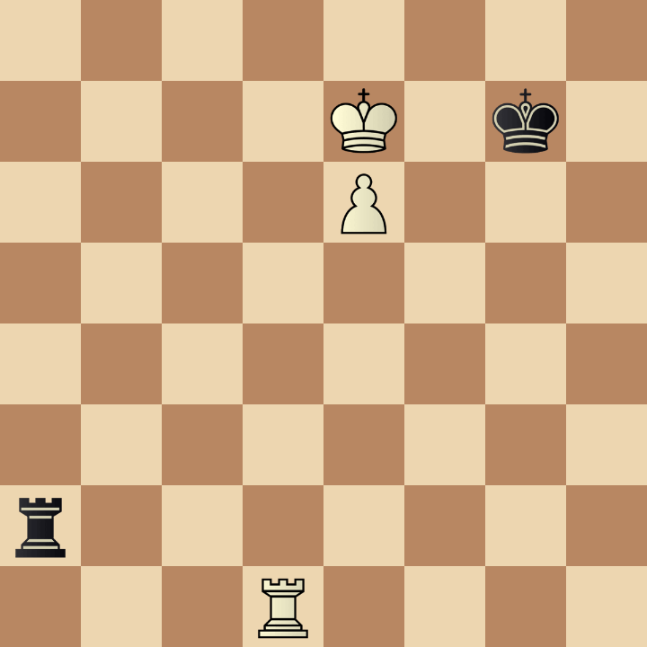
Example 10
Which position is the most similar
to the one in the given example: A, B, or C?
1. Rd7 Ra8 2. Rd6 Kg6 3. Rd1 Ra7+ 4. Rd7 Ra2
A
B
C
32... Re8 33. Rd7 Rxe5 34. Rxg7 Re1+ 35. Kb2
51... a3 52. Kd6 Ke8 53. e7 Kf7 54. Kc7
1... Rg2 2. Kd7 Ra2 3. e7 Re2 4. Rg1+

Slide 12
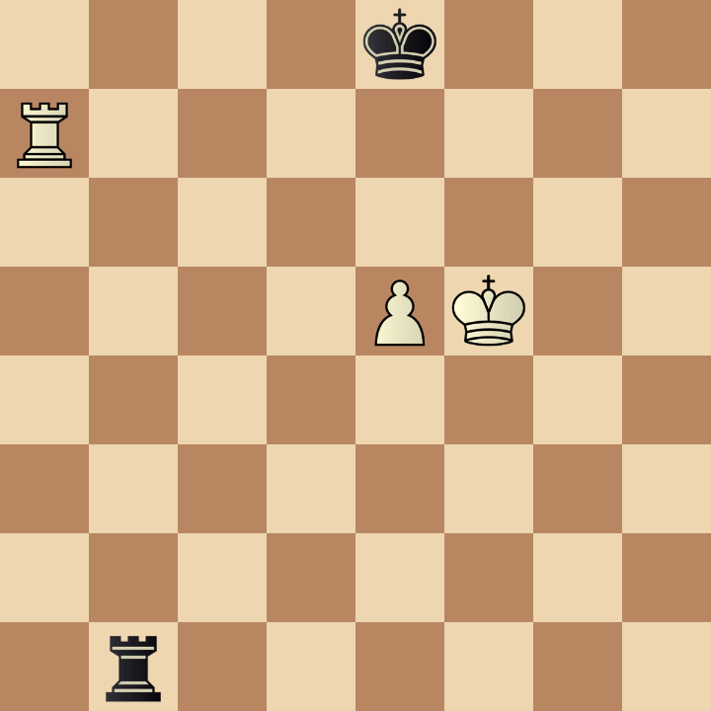
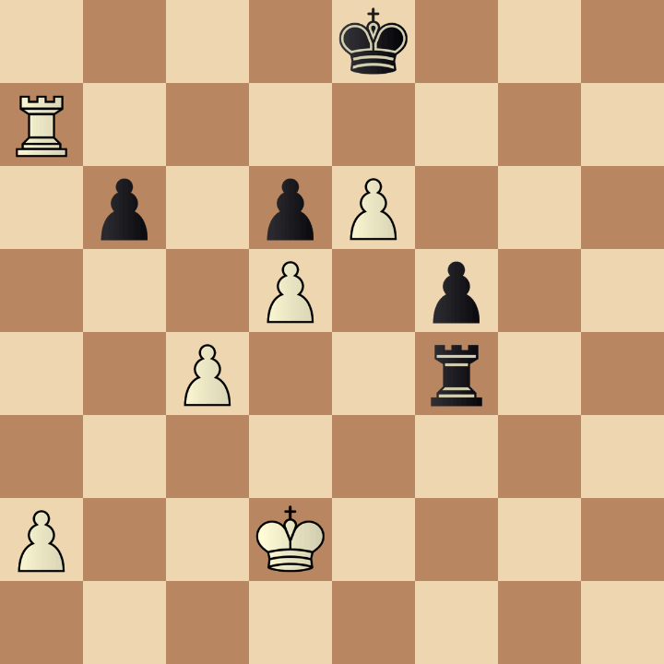
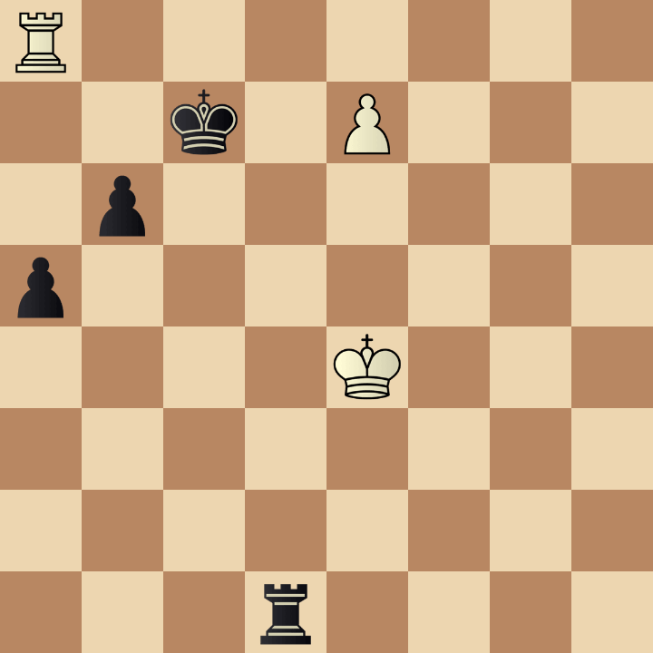
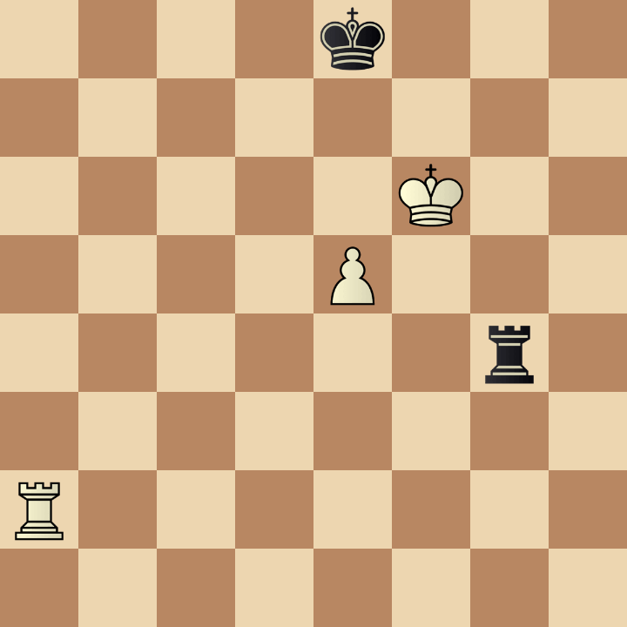
Example 11
Which position is the most similar
to the one in the given example: A, B, or C?
1. Ra8+ Kd7 2. Ra7+ Ke8 3. Kf6 Re1 4. Ke6 Kf8
A
B
C
52... Rg4 53. Ra8+ Ke7 54. Ra7+ Ke8 55. Kc3
46... Kd6 47. Rd8+ Kxe7 48. Rxd1 b5 49. Kd5
54... Rf4+ 55. Ke6 Kf8 56. Ra8+ Kg7 57. Kd7

Slide 13




Example 12
Which position is the most similar
to the one in the given example: A, B, or C?
1... Kb5 2. Kf7 Kc4 3. Ra8 Kb4 4. Rxa6 Kb3 5. Rc6
A
B
C
62... Kd4 63. Kg7 Kxc4 64. Kf7 Kd4 65. Kg6
52... g3 53. Kxe5 Kb5 54. Rc3 g2 55. Rb3+
68... Kc5 69. Kf6 a4 70. Kf5 a3 71. Ra8

Slide 14




Example 13
Which position is the most similar
to the one in the given example: A, B, or C?
1. Rb7 f4+ 2. Kg2 Rc2+ 3. Kf3 Rh2 4. Rh7+ Kg6
A
B
C
45. Ra5+ Ke4 46. Kg3 f4+ 47. Kg2 Rh1
71... Ra4 72. Rb6 Kf7 73. Rb5 Ra8 74. Kh2
45. g4 Rcc3 46. Kd5 Rf4 47. Rg1 Kf6

Slide 15



Example 14
Which position is the most similar
to the one in the given example: A, B, or C?
1. Kc4 b1=Q 2. Rh2+ Kc1 3. Rh1+ Kb2 4. Rxb1+ Kxb1
A
B
C
71. Rh1 b1=R 72. Rxb1 Kxb1 73. Kxb3 Kc1
78. Kd2 a2 79. Kd3 a1=Q 80. Ke3 b1=Q
80. d6 Rd1 81. Rd3+ Ke2 82. Rxd1 a2

Slide 16




Example 15
Which position is the most similar
to the one in the given example: A, B, or C?
1... Rb2+ 2. Ke1 Rd2 3. Ra4+ Rd4 4. Ra8 Kf3 5. Ra5
A
B
C
46... Rd5 47. Ke1 Rd2 48. a6 Kf3 49. h7
38. g4 Kf3 39. Rd8 Re7+ 40. Kd1 Kxg4
73... Ke3 74. Rc3+ Kf2 75. Kc2 Kg2 76. Rdd3

