Slide 1

Rook endgames – similar problems
Žiga Medved, Bachelor thesis

Slide 2
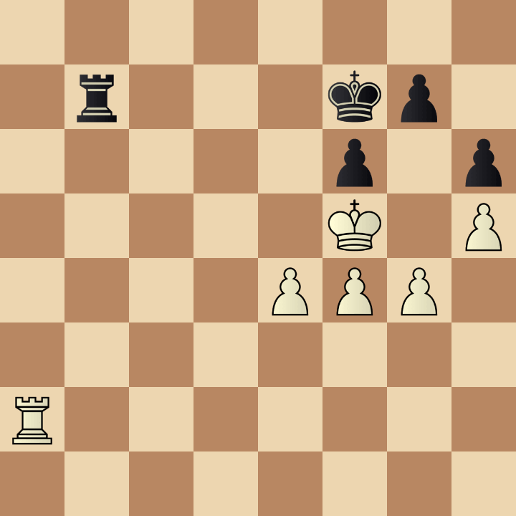
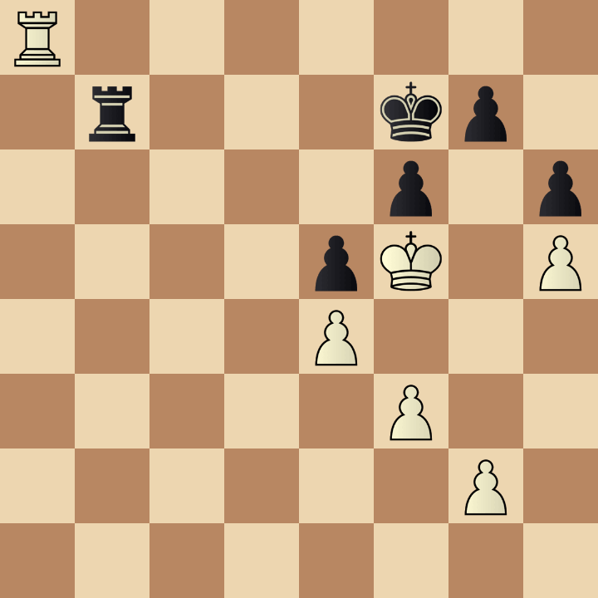
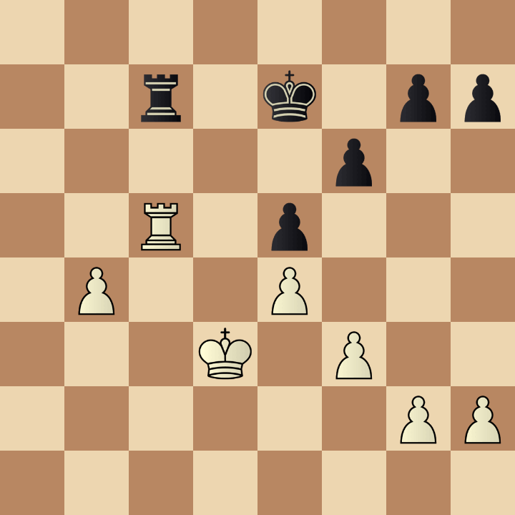
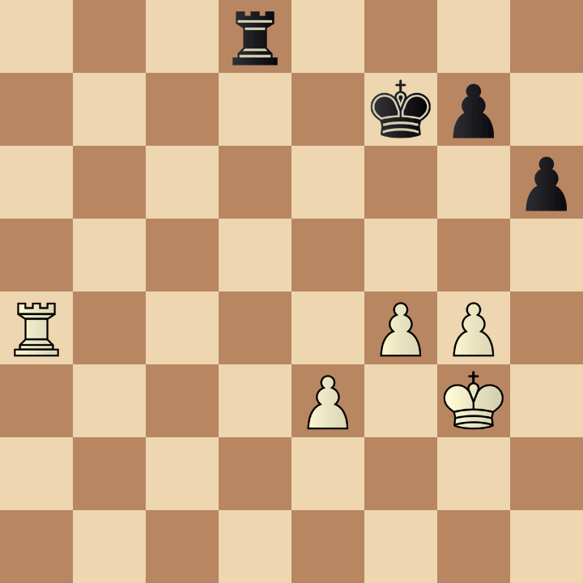
Example 1
A
B
R7/1r3kp1/5p1p/4pK1P/4P3/5P2/6P1/8 b - - 0 1
8/2r1k1pp/5p2/2R1p3/1P2P3/3K1P2/6PP/8 b - - 0 1
Query
8/1r3kp1/5p1p/5K1P/4PPP1/8/R7/8 w - - 0 1
C
3r4/5kp1/7p/8/R4PP1/4P1K1/8/8 b - - 0 1

Slide 3
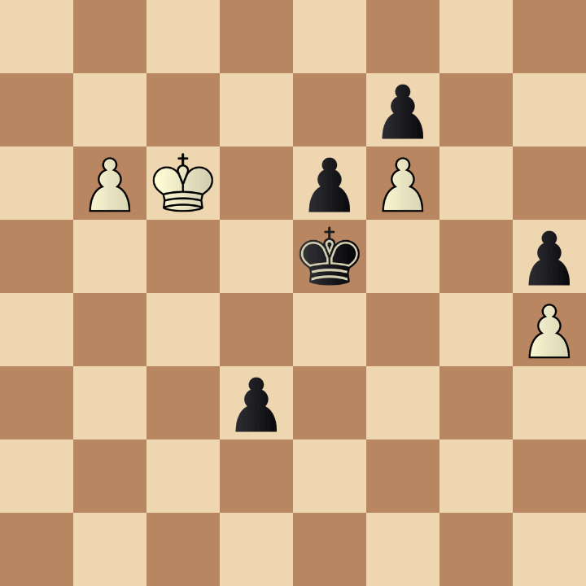
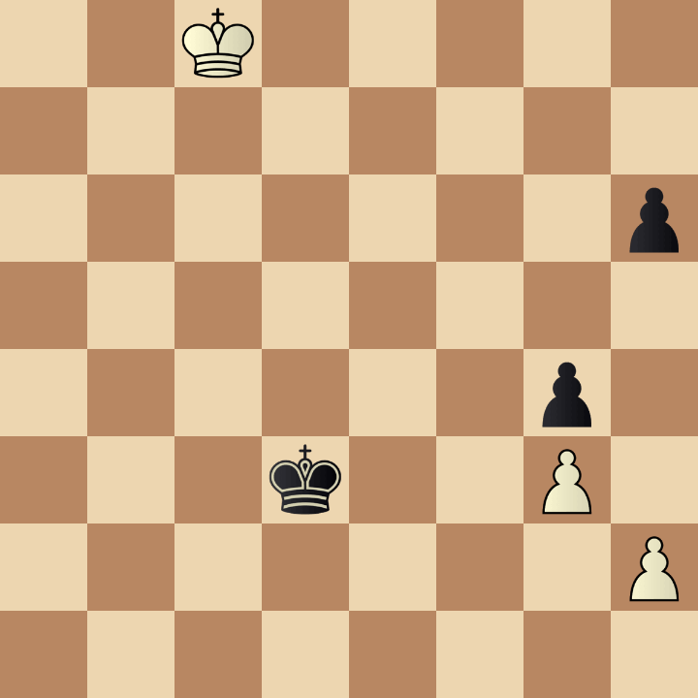
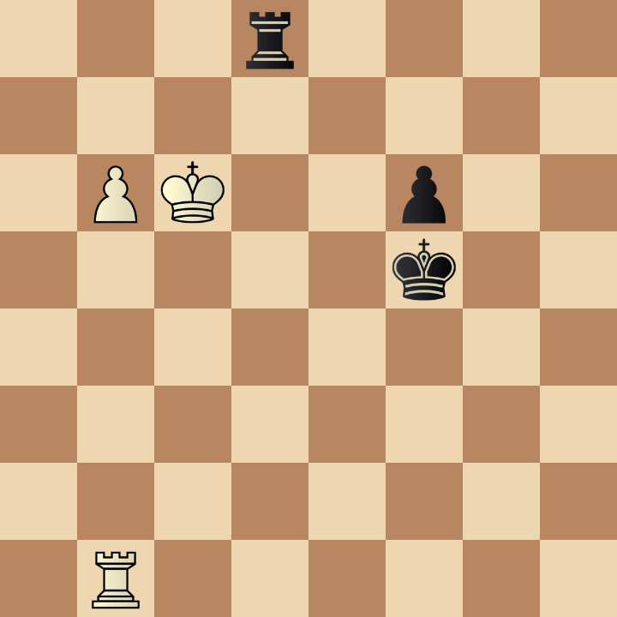
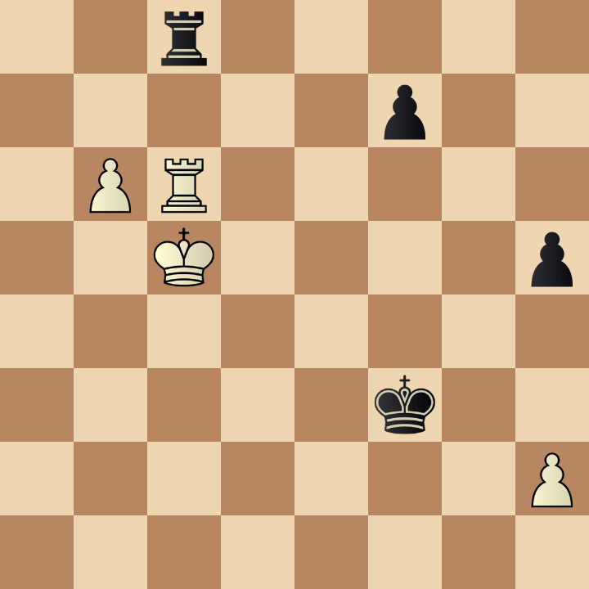
Example 2
A
B
8/5p2/1PK1pP2/4k2p/7P/3p4/8/8 b - - 0 62
2K5/8/7p/8/6p1/3k2P1/7P/8 b - - 0 69
Query
3r4/8/1PK2p2/5k2/8/8/8/1R6 b - - 0 1
C
2r5/5p2/1PR5/2K4p/8/5k2/7P/8 b - - 0 48

Slide 4
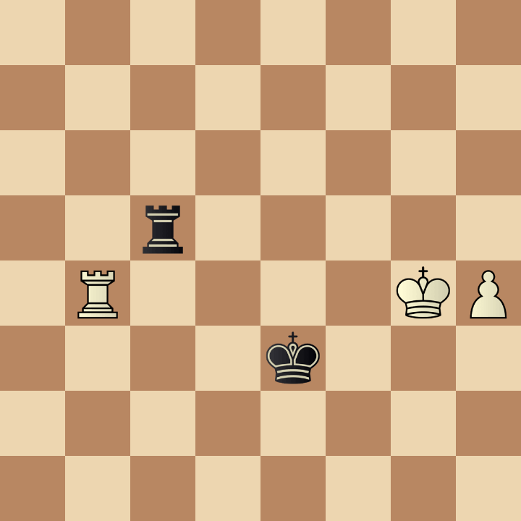
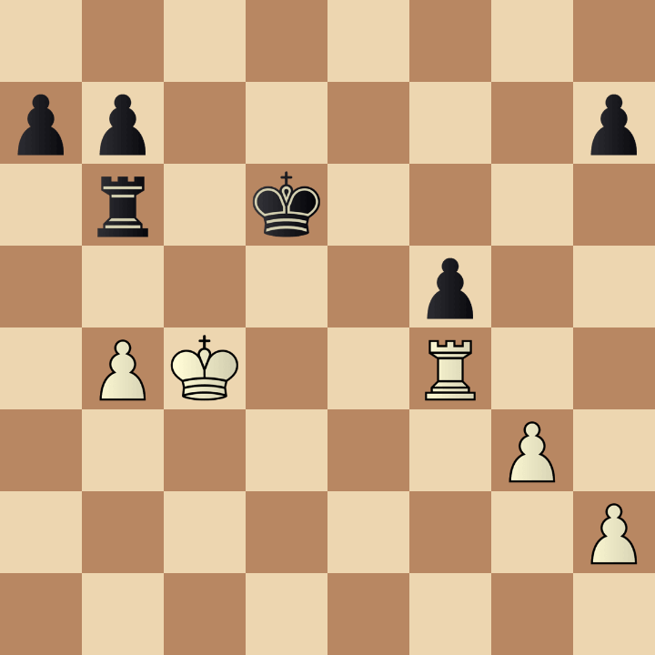
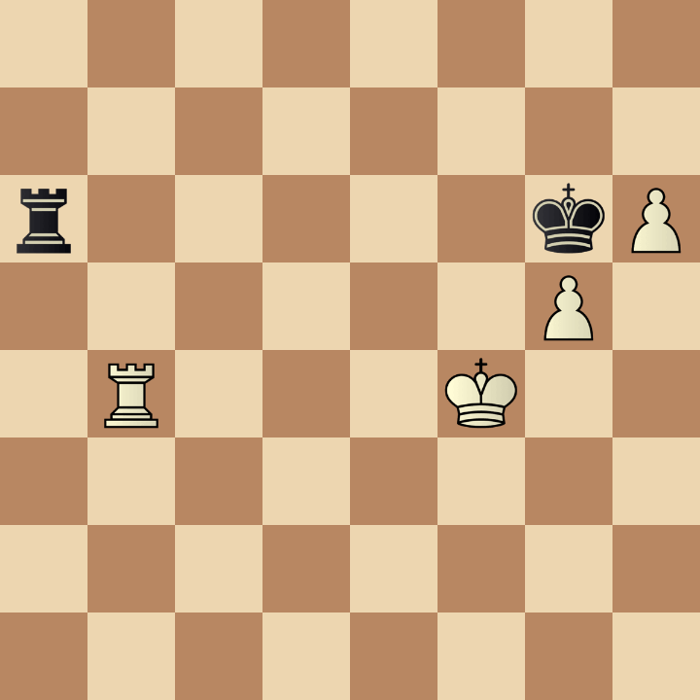
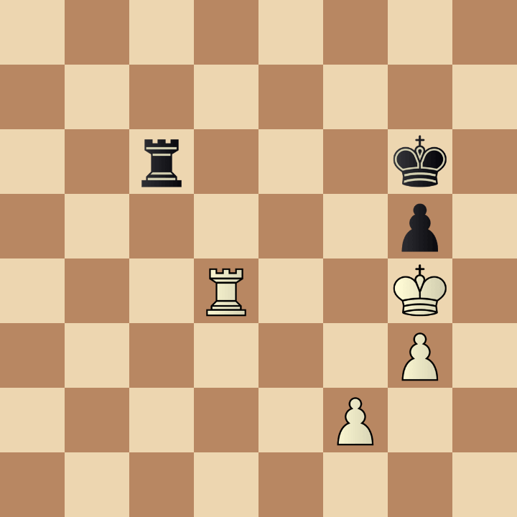
Example 3
A
B
8/pp5p/1r1k4/5p2/1PK2R2/6P1/7P/8 b - - 0 44
8/8/8/2r5/1R4KP/4k3/8/8 w - - 0 47
Query
8/8/r5kP/6P1/1R3K2/8/8/8 w - - 0 1
C
8/8/2r3k1/6p1/3R2K1/6P1/5P2/8 b - - 0 54

Slide 5
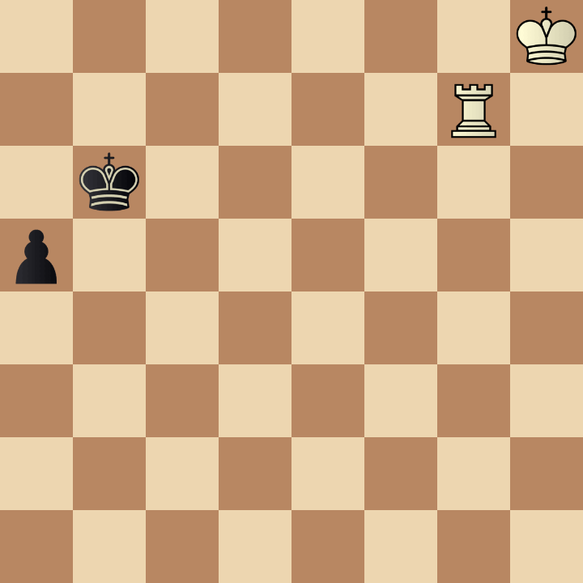
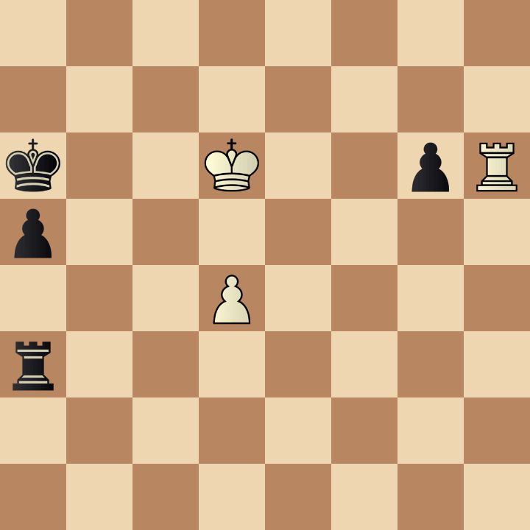
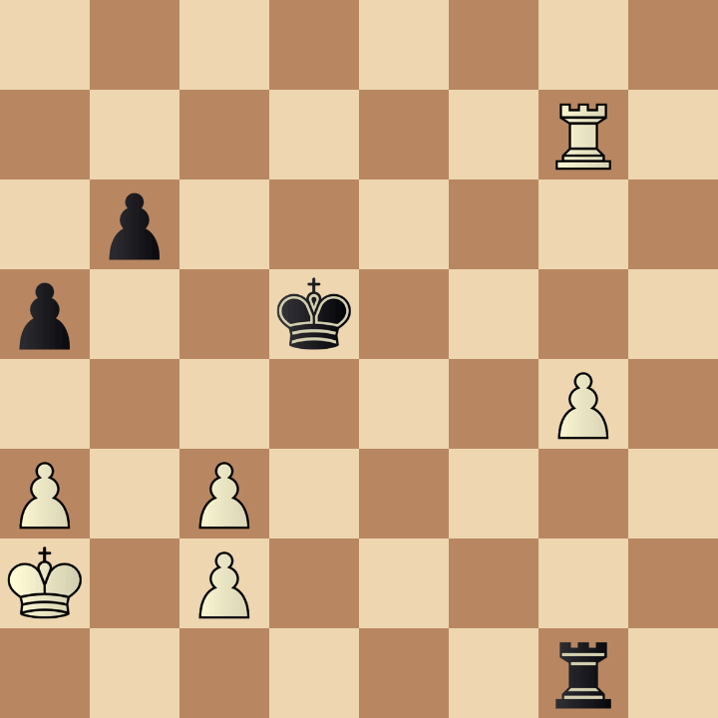
Example 4
A
B
8/8/k2K2pR/p7/3P4/r7/8/8 w - - 0 52
7K/6R1/1k6/p7/8/8/8/8 w - - 0 1
Query
7K/6R1/1k6/p7/8/8/8/8 b - - 0 1
C
8/6R1/1p6/p2k4/6P1/P1P5/K1P5/6r1 b - - 0 46

Slide 6
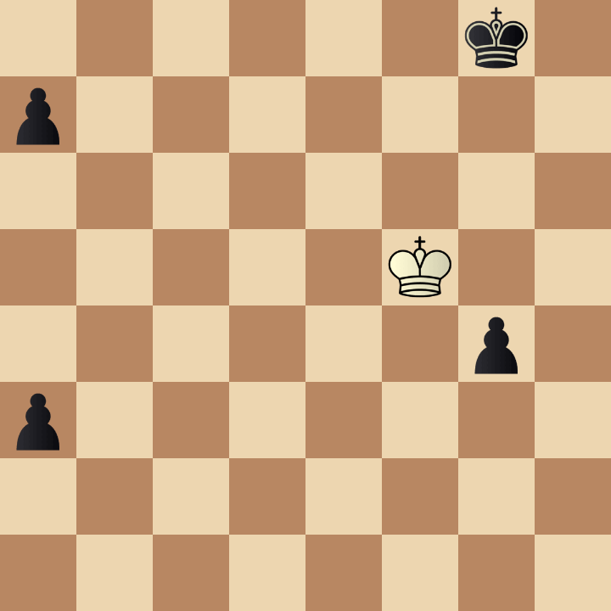
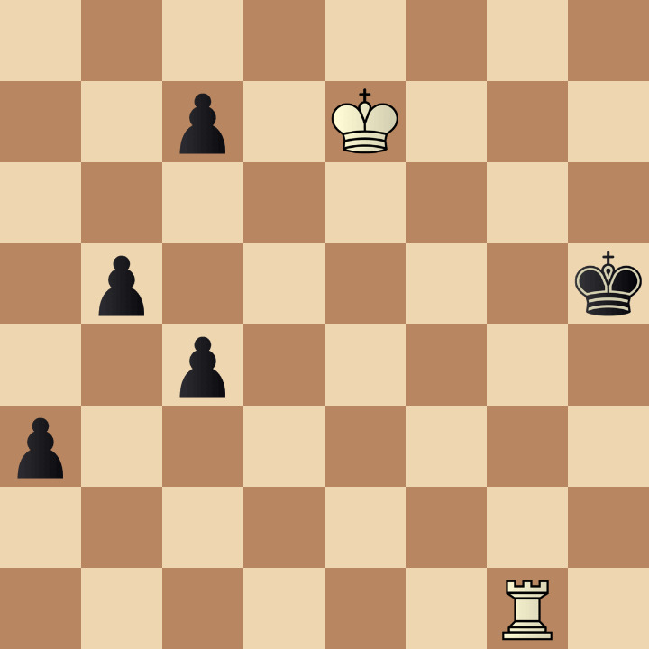
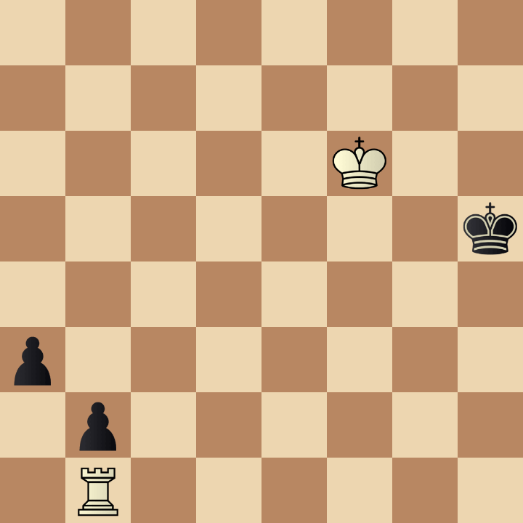
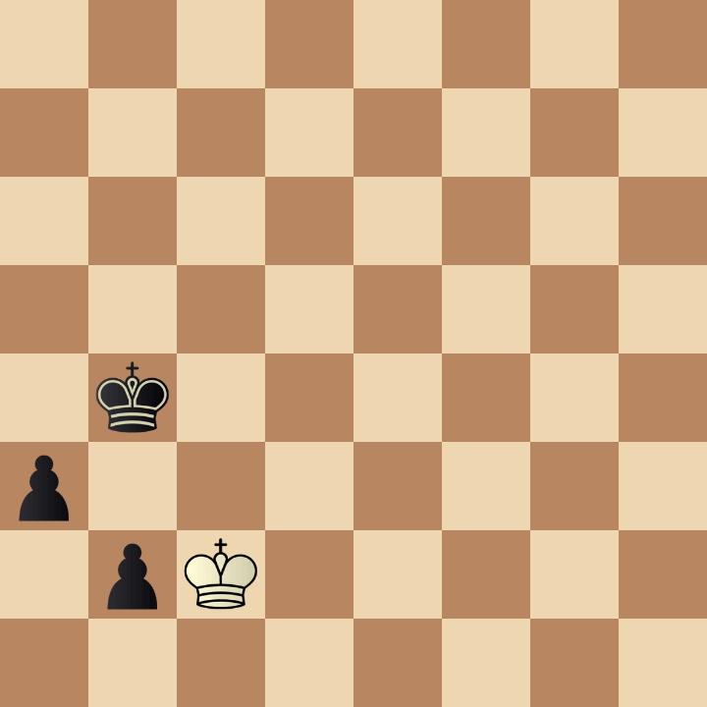
Example 5
A
B
8/2p1K3/8/1p5k/2p5/p7/8/6R1 b - - 0 70
6k1/p7/8/5K2/6p1/p7/8/8 b - - 0 49
Query
8/8/5K2/7k/8/p7/1p6/1R6 w - - 0 1
C
8/8/8/8/1k6/p7/1pK5/8 w - - 0 78

Slide 7
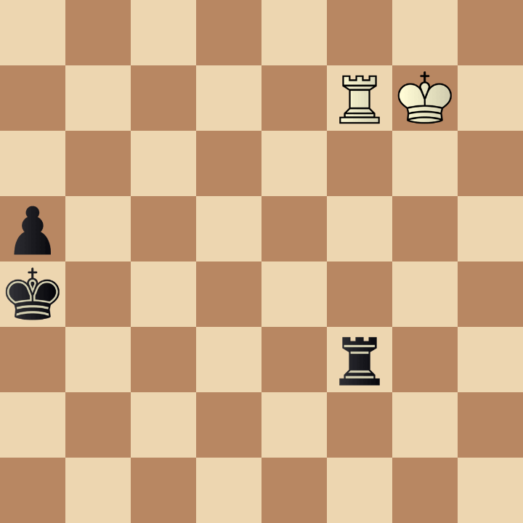
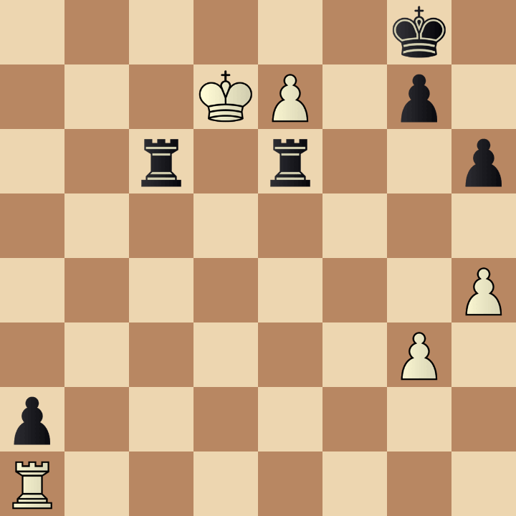
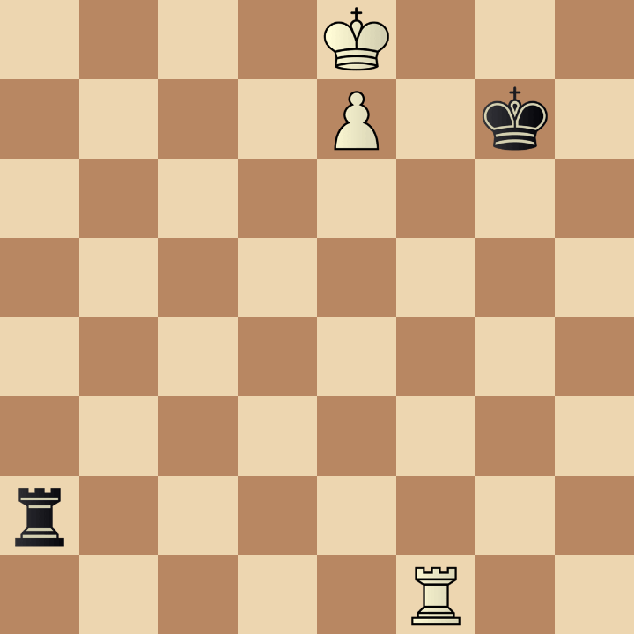
Example 6
A
B
6k1/3KP1p1/2r1r2p/8/7P/6P1/p7/R7 w - - 0 55
8/5RK1/8/p7/k7/5r2/8/8 b - - 0 74
Query
4K3/4P1k1/8/8/8/8/r7/5R2 w - - 0 1
C
4K3/4P1k1/8/8/8/8/r7/5R2 b - - 0 1

Slide 8
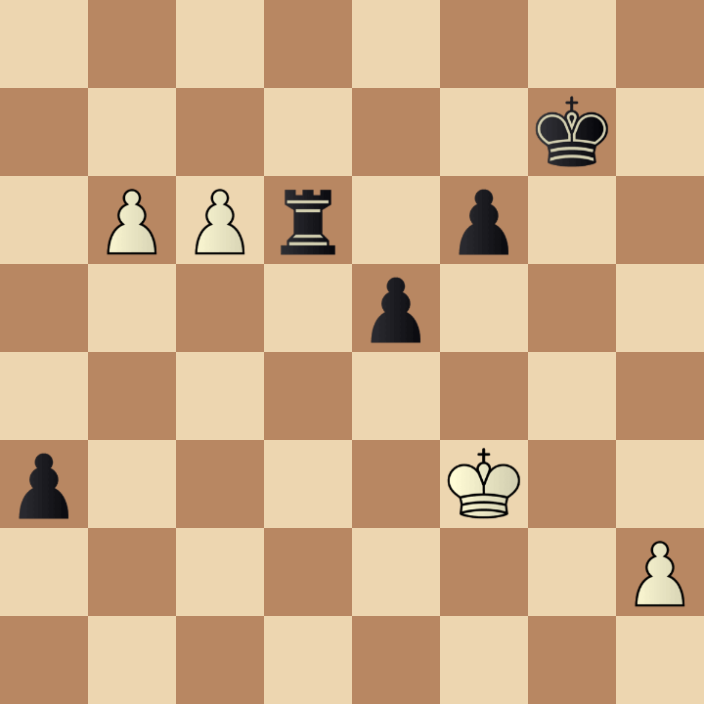
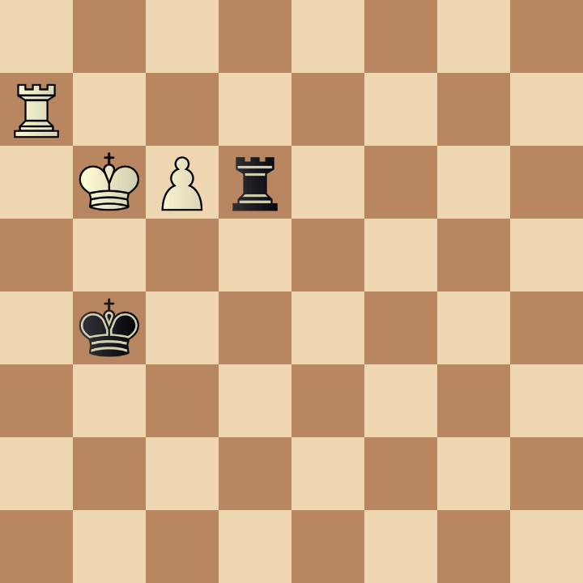
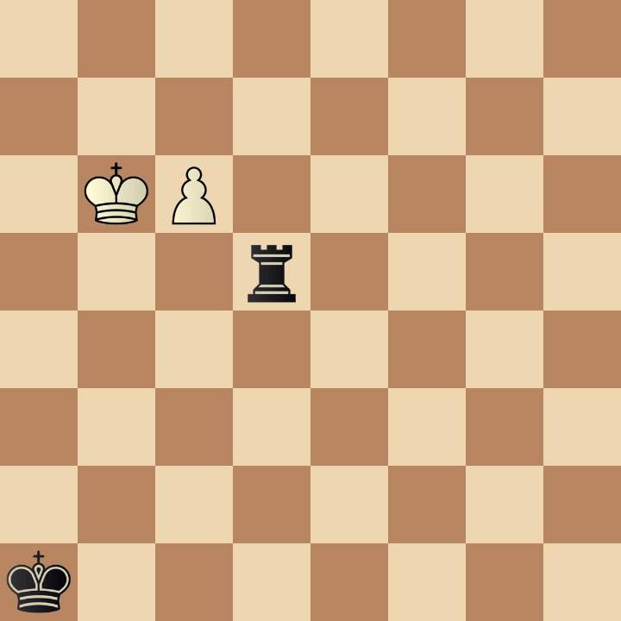
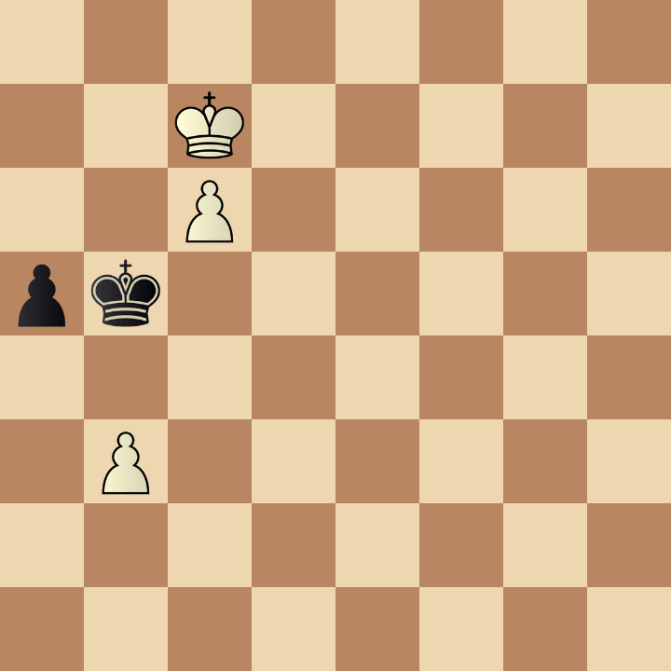
Example 7
A
B
8/6k1/1PPr1p2/4p3/8/p4K2/7P/8 w - - 0 55
8/R7/1KPr4/8/1k6/8/8/8 w - - 0 64
Query
8/8/1KP5/3r4/8/8/8/k7 w - - 0 1
C
8/2K5/2P5/pk6/8/1P6/8/8 b - - 0 62

Slide 9
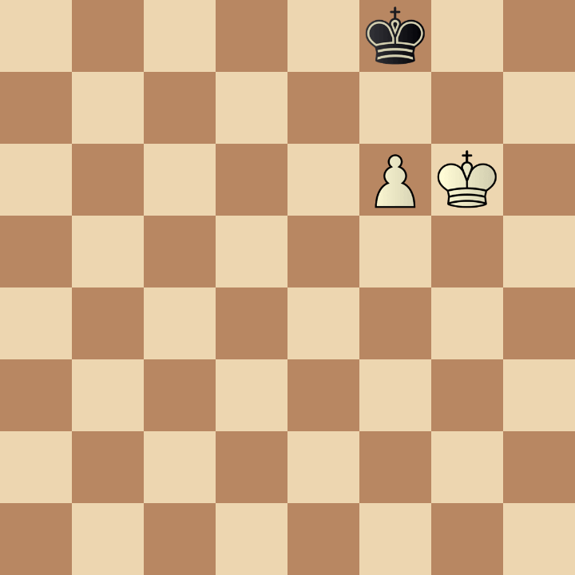
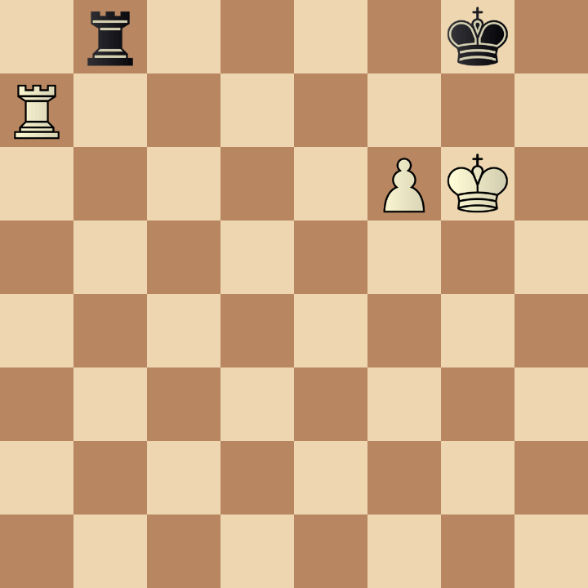
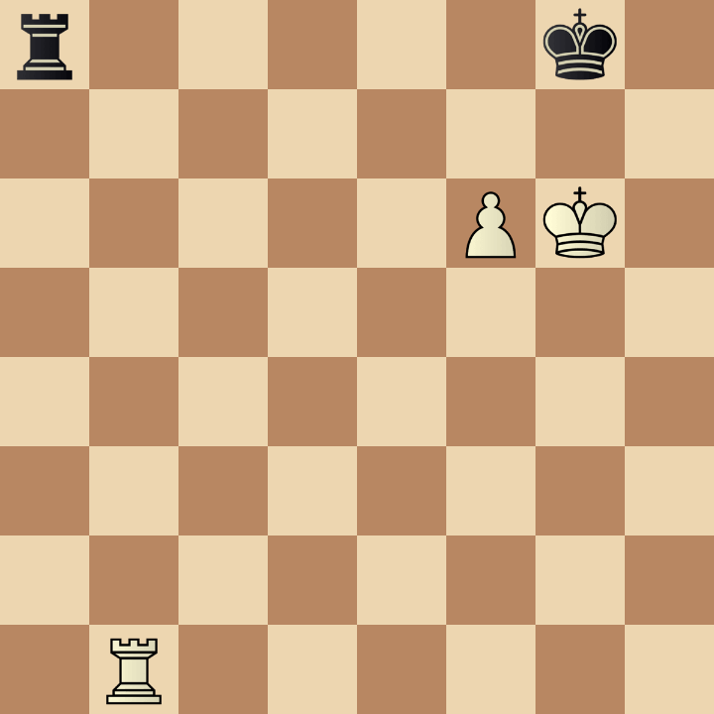
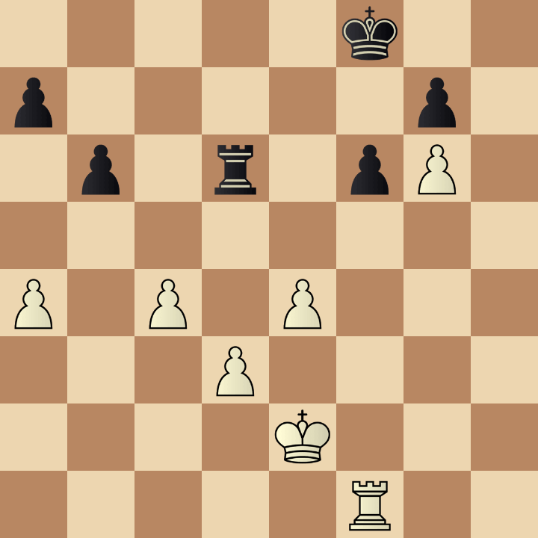
Example 8
A
B
5k2/8/5PK1/8/8/8/8/8 b - - 0 58
1r4k1/R7/5PK1/8/8/8/8/8 w - - 0 1
Query
r5k1/8/5PK1/8/8/8/8/1R6 w - - 0 1
C
5k2/p5p1/1p1r1pP1/8/P1P1P3/3P4/4K3/5R2 w - - 0 38

Slide 10
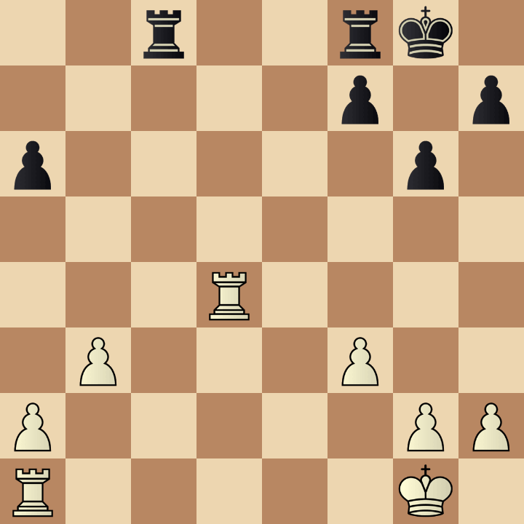
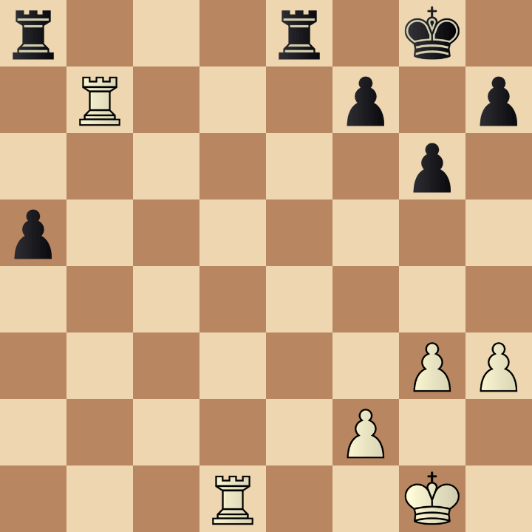
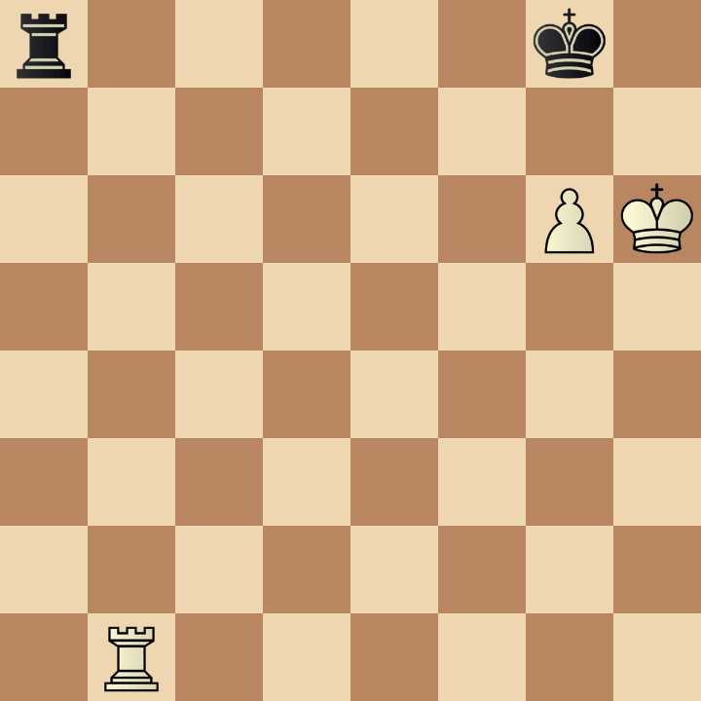
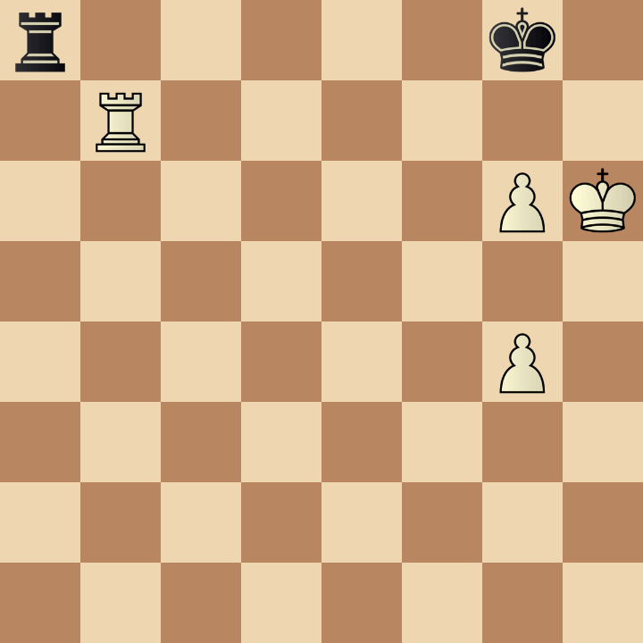
Example 9
A
B
r3r1k1/1R3p1p/6p1/p7/8/6PP/5P2/3R2K1 w - - 0 1
2r2rk1/5p1p/p5p1/8/3R4/1P3P2/P5PP/R5K1 b - - 0 1
Query
r5k1/8/6PK/8/8/8/8/1R6 w - - 0 1
C
r5k1/1R6/6PK/8/6P1/8/8/8 w - - 0 1

Slide 11
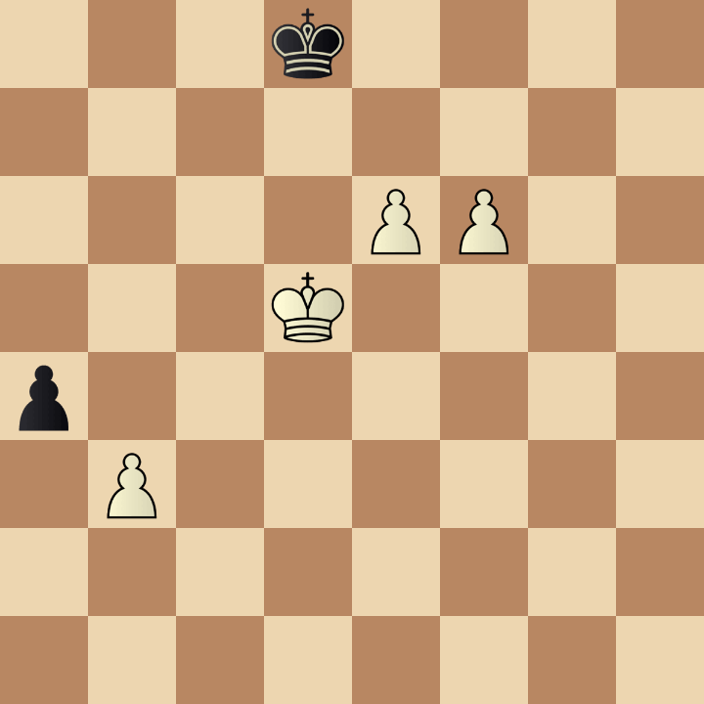
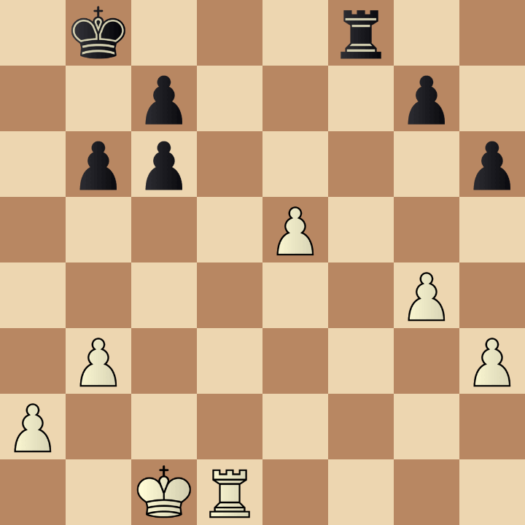
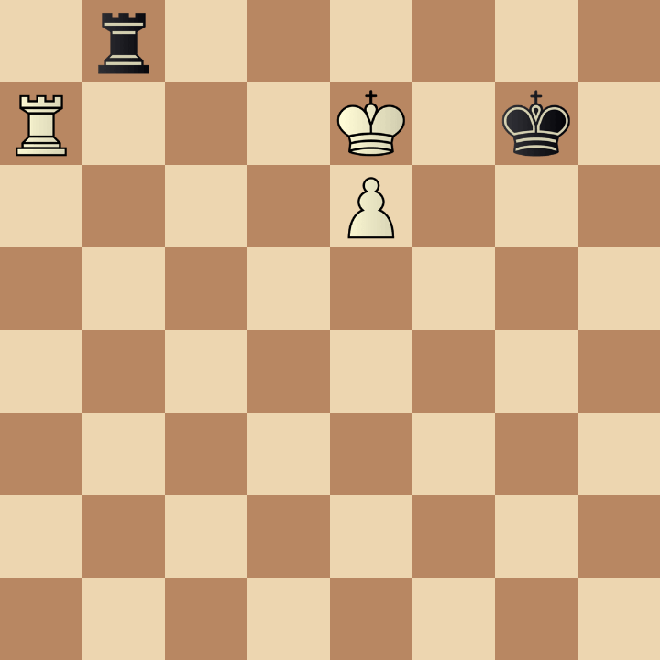
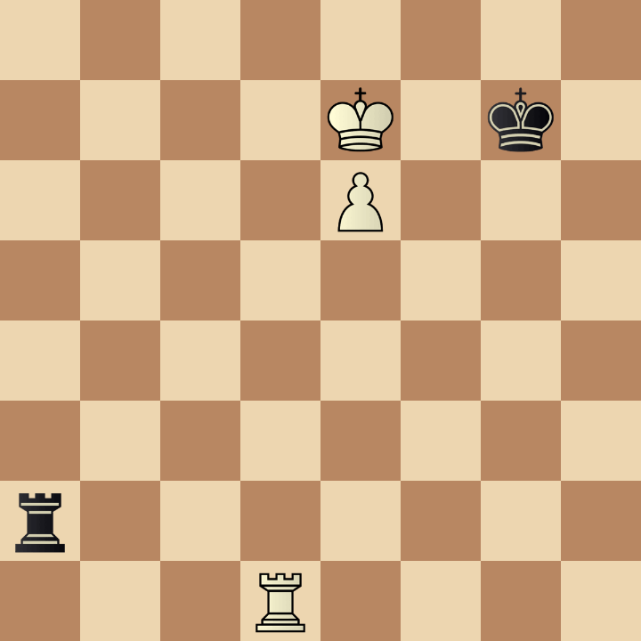
Example 10
A
B
1k3r2/2p3p1/1pp4p/4P3/6P1/1P5P/P7/2KR4 b - - 0 32
3k4/8/4PP2/3K4/p7/1P6/8/8 b - - 0 51
Query
1r6/R3K1k1/4P3/8/8/8/8/8 w - - 0 1
C
8/4K1k1/4P3/8/8/8/r7/3R4 b - - 0 1

Slide 12
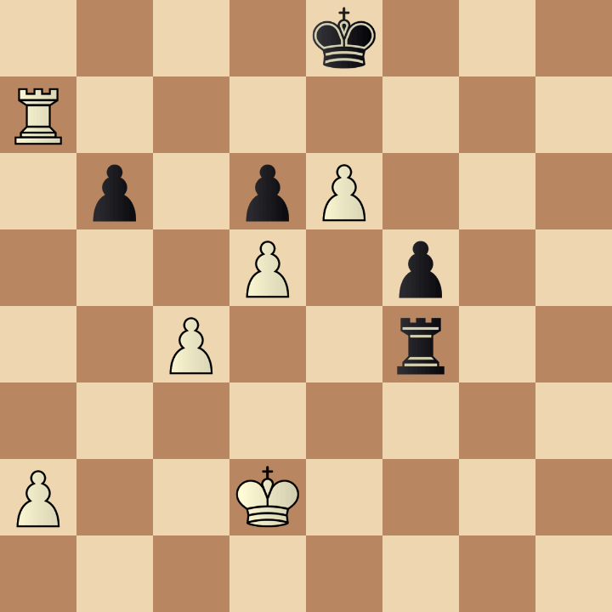
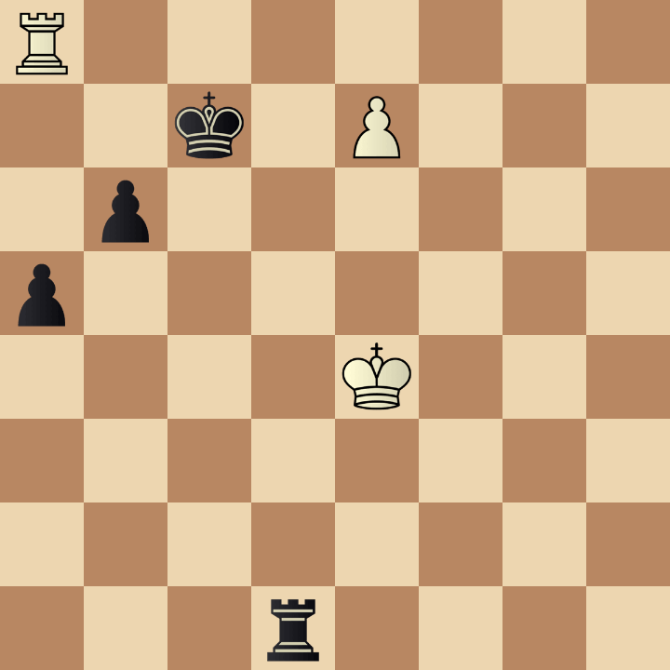
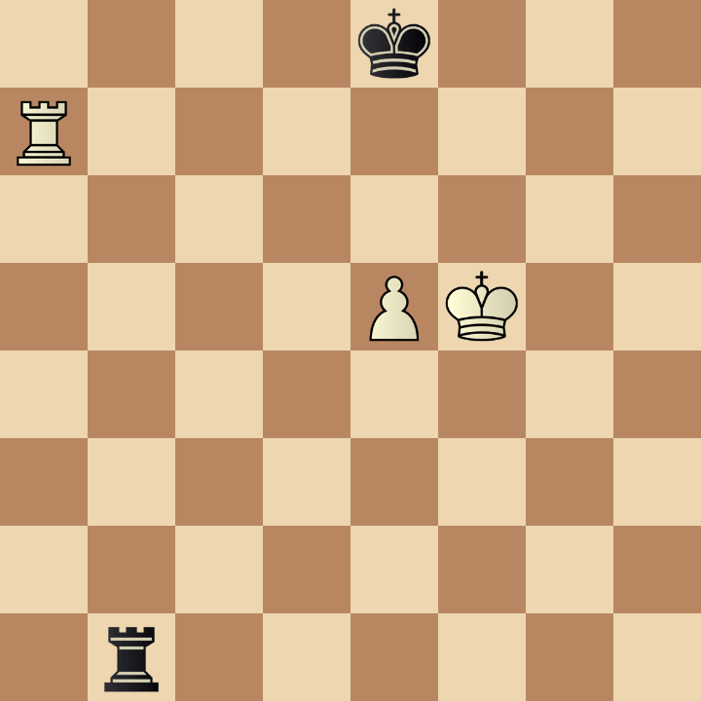
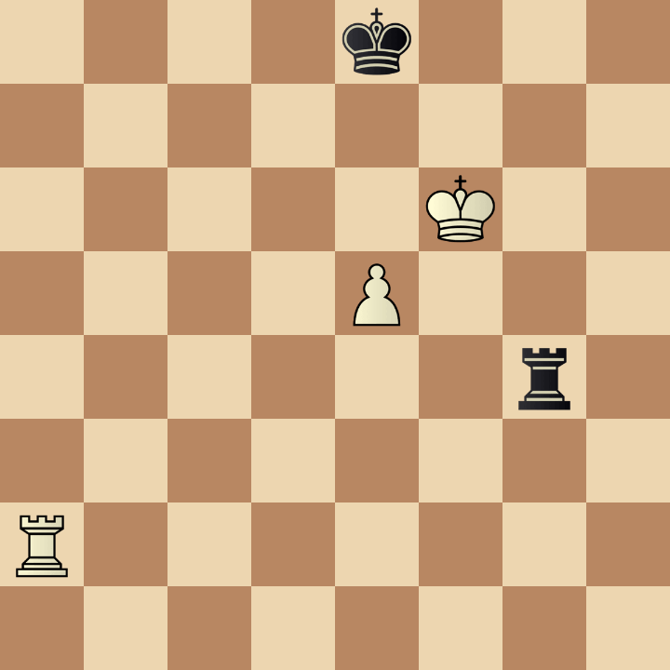
Example 11
A
B
4k3/R7/1p1pP3/3P1p2/2P2r2/8/P2K4/8 b - - 0 52
R7/2k1P3/1p6/p7/4K3/8/8/3r4 b - - 0 46
Query
4k3/R7/8/4PK2/8/8/8/1r6 b - - 0 1
C
4k3/8/5K2/4P3/6r1/8/R7/8 b - - 0 54

Slide 13
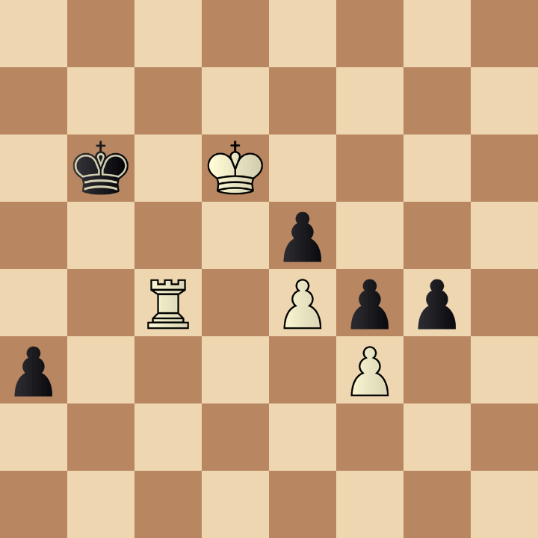
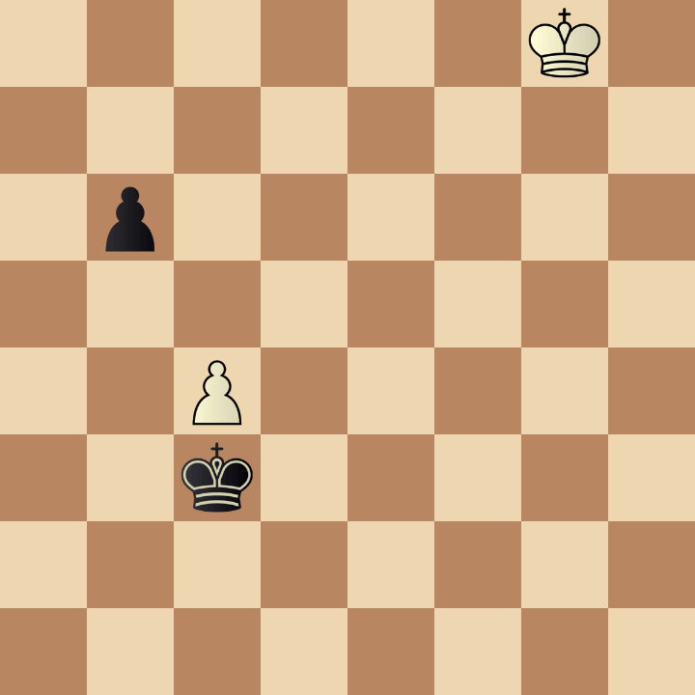
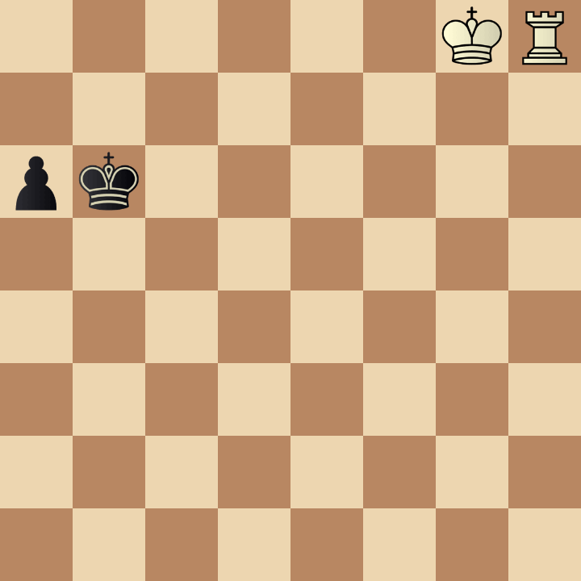
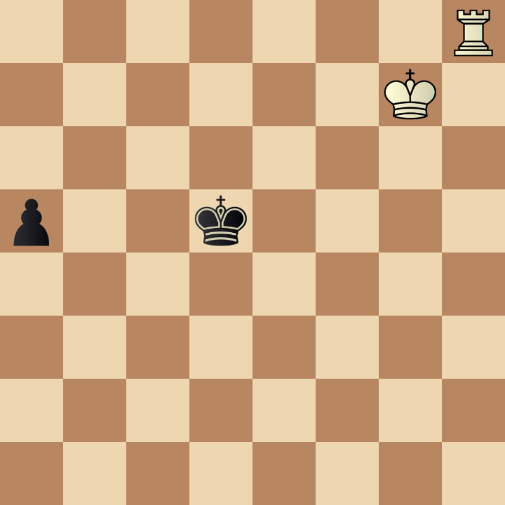
Example 12
A
B
6K1/8/1p6/8/2P5/2k5/8/8 b - - 0 62
8/8/1k1K4/4p3/2R1Ppp1/p4P2/8/8 b - - 0 52
Query
6KR/8/pk6/8/8/8/8/8 b - - 0 1
C
7R/6K1/8/p2k4/8/8/8/8 b - - 0 68

Slide 14
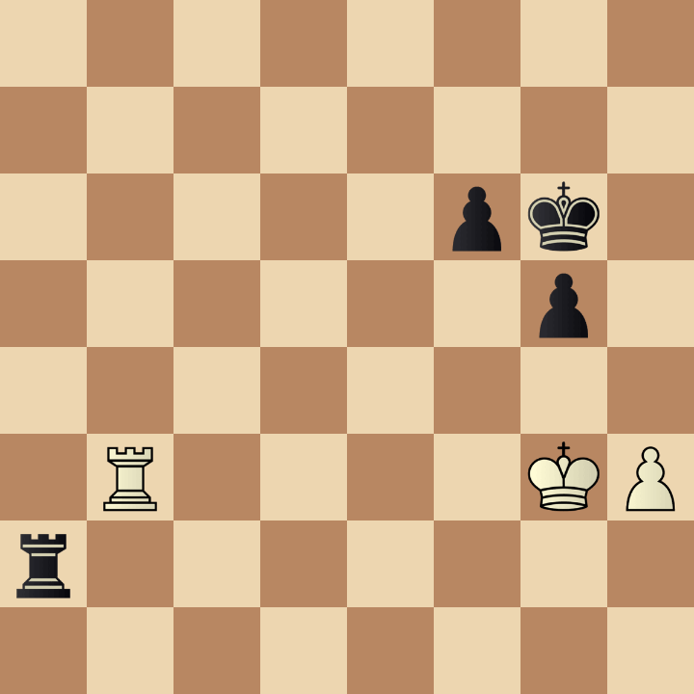
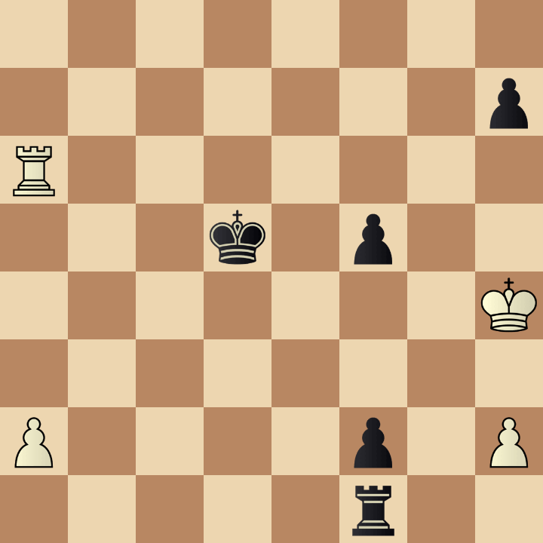
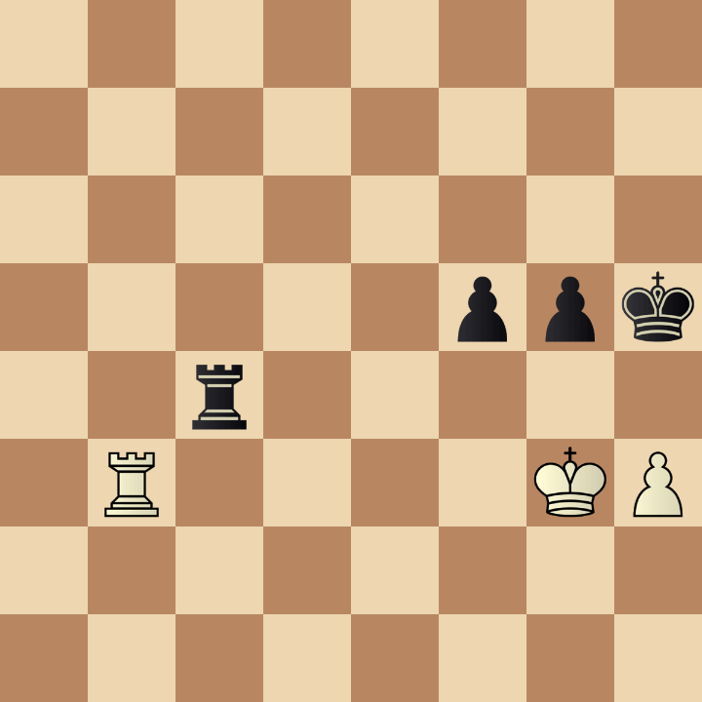
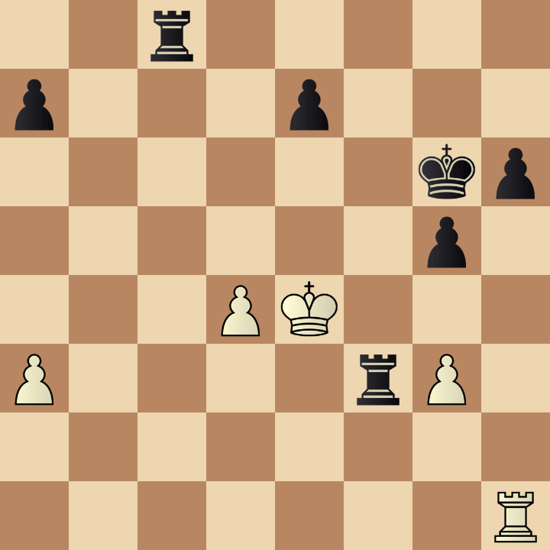
Example 13
A
B
8/7p/R7/3k1p2/7K/8/P4p1P/5r2 w - - 0 45
8/8/5pk1/6p1/8/1R4KP/r7/8 b - - 0 71
Query
8/8/8/5ppk/2r5/1R4KP/8/8 w - - 0 1
C
2r5/p3p3/6kp/6p1/3PK3/P4rP1/8/7R w - - 0 45

Slide 15



Example 14
A
B
8/8/8/8/7R/Kp6/1pk5/8 w - - 0 71
8/8/8/8/1k6/p7/1pK5/8 w - - 0 78
Query
8/8/8/8/1K6/7R/1pk5/8 w - - 0 1
C
8/8/8/3P4/3K4/p6R/1p1k4/1r6 w - - 0 80

Slide 16




Example 15
A
B
3r4/8/6RP/P4p2/1P3k2/2P1p3/4K3/8 b - - 0 46
7R/1p4r1/8/p5p1/3pk3/6P1/PP6/4K3 w - - 0 38
Query
8/8/8/R4p2/1r2k3/4p1P1/4K3/8 b - - 0 1
C
3R4/8/2R5/1p3p2/4kr2/1K3p2/8/8 b - - 0 73

