Slide 1
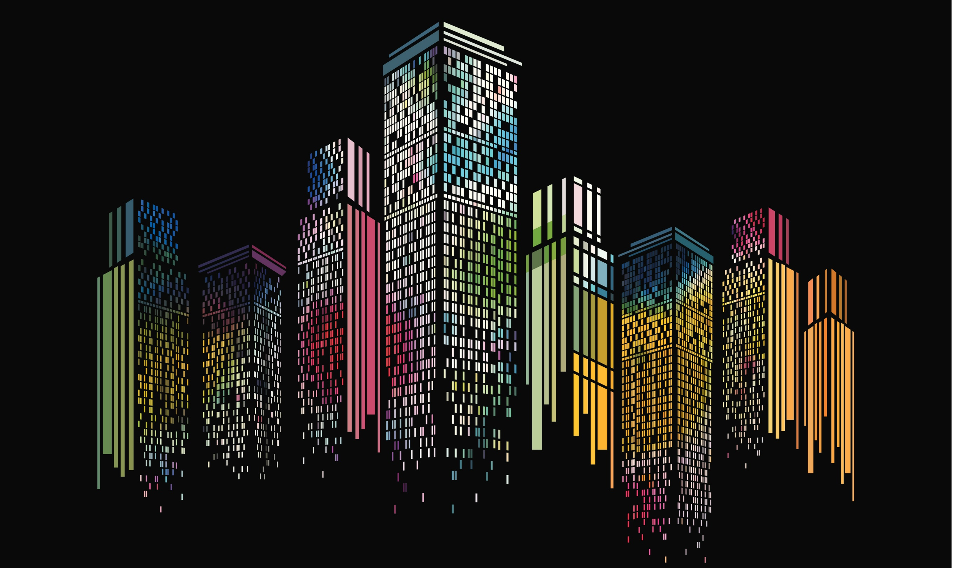
 |  |  |  | Kljfalkjdfal;
Ajldfkja kljadf a;fja
 |  |  |  |  | dfadfaffafaf

