Slide 1
Who writes the task, who solves it
An exploratory 2 x 2 study of author and solver strength in Terminal-Bench task generation
AfterQuery work trial · exploratory, user-approved deviation · pair: google/gemini-2.5-flash-lite (weak) / google/gemini-3-flash-preview (strong)

Slide 2
The trial: tasks a stronger model fails sometimes
Sonnet 4.6 writes tasks; Opus 4.8 (terminus-2) must pass 1 to 3 of 5 runs
We built gates, levers, a tuner and a failure judge
9 tasks calibrated against Opus: 8 too easy (4/4 or 5/5), 1 invalid, none in the band
Tuning moved nothing; a cheaper solver (Qwen) also solved them 5/5

Slide 3
Thesis: a student writing problems for a professor
The author cannot plant difficulty beyond what it can conceive and verify
The author holds the answer, so the solver only has to find it
A harness steers what the author tries, not what it is able to write
Prediction: weak author → strong solver gives mostly too-easy tasks

Slide 4
Design: same harness, only the models change
solver: weak
solver: strong
author: weak
weak->weak
control
weak->strong
the trial's setup
author: strong
strong->weak
professor for student
strong->strong
professor for professor
Each author writes a task from the SAME spec; every valid task is solved 5x by each solver.

Slide 5
Pipeline per task (all study events tagged `study`)
spec
(fixed seed)
blueprint
(author)
authoring
meta-task
free gates
build, oracle 3/3,
nop 0, lint, leak
5x terminus-2
weak + strong
Sonnet 4.6
failure judge
›
›
›
›
›
A failure counts as valid only if it quotes an instruction requirement; an invalid failure voids the task's verdict.

Slide 6
Is the pair really different? Gap check on 5 pilot packages
package | Opus 4.8 | weak | strong
p0-ledger-reconcil | 4/4 | 0/5 (3 inv) | 5/5
2f505f92f1c8 | 4/5 | 0/5 (1 inv) | 4/5
31ca491030e9 | 4/4 | 2/5 (1 inv) | n/a
b540d2ce9b80 | 5/5 | n/a | n/a
3bbd19e55510 | 5/5 | n/a | n/a
Only 5 of 10 gap jobs finished before the study's budget guard stopped it (a guard bug, fixed after). Where both ran, strong beat weak: 5/5 vs 0/5 and 4/5 vs 0/5. The pair clearly differs, but the weak solver also hits the 100-turn cap often (counted invalid).

Slide 7
Weak authors write far fewer valid tasks
0/7
4/8
weak author: tasks passing every free gate (0 on the first try)
strong author: tasks passing every free gate (2 on the first try)
0 of 7 weak-author tasks passed the free gates, against 4 of 8 for the strong author. Weak packages were missing solution/, instruction.md or the canary, or their oracle failed. They were not easy or hard: they were broken. 1 weak spec (02) was still authoring when the study stopped.

Slide 8
Results per author → solver cell
cell | valid | in band | too easy | too hard | invalid | mean pass
weak->weak | 0/7 | 0 | 0 | 0 | 0 | n/a
weak->strong | 0/7 | 0 | 0 | 0 | 0 | n/a
strong->weak | 4/8 | 0 | 0 | 0 | 4 | 0.00
strong->strong | 4/8 | 0 | 1 | 1 | 2 | 0.45
No cell has a task in the 1-3/5 band. Weak-author cells are empty (n=0), so the thesis (weak author -> strong solver gives easy tasks) could not be tested directly. Strong -> strong: 4 valid tasks split too easy 1, too hard 1, invalid 2 (raw pass counts alone: 2 easy, 2 hard). Strong -> weak: all 4 void (the weak solver hit turn caps) and 0 passes anywhere.

Slide 9
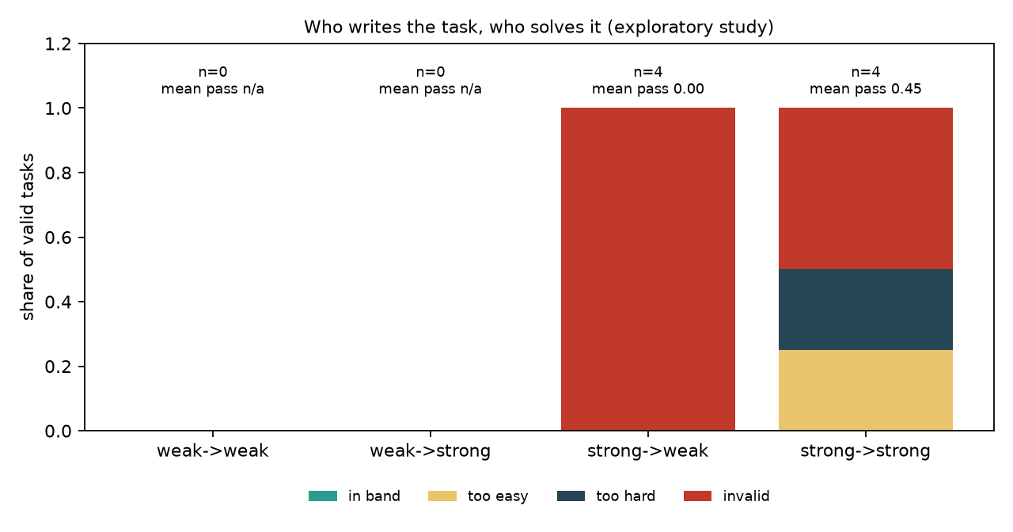
Verdict shares per cell

Slide 10
Does the thesis hold?
Not tested, and not supported by this data. The weak author never produced a valid task (0/7), so the weak -> strong cell is empty. What we can say: (1) author strength decided whether a task existed at all, before it decided difficulty; (2) even a strong author produced no task in the 1-3/5 band in 4 valid tasks (pass counts 0, 0, 4, 5 for the strong solver); (3) the solver gap is real (strong 5/5 and 4/5 where weak scored 0/5). The thesis stays a hypothesis; the evidence is small (n=4 valid tasks) and one model family.

Slide 11
Cost
$16.38
$40
$400
study spend (ledger, all study events)
approved hard cap for the study
ceiling for the whole key (of $500)
Ledger-recorded study spend is shown. The key's own usage rose by about $33.6 over the study window, which also includes the end of the solver pilot (capped at $6), killed DeepSeek jobs and calls whose cost the ledger could not price. Both are inside the $40 cap and the $400 account ceiling.

Slide 12
What it means for the trial
Author strength is a gate before difficulty: a weak author's packages mostly fail the free gates
Our gates caught every broken weak package (structure, lint, oracle) at no model cost
Not shown: that a stronger author lifts tasks into the 1-3/5 band; n is 4 valid tasks
Next: more specs per author, a repair budget matched to author weakness, and a same-strength pair with a wider gap

Slide 13
Caveats
Small N: 8 specs, 4 valid strong-author tasks, 0 valid weak-author tasks
One model family (Gemini); the first DeepSeek pair was abandoned for speed
Mixed repair policy: some tasks got 1 repair, some 3 (flagged in results.json)
Weak solver invalid failures (turn caps) void 4 of its 4 verdicts
Exploratory: nothing here is shipped or counted in the trial's results

