Slide 1
Use of Data in Construction Industry for Productivity Trends
Amber, Joseph, Michael, Tomislav

Slide 2



CONSTRUCTION INDUSTRY PROBLEMS
Today’s construction industry is facing multiple challenges…..
LACK OF INNOVATION AND DELAYED ADOPTION
INFORMAL APPROACH AND INSUFFICIENT RIGOR IN EXECUTION
INSUFFICIENT KNOWLEDGE TRANSFER
WEEK PROJECT MONITORING
LITTLE CROSS FUNCTIONAL COOPERATION
LACK OF COOPERATION WITH SUPPLIERS
CONSERVATIVE COMPANY CULTURE
TALENT SHORTAGE

Slide 3

WHY DOES IT MATTER(GLOBAL TRENDS)
6% GLOBAL GDP (Gross Domestic Product)
$15 TRILLION GLOBAL REVENUE BY 2025
25-40% GLOBAL GREENHOUSE EMISSIONS
CONSUMING 3 BILLION TONS OF RAW MATERIAL
CONSUMING 50 % OF GLOBAL STEEL PRODUCTION
200,000 GROWTH OF POPULATION PER DAY
CONSTRUCTION INDUSTRY 50 YEAR PRODUCTIVITY
IN NEGATIVE TERRITORY (-19%)
SO, what’s the solution???

Slide 4

THE SOLUTION IS…
BETTER DATA

Slide 5
THE SOLUTION IS BETTER DATA
In order to address the productivity and safety challenges, our team’s approach is:
Use the existing project data that was accumulated over past 3 years in order to correlate the following:
Relationships between :
Safety Infractions and WEATHER Conditions
Frequency of Quality Issues in regard to Project size
Frequency of Quality Issues and the role of specific subcontractors
Type of issues and dependency on project type

Slide 6
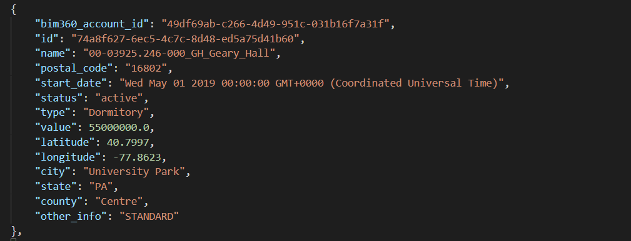
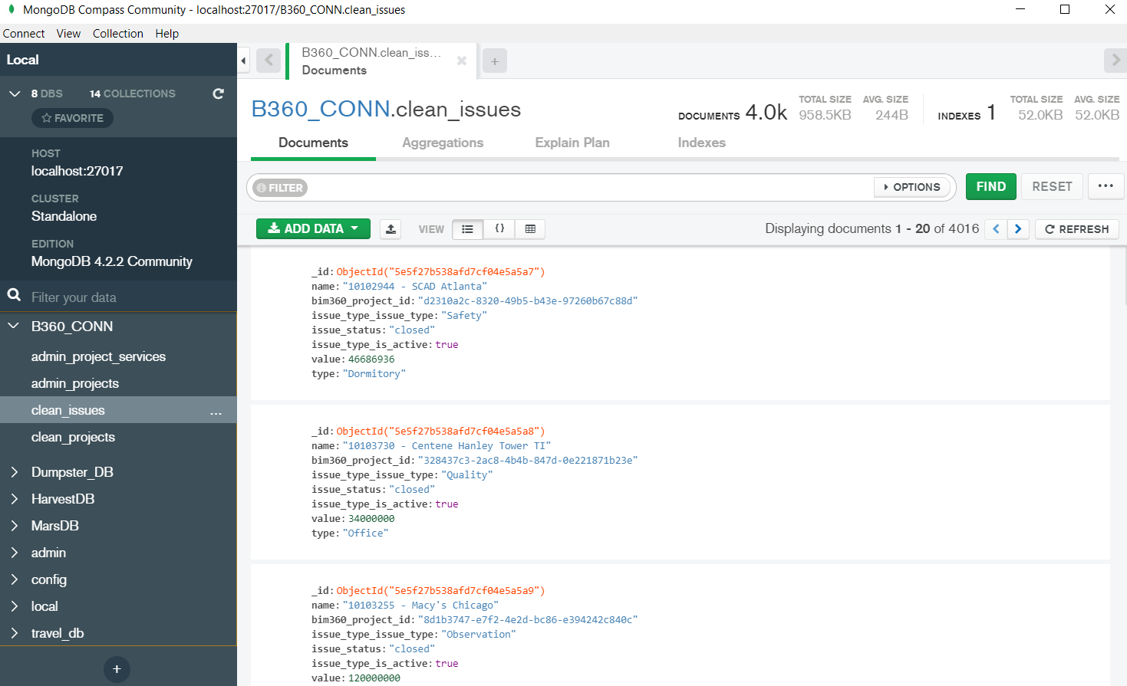
DATA + BASE
77 PROJECTS
4000 ISSUES
3000 USERS
POSTGRES- used to build database
PANDAS- combine dataframes and populate postgres from csv
MONGO- for projects, to store and retrieve projects, location data, and to store data pulled from cloud

Slide 7
TECHNOLOGY
PYTHON
DATA PARSING
BIM360 API
MONGO
POSTGRES
SQL
JAVASCRIPT
3LEGGED
AUTHENTICATION
DOM
HTML
FLASK
CLIENT
JAVASCRIPT
3LEGGED
AUTHENTICATION

Slide 8
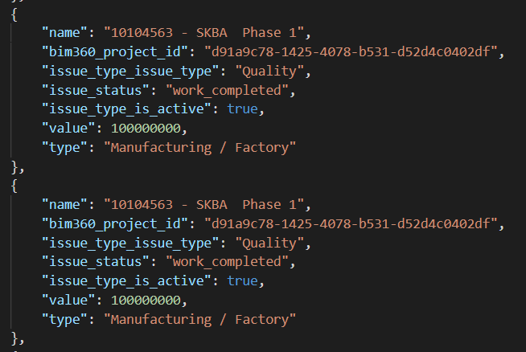
TECHNOLOGY
API_CALLS (FORGE / OPENWEATHER)
SQL
JAVASCRIPT / JQUERY
MAPBOX
LEFLET / POPUP CHARTS
D3
BOOTSTRAP
PLOTLY
FLASK / API CALLS

Slide 9
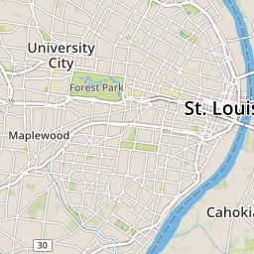
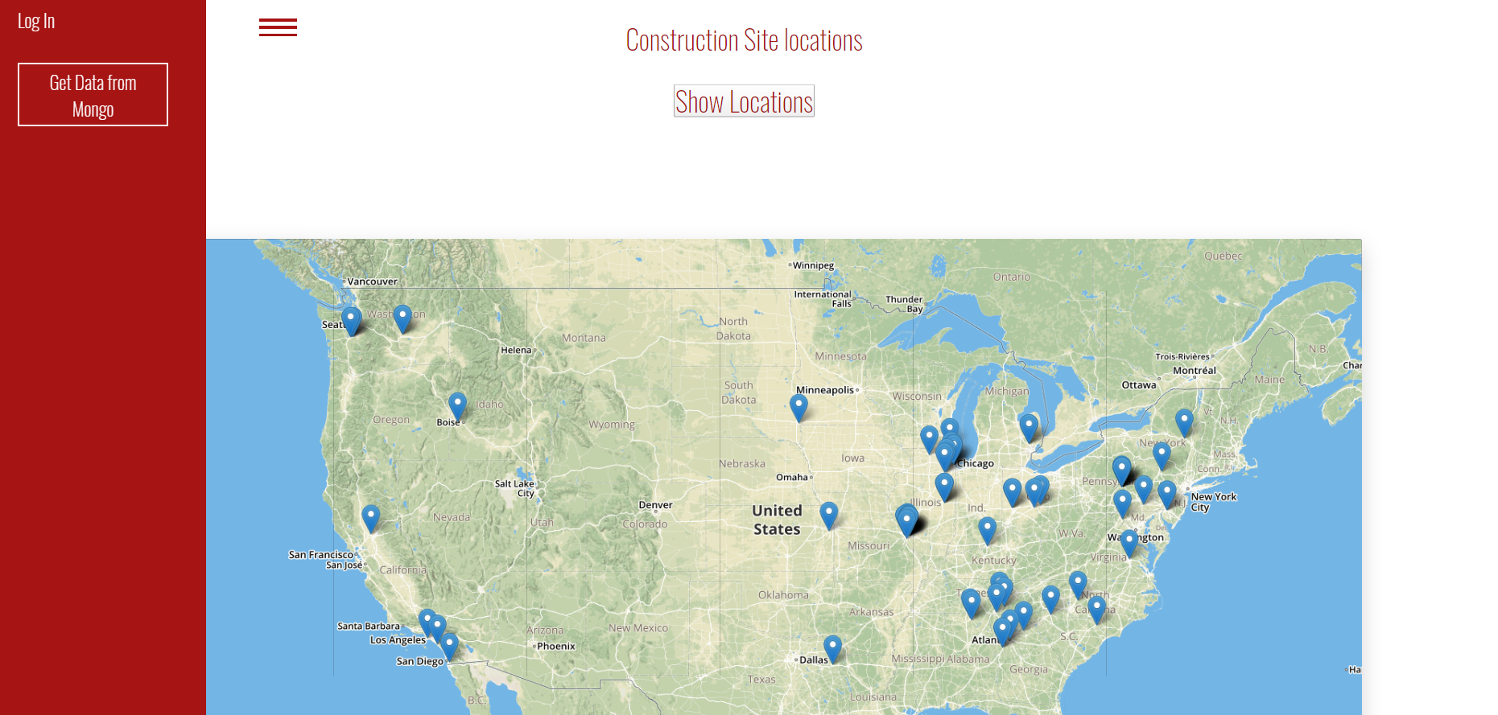
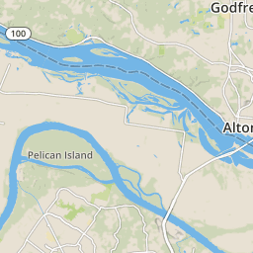
VISUALIZATION

Slide 10
ANALYTICS
TRENDS
JOB VOLUME VS QA/QC ISSUES
JOB VOLUME VS SAFETY INFRACTIONS
CORELATING WEATHER CONDITIONS WITH FREEQUENCY OF SAFETY INCIDENTS
CORELATING JOB TYPE WITH THE NUMBER OF ISSUES

Slide 11
CONCLUSION
DATA COLLECTION AND DATA RELIABILITY ARE STILL FACING SIGNIFICANT CHALLENGES.
THERE IS A ROOM FOR SIGNIFICANT IMPORVEMENT IN ORDER TO DEPLOY DATA ANALYTICS IN A MORE TARGETED FASHION FOR BETTER PROJECT OUTCOMES.
POTENTIAL FOR PREDICTIVE ANALYTICS BASED ON HISTORIC DATA ANALYSIS
STAY TUNED.

