Slide 1
Analyzing the frequency of construction issues
Amber V, TZ and MJ

Slide 2
Goal of Project
To understand the main drivers of issues that arise in construction projects
During planning and construction phases of a project, issues arise that need to be dealt with
These issues can increase re-work on the project
These issues can have a profound impact on overall safety
These issues delay the completion of the project
These issues therefore cost the construction firm money $$$
The goal of this exercise is to use the existing data from 110 construction projects to see if we could identify issues that come up often

Slide 3
The steps involved in the project
Gather, aggregate, and clean the data
Analyze the existing “issues” in the pre-existing data
Problems:
Issues are not always described in detail
Issues are not always consistently documented between various projects
Issues are frequently miss- categorized
Documenting issues is prone to human errors
Solution: use machine learning to better identify common issue topics associated with the construction process
Machine learning technique: LDA topic modeling

Slide 4
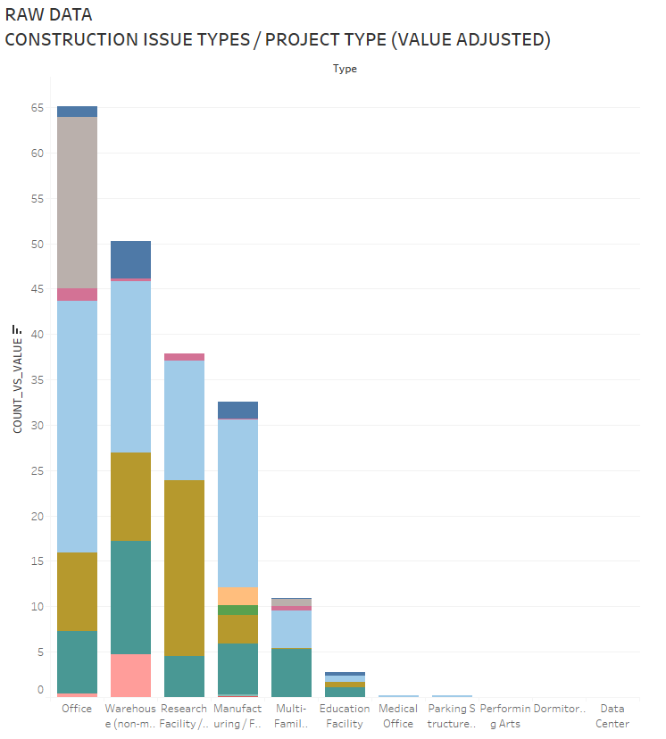
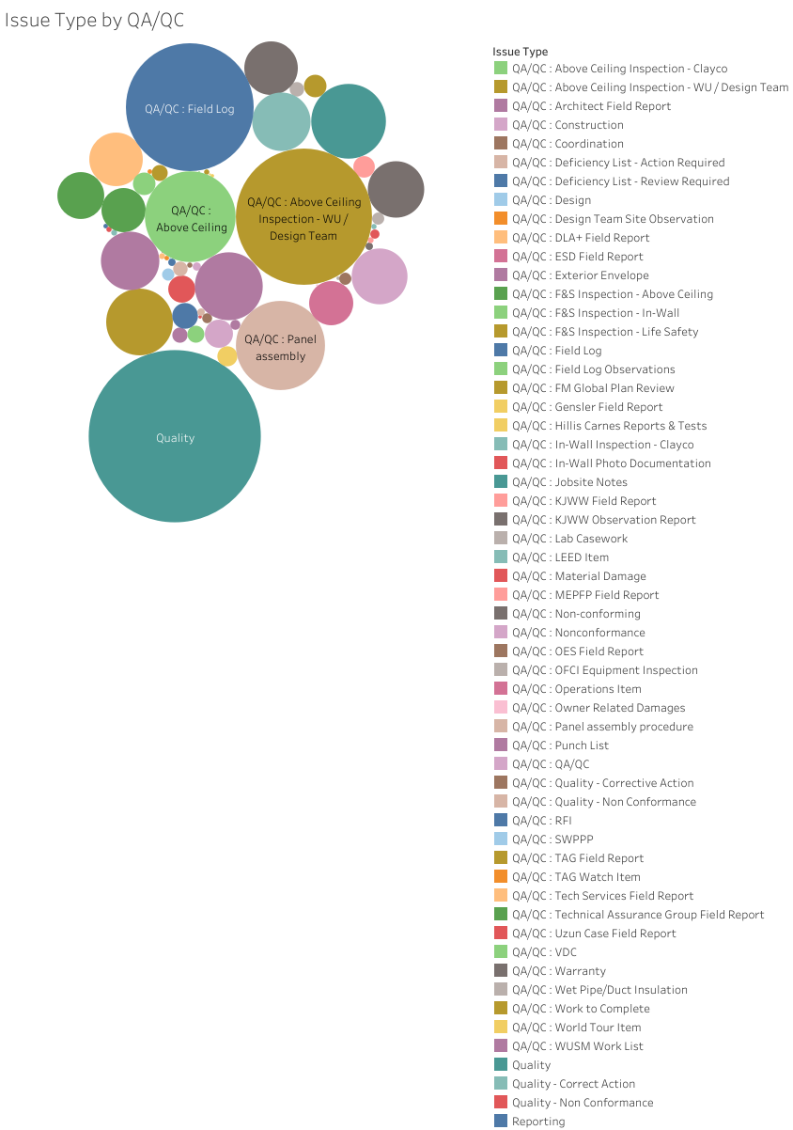
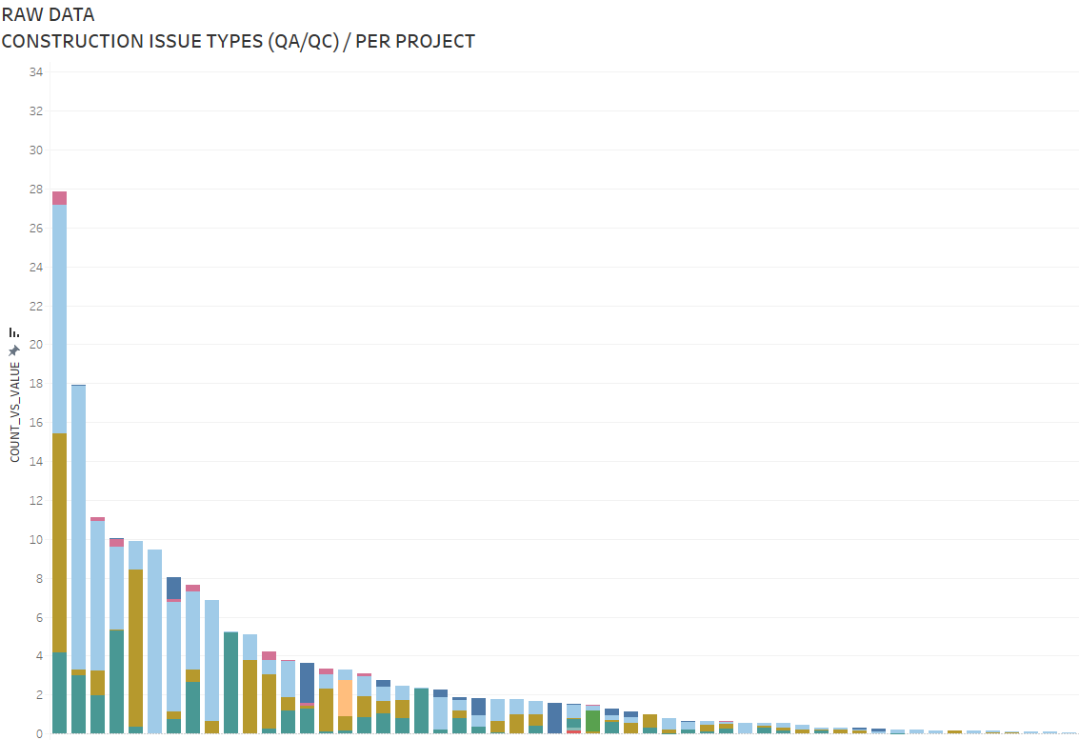
First glance…(before machine learning)
The following few slides illustrate some patterns we see among different projects and issues (as currently described in the dataset)

Slide 5
Machine learning steps
We applied LDA machine learning techniques on the description of issues in the original dataset
After applying LDA, we came up with 20 topics
The next slides demonstrates the distribution of issues that come up after we applied machine learning

Slide 6
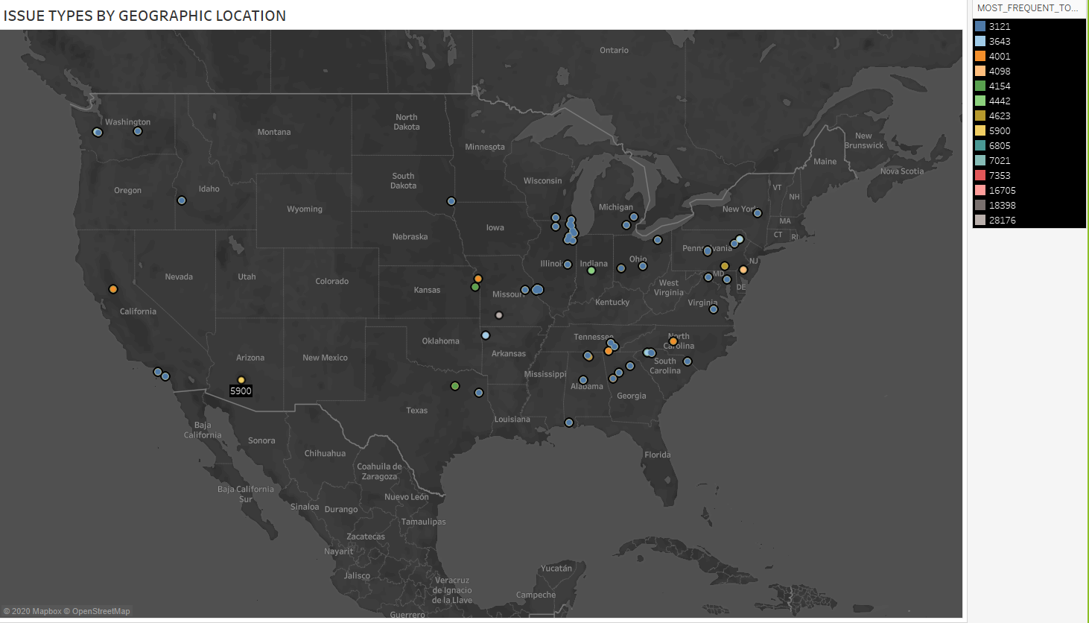

Slide 7
