Slide 1
Quanta Health
Product roadmap
Leadership review · 20 January 2027
H1
2027

Slide 2
How a member moves through Quanta
Join
Measure
Plan
Act
Renew
Onboarding quiz, 3 min
Wearable + lab sync
Coach builds a 12-week plan
Daily nudges and check-ins
Quarterly review
Retention is decided in step 4: members who answer 5 nudges in week one stay 3× longer.

Slide 3
H1 2027 roadmap
Jan
Feb
Mar
Apr
May
Jun
Coaching
AI coach v2
Group programmes
Devices
Oura + Whoop sync
Glucose sensor beta
Platform
SOC 2 audit
EU data residency
Growth
Employer plan
Spain launch
Today

Slide 4
What changes in the platform
AI coach
Member app
Care API
Device hub
EU data store
Data flows back to the member

Slide 5
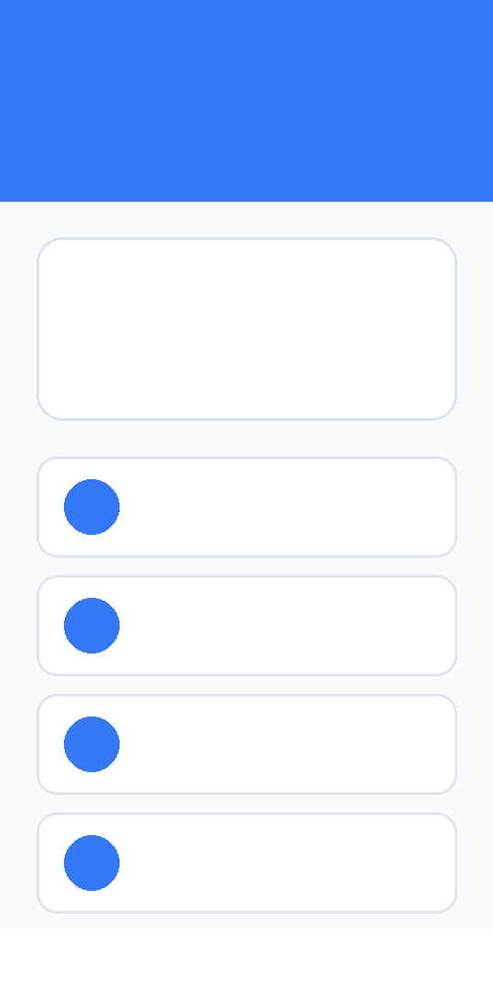

AI coach v2, first look
NEW
• Plans adapt to sleep and glucose data every morning
• Coach drafts, human coach approves
• Answers in Spanish, Portuguese and English

Slide 6
Risks we are watching
Regulation
EU AI Act: coach advice may count as high-risk
Data
Residency must ship before the Spain launch
Supply
Glucose sensors capped at 2,000 units in H1
Owner for all three: Marta Silva, COO

