Slide 1
MOVIES
Predicting IMDB Scores and Gross Sales
KRISHNA ANKLESARIA, KSHITIZ SIROHI, LUCINDA LINDE
ALY6040 - DATA MINING APPLICATIONS
PROF. AMIN KARIMPOUR
FEBRUARY 15, 2019

Slide 2
Goals
Predict IMDB score as a function of the best other columns
Text mining of plot words
Linear regression
Random Forest regression
Predict Gross sales as a function of the best other columns
Linear regression
Random Forest regression
Compare the Models’ predictions of IMDB score and Gross Sales- which worked best?

Slide 3
Data Set and Process
5000 Movies, 28 fields including IMDB rating, critics for, gross sales etc.
Clean and Prepare Data
Explore the Data, Look for Relationships
Visualize the Data, Look for Patterns
Build and Test the Models
Compare the Results

Slide 4
1. Clean and Tidy the Data
Data cleaning
Remove duplicates, removing rows with many NAs,
Thoughtfully impute values of NAs
Clean up titles, remove special characters
Remove rows with outlier budgets in non-US currencies (India, Japan, Korea etc.)
Result
Master data frame with clean data, while keeping over 95% of the rows

Slide 5
2. Data Exploration Observations
1- As the year went by from 1920-2015, the number of likes movies are getting are linearly increasing.
2- Movies that have zero likes are mostly centered around year 2000
3- Each country seems to have equally distributed IMDB rating.
4- Screen aspect ratio does not signify how expensive the movie can be.
5- Most number of movies are Drama, followed by Action and Comedy.

Slide 6
3. Visualize the Data, Look for Patterns
Visualize the Data
Single variables – histogram, boxplot etc.
Pairs of variables - scatterplots, line graphs
Visualize variables over time

Slide 7
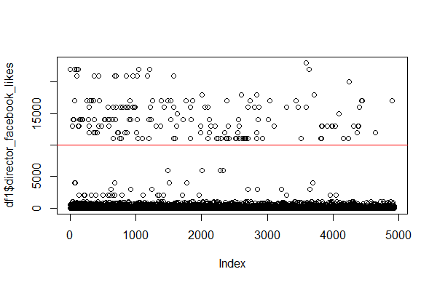
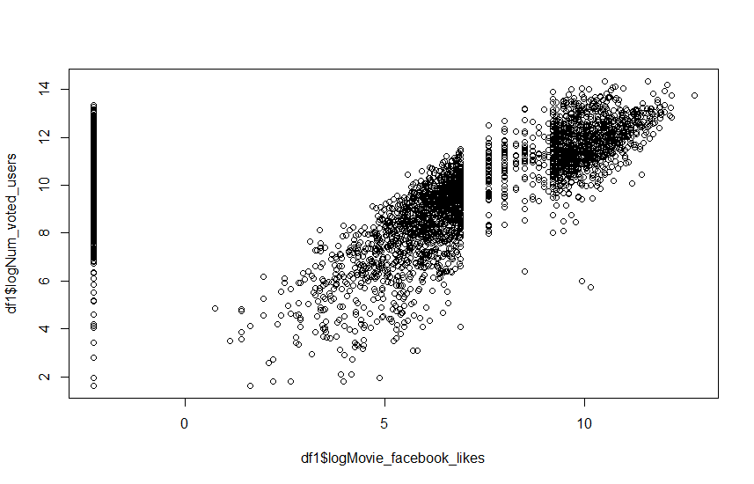
Some Data with Facebook Likes is Suspect,
So those columns were not included in models

Slide 8
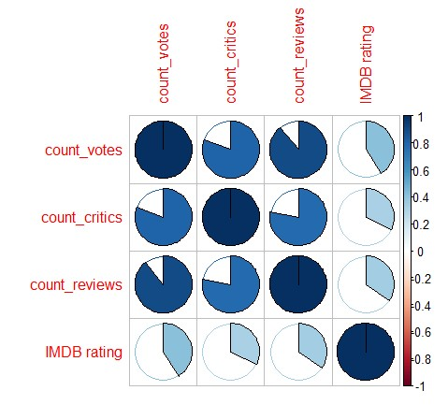
Correlation Patterns
Highly Collinear Variables
Total votes given to a movie and total number of reviews the movie had.
Total number of reviews the movie have got and total number of critics the movie received.
Not Correlated Variable
Number of Reviews and IMDB rating
Simplified
Correlation
Matrix

Slide 9
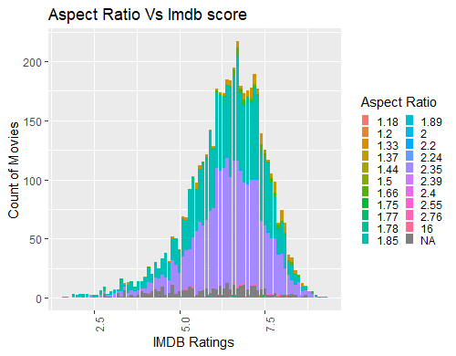
Eliminating Aspect Ratio
Within each IMDB Rating,
Aspect Ratios are equally distributed, therefore not a predictor
Removed other variables with similar logic

Slide 10
4. BUILD MODELS WITH TRAIN DATA SET;
TEST MODELS WITH TEST DATA SET
Model Building and Testing
  Randomly divide the dataset into Train and Test sets
  Run models
  Compare model results

Slide 11
Linear Regression Models were not very Predictive
Linear Model | R² | Most Predictive Variables
IMDB Score | 0.27 using all numeric, highly correlated | Critical Reviews For, Duration, Gross, Users voted for, Number of User For Reviews, Facebook likes of movies
Gross Sales | 0.60 using all numeric, highly correlated | Users voted, Users voted for, Cast FB likes, Actor FB like, Critical Reviews For

Slide 12
Text Mining Plot Keywords Predicts IMDB Score Well
1- Extract plot keywords associated with each movie
2- Make a corpus of those words and converting them into a matrix
3- Classify if the movie have a rating less or equal to 7 or greater than 7 (8 or 9).
4- Use K-nearest neighbour
5- 83% accurate result

Slide 13
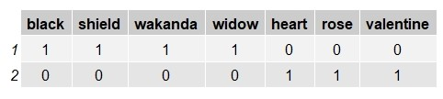
Example of Text mining
Wakanda | Shield | Black Widow
Heart | Valentine | Rose
Test: “Heart break on Valentine”
Result: Nearest neighbour is Love story, so it will predict it to be a Love story.

Slide 14
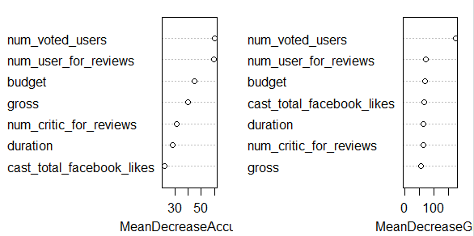
Random Forest Variable Importance for IMDB Scores
Random Forest with the training data for the IMDB Score.
OOB Estimate Error rate: 6.33%
No. of trees: 500
Split variables: 5

Slide 15
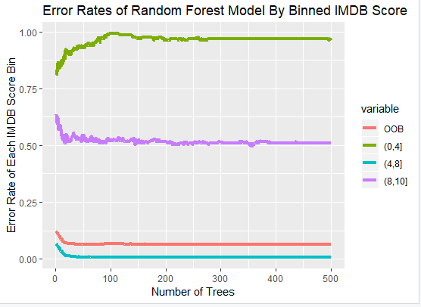
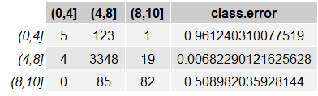
Random Forest Plot for binned IMDB Score
Confusion Matrix:

Slide 16
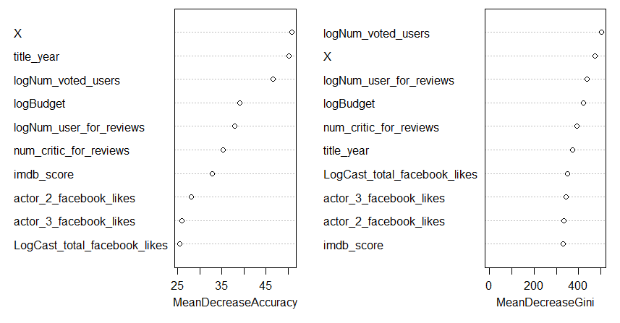
Random Forest delivered 98% accuracy
for binned Log(Gross Sales)
Best Predictors in Random Forest model
Number of users who voted
Year the movie came out
Number of user FOR reviews
Number of critic FOR reviews
Cast total FB likes

Slide 17
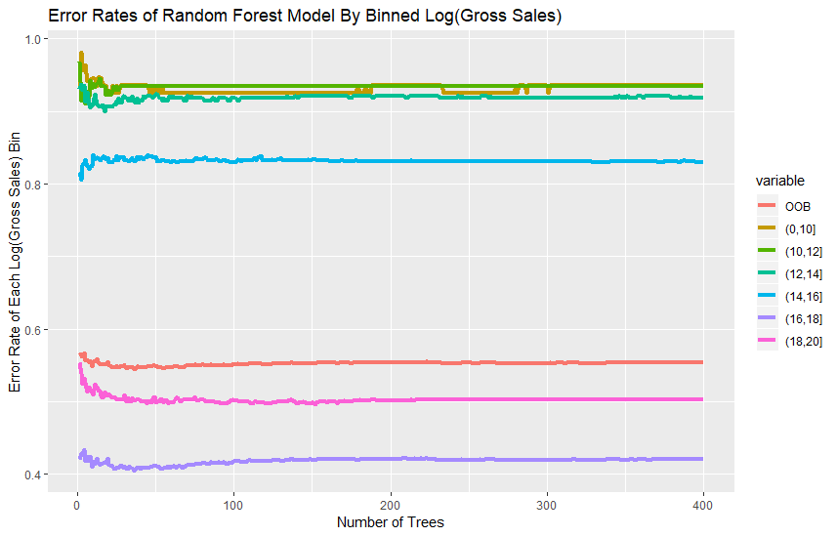
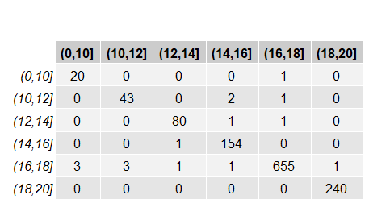
Random Forest Prediction Error Rates of Gross Sales
Confusion Matrix
98 % Accurate

Slide 18

5. Comparing all Results
Text Mining
for IMDB score
Random Forest for IMDB Scores:
Random Forest for log(Gross Sales):
83 % Accuracy
94% Accuracy
98% Accuracy
Linear models performed poorly than the algorithms above.

Slide 19
Appendix

Slide 20
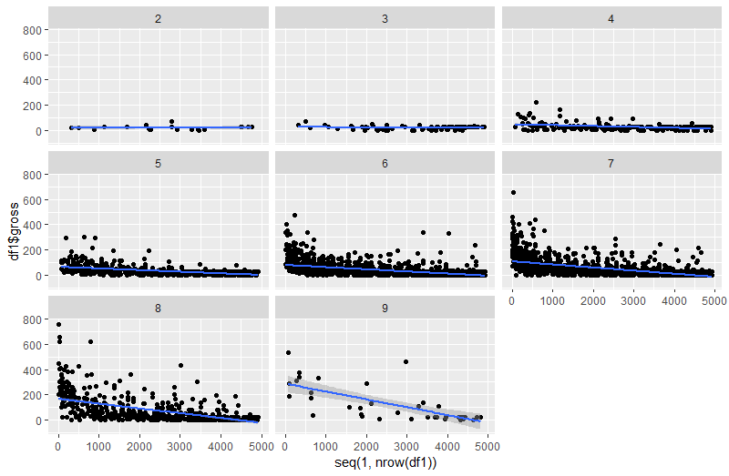
facebook likes actor 1 2 3 respec..
Slope increases as IMDB score increases

Slide 21
Data Dictionary
Variable Name | Description
movie_title | Title of the Movie
duration | Duration in minutes
director_name | Name of the Director of the Movie
director_facebook_likes | Number of likes of the Director on his Facebook Page
actor_1_name | Primary actor starring in the movie
actor_1_facebook_likes | Number of likes of the Actor_1 on his/her Facebook Page
actor_2_name | Other actor starring in the movie
actor_2_facebook_likes | Number of likes of the Actor_2 on his/her Facebook Page
actor_3_name | Other actor starring in the movie
actor_3_facebook_likes | Number of likes of the Actor_3 on his/her Facebook Page

Slide 22
Data Dictionary (continued)
Variable Name | Description
num_user_for_reviews | Number of users who gave a review
num_critic_for_reviews | Number of critical reviews on imdb
num_voted_users | Number of people who voted for the movie
cast_total_facebook_likes | Total number of facebook likes of the entire cast of the movie
movie_facebook_likes | Number of Facebook likes in the movie page
plot_keywords | Keywords describing the movie plot
facenumber_in_poster | Number of the actor who featured in the movie poster
color | Film colorization. ‘Black and White’ or ‘Color’
genres | Film categorization like ‘Animation’, ‘Comedy’, ‘Romance’
title_year | The year in which the movie is released (1916:2016)
language | English, Arabic, Chinese, French, German, Danish, Italian etc.
country | Country where the movie is produced

Slide 23
Data Dictionary (continued)
Variable Name | Description
content_rating | Content rating of the movie
aspect_ratio | Aspect ratio the movie was made in
movie_imdb_link | IMDB link of the movie
gross | Gross earnings of the movie in Dollars
budget | Budget of the movie in Dollars
imdb_score | IMDB Score of the movie on IMDB

