Slide 1
Homework - TSNE
201800130112 赵子涵

Slide 2
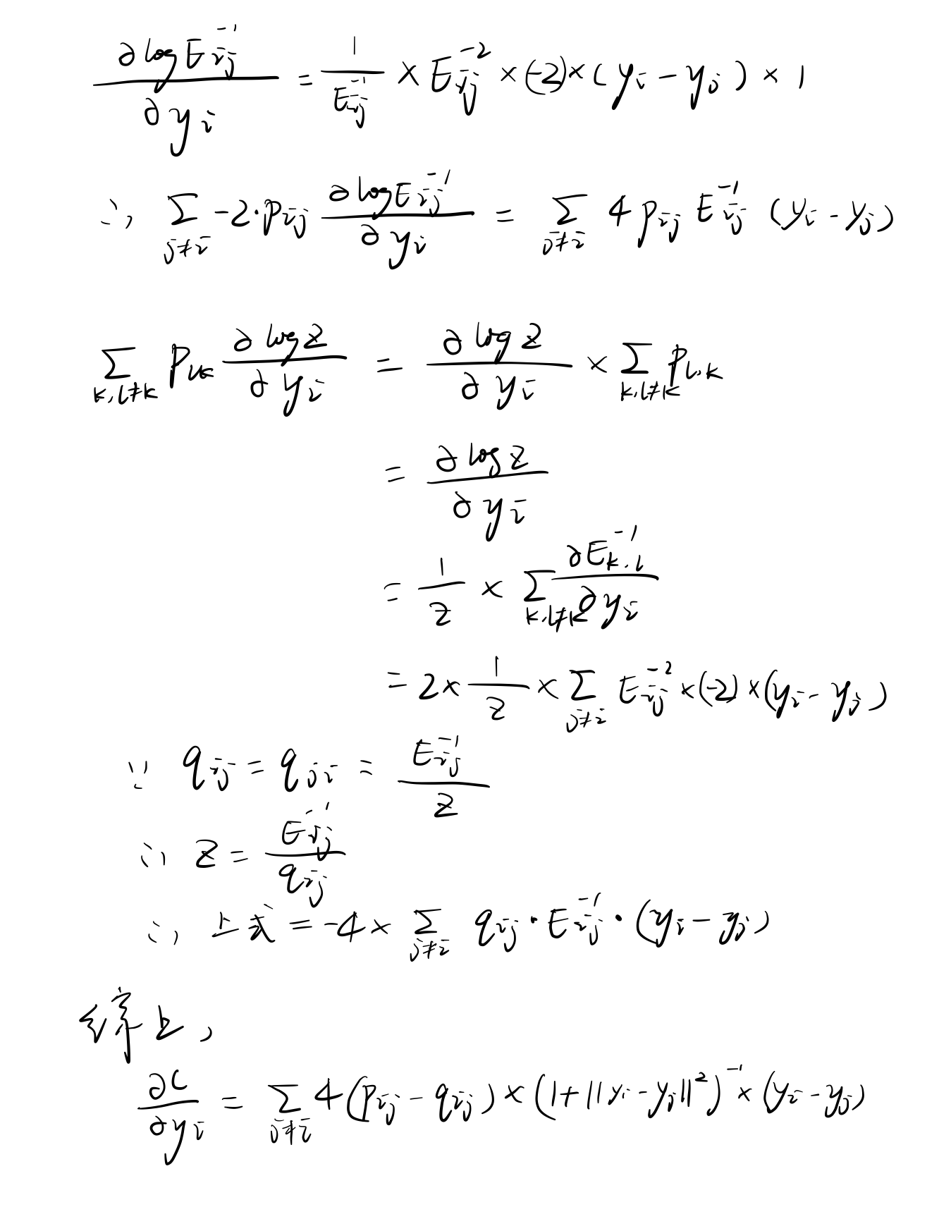
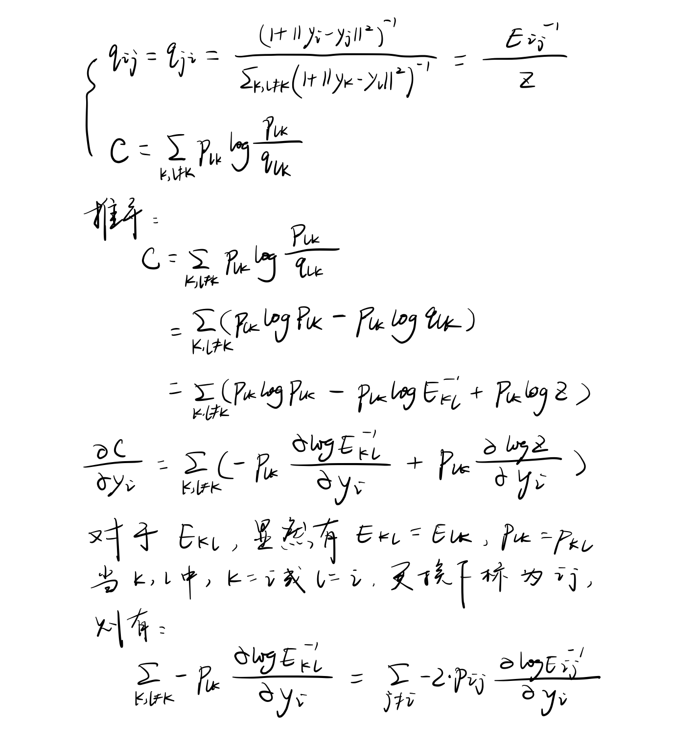
1. 公式推导

Slide 3
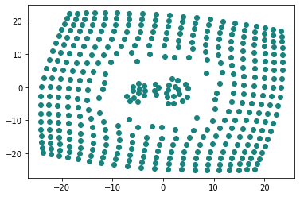
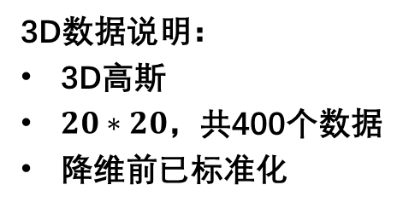
2. tsne参数与图像 —— 使用scikit-learn默认参数值
n_components=2
perplexity=30.0
early_exaggeration=12.0
learning_rate=200.0
n_iter=1000
n_iter_without_progress=300
min_grad_norm=1e-07
metric='euclidean'
init='random'
verbose=0
random_state=0（默认值None，为保证每次结果相同设置为0）
method='barnes_hut'
angle=0.5
n_jobs=None
3D数据说明：
3D高斯
$20∗20$，共400个数据
降维前已标准化

Slide 4
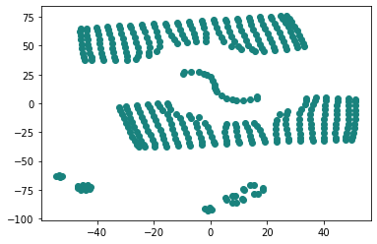
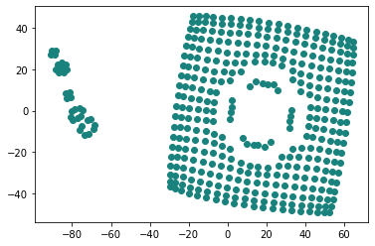
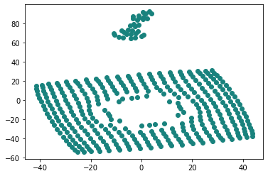
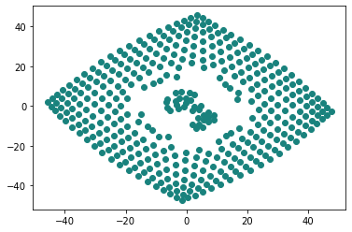
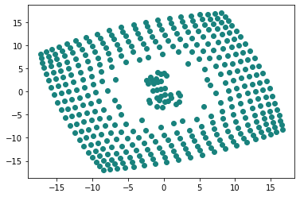
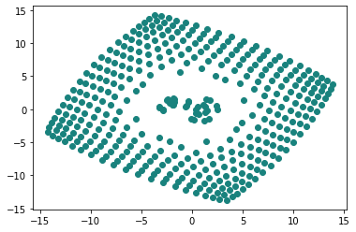
2. tsne参数与图像 —— 仅调整perplexity
perplexity：number of nearest neighbors
random_state=0（以保证每次生成的结果相同）
perplexity=5
perplexity=10
perplexity=15
perplexity=20
perplexity=40
perplexity=50

Slide 5
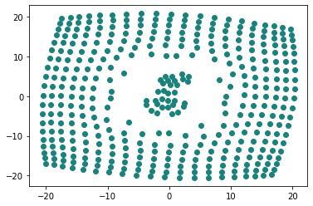
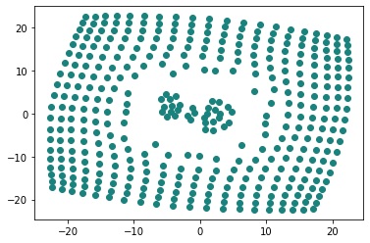
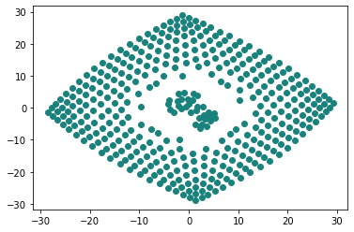
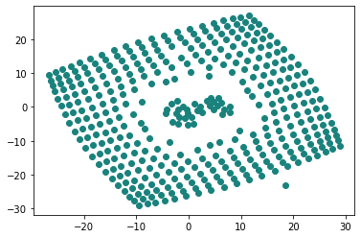
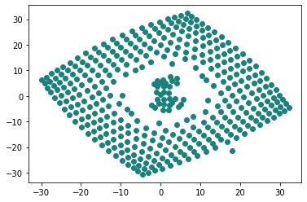
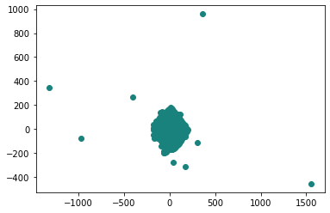
2. tsne参数与图像 —— 仅调整learning rate
learning rate
random_state=0（以保证每次生成的结果相同）
learning rate =10
learning rate =50
learning rate =100
learning rate =500
learning rate =1000
learning rate =1500

Slide 6
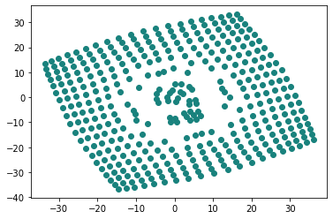
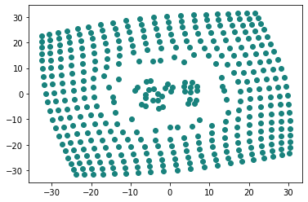
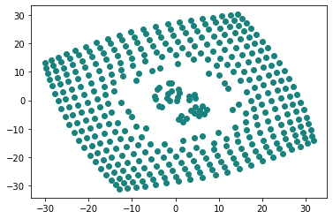
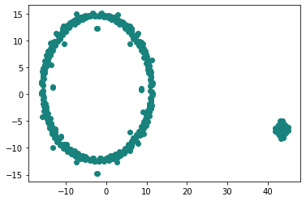
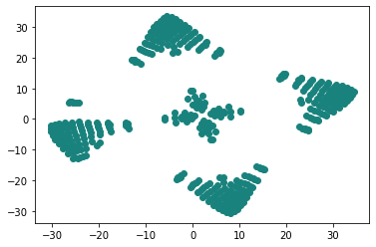
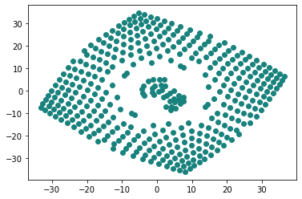
2. tsne参数与图像 —— 仅调整metric
metric：calculating distance between instances in a feature array
random_state=0（以保证每次生成的结果相同）
cityblock
minkowski
chebyshev
cosine
canberra
braycurtis

Slide 7
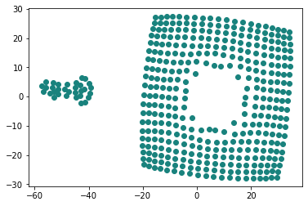
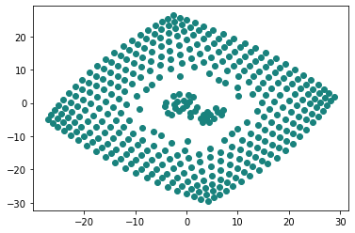
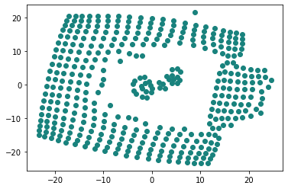
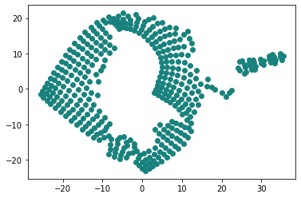
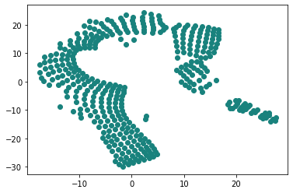
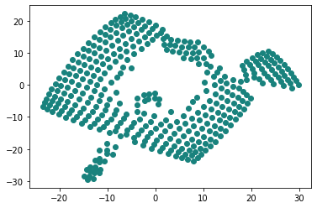
2. tsne参数与图像 —— 仅调整early_exaggeration
early_exaggeration：Controls how tight natural clusters in the original space are in the embedded space and how much space will be between them.
random_state=0（以保证每次生成的结果相同）
early_exaggeration=5
early_exaggeration=10
early_exaggeration=50
early_exaggeration=100
early_exaggeration=150
early_exaggeration=200

Slide 8
THANKS
201800130112 赵子涵

