Slide 1
AC 209b | Milestone 3
Emotion-Informed MBTI Prediction
Project 66 | Harry Hu, Tom Shan, Wendy Wang, Kemeng Zhang
01

Slide 2
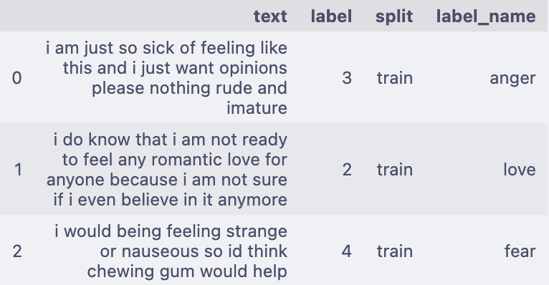
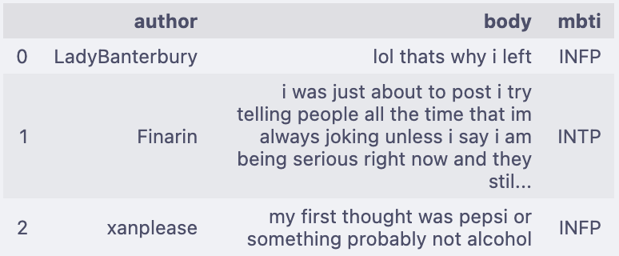
Can emotion-aware language signals predict MBTI?
Emotion source
Reddit MBTI target
20k rows
6 balanced emotion classes
HuggingFace corpus
~13M posts
16 self-reported types
Kaggle Reddit corpus
transfer
2

Slide 3
Four MS2 Concerns -> Four Design Decisions
1
16-type skew
2
Authors repeated
4 binary dimensions
author-level split
3
Posts too short
4
Does emotion help?
author aggregation
matched B1 vs B2
3

Slide 4
Refined Research Question
Do text + emotion features beat text-only baselines on author-level MBTI?
On all four binary dimensions: E/I, N/S, F/T, J/P
4

Slide 5
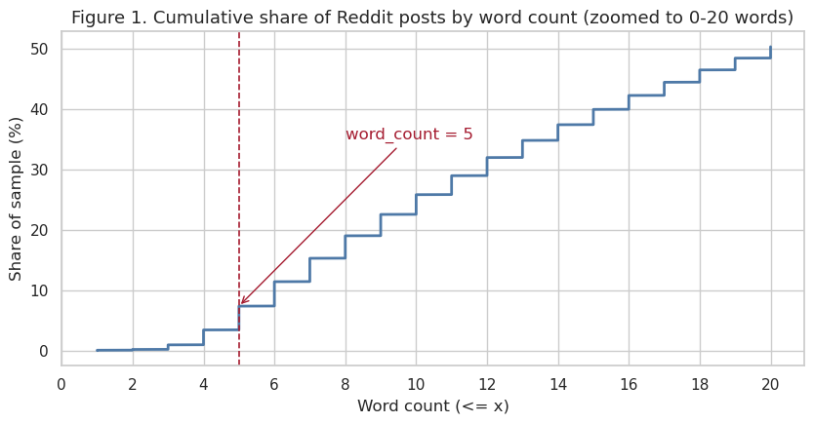
Short-Post Tail Is Noise
Decision
Drop posts under 5 words
1-4 words: 3.4% of sample
Duplication: 1.1% -> 0.2%
Examples: lol, thanks, same
5

Slide 6
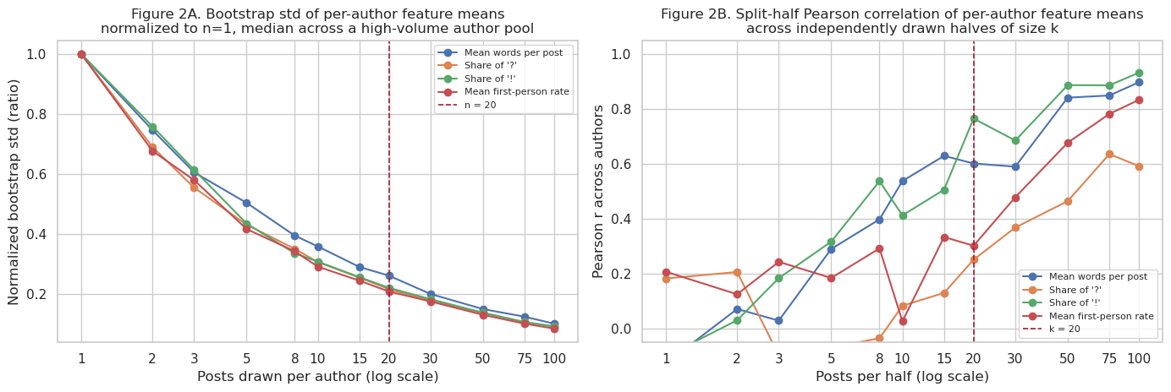
Author Feature Stability -> 20-Post Floor
Bootstrap std tracks 1/sqrt(n)
20 posts clears r >= 0.25
Only ~8% author loss
6

Slide 7
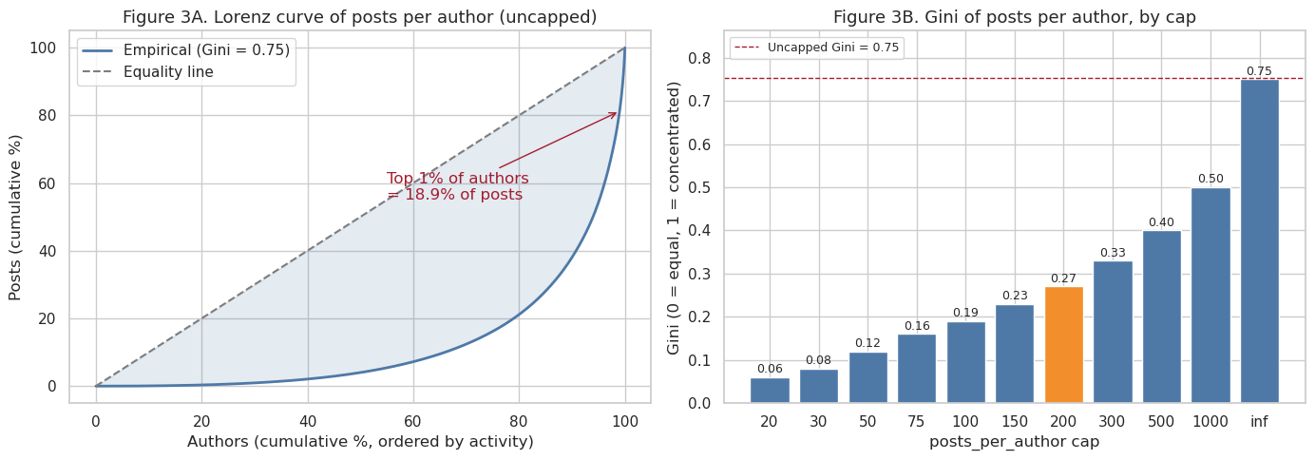
Author Concentration -> 200-Post Cap
Uncapped Gini 0.75
Top 1% = 18.9% posts
Cap 200: Gini 0.27
~1.7M posts retained
7

Slide 8
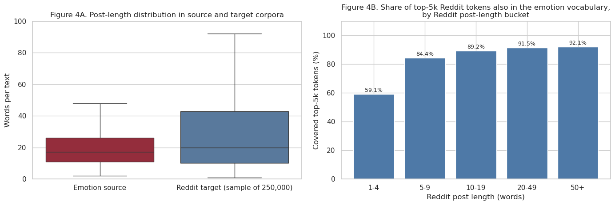
Source -> Target Transfer Is Feasible
Coverage rises: 59% -> 92%
Reddit 95th pct ~3x source
Use soft 6-d probabilities
8

Slide 9
EDA -> Decisions
Every threshold is EDA-derived
word floor >= 5
author floor >= 20
author cap <= 200
emotion soft probs
Data choices
sequence encoder variable text
author aggregation post -> author
matched pair B1 vs B2
Modeling choices
9

Slide 10
Model Input, Output, and Architecture
Stage 1
short text
HF emotion 20k
WordPiece
vocab 30k
max_len 64
Embedding
30k -> 128-d
GRU
hidden = 128
1 layer
Dense -> Softmax
128 -> 64 -> 6
6 emotion classes
Emotion classifier (pretrained, frozen in B2)
same text -> Stage 1
Baseline 1
Reddit text
post, 5 - 200 words
WordPiece
vocab 30k
max_len 128
Embedding
30k -> 128-d
GRU
hidden = 128
1 layer
Dense head
128 -> 64 -> 4
4 MBTI logits
Text only
6-d emotion probs -> B2
Baseline 2
Reddit text
post, 5 - 200 words
WordPiece
vocab 30k
max_len 128
Embedding
30k -> 128-d
GRU
hidden = 128
1 layer
Dense head
concat 128 + 6 -> 134
134 -> 64 -> 4 logits
Text + emotion
10

Slide 11
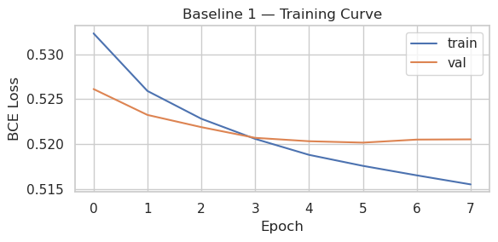
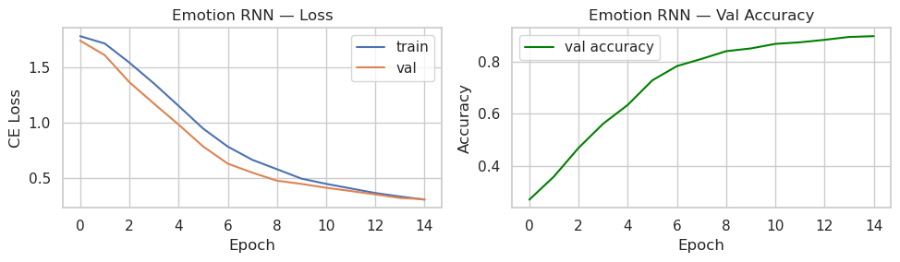
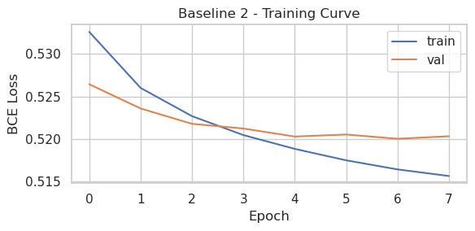
Training Curves + Stage-1 Emotion
val_acc = 0.897 test = 0.908
B1/B2 plateau: val BCE ~0.520
Stage 1 is not the bottleneck; the MBTI baselines converge to the same loss floor.
11

Slide 12
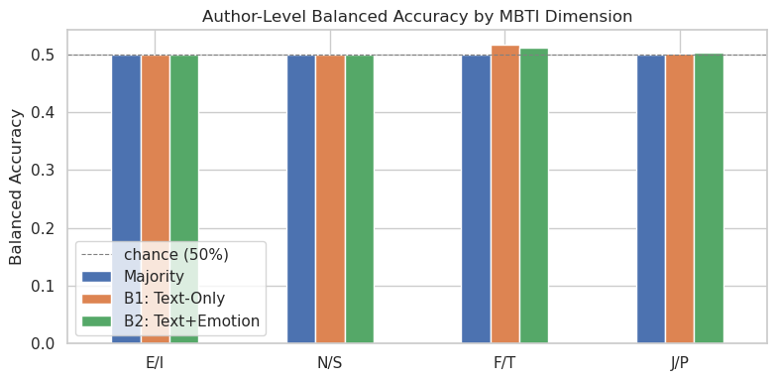
Author-Level Results: Majority-Class Collapse
Balanced accuracy
E/I, N/S, J/P collapse to prior
B2 - B1 gap ~0
F/T precision 86-88%
Recall only 2-4%
12

Slide 13
Interpretation: Where the Signal Dies
hard 50% majority vote
per-post probabilities
author-level label
Vanilla BCE -> class-prior solution
Hard vote discards high-precision minority signal
13

Slide 14
Final Pipeline: 4 Targeted Upgrades
(1) class-weighted BCE
(2) soft author aggregation
(3) DistilBERT emotion encoder
(4) DistilBERT text encoder
14

Slide 15
Potential Challenges & Open Questions for TF
Potential challenges & concerns
Open questions for TF
• Compute budget
• Domain shift
• Label noise
• For the heavily skewed N/S dimension (~93/7), what’s your recommendation?
• Once soft aggregation produces continuous author-level scores, is AUC-ROC (per dimension, author-level) acceptable as the headline metric alongside balanced accuracy?
15

Slide 16
Next Steps
HH
TS
WW
KZ
weighted BCE + soft aggregation
DistilBERT S1 + prob cache
DistilBERT S2 fine-tune
evaluation + ablations
16

