Slide 1


ALY6080
Individual Draft Presentation
Harnessing Data to Drive Growth:
An Analysis of Locally Inspired's Sales
Team 2
Zihan Ma ma.zihan1@northeastern.edu

Slide 2

Executive Summary - Key Insights from Sales Data
A brief overview of the presentation
My individual works in the XN project
Key findings from the data analysis
Recommendations based on the findings

Slide 3

Business Issues - Identifying Business Challenges through Data
Revenue Analysis: Understanding the overall revenue and identifying any potential issues such as a decline in sales.
Customer Retention: Analyzing the repeat customers vs. new customers.
Effectiveness of Marketing: Investigating the proportion of customers who have opted for marketing content and their contribution to overall sales.

Slide 4
My Individual Works In XN Project
Cleaning the data with Puchang Yin and Haoran Wang.
Notice that the cleaning process done by my team member is not included in the following slides, such as joining two datasets together and some code to fill the missing value or create new columns based on existing columns.
A script tan can process different datasets that are close to the sponsor given.
Produce some graphs in the EDA section.
Which we didn’t include in the presentation.

Slide 5
Main Data Cleaning Process
Step 1: Remove all columns that have NAs for every row
Step 2: Added code to choose either remove columns that have no effects on the problems we want to solve (Tax, ID, Phone number. Etc.) or keep them.
Step 3: Randomly separate 30% of the data for faster graph building
The whole dataset will need a few minutes for graphing without separate
Step 4: In the Financial Status and Fulfillment Status column. Select records that are paid and fulfilled.
This step removed about 45% of records that are unpaid/refunded/unfulfilled
Step 5: Remove rows that have most columns missing (Around 2% of data)
Step 6: Separate the dataset into two, which are online orders and orders at the shop
Step 7: Apply the same steps to the whole dataset. The processed dataset is used for the project

Slide 6
Main Data Cleaning Process （Reworked）
Added R script running instruction.
Add a section that installs all needed libraries.
Separite every part of the data processing process for more accessible add-remove code parts.
Reduce the code that points to specific column names.
Output two datasets that are cleaned for easier graphing or machine learning.

Slide 7
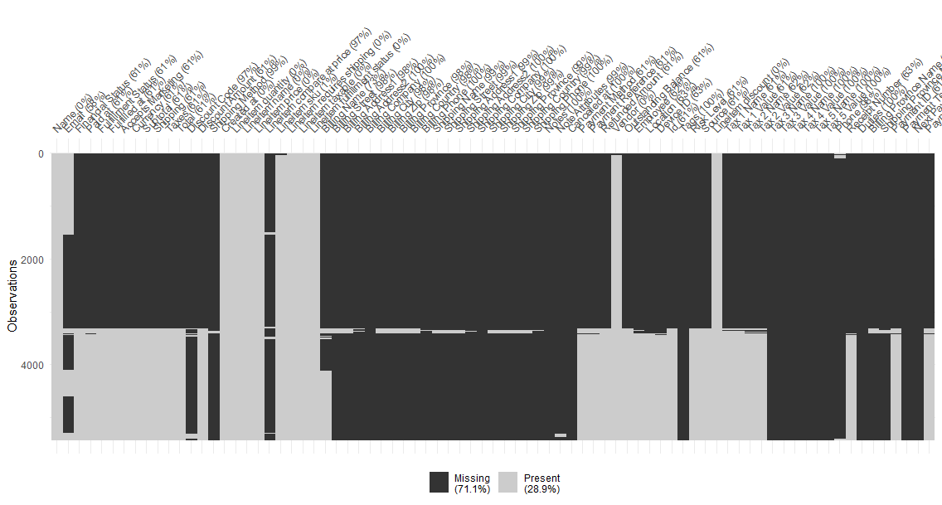
Missing Value Situation Before/After Data cleaning
The dataset before cleaning. It is sorted by missing data pattern.

Slide 8
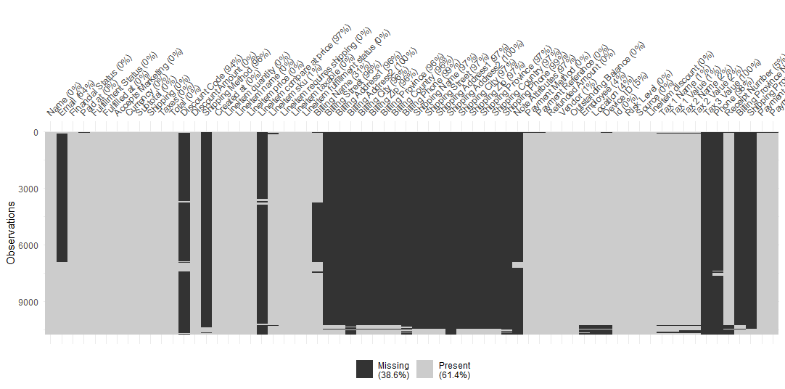
Missing Value Situation Before/After Data cleaning
The final data set which used to build visualization for the sponsor. The dataset is mostly cleaned at the moment. Most black(Missing) here is because it includes the online sales data.

Slide 9
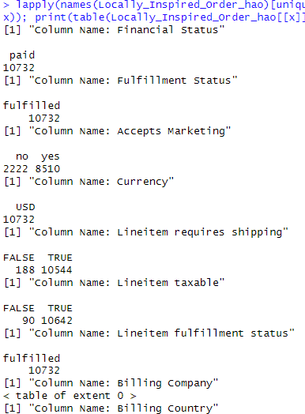
Identify Yes/No Columns For Better Understand To The Dataset
Every column that has less than 7 unique values has been printed out, followed by each unique value’s amount.
Some columns here can be transformed into numerical columns to enhance the model.
This step and Visdat missing data graph have been used at every step during data cleaning for the guide to the next step.

Slide 10
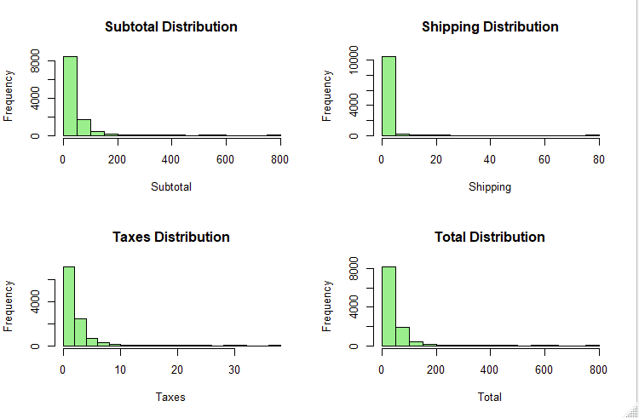
Few More Codes Used During Data Cleaning
A code block that can be easily edited to view the rows we are trying to delete.
Many simple graphs for showing how some numerical data is distributed during data cleaning.

Slide 11
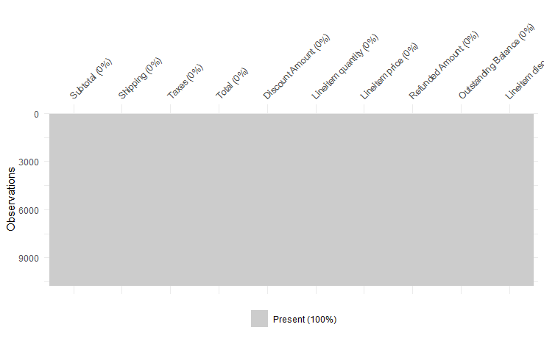
Dataset Use to Build Model
Notice that this is far from the final dataset used for modeling. Few columns will be added/removed/edited during the model testing depending on the performance.

Slide 12
Recommendations and Findings: Data-Driven Recommendations for Business Growth
Revenue Analysis: We should continue to capitalize on the high sales during the holiday season, perhaps by offering special deals or products during this time.
Customer Retention: We have a good number of repeat customers. However, efforts could be made to increase customer retention, such as by introducing loyalty programs or personalized marketing.
Marketing Effectiveness: The marketing efforts appear to be effective, as customers who accept marketing contribute significantly more to sales. We could consider ways to encourage more customers to opt into marketing.

Slide 13
Future Research: Looking Ahead - Areas for Future Research
Customer Satisfaction: Implementing customer satisfaction surveys could provide valuable feedback to improve products and services.
Product Popularity: Analyzing the popularity of different products could help the store optimize its product range and marketing efforts.
Seasonal Trends: Further analysis could be done on seasonal trends to optimize sales during different times of the year.

Slide 14

Conclusion
Through data analysis, Locally Inspired can further capitalize on holiday sales, enhance customer loyalty, amplify marketing engagement, and harness future research in customer satisfaction and product trends to drive informed decisions.

Slide 15
THE END
THANKS

Slide 16
References:
Locally Inspired. (2022). Locally Inspired WI. https://locallyinspiredwi.com/
Kusumadewi, S., & Hartati, S. (2019). Predictive analytics to predict customer behavior: A behavior informatics and analytics approach. 2019 International Conference of Artificial Intelligence and Information Technology (ICAIIT).
McKinsey & Company. (n.d.). Marketing & Sales Big Data, Analytics, and the Future of Marketing. McKinsey & Company. Retrieved from https://www.mckinsey.com/~/media/McKinsey/Business%20Functions/Marketing%20and%20Sales/Our%20Insights/EBook%20Big%20data%20analytics%20and%20the%20future%20of%20marketing%20sales/Big-Data-eBook.ashx

